Slide 1
Test Writing Strategies
Opportunities to Improve Our Educational Approach
http://www2.palomar.edu/pages/testwritingstrategies
Notes:
Welcome to “Test Writing Strategies, Opportunities to Improve Our Educational Approach.”
I am Tracy Johnston, from the Math Department.
This talk is based on the Palomar blog of the same title and uses its resources.
You can view that blog at this web address.
It was started last February and will continue on this school year until completed.
The blog and this talk are part of the Palomar College STEM 1 Grant.

Slide 2
Many of us have
no formal training
in designing assessments.
Notes:
But we need tests anyway.
We tend to write them using the experiences we’ve had with our own education and from sample tests written by others.
This is fine but we want to do our best for our students.
What can we do to improve ourselves?
Let’s explore what others are doing to write effective exams.

Slide 3
What is a good exam?
An accurate measure of student achievement of instructional objectives.
Notes:
We start with the definition of a good exam.
<click>
<read definition>
This is straightforward and probably obvious but is still good to think about.
What are the challenges and problems that keep tests from being accurate measures?

Slide 4
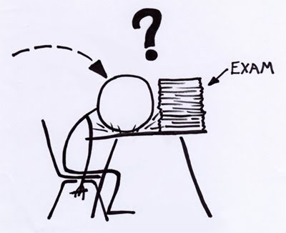
Problems
Too many questions or too few
Too little feedback
Ambiguous or unclear questions
Not offering a variety of test item formats
Notes:
<“Too many” bullet>
Students can get tired from too many questions or simply run out of time. Too few questions might not cover enough information to show us what they learned.
<“Feedback” bullet>
The questions need to cover a range of information from the course to tell us in depth what the students have learned. We need to measure more than rote memorization, like comprehension, application of knowledge, evaluation using knowledge, and creating new ideas.
<“Ambiguous” bullet>
We might write a question that makes complete sense to us but the student interprets it in a valid but different way. Then we only see our interpretation as correct.
<“Not offering” bullet>
Exams that are strictly multiple choice or essay or true/false, et cetera, may not allow students with different verbal, reading, or writing strengths to show what they know.

Slide 5
Features
Assesses mastery of topic
Provides feedback on teaching
Items vary in difficulty level
Questions are not easily answered without proper studying
Notes:
So what are the features of a well-constructed test?
<“Mastery” bullet>
A well-constructed test assesses student mastery of the topics you have presented. It should answer the question, “How well did the students learn the course material?”
<“Feedback” bullet>
It should highlight the areas you didn’t make clear or need to spend more time on and also show you where you did a good job presenting the material.
<“Items” bullet>
Some test items should be easy to answer if the student has put in learning effort. Think of them as “C” level questions.
Some should be more challenging, forcing the student to show a comprehension of ideas or an application of the concepts. “B level”
A few should be answerable by those students who have thoroughly learned the course material and can show it by using it in a new way. I call these “the A-B breakers.” They distinguish the A students from the B students.
<“Questions” bullet>
Watch out for questions that are designed to show the unstudied student the answer; for example, through context clues.

Slide 6
General Design Tips
Not too long or too short
Clear, concise instructions
Use a variety of item types
Check for accuracy; proofread
Avoid answer dependency
Use humor!
Notes:
Considering the previous slides we can see some general design tips.
<First four bullets: bring up and read>
We can also add these ideas:
<“Avoid answer” bullet>
If at all possible, avoid having the answer of one question depend on the answer of a previous question. I teach math which means sometimes I have this situation; my dilemma is whether to give one question that requires students to recall a complex series of steps or to put the steps in as parts of the problem.
<“Use humor” bullet>
You can use wording that is a bit playful, as long as it doesn’t make the problem confusing. I like to put cartoons at the end of the test whenever possible.

Slide 7
In the Beginning
What should the students get from the chapters and sections?
What are the “big picture” goals?
What are common mistakes and misconceptions?
Notes:
It is all well and good to make lists of things to do in order to write a good exam. Sometimes, though, it is hard to get started.
So ask yourself some basic questions that help define your instructional objectives for this test.
<click>
<read the bullets>
To implement this, you will be thinking deeply about what is and isn’t important in your class.

Slide 8
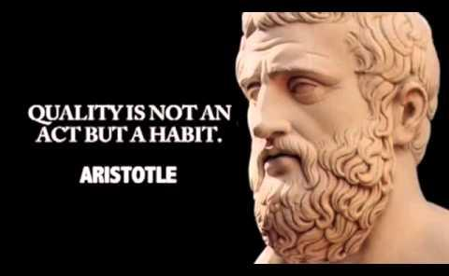
Technical Quality
“conformance to requirements”
“fitness for use”
Notes:
Once we understand the content of the exam, we can consider its technical quality.
<click>
By that I mean,
Does the exam satisfy stated or implied needs?
Is it free of deficiencies?
We need criteria to help us judge the quality level.

Slide 9
Quality Criteria
Cognitive complexity
Content quality
Meaningfulness
Language appropriateness
Transfer & generalizability
Reliability
Fairness
Notes:
<“Cognitive” bullet>
We should challenge our students with a range of intellectual activity. For example, a student response of “I have seen this before and I can remember it” on some questions, all the way to “Hmm, how can I use what I have learned to answer this?” on others. If they have the knowledge and tools you have provided, they should be able to figure it out.
We might be tempted to test on the easier parts of the material, rather than the important parts. Considering cognitive complexity helps us focus on drawing from our students what they have learned beyond simple recall.
<“Content” bullet>
This is testing on more than simple recall but also not writing questions that test outside of the course material, even if the connections seem obvious to us, the content experts.
Also, it is more than just testing on what was emphasized in the lecture. We need our students to focus on more than the bolded, highlighted, and underlined words and phrases; they need to learn the material as a whole and in context.
<“Meaningfulness” bullet>
Each question should trigger a memory in any student who has prepared and studied. We also don’t want to test on trivia.
<“Language” bullet>
Consider the vocabulary and presentation of ideas as you have used them in the classroom and how the textbook uses them. Attempt to mimic that style when writing test questions. You want the student to think about what the question needs to be answered and not worry about unusual wording.
<“Transfer” bullet>
What goals do you have for a student who successfully completes your course? For my classes, I want them to learn the material in such a way that they can perform the skills, understand the ideas, recognize the vocabulary and notation, and be prepared to complete the next course successfully. You might have a different answer for your discipline.
<“Reliability” bullet>
Answers to test questions will be consistently trusted to represent what the student has learned.
We also want the questions to help us discriminate between different levels of student performance. Think about how you would grade a problem before you see what the students have done with it. Of course, you should leave the door open to change your mind if it appears many students have misunderstood it.
<“Fairness” bullet>
Considering fairness, especially from a student’s perspective, can greatly reduce incidents of student outrage towards a test.
It also measures student performance in a way that does not give advantage to factors irrelevant to school learning.
Think about the fairness of the questions as well as the fairness of the scoring schemes.
Let’s examine the basic rules of fairness.

Slide 10
Fairness Rules
Questions reflect course objectives
Expectations are clearly known
Each item presents a clear task
Ample time is allowed for completion
Scoring is determined before test is graded
Notes:
<“Questions” bullet>
When students see the questions, they should be assured that you are testing them on the concepts and skills you have been teaching them.
<“Expectations” bullet>
At some point in your lecture, class activities, homework, or projects the students should see what you value in the course. Find a way to communicate this, either directly with rubrics or statements, or indirectly with your grading – the point allotments, your comments, or other feedback. Then stick with this while you are designing and grading the exam.
<“Each item” bullet>
The question should be written in a way so its goal is clear, not ambiguous. Is the student to define a word? Express an opinion? Analyze a paragraph? Perform a skill? Look at the wording from a “you’ve never seen it before” viewpoint to see if it is truly asking what you expect the student to see.
<“Ample time” bullet>
It is not always easy to judge how much time students need to complete an exam. Some groups can take longer than others on the same exam. Keep track of this information as you pass through each semester to help you improve your sense of what is right. If you make a mistake and offer an exam that needed more time, give consideration as to how you can adjust the grading for fairness.
<“Scoring” bullet>
We don’t always have time to determine the point allocation before printing or even giving the test. However it should be done before you start grading or looking at the student work.
Use your knowledge of common mistakes and misconceptions to decide how many points an item is worth, as well as what you expect to see in the answer.
Be willing to regrade a question if you think you did not decide well.

Slide 11
Looking Closer
Notes:
Now that we have a feel for our overall test design, we need to start considering general ideas for writing questions.

Slide 12
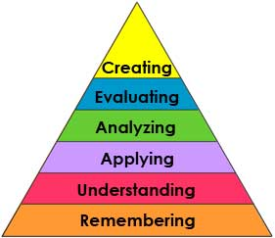
Bloom’s Taxonomy
Notes:
One recurring recommendation in the resources is to consider Bloom’s Taxonomy.
It was created as a method for classifying educational goals for student performance evaluations and has been revised over the years.
Bloom’s applies to acquiring knowledge, which involves intellectual skill development.
The major idea is that what educators want students to know can be arranged in a hierarchy from less to more complex (moving upward).
The levels are successive, so that one level must be mastered before the next level can be reached.
This diagram is a revised version of the original Bloom’s Taxonomy, using action verbs to describe each level.
Let’s look in detail at what the levels mean.

Slide 13
Recall of information
Interpretation
Grasping meaning
Notes:
Level one is remembering. It is simple recall of information, a knowledge of facts, dates, events, places.
<click>
Next is understanding. It is interpreting the knowledge into one’s own words and knowing the meaning of them, beyond simple recitation.
You can see the hierarchy at work. You cannot understand the knowledge without first having the knowledge. But you can have the knowledge without understanding it.

Slide 14
Application of methods, theories, and concepts to new situations
Notes:
For applying, you are asking the student:
Can you use the knowledge you remember and understand?
Can you see when to apply the rule or cite the fact in a way that makes sense to the situation?

Slide 15
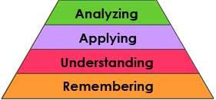
Identification of patterns
Recognition of components and their relationships
Notes:
When you analyze, you should be able to see patterns and justify them with evidence.
This could be patterns in behavior, development, responses over time, growth, reactions, anything, and applies to all disciplines.
Also you should be able to break apart a situation or problems to see the individual components and map out their relationships.
See the underlying structures inherent in the situation.

Slide 16
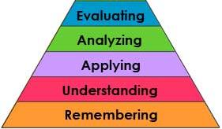
Make judgments
Assess value of ideas, theories
Compare & discriminate between ideas
Evaluate data
Notes:
When evaluating, you might judge if a process will or won’t work to solve a problem.
You can decide if the proposed ideas or theories are truly applicable to the discussion and how much they may contribute.
You can compare ideas and describe their relative merits.
And you can evaluate data, not only to see if it is applicable but also to see if it is giving you the information you need for your topic.

Slide 17
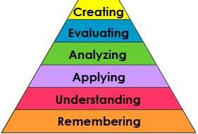
Generalize
Use old ideas to create new
Organize & relate
Draw conclusions, predict
Notes:
The highest level, creating, means you can generalize from given knowledge.
You use old ideas to create new ideas, “synthesis.”
You can organize and relate knowledge from several areas, seeing the connections and relationships.
And you can draw conclusions about the situation or use what you see to predict outcomes.

Slide 18
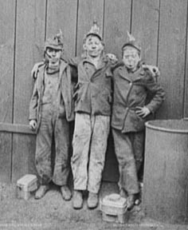
The Value of Bloom’s
http://www.learnnc.org/lp/media/articles/bloom0405-3/bloompix.html
Notes:
The website illustrates how the various levels of Bloom’s Taxonomy can be applied to this one picture.
Pay attention to the way the questions are worded for each level to see how to draw out your student’s knowledge.

Slide 19
Level 1. Remembering
When was this picture taken?
Where was this picture taken?
Question cues: List, define, tell, label
Level 2. Understanding
What is happening in this picture?
Why are these boys dressed like this?
Question cues: Describe, name, identify, discuss
Notes:
The question cues give you ideas on other types of questions to write that fit into each level.

Slide 20
Level 3. Applying
How would you describe the photograph to others?
What caption would you write for this photograph (say, in a newspaper)?
Question cues: Modify, solve, change, explain
Notes:
Do you see how the cognitive complexity increases in each level?
The questions require the students to think deeper about the picture than they might if you just showed it to them.

Slide 21
Level 4. Analyzing
Why are these boys here and not in school?
What do you know about their lives based on this photo?
Question cues: Analyze, separate, compare, contrast
Notes:
These questions have the students think beyond their own lives and experiences to better understand others.

Slide 22
Level 5. Evaluating
What is the significance of this photo for the time period depicted?
Compare this photo with one of three boys from today of the same age. How are their lives similar? How are they different?
Question cues: Give opinion, criticize, discriminate, summarize
Notes:
Now the students are using their knowledge of history to evaluate the boys’ situation.

Slide 23
Level 6. Creating
What might these boys say about their work in an interview setting?
What might they say about their future?
Question cues: Create, construct, plan, role-play
The photograph "Coal Breaker Boys" was taken in Kingston, Pennsylvania, between 1890 and 1910. It is available in the American Memory Collection Touring Turn-of-the-Century America: Photographs from the Detroit Publishing Company, 1880-1920, from the Library of Congress.
Notes:
I particularly like the “role-play” idea to get the students to imagine the lives of these boys.
<click>
Here are the photo credits.
From this example, it is clear that students can “know” about a topic or subject in different ways and at different levels.
Research has shown that students remember more when they have learned to handle the topic at the higher levels.

Slide 24
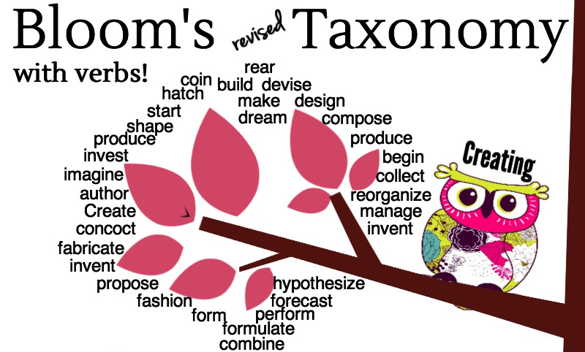
Using Bloom’s
Verb lists
“Question frames”
Notes:
When I first started considering how to use Bloom’s Taxonomy, I thought it would help expand my ideas on how to test, but I struggled with applying it directly.
I appreciated the increasing cognitive levels but needed help in writing test questions that utilized them.
<click>
What I found was compiled lists of verbs that applied to each level and also pages of “question frames”, which are nearly complete questions that you can manipulate to fit into your course material.

Slide 25
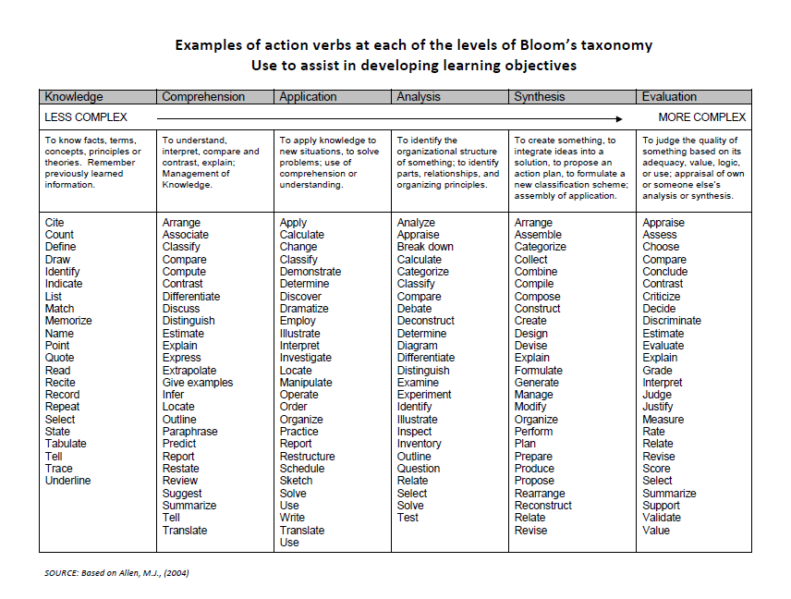
Verb Lists
Notes:
You have a handout with this list, which conveniently puts a variety of verbs in each category and on one page.
Note that the taxonomic level titles are slightly different – this is based on the original Bloom’s classification.
You can reference this sheet while you are designing test questions.

Slide 26
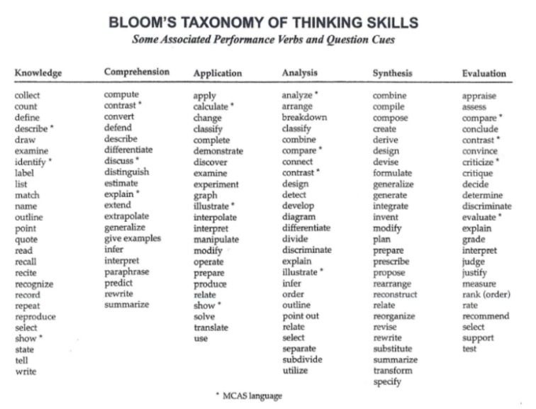
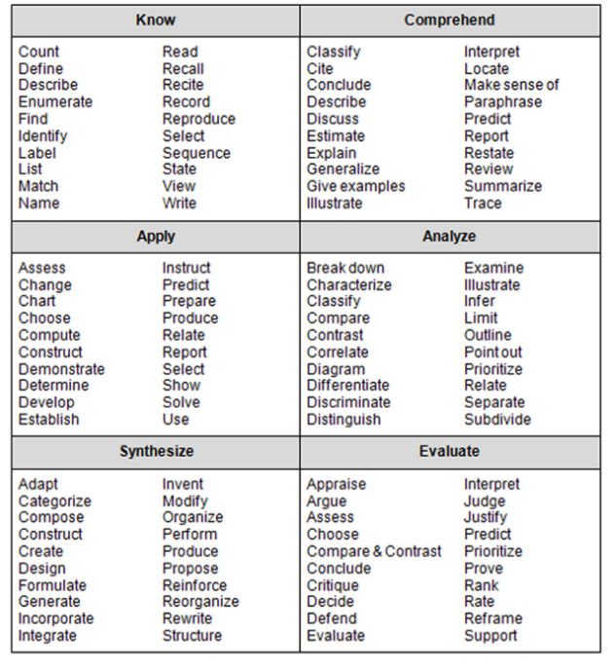
Verb Lists
Science
Math
Notes:
I found some verb lists that were designed for specific disciplines.
In this case, math and science.
They can still be helpful in other disciplines, too.

Slide 27
Example Items
Remembering:
“Name the act that began the Civil War.”
Understanding: “Explain Brutus’ motivation for participating in Caesar’s assassination.”
Notes:
<Remembering>
This is simple recall.
<click>
It might be simple recall but it also might be a summary in the student’s own words from reading or a class discussion.

Slide 28
Example Items
Applying:
“Use the Addition Method to solve this linear system.”
Analyzing: “Draw a Venn Diagram illustrating the following argument.”
Notes:
<Applying>
Not only do you have to recall the Addition Method and understand how to work it, you have to know what parts of this linear system are important for the method.
<click>
<Analyzing>
Here you have to be able to analyze the argument to find its basic structure and then represent it symbolically.

Slide 29
Example Items
Evaluating:
“Decide if this argument is valid and provide your reasons.”
Creating: “Propose a solution to the traffic flow problem at this intersection.”
Notes:
<Evaluating>
Here you would have to analyze the argument and then compare it to valid forms to see if it is valid. You also have to explain how you got to your conclusion.
<click>
<Creating>
After evaluating the problem, you have to use your wider knowledge to create a plausible solution.

Slide 30
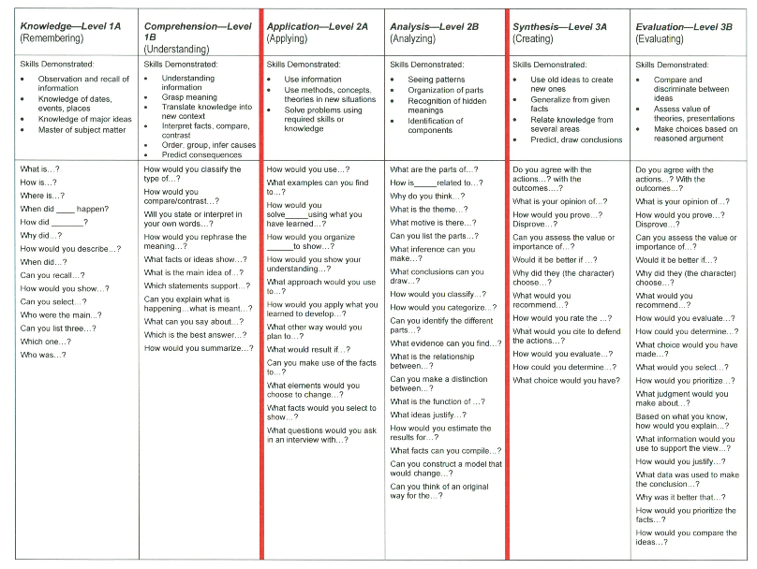
Question Frames
Notes:
You have handouts of question frames examples, too. This page and another with two pages.
I found starting with the frames word-for-word was helpful; after practice I could see how to design them myself.

Slide 31
Using Question Frames
“Can you list three…”
-- types of polygons?
-- steps of cellular reproduction?
“What facts or ideas show…”
-- the likely diagnosis?
-- the protagonist’s mindset?
Notes:
Take a moment to think about how you would finish these questions for a class you teach.
<Can you list>
This looks like remembering.
<click>
<What facts or ideas>
This could be understanding or analyzing, depending on how you finish the question.
<click>
<Pause then say,>
I used the wording directly from the list, however I personally would not choose to use “Can you” as part of a test question. I would expect a student to answer, “No.” and expect full credit for it.

Slide 32
Using Question Frames
“What approach would you use to…”
-- identify the mammal’s skull?
-- change the mood of the music?
“Can you make a distinction between…”
-- Rockabilly and Folk songs?
-- oxidation and reduction?
Notes:
<What approach>
I would call this understanding or applying.
<click>
<Can you make>
This could be understanding or evaluating.
<click>

Slide 33
Using Question Frames
“How would you select…”
-- the bandaging method for a wound?
-- the lighting for a scene?
“What is the importance of…”
-- the antagonist’s decision to leave?
-- the concept of countability?
Notes:
<How would you>
Depending on the wording, it could be applying, evaluating, or creating.
<click>
<What is the importance of>
This could be understanding, analyzing, applying, or evaluating.
<click>

Slide 34
Even More Value
Creates a culture of learning:
Encourages deep thinking
Models higher level thought processes
Appreciates cognitive challenges
Shows students depth of topics
Shows thinking is important
Notes:
What comes across to me again and again throughout the sources is that considering the hierarchy when designing exams creates a culture of learning that involves thinking deeply about the course material, taking it beyond rote memorization and recitation.
This culture would benefit from also considering Bloom’s while you are teaching.
The process models higher level thought processes,
shows joy at cognitive challenges, and
explores topics in depth (if time permits) or mentions that the depth exists (if time is short).
This can send a strong signal that thinking is valued, encouraged, and important to learning.

Slide 35
Knowledge Domains
Factual knowledge
Conceptual knowledge
Procedural knowledge
Metacognitive knowledge
Notes:
Another aspect of using Bloom’s Taxonomy in test writing is to consider the knowledge domains inherent in your course material.
The kinds that can be tested are:
<Factual knowledge. >
This consists of terminology, facts, and figures.
<Conceptual knowledge.>
Understanding how to classify, explain principles and theories, and identifying structures and frameworks.
<Procedural knowledge.>
Demonstrating the use of algorithms, techniques, and methods. Also know when and how to use them.
<Metacognitive knowledge.>
Planning a strategy, identifying an overview, having self-knowledge and knowing how you know.
When I put this list with the verb lists, I get more ideas for test questions and new directions for exploring student acquisition of course information.

Slide 36
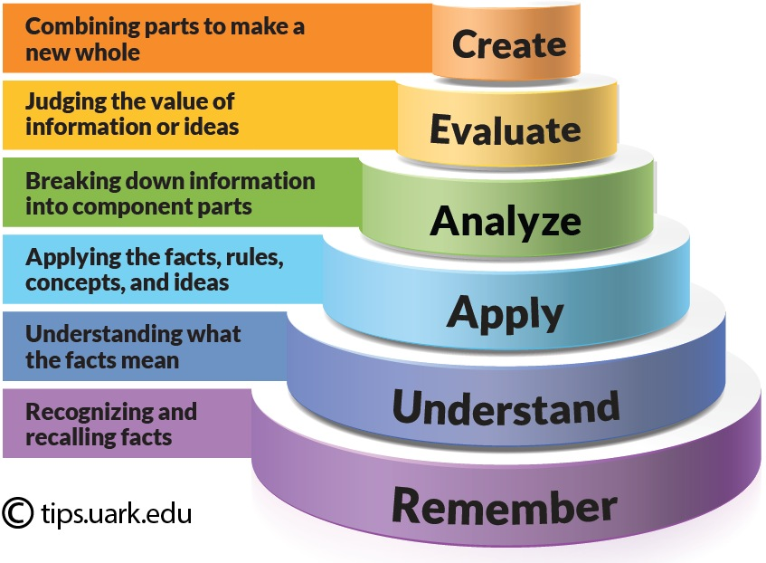
Give It a Try
Factual knowledge
Conceptual knowledge
Procedural knowledge
Metacognitive knowledge
Timer
Notes:
You have been learning about Bloom’s Taxonomy and knowledge domains. Now it is time for you to try it yourself.
Analyze the questions on the worksheet by deciding which Bloom’s category and which domain each represents. Discuss it with your neighbors!
Remember, you are not trying to answer the questions, just analyze them.
********** for my reference:
Factual knowledge.
This consists of terminology, facts, and figures.
Conceptual knowledge.
Understanding how to classify, explain principles and theories, and identifying structures and frameworks.
Procedural knowledge.
Demonstrating the use of algorithms, techniques, and methods. Also know when and how to use them.
Metacognitive knowledge.
Planning a strategy, identifying an overview, having self-knowledge and knowing how you know.

Slide 37
Quick Summary
Write an accurate measure
Consider good test design
Know your testing goals
Consider technical quality
Use Bloom’s Taxonomy
Use verb lists, question frames
Consider knowledge domains
Notes:
We can make a quick summary of the test writing strategies we have covered today.
<“Write” bullet>
We want an accurate measure of student achievement that motivates students, reinforces learning, see student mastery, and gives us feedback on what was and was not communicated clearly.
<“Consider good” bullet>
To do this, we look at test length, write clear instructions, use a variety of test item formats, proofread, and use humor.
<“Know your” bullet>
Before we write anything we should think about what our students should get from the class, communicate what we value, and have the questions vary in levels of difficulty.
<“Consider technical” bullet>
As we are writing, we should offer cognitive challenges, write meaningful questions, use appropriate language, and make it fair.
<“Use Bloom’s” bullet>
We also keep in mind the hierarchy and compose questions that explore a variety of levels.
<“Use verb” bullet>
The verb lists and question frames help guide us through the use of Bloom’s Taxonomy.
<“Consider knowledge” bullet>
And knowledge domains remind us of different ways to view the course material and vary the types of questions we ask.

Slide 38
This slide show is available on the blog.
As are my notes for each slide.
The next direction for the blog
is to study features of specific test item types.
Thank You!
Notes:
Feel free to look over the blog articles as this talk is a condensed version of them.
The blog has lists of resources for you to explore, too.
You are welcome to sign up for notifications of new posts.
<click>
Now that we have studied good test design in general, we begin to explore the features and qualities of specific item types, like multiple choice, true/false, matching, and essay. Stay tuned throughout this school year to see what we learn.
<click>
Thank you for your time and attention.
Any questions?

Slide 39
Talk prepared by Tracy Johnston
as part of the STEM 1 grant of Palomar College August 2015
http://www2.palomar.edu/pages/testwritingstrategies

