Slide 1
COR Outcomes and Objectives Guide
Tiny URL for this presentation
https://tinyurl.com/yyvuuh7h
Tiny URL for one page handout and sample outcomes and objectives
https://tinyurl.com/yxtx966j
Questions? Contact kfarrell@palomar.edu

Slide 2
COR Outcomes and Objectives Guide
“One of the most significant aspects of a COR is the inclusion of student learning outcomes (SLOs). SLOs can be a driver of many, if not all, elements of a course outline of record.” Academic Senate for California Community Colleges

Slide 3
Course Outline of Record (COR)
A legal document containing required elements specified in §55002
Legal contract between faculty, student, and college
Basis for articulation agreements and statewide course identification number (C-ID)
Ensures quality and consistency of course delivery for faculty
Ensures instructional integrity, content and rigor across all section offerings
Identifies a body of knowledge that distinguishes one course from another
Justifies unit credit
Approval: Curriculum Committee, Board of Trustees, Chancellor’s Office

Slide 4
STEPS TO DESIGNING OUTCOMES AND OBJECTIVES
Define Outcomes – What are the abilities and knowledge students can demonstrate upon course or program completion?
Create at least 2 outcomes for each course and program.
Use language that students can understand.
Design Assessment Methods – How will you know if students have achieved the outcomes?
Align Outcomes –Course outcomes should be aligned to program outcomes AND college outcomes (i.e. general education/institutional outcomes).
Build Supporting Objectives – Objectives on the COR state the concepts or skills needed to meet the outcomes. Objectives are the means, not the ends. They are the building blocks designed to help students to achieve the course learning outcomes.

Slide 5
Learning Outcomes are the Start and Finish
What are the abilities and knowledge students can demonstrate upon course or program completion?

Slide 6
Step 1: Develop Course Learning Outcomes
ID 170: Complete an interior from a given building core and shell with a full wall layout, electrical service overlay that is organization (business type) specific.
BIO 125: Apply knowledge of osmosis, diffusion and membrane transport to conduct and analyze laboratory experiments that explore molecular transport in plants.
WELD 108: Select the correct mathematical systems and equations to solve common industrial problems.

Slide 7
Step 2: Design Assessment Methods
How will you know if students have achieved the outcomes?
BIO 125 Outcome: Apply knowledge of osmosis, diffusion and membrane transport to conduct and analyze laboratory experiments that explore molecular transport in plants.
Assessment: Lab Laboratory experiments that may be selected as part of this assessment include:
Conducting experiments that measure rates of diffusion through different mediums.
Conducting and analyzing molecular movement through semi-permeable membranes (dialysis bags) to demonstrate the principles of diffusion and osmosis.
Preparing, observing, and analyzing living plant cells in solutions of various tonicities.
Record detailed assessment methods in Nuventive Improve (TracDat)

Slide 8
Step 3: Align Outcomes
Course outcomes should be aligned to program outcomes AND college outcomes (i.e. general education/institutional outcomes).
Document this in Nuventive Improve (TracDat)

Slide 9
Step 4: Build Supporting Objectives
Objectives on the COR state the concepts or skills needed to meet the outcomes. Objectives are the means, not the ends. They are the building blocks designed to help students to achieve the course learning outcomes.
Academic Senate for California Community Colleges Curriculum Guide

Slide 10
CSCI 260, Video Game Programming I
Student Learning Outcomes
Upon successful completion of the course, the student will be able to:
Develop a basic 3D video game from scratch using Microsoft DirectX.
Maintain and upgrade existing video game programs.
Specific Course Objectives
Upon successful completion of the course, the student will be able to:
Understand all the math required to properly construct a 3D game;
Compile applications using the current version of DirectX;
Write an application that moves 3D objects on the screen;
Modify the application to detect and respond to collisions with the screens edges;
Utilize graphics techniques to give objects different appearances;
Query user-input devices to control objects on screen;
Design complex 3D special effects;
Understand proper terrain rendering;
Design particle systems;
Understand how lighting in 3D works;
Write an efficient object oriented 3D game engine;
Utilize the engine to create a 3D breakout game;
Design efficient algorithms to solve game-related problems;
Optimize slower routines to make them run faster;
Locate the answers to technical questions on the Internet using specialized search engines;
Demonstrate an understanding of what it's like to work in the video game industry.
Outcomes
Objectives
Content

Slide 11
Want More Examples???
Click here for sample Course outcomes and objectives starting on page 2
https://tinyurl.com/yxtx966j

Slide 12
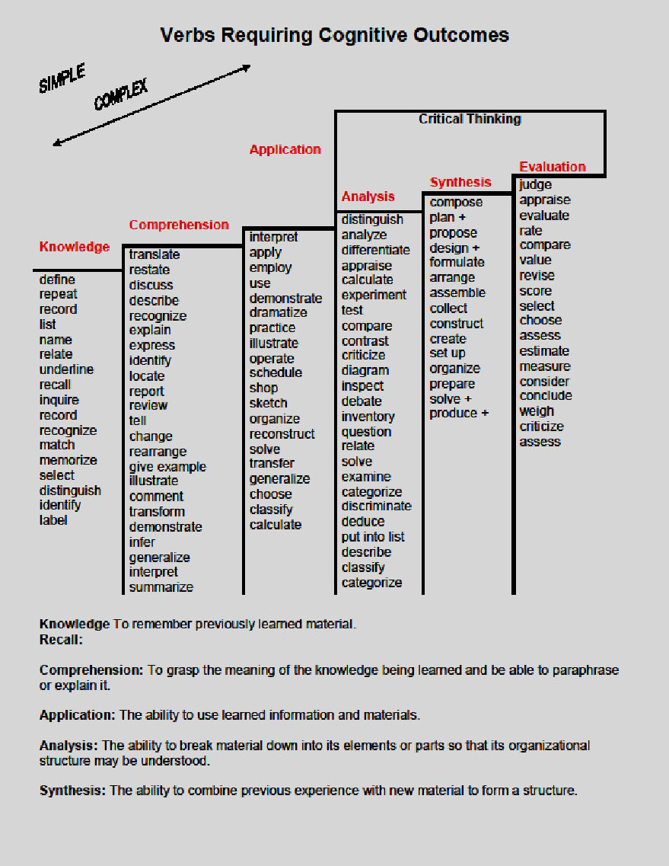
Learning outcomes and objectives using begin with critical thinking behavioral verbs
Analysis
Synthesis
Evaluation
Bloom’s Taxonomy Higher and Lower Order Thinking Verbs

Slide 13
Write Outcomes & Objectives with Rigor
ASCCC Curriculum Institute 2016

Slide 14
Course Content & Alignment
A reviewer should be able to find a match between:
the outcomes and the objectives that support the outcomes.
an objective and the content that supports that objective.

Slide 15
Example of Alignment
Outcome | Objective | Content
1. Develop a basic 3D video game from scratch using Microsoft DirectX. | 1. Understand all the math required to properly construct a 3D game; | 1. 3D Math required for creating 3D video games a. Vector Algebra i. Vectors Vectors and Coordinate Systems B. Left Handed vs. Right Handed Coordinate Systems C. Basic Vector Operations ii. Length and Unit Vectors iii. Dot Product A. Orthogonalization iv. Vector Cross Product, etc.
ASCCC Curriculum Institute 2016

Slide 16
Class Assignments
How do they support the development and assessment of course outcomes and assessments?
The assignments section of the COR should be detailed enough to give instructors, students, and reviewers a clear understanding of the rigor of student work that is expected.
Should not be so restrictive that it limits the academic freedom of individual instructors, however.
Alternate assignments may be included in lieu of a field trip of theatre performance.
Assignments must be described sufficiently to document independent work, critical thinking, and a level of difficulty consistent with college-level work.
ASCCC Curriculum Institute 2016

Slide 17
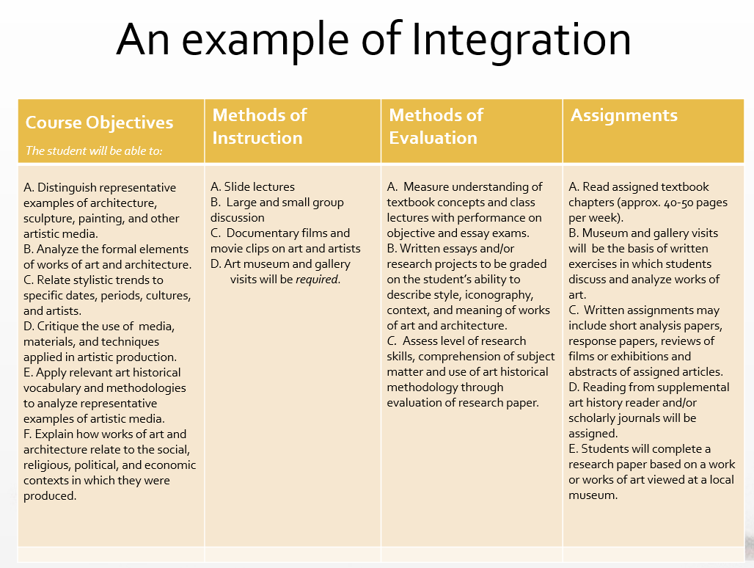
Course Outcomes
The student will be able to:
A.
ASCCC Curriculum Institute 2016

Slide 18
Questions? Contact Us
Learning Outcomes Coordinators
Katy Farrell, kfarrell@palomar.edu, ext. 3640
Mark Bealo, mbealo@palomar.edu, ext. 2958
Department SLO Facilitators
Nuventive Improve (TracDat) Technical Support
email learningoutcomeshelp@palomar.edu
More Resources
Developing Outcomes & Objectives for the COR handout
Teaching Excellence website

