Slide 2
Campus Security Authority Training Presented by: Palomar College Police Department

Slide 3
agenda
The Clery Act
What is the Clery Act
Consequences for Violating
Requirements
Campus Security Authority (CSA)
Who
Clery Crimes & Reporting Requirements
Crimes
Geography
Alerts
Crime Log
Reporting Crimes
Where
How
Resources

Slide 4
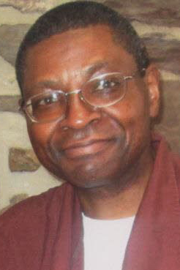
What is the Clery Act
The Jeanne Clery Disclosure of Campus Security Policy & Campus Crime Statistics Act:
Federal Law requiring institutions of higher education in the US to disclose campus security information:
Crime statistics for the campus & surrounding areas

Slide 5
What is the clery act
Purpose
Provides students and their families with accurate, complete, and timely information about crimes and campus safety
Ensures the student population and their families have access to the most up-to-date campus safety
Informative decisions for attending the campus

Slide 6
What is the clery act
Consequences for Violating
LOSS of Title IV funding (financial aid)
$55,000 fine PER VIOLATION

Slide 7
What is the clery act
Requirements
Identify Campus Security Authorities (CSA)
Determine Palomar’s Clery Geography
College Clery Crime Statistics
Issue Timely Warnings & Emergency Notifications
Maintain Crime Log
Publish the Annual Security Report by October 1st
Submit crime statistics to the US Department of Education

Slide 8
Campus security authority
Who?
Campus Police & Campus Security Officers
Professional staff in a dean of students office, including leaders in student affairs & housing
Staff in the student center or student union building
Staff in the student activities officer (handling extracurricular activities)
Faculty or staff advisors; resident and/or community directors
Students who monitor access to dormitories or other facilities
Coordinator of Greek affairs (or related positions)
Athletic directors (Ads) and coaches (including assistance Ads & assistant coaches)
Event security staff
Administrators at branch/satellite/separate campuses
Physicians in a campus health center, a counselor in a campus counseling center, or a victim advocate in a campus rape crisis center if they are identified by your school as someone to whom crimes should be reported or if they have significant responsibility for student & campus activities

Slide 9
Clery Crimes & Reporting Requirements
Crimes
CLERY CRIMES REPORTED TO A CSA MUST IMMEDIATELY BE REPORTED TO CAMPUS POLICE
CRIMINAL OFFENSES
Criminal homicide: murder and non-negligent manslaughter, manslaughter by negligence
Sexual assault: rape, fondling, incest, statutory rape
Robbery
Aggravated assault
Burglary
Motor vehicle theft
Arson
HATE CRIMES
(ANY OF THE ABOVE MENTIONED OFFENSES, & ANY INCIDENTS OF)
Larceny-theft
Simple assault
Intimidation
Destruction/damage/vandalism of property

Slide 10
Clery Crimes & Reporting Requirements
Crimes
CLERY CRIMES REPORTED TO A CSA MUST IMMEDIATELY BE REPORTED TO CAMPUS POLICE
VAWA OFFENSES
Domestic violence
Dating violence
Stalking
ARRESTS & REFERRALS FOR DISCIPLINARY ACTION
Weapons law violations
Drug abuse violations
Liquor law violations

Slide 11
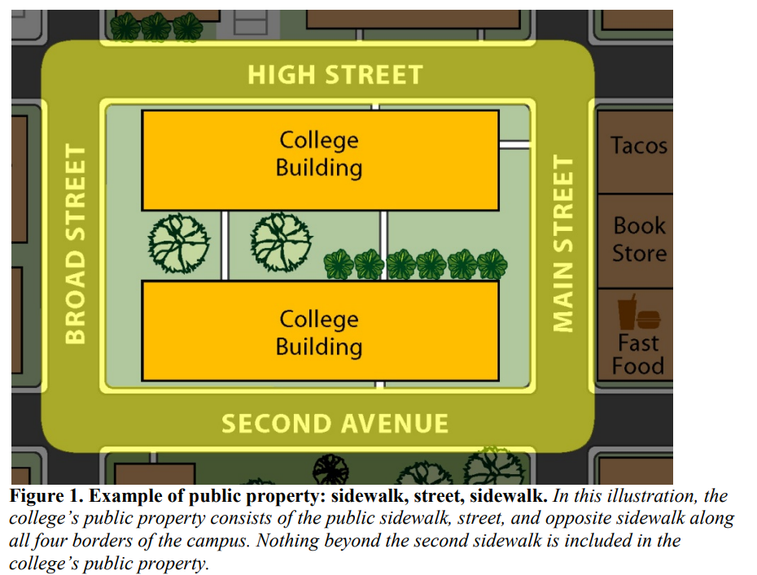
Clery Crimes & Reporting Requirements
Geography
Non-Campus Property
On-Campus
Public Property
San Marcos Campus
Escondido Educational Center
Rancho Bernardo Center
Fallbrook Center
All satellite campuses and other locations where classes are held.
Sidewalk/Street/Sidewalk

Slide 12
Clery Crimes & Reporting Requirements
Alerts
ALERTING CAMPUS COMMUNITY
Timely Warnings
A warning to the community that must be issued for any Clery Crime that occurs on Palomar’s Clery Geography & is considered to represent a serious or continuing threat to students & employees
Emergency Notifications
A notification that must be initiated for any significant emergency or dangerous situation involving an immediate threat to the health or safety of students or employees occurring on the campus

Slide 13
Clery Crimes & Reporting Requirements
Crime Log
A record of criminal incidents and/or alleged criminal incidents that are reported to the Palomar College Police Department & made available to the public.
The log must contain the following:
Date the crime was reported
Date and time the crime occurred
Nature of the crime
General location of the crime
Disposition of the complaint, if known
THE CRIME LOG IS THE MOST COMPREHENSIVE LIST OF CRIME REPORTS ON CAMPUS
CRIME LOG CAN BE OBTAINED AT THE PALOMAR COLLEGE POLICE WEBISTE
https://www2.palomar.edu/pages/police/

Slide 14
Reporting Crimes
Where
Reporting Depends on Location
You must report if incident occurred…
Off campus but closely related to the College
Under the law, some off-campus locations are deemed so closely related to the College that crimes at these locations are included in campus crime statistics
Any building or property owned or controlled by a student organization officially recognized by Palomar College
Any building or property owned or controlled by Palomar College that is used in direct support of Palomar’s educational purposed, is frequently used by students, and is not “on-campus” property
Do not report if…
A person tells you about a crime that occurred before he/she came to the College
While he/she was away from campus and not involved in a Palomar College activity (e.g., at home during spring break)

Slide 15
Reporting Crimes
How
Reporting an Incident
As a Campus Security Authority, you are REQUIRED to…
Get the facts: When, What, Where, Who, etc…
Report all Clery Act related crimes IMMEDIATELY to the Campus Police Department so that campus can comply with Timely Warning Policies & have accurate crime statistics for the Annual Security Report
Inform victims of their options, including confidential reporting option & referrals to resources

Slide 16
Reporting Crimes
How
TWO REPORTING OPTIONS
Police Report
A report used by Campus Police to initiate a criminal investigation
PCPD (760) 891-7273
Or
(760) 744-1150 Ext. 2289
Take the reporting party to the PCPD to observe that the crime has been reported
CSA Report
Crime Statistic Reporting Form which can be found on the PCPD website under “Campus Security Authority (CSA)”
https://www2.palomar.edu/pages/police/campus-security-authority-csa/
This form is submitted via inter-office mail or drop off at PCPD

Slide 17
Reporting Crimes
How
CSA REPORT
Must have information
Who was involved
What occurred
Where did it occur
When the crime occurred (date & time)
When the crime was reported (date & time)
How did it occur
The accuracy of the information provided can assist with the
Criminal investigation
Annual reporting requirements
The issuance of a Timely Warning, if appropriate
If the reporting party does not want to give you the information that you are requesting, DO NOT PUSH IT. Report all of the information that you were able to collect from the reporting party, even if some of it is missing.

Slide 18
Reporting Crimes
Your Actions
WHAT YOU SHOULD NOT DO
A campus security authority is not responsible for determining authoritatively whether a crime took place—that is the function of law enforcement personnel.
A campus security authority should not try to apprehend the alleged perpetrator of the crime. That too is the responsibility of law enforcement.
It’s also not a CSA’s responsibility to try and convince a victim to contact law enforcement if the victim chooses not to do so.

Slide 19
Reporting Crimes
Resources
Notify students & employees about existing resources (on-campus & off-campus)
Palomar College PD
Student Affairs
Behavioral Health Counseling Services

Slide 20
Questions?

Slide 21
Palomar College Police Department
760-891-PCPD (7273)
760-744-1150 Ext 2289 Dispatch
Brittany Woolsey Ext 3977
bwoolsey1@palomar.edu

