Slide 1
Welcome to the Palomar College Nuts & Bolts!

Slide 2
The Nuts and Bolts of Teaching at Palomar College
or
Getting Ready for the First Day of Class (and Beyond)

Slide 3
Before We Get Started…
Welcome!
Why are we here today?
How many of you are new to Palomar?
How many of you are returning?
How many of you who are returning have attended this presentation before?
Introductions of Attendees (name, discipline, years at Palomar)
Introductions of Presenters
Please be sure to sign in.
Please fill out the evaluation form before leaving.
Feel free to get up and stretch and get coffee or eat a cookie at any time along the way of the evening.
As we go along, write your questions down. We will break three times to answer your questions as best we can!

Slide 4
PD Code #32
HR Website Resources for PT Faculty: http://www2.palomar.edu/pages/hr/employees/personnel/ptfaculty/

Slide 5
Presenters
Dr. Jack Kahn, Dean of Social and Behavioral Sciences, x2759, MD-155A
Barbara Blanchard, Dean of Arts, Media, Business, & Computer Science, x2154, MD-155D
Shayla Sivert, Dean of Languages and Literature, x2251, H206B
Kathryn Kailikole, Interim Dean of Mathematics & the Natural and Health Sciences, x2253, NS-147C
Interim Dean of Career, Technical, and Extended Education, x2276, AA-134
Dr. Kendyl Magnuson, Director of Enrollment Services, x2171, SSC-44
Brian Stockert, Dean of Counseling, x2296, SSC-38
Sherry Titus, Director of Student Affairs, x2594, SU-201

Slide 6
Content
Getting Ready
The First Day of Class
Student Discipline
Other Incredibly Valuable Information (☺)

Slide 7
Getting Ready

Slide 8
Where Are You Going?
Palomar College San Marcos Campus
Other Palomar College locations PC Escondido Center, x8134 PC at Fallbrook High School, (760) 723-1058
PC at Mt. Carmel High School, x3890 PC at Camp Pendleton, x2259 PC at Pauma Indian Reservation, (760) 742-1121
Center/Sites Staff
Get to know them, and be good to them. They will be the ones to rely on when you’re in a bind.
Services at Palomar College Center/Sites
Call to find out what services are available.
Visit the classroom before class — Get key if needed, use computer and AV Equipment.

Slide 9
Who to Contact For Help and Information
Academic Department Assistant (ADA)
Department Chair/Director
Dean
Instructional Services Office, x2246
Office of Student Affairs, x2594
Human Resource Services, x2609
Center Staff
Evening Administration (until 7:30PM) – Will vary, so check General Information email (This means that you need to be using your Palomar email.)
Sherry Titus, Director of Student Affairs, x2594
Campus Police, x2289 OR 760-891-7273 (put this in your cell phone)
All HelpDesk/Information Services, x2140

Slide 10
Minimum/Maximum Class Size
Consult your department chair if you are concerned about the lack of enrollment in a class to which you are assigned.
Maximum Class Size: Set by the PFF Contract and/or the number of student stations in the classroom or laboratory--whichever is smaller. (http://www.palomar.edu/INSTRUCTION/CourseMaxList.pdf)
Please do not allow students to sit on the floor or to bring chairs from other rooms. We need to be concerned about fire code violations.

Slide 11
Odds and Ends
Check with the bookstore to see if books have arrived
Tammy Wagonis (twagonis@palomar.edu), x2225
Jessica Dador (jdador@palomar.edu) OR Leon Springer (lspringer@palomar.edu), x2223
Note: Never manage textbook or material transactions with students yourself. All required materials must be listed on the enrollment information when students sign up for the course.
Get a parking pass (will be issued at Plenary; easiest to get it then)
Campus Police—bring ID
Linda Mack, x3289
Other things to think about — bathrooms, Health Services (location & hours), security, space for office hours
Get handouts copied at http://www.palomar.edu/printservices/Comet%20Copy.html or according to your department’s direction.
Ask your ADA to set up a Palomar phone extension where students can leave messages for you (do not use your personal #).

Slide 12
Instructional Help/Support
Campus Police, x2289 (Do not call 911 directly.)
Information Systems Help Desk, x2140
Technical support for computers, software, voice mail, email, audio-visual requests/problems
Academic Technology Resource Center, x2862, http://www.palomar.edu/atrc/
Instructional support: Blackboard, instructional software, etc.
Print Services http://www.palomar.edu/printservices/Comet%20Copy.html
Admissions Office Help Line, x2274
Library, http://www.palomar.edu/library/

Slide 13
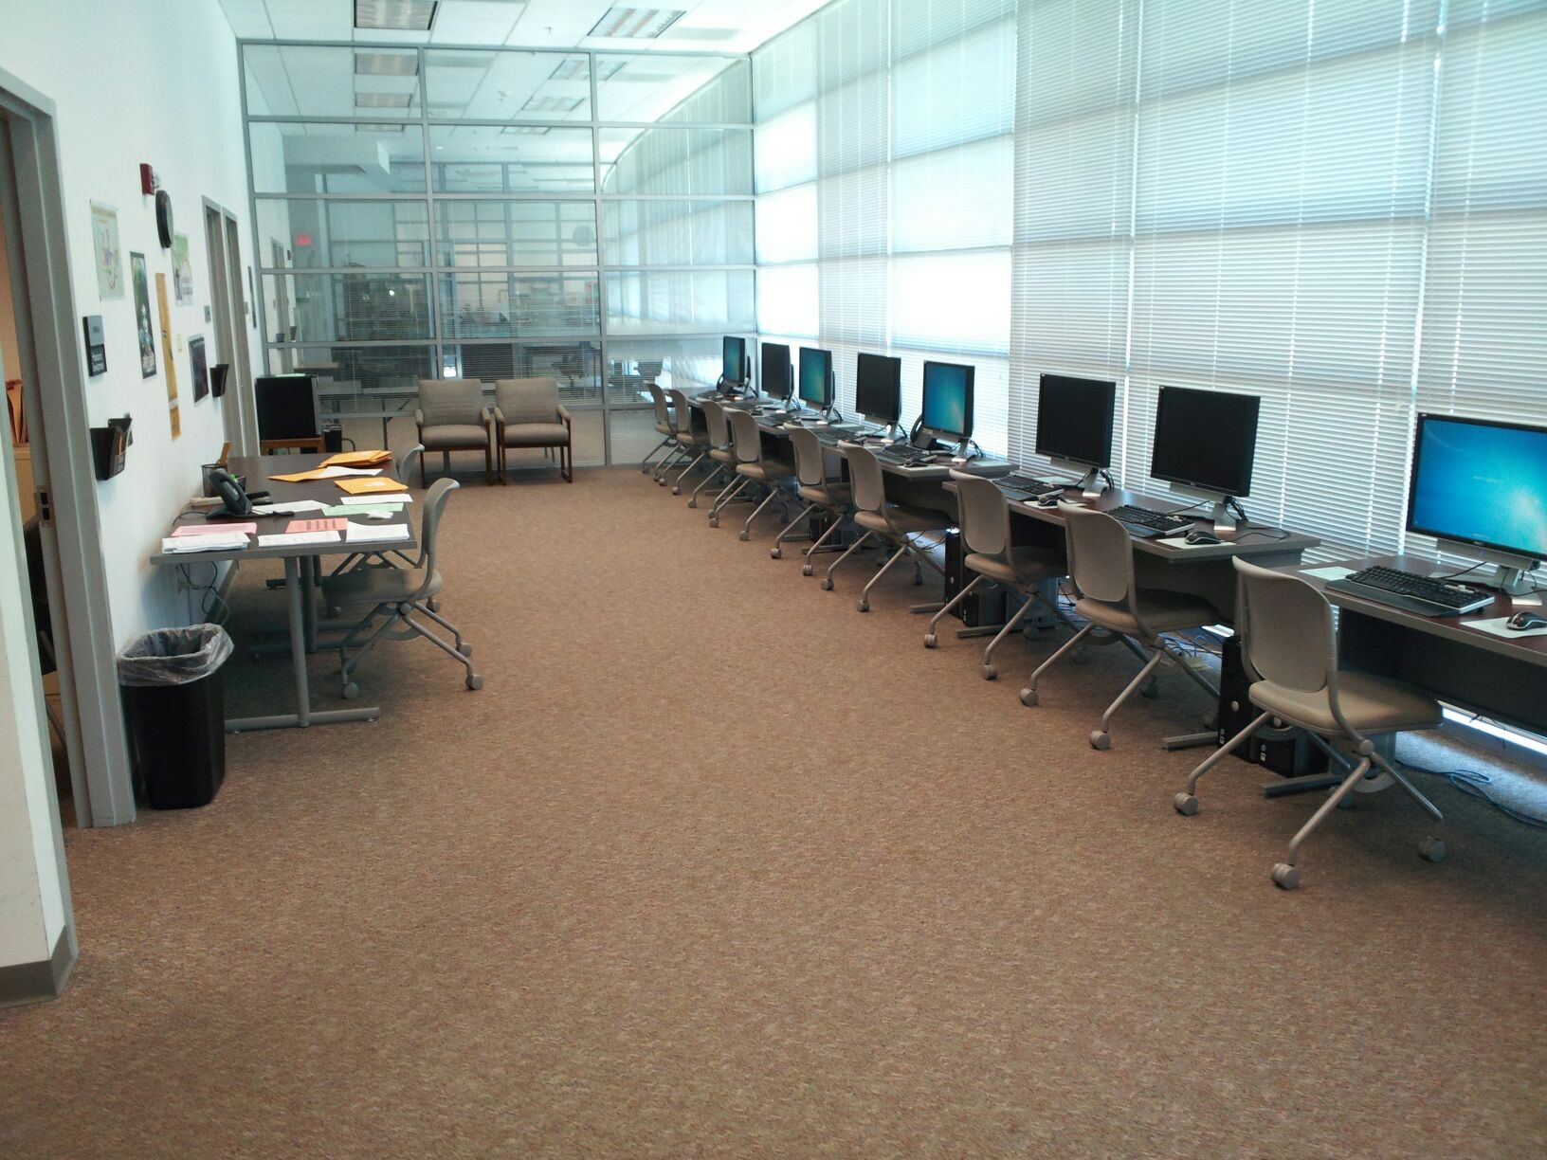
Part-time Faculty Work Room and PD Offices NS-153
Computers
Work space
Conference Rooms
PD Offices
Other Resources
M-Th,7:30 a.m. – 6 p.m., F 8- 11 a.m.
x2244

Slide 14
Preparing Your Syllabus
Palomar has no required format for syllabi. Please see your department chair or a colleague for examples. Keep it short, simple, and to the point. Be sure to include the elements discussed in the following.

Slide 15
Preparing Your Syllabus
Your syllabus is a contract between you and your student and provides information about the class and sets expectations. At a minimum, it should contain:
Class meeting place and time
Required course materials (no surprises; no money to be collected in class)
Your contact information
List your Palomar email address, not your personal email address.
List a Palomar phone extension—contact your ADA to set one up for you. Do not give students your cell phone or home phone.
Your Office Hours (dates, times, and locations) – more info to follow.
Course Objectives – more info to follow
A welcoming tone
A calendar/schedule of activities or an outline of class by date
Important dates
Grading policy and grading structure
Note: “Attendance” should never be tied to grades.
Check your addition.
Keep it straightforward.
Everything that the student needs to know about how he/she will be graded for your class should be made crystal clear in this one brief section. Don’t throw surprises in elsewhere.

Slide 16
Important Dates – Spring 2016
2015-16 Academic Calendar
Spring 2016 Final Exam Schedule
YOU ARE REQUIRED TO MEET FOR THE TIME LISTED IN THE FINAL EXAM SCHEDULE.
Include the date and time in your syllabus.
You are paid for Final Exams, so be there!
If you are delayed or going to be absent, contact your department ADA, chairperson, and site staff.
Important Dates Spring 2016

Slide 17
Course Information
Review the Course Outline of Record CurricUNET (http://www.curricunet.com/palomar/). Use your Palomar email user name and password.
Review the Course Student Learning Outcomes (http://www2.palomar.edu/slo/). The information for your class should go onto your syllabus. If you aren’t sure, email your chairperson.
Prepare your syllabus/website/Blackboard.
Remember that not all of our students have easy access to the internet or a fast computer.
Familiarize yourself with course materials (text, etc.).

Slide 18
Part-time Office Hours
http://www2.palomar.edu/pages/hr/files/2013/09/PT-Faculty-Voluntary-Office-Hours-Verification-10.2.152.pdf
Contact Department Chair or ADA for additional information.
2015-16 Deadlines for Part-Time Instructor Office Hours
Submit to department office by Spring – 4/25/16

Slide 19
Preparing Your Syllabus (cont’d)
Behavioral expectations including consequences. Keep in mind that we are a community college. We accept the top 100% of all applicants. Your expectations should be reasonable but clear.
Student Learning Outcomes (SLOs) http://www2.palomar.edu/slo/
Financial aid student drop policy (Details later.)
Safety information, if relevant (e.g., Chemistry Labs)
Field trips, class fees, etc.
All field trips require advanced approval and Clery Act Training on your part (contact Karen Boguta-Reeves at x3977).
Class fees, etc., are set up and communicated to students well in advance of your class.
Proofread your syllabus to make sure that you have not included information about teaching assignments at other colleges.
Think ahead about how you will manage students trying to crash your class. (I put a signup sheet for crashers on the door so that my class and I could get started without interruption.)

Slide 20
SLOs (Student Learning Outcomes)
Course SLOs and their assessments:
The course SLOs must be included in the syllabus.
http://www2.palomar.edu/slo
Know which SLOs are being assessed this semester for the course you teach, know the plan for assessment, and how to collect and report the data.
Discuss SLOs and Assessments with the department chair before the start of the semester.

Slide 21
Preparing Your Syllabus (cont’d)
Directions/instructions for students with disabilities
If a student is granted an accommodation from the DRC, the student will bring you verification of that. You cannot deny that accommodation.
Disability Resource Center http://www2.palomar.edu/drc/
Example of statement that may be used: Disclosure of Disabilities to Instructors/Staff If you have specific disabilities and require special accommodations, please let me know right away. DRC (Disability Resource Center) will, upon student request, inform faculty/staff about functional and/or educational limitations and about recommended accommodations.

Slide 22
Disability Resource Center
Encourage students with possible disabilities to go to the DRC for diagnosis.
Students with identified disabilities may bring forms with verification to the DRC asking for “reasonable accommodations.”
A DRC counselor will give the student an Accommodations Form to show his/her instructor. On the back of that sheet are directions for the professor on how test accommodations work and what information you need to communicate for any testing proctoring.
Feel free to contact and work with DRC personnel.
Disability Resource Center http://www2.palomar.edu/drc/.
Check out this link with information developed by Leigh Ann Van Dyke, one of our DRC Counselors.

Slide 23
Questions on Syllabi Prep?
5-minute break?

Slide 24
Student Support Services
Access & Assessment Center, x2476
Veteran’s Services, x2173
Tutoring Services
http://www2.palomar.edu/tutoringservices/
Early Alert (English and Math)
FYE, TRIO, Athletics
TLC (San Marcos & Escondido)
Summer Bridge, FYE, Village Mentoring

Slide 25
Student Support Services
Counseling Services, Carol Moore, x2197 (Classroom visits can be arranged.)
Behavioral Health Services. Call Carol Moore, x2197, for referral assistance for currently enrolled students.
Career Center, x2194
Transfer Center, x2552
Disability Resource Center (DRC), x2375
Extended Opportunity Programs & Services (EOP&S), x2449

Slide 26
eServices, email, and PD
Be sure browser is in Compatibility View (under Tools menu)
Faculty e Services (http://www.palomar.edu)
My Class Schedule, My Weekly Schedule
View Schedule of Classes
Access Class Roster, Drop Roster, Census Roster, Permission Roster,Early Alert Roster, Athletic Participation Roster, Positive Attendance Roster
Record Grades
Palomar email (https://mail.palomar.edu/)
Your ADA will help you get this and your phone extension.
Professional Development (http://www.palomar.edu/pd/)
Contact the PD Office, NS 153A, x2250 or Kelly Falcone (PD Coordinator) at x3643 if you have questions.
PD pay is available.

Slide 27
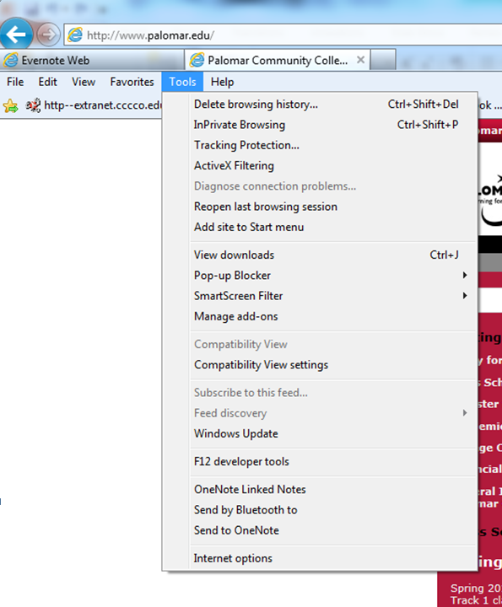
Set Browser on Compatibility View

Slide 28
Eservices Instructions
The following link is meant to assist faculty in using eservices more effectively:
http://www2.palomar.edu/pages/enrollmentservices/faculty-eservices-instructions/

Slide 29
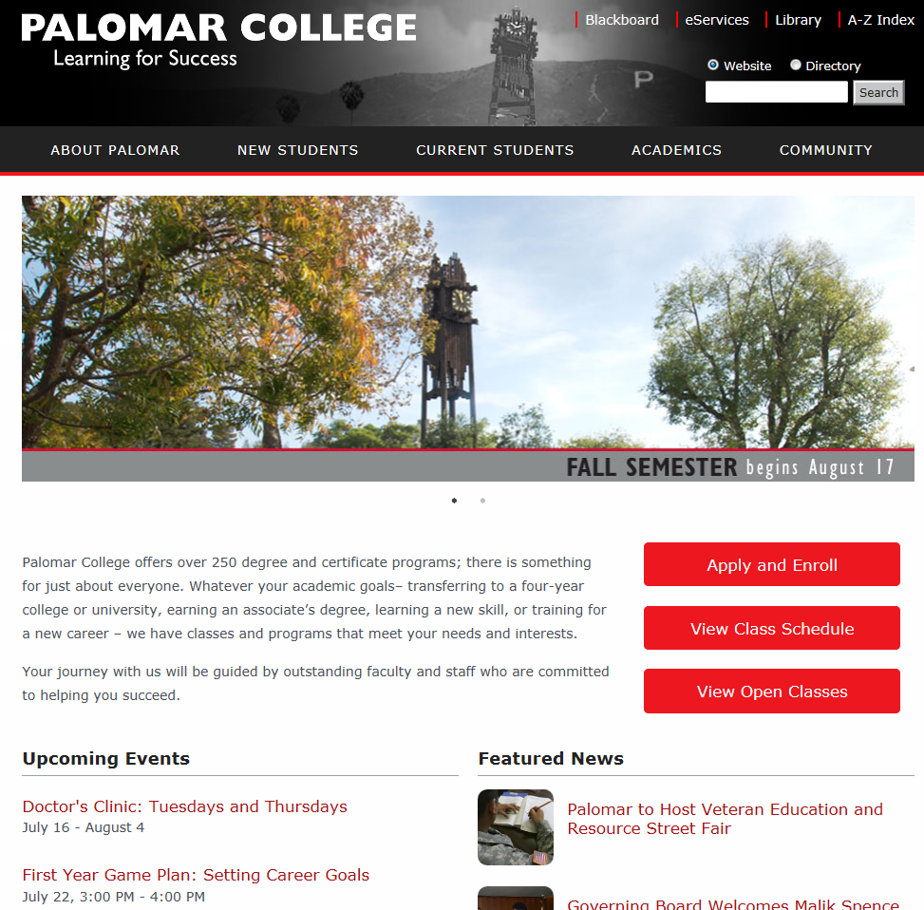

Slide 30
Class Rosters
In classes that are full/closed, rosters are frozen the Wed before classes begin.
If there is no waitlist or there are no students on the waitlist, the roster will reopen on the first day of the semester, and students may add without a permission number until the class fills.
If there is a waitlist with students, the class will be frozen and will not reopen even if numbers drop below the maximum. Students, waitlisted or not, may only add with a permission number (available in eservices) that is issued by the instructor.

Slide 31
Class Rosters
All students (including waitlisted) require permission numbers to enroll in Week 2 of classes.
No students may add a class on or after the Census Date (August 31) (except for late-start fast-track classes).
Students may drop online without instructor signature (up to the 8th week of classes). However, after January 31, 2016, students will receive a W on their record, which will count as one of their 3 allowed course attempts.
Use this link for Spring 2016 Add/Drop deadline information: http://www2.palomar.edu/pages/enrollmentservices/important-dates-deadlines-spring-2016/.

Slide 32
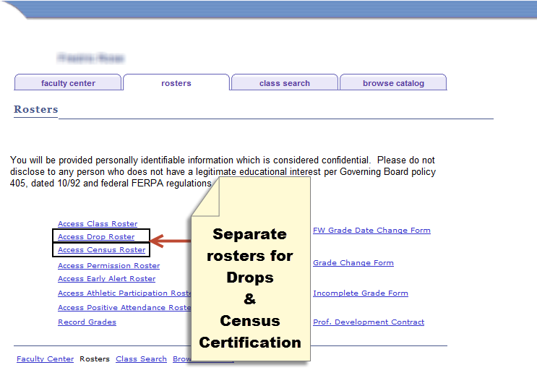
Census Roster and Drop Roster

Slide 33
Census Roster (February 1*)
The Census Roster is used one time at or as near to the census date of your class as possible
All class rosters, except positive attendance classes, MUST BE CERTIFIED (even if no students need to be dropped)
Students listed on your roster must be active students, i.e., have been attending, participating, etc.
In online classes, students should do something, i.e., take a quiz, turn in an assignment, etc., prior to the census date and certification (as proof of their attendance in your course).
Census Certification is required to claim apportionment funding for your section. (This is the college’s primary revenue source.)

Slide 34
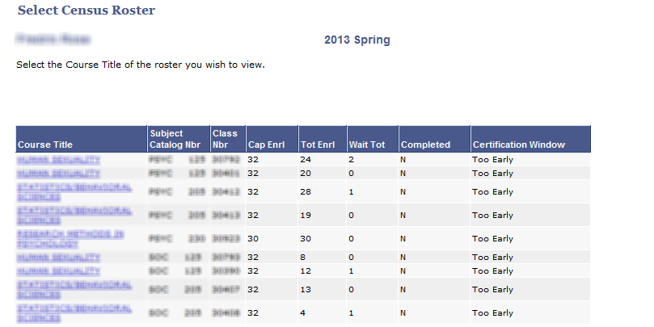
Census Certification Page
Completed Indicator
Certification Window
Too Early, Open, and Closed.

Slide 35
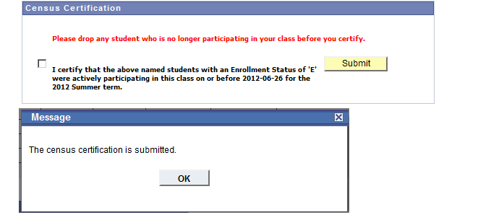
Census Certification Page

Slide 36
Drop Roster
Available in Faculty eservices
The Drop Roster is designed to be used on an on-going basis starting the first day of class throughout the semester.
Drops before Census means the student gets no grade notation on their record.
The Drop Roster is available to you for all your students through the 50% point of your class (8 weeks for full-term classes) and results in the student getting a “W” grade. This counts as one the three attempts a student has for this course.
The Drop Roster remains available after the 50% point in the semester to just before final grading for Financial Aid, Veterans, and other students whose financial aid is affected by their enrollment. These students will have an “*” preceding their name on the roster.

Slide 37
Repeatability and Drop Dates
Students may only attempt a class three times before being barred from enrolling in that class.
Students may drop a class up to the Census date without a notation on their record—in effect, they never attempted the class.
After the Census date through the 8th week, students may drop with a notation (W) on their records—the W means they attempted the class. The W has no impact on GPA calculation.
Bottom line—if a student stays past the 2nd week, it counts as an attempt.
Students who pass a class may not repeat the same class (with very few exceptions).

Slide 38
Students Receiving Federal Financial Aid
These students have an asterisk by their names on the rosters.
They need twelve units to qualify for financial aid and they must participate in the class to receive the funding.
Some students sign up for classes but do not attend/participate.
They MUST be dropped for non-participation (excessive absences, failure to complete assignments, and failure to take exams) as soon as it is determined, because Palomar must return any funds paid to a student who is not participating.
It is important to monitor these students closely and require weekly participation.
Establish a policy and put it in your syllabus.
Access the Drop Roster in eservices and list the last date of activity.

Slide 39
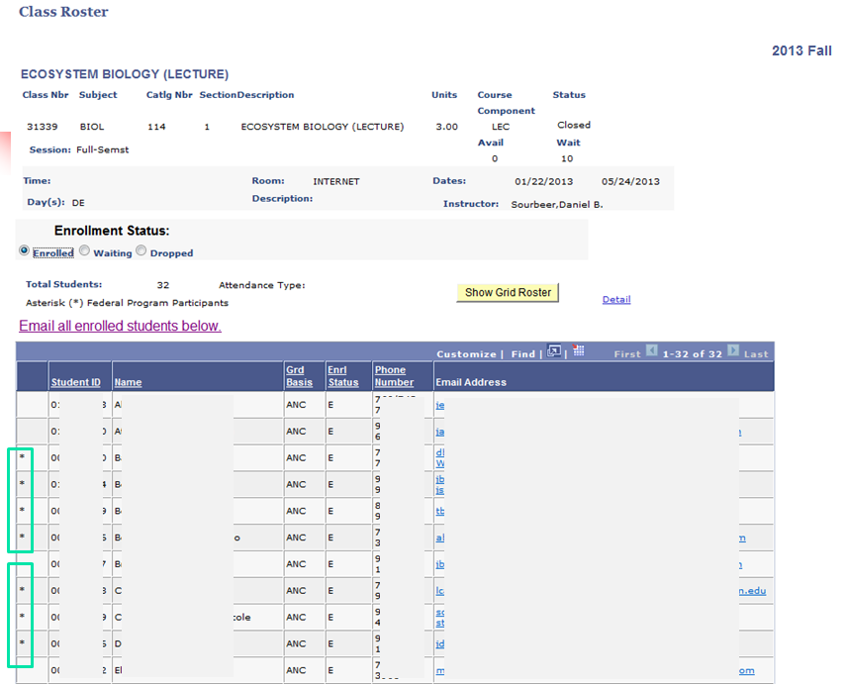

Slide 40
Grades
Possible grades. A, B, C, D, F, FW, P, NP, I, W, MW
The difference between an F and an FW
F = the student earned an F on the basis of all required completed work
FW = the student stopped attending class and consequently earned an F because he/she is missing work and has missed the final.
W = only available until 50% of class completion
Grades are due 5 days after final exams.
Please submit grades on time. Late grade submissions may hurt a student’s chance to register for a class for the next semester and may hurt their chance to transfer as well.
Submit grades via Grade Rosters in eservices.
Family Educational Rights and Privacy Act (FERPA) http://www.ed.gov/policy/gen/guid/fpco/ferpa/index.html
Do not backdate drops.

Slide 41
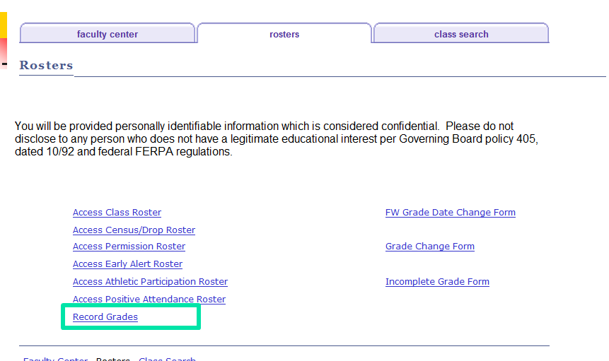

Slide 42
Questions about Rosters/Eservices?
5-minute break?

Slide 43
The First Day of Class
Print your roster and permission #s (eservices) on the night before or day of your 1st class.

Slide 44
The First Day of Class
Leave for campus MUCH EARLIER than normal
Traffic around the campus will be very congested the first week or two
Parking spaces may be difficult to find as other instructors are coming in early or staying late and students may be taking instructor spaces. Lot 12 will be especially crowded due to the closing of the parking lot next to the Humanities Building.
Arrive early to class so you can be sure to be prepared.
Whiteboard markers
Roster
Check AV equipment
…and so on…

Slide 45
The First Day of Class
Introduce yourself.
Cover the basics and information in the class syllabus
The content and nature of the course
Important dates
Grading procedures
Academic honesty policy and consequences
Course rules (including cell phones)
How to do well in the class
Set the tone for the class (be interesting, organized, well prepared, clear, enthusiastic, and approachable).
Create rapport with your students.
Save time for questions.

Slide 46
Overlapping Classes and Auditing
We STRONGLY discourage students from enrolling in overlapping classes.
You MUST meet and document the missed time outside of normal class time.
Convenience is NOT an acceptable reason.
The Overlapping Class form can be found at: http://www.palomar.edu/instruction/Front%20Desk/Overlap%20Approval%20Request%20Form%20rev%20effective%20Spring%202012.pdf.
Auditing is typically approved only when a student is unable to enroll in a class for credit.

Slide 47
Student Discipline

Slide 48
Student Discipline
Sherry Titus-Director of Student Affairs: stitus@palomar.edu
Student Incident Report: http://www2.palomar.edu/pages/studentaffairs/incident-report-form/
Complete and submit an Incident Report for ALL cases of academic dishonesty, and for other Code of Conduct violations, as well.
When in doubt, submit an incident report.
Keep in mind that students have DUE PROCESS rights.
Students can file a “grade dispute” once grades are posted. They must provide documentation and/or supporting evidence for the dispute. Below are links to the process and the appeal form itself.
Grade Dispute Policy
Grade Appeal Form

Slide 49
Student Discipline
Academic Dishonesty
Explicitly state your policy in the syllabus.
Make your grading scale crystal clear, and stick to it. (Make sure that it adds up correctly too. ☺)
Do what you say you will do—if you make one exception, then you have defined a new policy for the class.
Submit the Incident Report on ALL incidents, great and small, to Sherry Titus in Student Affairs (stitus@palomar.edu).

Slide 50
Student Discipline
Instructors may dismiss a student from class for two class meetings for an incident (last resort). Document all attempts to resolve issue with the student.
You must submit an Incident Report and coordinate with the Office of Student Affairs as students may only be asked to leave class for two days; it may take longer than that for them to schedule a meeting with Sherry Titus.
Student Code of Conduct http://www2.palomar.edu/pages/studentaffairs/home/student-discipline/.
Do not give out your personal phone numbers or email addresses—it can lead to serious problems. Use your Palomar email or Palomar phone for any contact with Palomar students. Encourage students to use their Palomar email as well.
Be cautious with social media.

Slide 51
Questions about Your First Day or Student Discipline?

Slide 52
Other Valuable Information

Slide 53
Reporting Your Absences
Report your absences as early as possible.
Go down this list in order until you have SPOKEN to at least one of the following so that your class can be posted:
Your Department ADA or Center Staff
Your Department Chair
Your Division Office (Dean)
The Instructional Services Office: x2246
Evening Administrator, Variable—check email
Campus Police: x2289
Use Blackboard or email to let students know in advance when possible.

Slide 54
Reporting Your Absences
Also email your Department Chair and ADA.
You may also email the entire class via
Eservices
Blackboard
This may help them avoid making a trip to campus only to find out that their class has been cancelled.
Even if you do this, remember to follow the procedure from the previous slide.

Slide 55
Classroom Breaks
For three-hour classes:
A ten-minute break at the end of the first and second hour (teach 50 minutes, 10 minute break), OR a 20 minute break at the midpoint in the class are permissible options.
There is no break associated with the “third hour” (the class ends).
You may NOT “save” or “stack” your breaks at the end of the class—if a class is scheduled for 6-8:50PM, you may not teach 6-8:30 and send the students home.

Slide 56
Evening Classes
Bookstore is open until 7:30 pm.
Enrollment Services is open until 6:00 pm.
A General Information email is sent out each week informing you of that week’s evening administrator.
Campus Police offers escort service to your vehicle and, of course, is available in the event of an emergency, x2289 or 760-891-7273.

Slide 57
ScanTron Machines
Department Room Open until?
Humanities Building Resource Room 2nd floor 8:30 PM
ART C-13 10PM*
BEHAVIORAL SCI MD-260, x2329 M-Th 7 PM*
EARTH SCIENCES NS-110, x2519 4PM
BUSINESS MD-342 10PM*
FACULTY RESOURCE NS-153 6pm M-TH
HISTORY MD-377, x2412 10PM*
LIFE SCIENCES NS-210 10PM*
NURSING HS-200, x2580 4pm
RADIO/TV Q-3, x2964 10PM*
Escondido Center Teachers’ Lounge/EC 204 9:30 PM
Camp Pendleton Back Room M-Th 8:30 AM – 6 PM
Camp Pendleton Counseling Dept. F 8 AM-2 PM
*10PM = Approximate time room is locked by campus police.

Slide 58
Human Resource Services
HRS Office is located in ST-1, ext. 2609
Mon-Thurs (7:30 am -5:00 pm) Fri (7:30 am – 4:00 pm)
Injured at work?
If you are injured during work please contact your Dean/Chair/Director and Human Resource Services immediately. If it is after hours, contact Campus Police x2289 or the evening administrator.
Visit the HR Website: http://www2.palomar.edu/pages/hr/
View salary schedules, PFF Contract, Benefits, Salary advancement, leave information etc.
Call HRS (x 2609)
PT Faculty– Tania Silva tsilva@palomar.edu or x2148
FT Faculty – Christine Winterle cwinterle@palomar.edu or x2674

Slide 59
Palomar College Nuts and Bolts Session
QUESTIONS?
Fill out your evaluations!
Meet your dean?
Have an amazing semester!

Slide 60
Palomar College Nuts and Bolts Session
Thank You
For Attending!
PD Code #32

