Slide 1
Guided Pathways – did you know
Plenary Workshop
January 28, 2021
(3:30pm – 4:30pm)
Presenters:
Wendy Nelson, Pillar 1 Lead
Alex Cuatok, Pillar 2 Lead
Glyn Bongolan, Pillar 3 Lead
Sabrina Santiago, Pillar 4 Lead

Slide 2
Guided Pathways - who?
Taskforce
Pillar Leads
Pillar Partners / Guided Pathways Student Ambassadors
All Palomar College Employees
Students
Presenter: Wendy Nelson

Slide 3
Guided Pathways - What?
In 2015, researchers from the Community College Research Center published "Redesigning America's Community Colleges", which brought about the idea of Guided Pathways.
Guided Pathways is a movement that seeks to streamline a student’s journey through college by providing structured choice, revamped support, and clear learning outcomes—ultimately helping more students achieve their college completion goals.
Guided Pathways provides a framework for integrating California-based initiatives such as SSSP, Equity, Basic Skills Transformation, the Strong Workforce Program, and California College Promise
As of 2018, more than 250 community colleges had committed to using a guided pathways approach.
Research shows that the practices used in guided pathways programs can lead to better outcomes for students – transfer, retention and completion.
Presenter: Wendy Nelson

Slide 4
Guided Pathways - where?
Everywhere –
In arts and sciences and career/technical programs.
Student Services –Counseling, Career Center, EOPS, Financial Aid, etc.
Faculty--Academic Senate, faculty-led professional development & pedagogical training.
ASB, student groups and campus activities.
Service Learning, Internships, Study abroad, clinical placements, group projects outside of class.
Institutional Planning, administration & staff.
Alumni, Regional employers, Local Community
Presenter: Sabrina Santiago

Slide 5
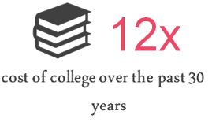
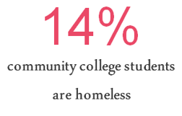
Guided Pathways - why?
Need to increase student access to college and increase student success including completion of students' educational goals in a timely manner while also paying attention to patterns of inequity in student outcomes and addressing them.
Access: College tuition increasing 12 x over past 30 years while 14% of college students are homeless
Success: 43% dropped from 2 yr college for 2011-2012 year
Timely manner: average units completed for some was as high as 112 units – 160 units.
Systemic inequities: scheduling for FT student only, less or no access to resources, stereotypes threats, assumptions that the student doesn't value education (deficit model) vs system inequities
Presenter: Glyn Bongolan
Notes:
Access: College tuition increasing 12 x over past 30 years while 14% of college students are homeless
Success: 43% dropped from 2 yr college during 2011-2012 year according to NCES – no degree
Timely manner: Palomar is 87
Systemic inequities: less or no access to resources, stereotypes threats, assumptions that the student doesn't value education (deficit model) vs system inequities. Scheduling for FT student

Slide 6
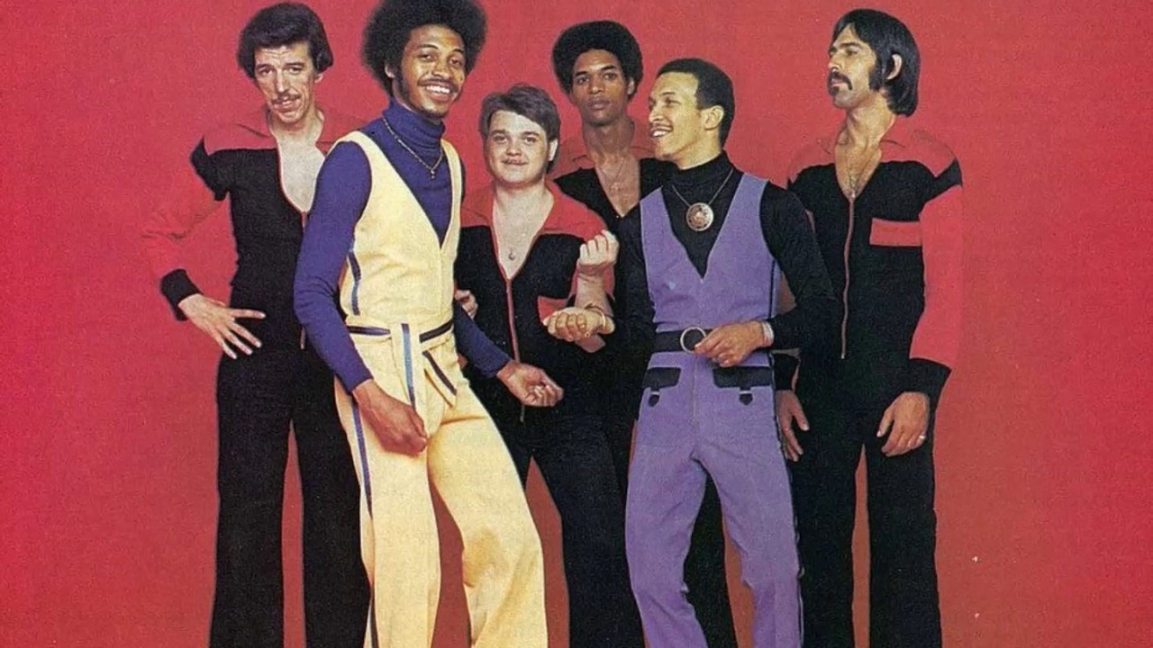
Guided Pathways - when?
CCCCO Timeline & Budget
1.5 million allotted over 5 years
1 million left to spend by 6/30/2022
Always and Forever
Initiative of all initiatives
Intentional work that is ongoing
Set of principles which guide our actions
Presenter: Glyn Bongolan
Notes:
Mandalorian isn't a race. It's a creed.

Slide 7
Guided Pathways - how?
Mapping pathways to student end goals. Palomar College creates clear maps for every program offered. These maps are accessible on the websites (Palomar Pathway Mapper) so students will understand what courses are necessary to complete a program or qualify for transfer, how long completion will take, and what opportunities for employment or further education they will have at the end of the program.
Helping students choose and enter a program pathway. Palomar College helps new/continuing students explore programs, consider possible careers, and develop complete career and academic plans. Undecided students meet with a professional staff to narrow their options by choosing from clusters of majors.
Keeping students on a path. Students’ plans are mapped out through graduation, completion or transfer. Palomar College keeps track of students’ progress. If students get off track or have trouble in a course, alert systems (Starfish Early Alert) bring these issues in the forefront so students can utilize academic assistance or other supports.
Ensuring that students are learning. Programs are designed around a coherent set of learning outcomes, rather than as a collection of courses. Program learning outcomes align with requirements for success in further education and employment in a related field. Palomar College tracks student learning outcomes and work to improve teaching.
Funding. Funding is available to support innovative activities/projects to support student learning and success (as long as it supports the goals and objectives of Guided Pathways.)
Presenter: Alex Cuatok

Slide 8
Pillar 1 – Clarify the Path
What is clarify the path?
Create clear curricular pathways to employment and further education.
Simplify students’ choices with program maps .
Establish transfer pathways through alignment of pathway courses and expected learning outcomes with transfer institutions.
What activities are part of this path?
Develop Palomar pathways (meta-majors).
Develop maps and manage the Mapper.
Work with CSUSUM to create 4-year maps.
Connect Support Services to Meta Majors in a systematic fashion.
Provide students with information about occupations and wages, labor market information, and lists of potential career/majors achievable by discipline.
Identify critical courses, math courses other key progress milestones for pathways.
Support student-friendly website and catalog.
Build relationships with K-12 schools, outreach and dual-enrollment.
Presenter: Wendy Nelson

Slide 9
Pillar 2 – Enter the Path
What is Enter the path?
Helping students choose and enter a program pathway. Palomar College helps new/continuing students explore programs, consider possible careers, and develop complete career and academic plans. Undecided students meet with a professional staff to narrow their options by choosing from clusters of majors.
What activities are part of this path?
Providing a Career and Educational Plan once a career/major choice is decided.
Ensure that underprepared students are provided additional support and assistance.
Providing workshops (academic, career, student development and engagement) to faculty and students.
Partner with middle school and high school to ensure early preparation and decision before coming to Palomar College.
Presenter: Alex Cuatok

Slide 10
Pillar 3 – Stay on the Path
What is Stay on the path?
Helping students to see their progress toward their educational goals and supporting the students to stay on task through their journey.
Making sure that the path is one that a student can complete regardless of life circumstances.
What activities are part of this path?
Tracking progress toward students' educational goals utilizing software and creative support systems.
Installing guardrails for students to keep them on the path.
Creating alternative pathways for those who need it when thrown a curveball.
Building a path that is possible for students through creative scheduling for all types of students.
Presenter: Glyn Bongolan
Notes:
Remember when we live life without google maps? How did we do that?

Slide 11
Pillar 4 – Ensure Learning
What is Ensure Learning? & What activities are part of this path?
Program learning outcomes are designed for success in further education and employment outcomes targeted by each program.
Students engage in active & applied learning, encouraging them to think critically, solve meaningful problems, & work & communicate effectively with others.
Students can apply & deepen knowledge & skills via:
In class projects
internships
clinical placements
group projects outside of class
service learning
study abroad
other experiential learning
Faculty/programs assess whether students are mastering learning outcomes & building skills across each program, in both arts & sciences, & career/technical programs.
Results of learning outcomes assessments are used to improve teaching & learning through program review, professional development, & other intentional campus efforts.
Students are helped to document learning for employers & universities (portfolios, certificates, etc.)
The college assesses effectiveness of educational practice & uses the results to create targeted professional development.
Presenter: Sabrina Santiago

Slide 12
End of the Year Presentation
May 21, 2021
Q & A
Ideas
Call to action
Presenter: Wendy Nelson

