Slide 1

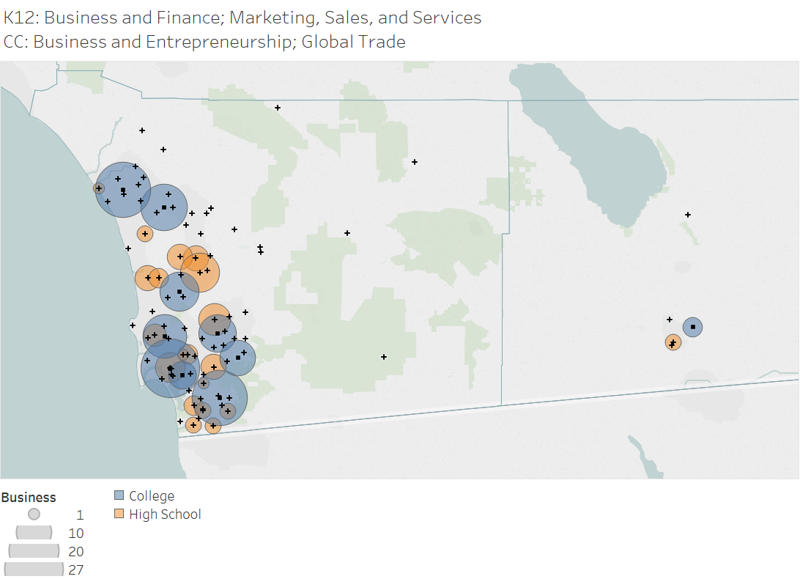
San Diego Imperial Pathways
Randy Tillery
rtiller@wested.org
Allie Bollella
abollel@wested.org

Slide 2
San Diego Imperial Pathways Project
Project Goal: To map and inventory every high school and community college career education program in the San Diego Imperial Region.
Understand the relationship between high school and college offerings and if they are responsive to regional labor demand
Inform pathway planning between high schools and colleges – fill in gaps, develop new programs, improve existing pathways
Develop advising tools to help counselors direct students to CC programs and to support college and career exploration

Slide 3

Data Points are an Excuse for a Good Conversation
Assumptions about Pathways that Inform the Study
The pathway to sustainable wage employment passes through post-secondary education
K12 CE pathway programs are foundational and should be aligned to a broad range of postsecondary opportunities and programs
Some CE programs are both pathways and foundational – Arts & Media, ICT, Business

Slide 4
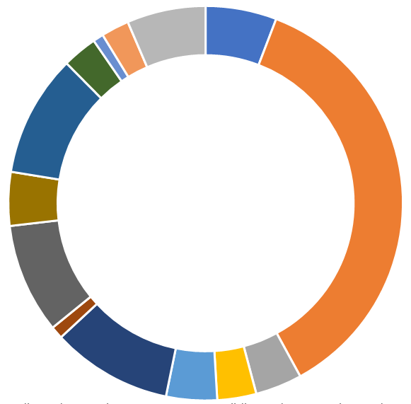
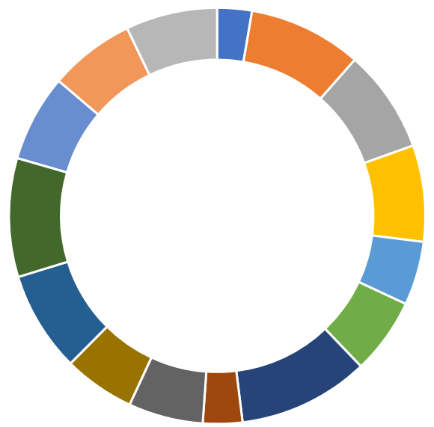
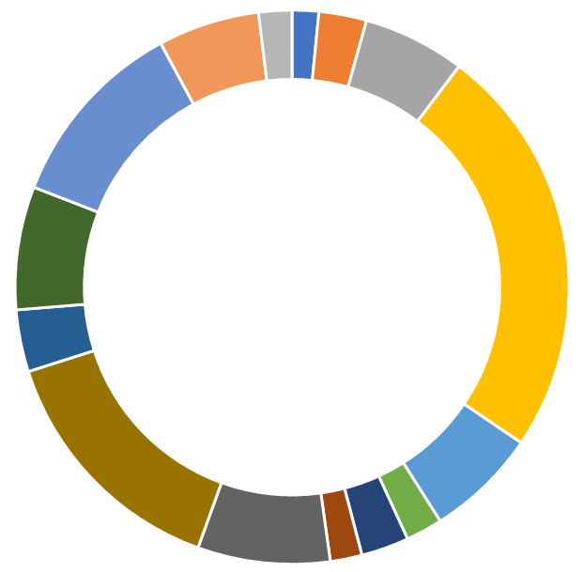
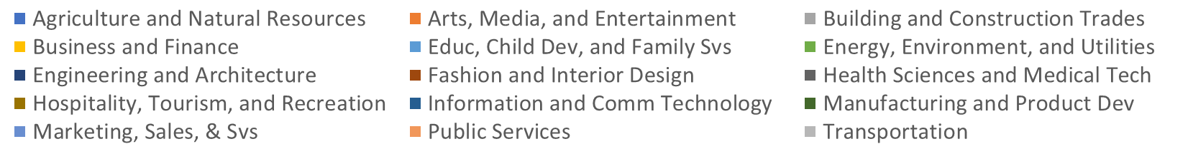
Not a Supply and Demand Analysis
K12 CE Offerings
College CE Awards
Employment

Slide 5

Data Points are an Excuse for a Good Conversation
How do we strengthen our pathways?
Why does the relative balance between offerings and employment look the way it does?
What should be the relationship between K12 offerings and college programs – K12 offerings and the labor market?
What needs to change about this equation?
What should we be telling our students about their pathways and opportunities?

Slide 6
Methodology
Interviewed and received course data from 23 K12 Districts
Extracted CC program level data from statewide curriculum inventory and LaunchBoard
Developed master data files based on K12 and CC data collection and CalPADs/TOPS crosswalks
Pulled demand data from COE’s demand tools based on occupational types related to CDE sector
Developed visualizations using Excel and Tableau

Slide 7
Data Fields – K12
For Every K12 CTE Course:
District Name
School Name
SIS System
Sector
Pathway
Course Code
General Course Name
Course Descriptor
Sections
Perkins Sequence
Course Length
Articulation Status
A – G Status
School Address
1,751 course records across 23 K12 Districts:

Slide 8
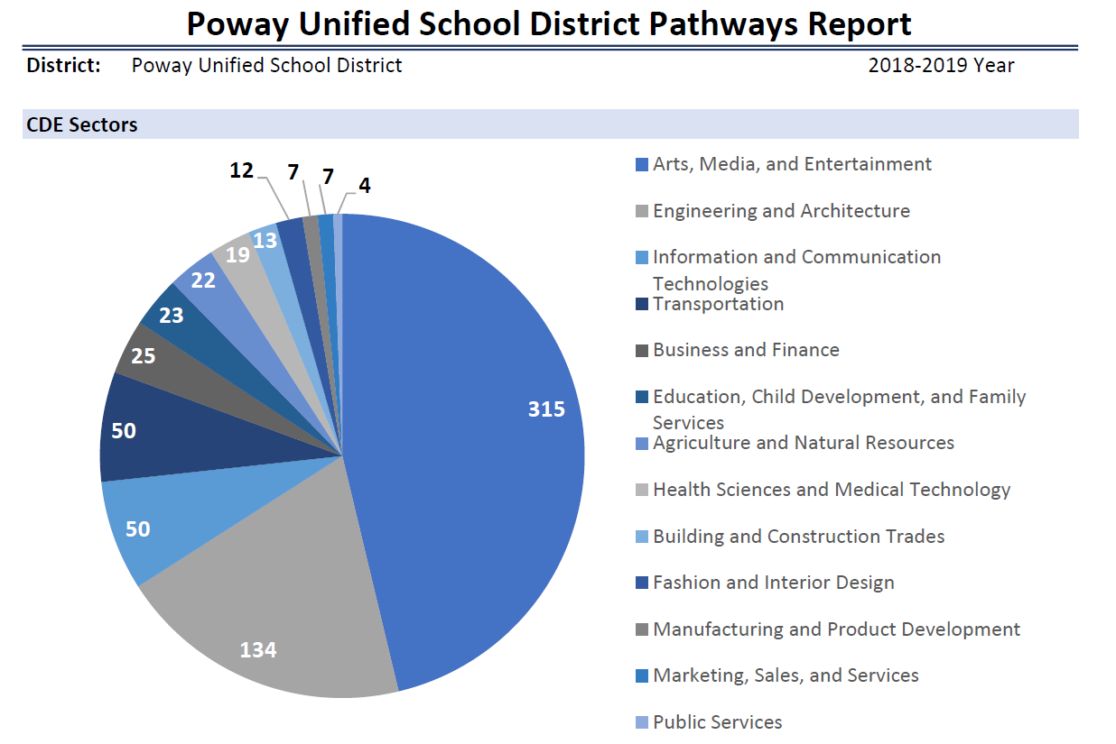
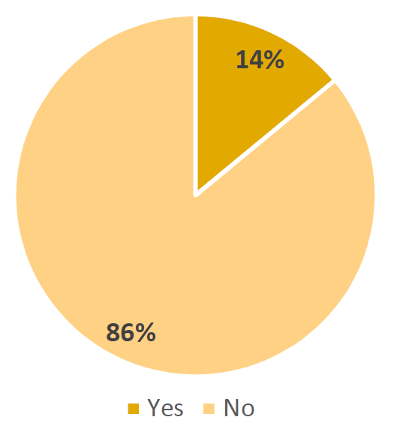
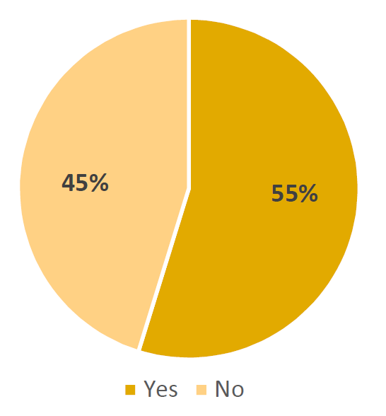
District Reports
Articulated Courses
A – G Eligible Courses

Slide 9
Data Fields – Community College
For Every CC CTE Program:
College
Sector
TOP 6 Title
TOP 4 title
Award Type (cert/degr)
Award Name
TOP 6 Code
CIP Code
SOC Code
Enrollments
Unduplicated Students
Course Sections
1,072 distinct CTE awards from 10 colleges

Slide 10
Data Fields – CalPADs/TOPS Crosswalk
Maps every 3 digit K12 pathway code to corresponding 4 digit TOP Codes

Slide 11
Data Caveats
K12 Sectors and pathways map to many CC programs and awards
Many of the same CC programs map to multiple K12 sectors
Same many to many relationships exist related to occupations
Best use of data is for identification of broader patterns which can inform pathway conversations

Slide 12
Data Caveats: One to Many Relationships – K12 to CC
Community College Awards (1 district)
(30 awards; 914 course sections)
Associates Degrees
Accounting, Business Administration (ADT), Business Management, Computer Business Technology, Entrepreneurship, Financial Services, Legal Admin Assistant, Marketing, Real Estate, Retail Management, Small Business Accounting, Small Business
K12 Business Pathways
(11 course sections; )
Advanced Accounting
Business
Business & Financial Markets
Business Management
Business Law
Certificates
Accounting, Accountancy, Accountancy for Enrolled Agents, Business Administration, Business Management, Entrepreneurship, Financial Services, Legal Administrative Assistant, Marketing, Real Estate Broker, Retail Management, Small Business Management
Noncredit Certificates
Account Clerk, Accounting, Business Management, Project Management, Small Business Growth, Small Business Planning

Slide 13
One to Many Relationships – K12 to CC

Slide 14
Many K12 Sectors align to Same College Pathways

Slide 15
Analysis
Source: CalPASS Plus

Slide 16
Regional Mapping
Source: CalPASS Plus

Slide 17
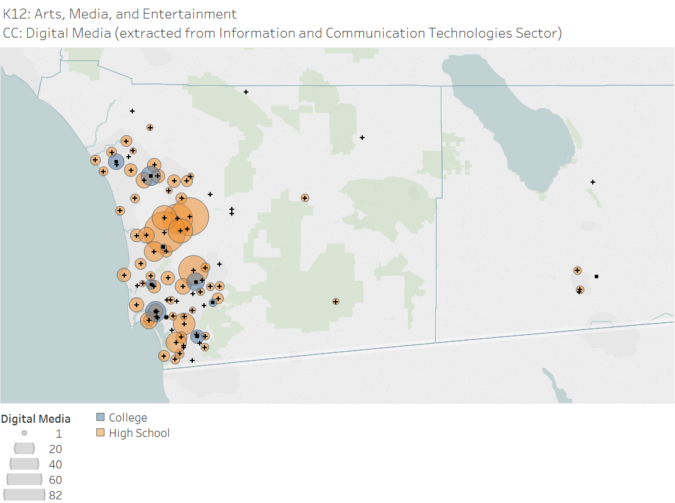
Regional Mapping
Source: CalPASS Plus

Slide 18
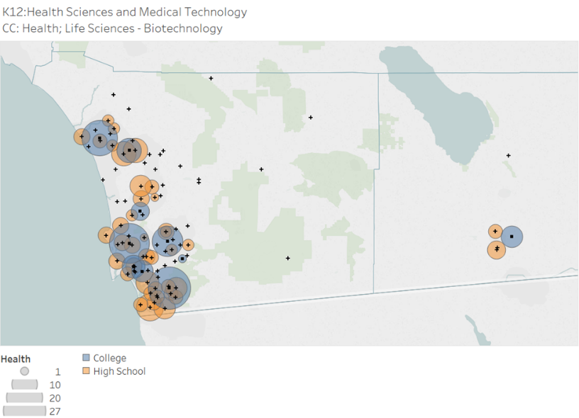
Regional Mapping
Source: CalPASS Plus

Slide 19
Sector Comparisons

Slide 20
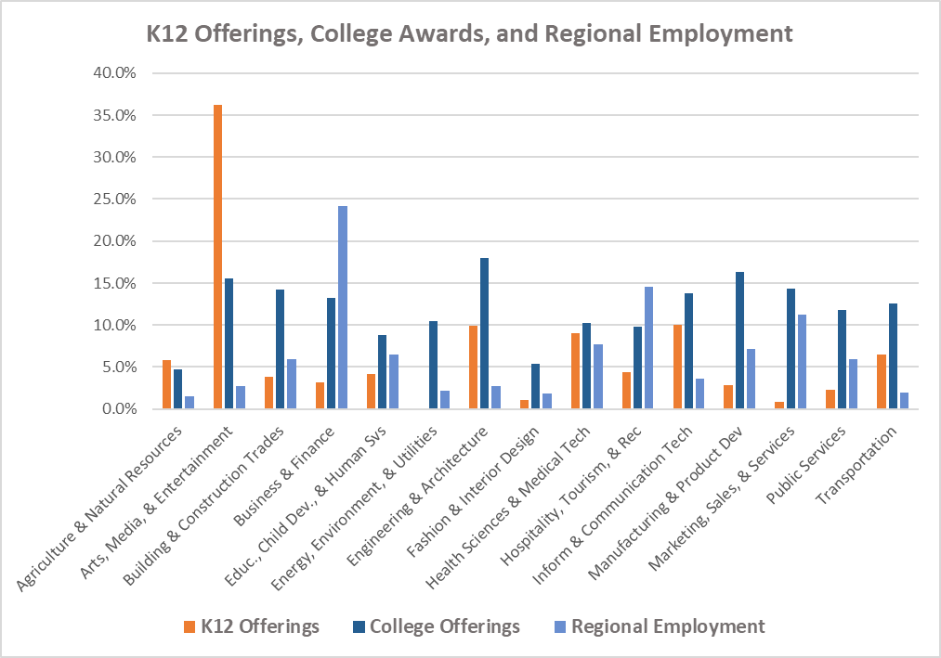
Sector Comparisons

Slide 21
Sector Comparisons

Slide 22
Sector Comparisons
Sector Rankings
Comparative Wages by Education
Award Types

Slide 23
Pathway Scenarios in the Analysis
Over-representation of K12 programs compared to colleges or the labor market
Under-representation of K12 programs compared to colleges or the labor market
Sectors that align to the same or nearly the same college programs
Sectors that may be pathways and are foundational

Slide 24
Over Represented K12 Pathways
Agriculture and Natural Resources (Ag): Ag programs account for 5.8% of high school courses, 4.8% of community college programs, only 1.6% of jobs and 1.7% of annual openings, 66% of agricultural employment are farm workers and laborers.
Arts, Media, and Entertainment (AME): AME offerings are 36.3% of all high school career education courses taught in SDIC region high schools, align to 15.6% of program awards in the regional community colleges, but only account for 2.8% of regional employment and 2.1% of regional annual openings.
Information and Communication Technology (ICT): ICT courses constitute 10% of regional K12 offerings and 13.8% of community college programs but only 3.6% of regional employment and 2.3% of annual openings. ICT jobs are high wage occupations however and ICT skills are foundational to many other career pathways.
Transportation: Transportation courses account for 6.5% of regional K12 courses, 12.6% of regional college programs, and 1.9% of regional employment and 1.6% of annual openings.
Engineering and Architecture (Engineering): Engineering K12 courses account for 9.9% of all regional offerings, are aligned to 18% of college offerings (counting advanced industrial trades pathways) but only accounts for 1.9% of regional employment and 1.6% of annual openings.

Slide 25
Under-Represented K12 Pathways
Business and Finance (Business): Business courses constitute 3.2% of regional K12 course offerings, 13.2% of regional college programs, 24.2% of regional jobs and 20.9% of regional openings each year.
Marketing, Sales, and Service (Marketing): Marketing courses constitute .9% of regional K12 courses, aligned as potential pathways with 14.4% of college programs and are 11.3% of the regional labor market and 12.3% of annual openings. However, 52% of jobs in this sector are low wage sales and retail jobs.
Energy, Environment, and Utilities (Energy): K12 providers identified no courses taught in this sector at regional high schools, although 5.8% of college programs are aligned to this sector. Energy occupations only account for 2.1% of regional jobs and 1.7% of annual openings, however energy occupations had the second highest median wage in this study and includes competencies directly aligned to engineering, manufacturing, construction, and transportation.

Slide 26
Organizing Across Sectors

Slide 27
Pathways that are also Foundations
College Business and Marketing programs cross-walked to K12 sectors in Business, Marketing, Fashion, Hospitality, and Information Communication Technology,
College ICT programs cross-walked to K12 sectors in Arts & Media, Construction, Engineering, Business, Engineering, Manufacturing, Marketing, and other sectors,
College Arts and Digital Media programs cross-walked to Construction, Engineering, Fashion, and Manufacturing pathways among other sectors.

Slide 28
Using the Report
Section 1: General Report
Section 2: Sector descriptions and data
Appendices
County and Subregional Maps by K12 sector
Award types by college, K12 sector and pathway
Crosswalk of college programs to K12 sectors and pathways
Demand Allocation of occupations by K12 sector

Slide 29
Next Steps – Where to go from Here (Recommendations)
Convene Regional Pathway Conversations Using a K14 Meta-Major Approach (June)
Address Critical Regional Pathway Imbalances
Expand Scaffolding of Career Exploration Strategies Across K12 Sectors and Develop Regional Career Exploration Tools
Mapping of relevant STEM and Basic Skills Pathways for Sectors

Slide 30
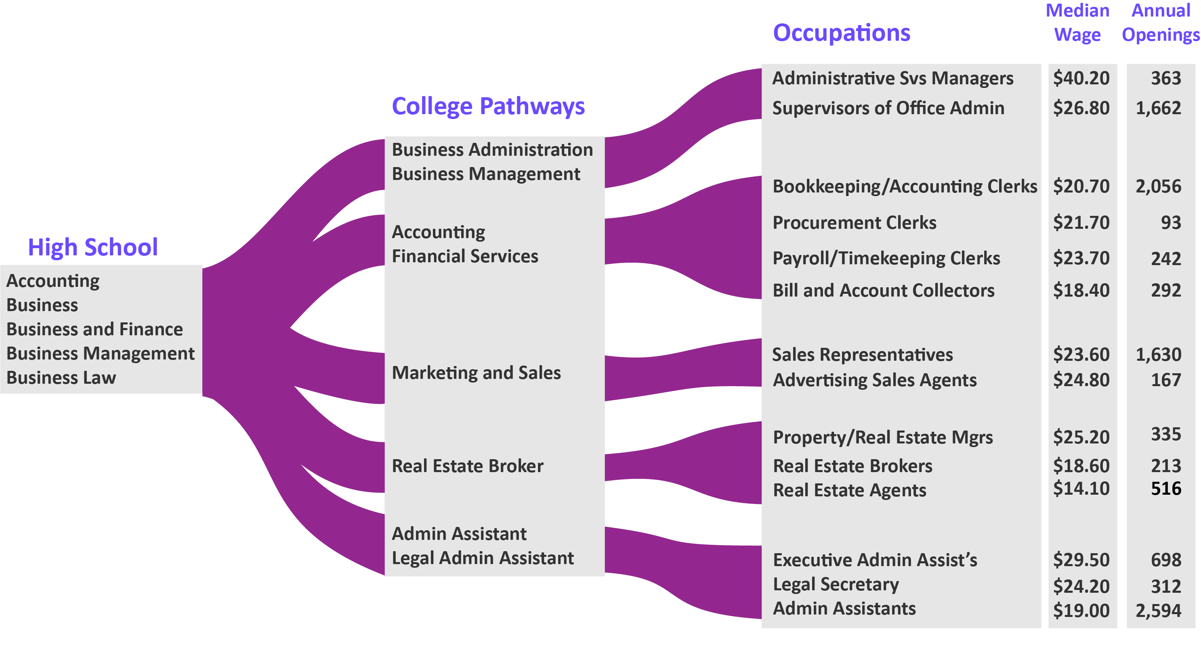
Student Advising Tools

Slide 31
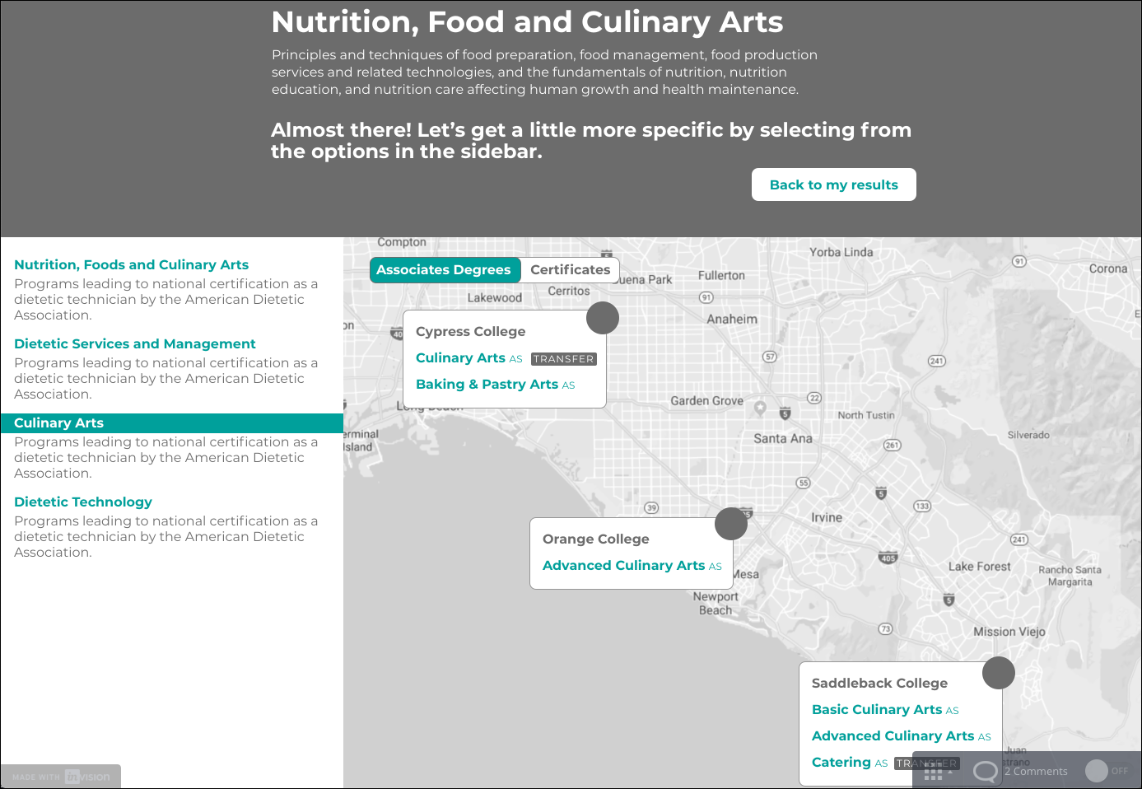
Student Advising Tools – OC Pathways

Slide 32
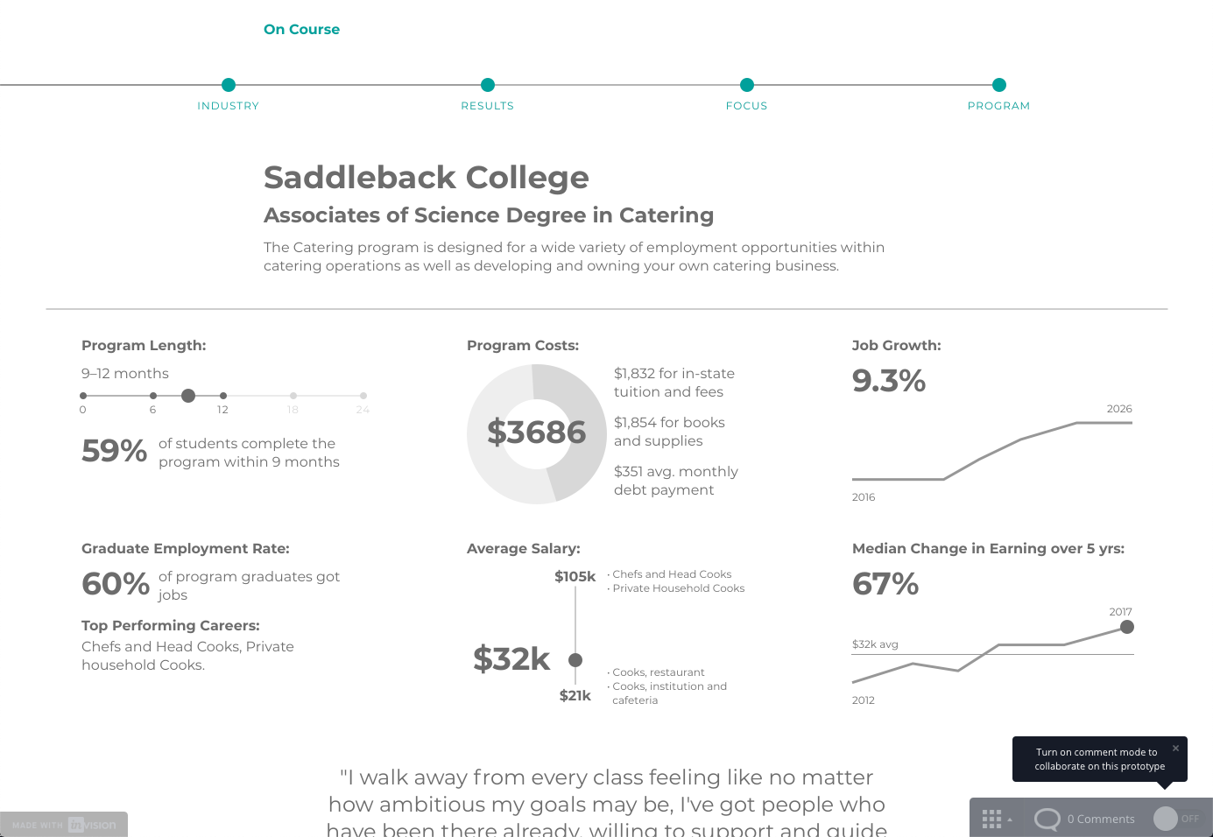
Student Advising Tools – OC Pathways

Slide 33
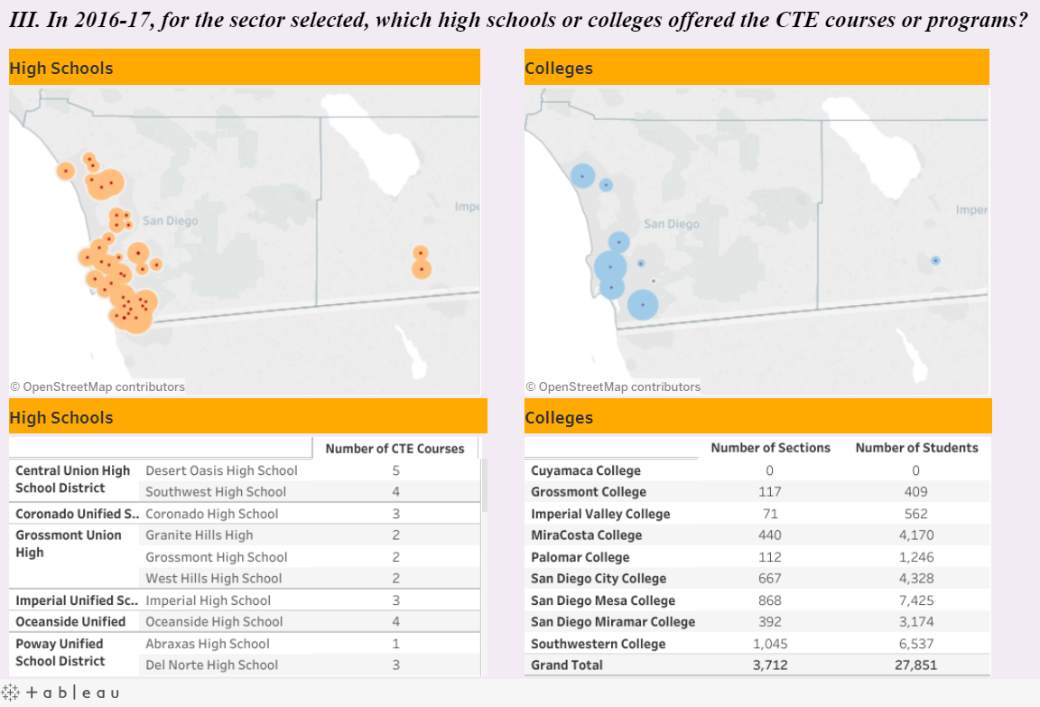
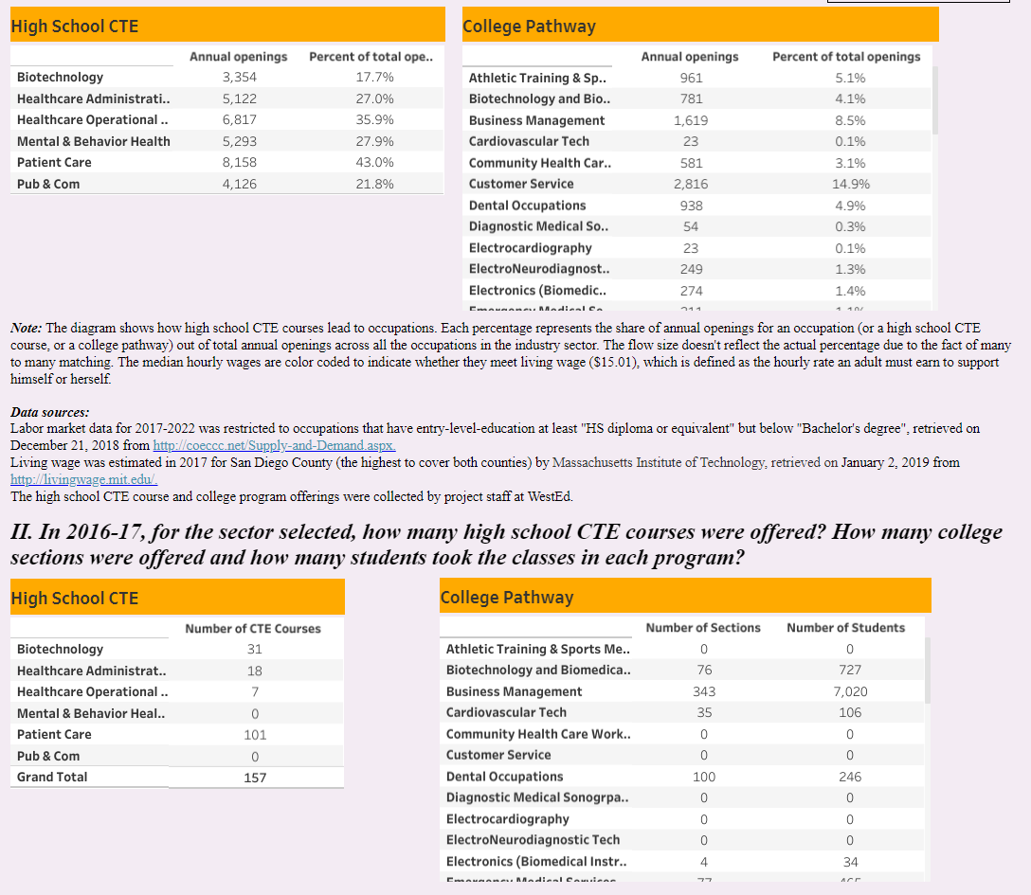
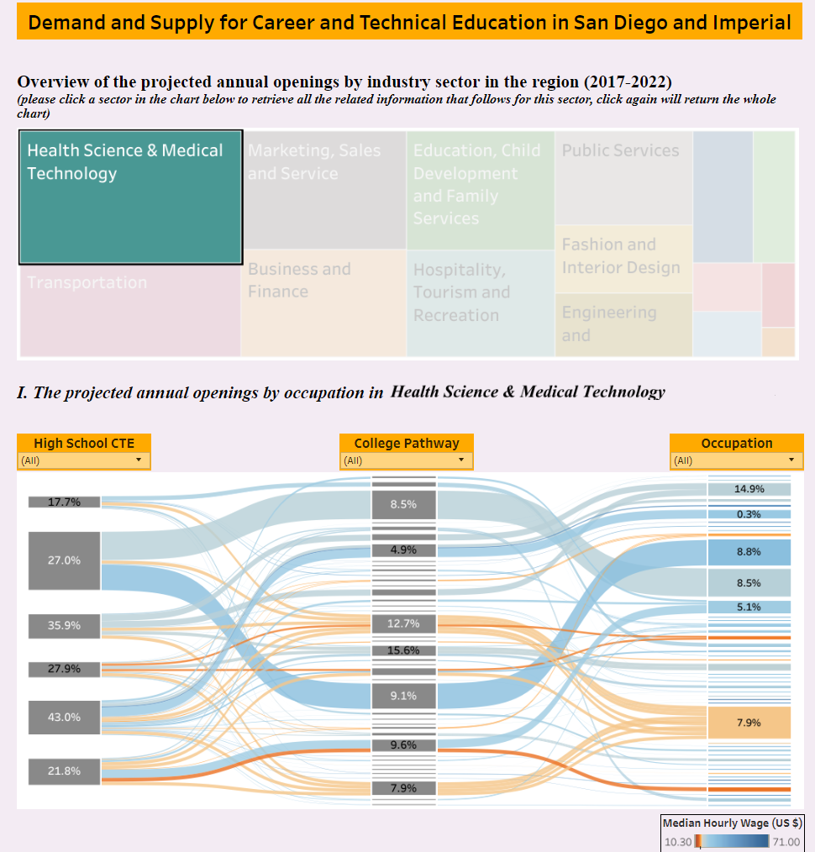
Student Advising Tools – Interactive Tools

Slide 34
Questions/Discussions
What resources or data sources do you use for providing college and career guidance
What kinds of information do you feel are most powerful for students to help them set their college and career goals
What kinds of tools (paper, online, interactive) do you feel would be most useful for teachers, counselors, students and parents to inform college/career planning, exploration, and advising
Randy Tillery
rtiller@wested.org
Allie Bollella
abollel@wested.org

