Slide 1
Palomar College Registered Nursing Program and LVN-RN Step-Up Program
Information Session

Slide 2
Our Program
Course Topics:
Fundamentals: Essential concepts of nursing practice; critical thinking, the nursing process, therapeutic communication, health assessment, multi-cultural considerations, and managerial skills.
Medical-Surgical: The primary practice in the hospital setting. Requires broad knowledge of all body systems and a sweeping number illnesses.
Obstetrics: The practice of caring for pregnant persons and the delivery of babies.
Pediatrics: The practice of caring for children and adolescents in preventative and acute care settings.
Psychiatrics: The practice of caring for patients diagnosed with mental illnesses.
Geriatrics: The practice of caring for elderly patients and providing high quality of life.
The program is very rigorous with limited flexibility and students are required to be available Monday through Saturday for lab, lecture, and clinical hours
Palomar provides an affordable and excellent education. Students are statistically hired within 6 months of graduating the program.
The goal of our program is to prepare students to pass the National Council Licensing Examination for Registered Nursing (NCLEX-RN).
We have multiple partnerships with RN to BSN programs at local San Diego area schools for those who want to pursue higher education.
2

Slide 3
Palomar College NCLEX Pass Rates
2015/2016 | 2016/2017 | 2017/2018 | 2018/2019 | 2019/2020 | 2020/2021
# Taken: 40 | # Taken: 72 | # Taken: 67 | # Taken: 69 | # Taken: 72 | # Taken: 39
Pass Rate: 95% | Pass Rate: 91.67% | Pass Rate: 95.52% | Pass Rate: 92.75% | Pass Rate: 90.28% | Pass Rate: 92.31%

Slide 4
Accreditation
Accredited by the Accreditation Commission for Education in Nursing
Approved by the California Board of Registered Nursing
Accredited by the Accrediting Commission for Community and Junior Colleges of the Western Association of Schools and Colleges
4

Slide 5
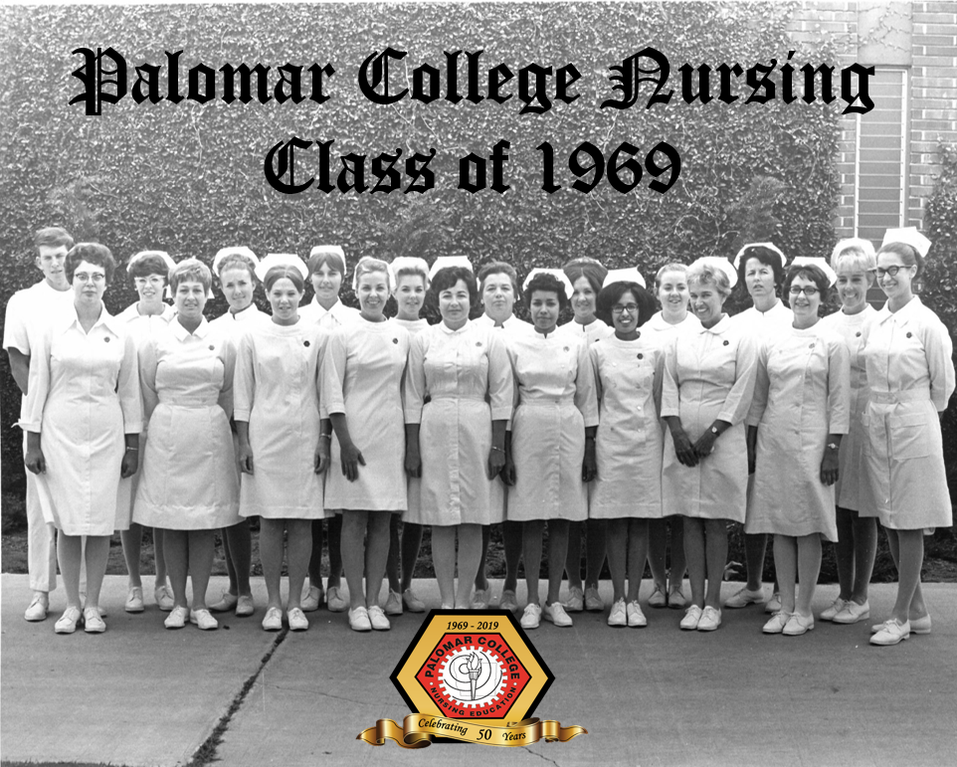
DID YOU KNOW?
Palomar Community College is the oldest community college registered nursing program in San Diego county

Slide 6
Multi-Criteria Admission
Admission to our generic RN program is based on points given in review using a multi-criteria screening tool. The higher your point total, the more likely that you will be admitted to our program.
You will receive points for your science coursework GPA, fixed set general education GPA, and your TEAS score.
Points will also be awarded for any US academic degrees, allied health certifications/corpsmen, work or volunteer hours, veteran status, life experience, and second language proficiency.
6

Slide 7
What makes you eligible to apply?
#1: Science Coursework
Anatomy (BIOL 210) taken within the last 10 years
Physiology (BIOL 211) taken within the last 7 years
Microbiology (BIOL 212) taken within the last 7 years
A minimum of 2.5 GPA is required for eligibility. Online lab science coursework will not be accepted. Lecture/Lab course must be 4.0 semester units or greater.
7

Slide 8
What makes you eligible to apply?
**TEAS Version7 coming June 2022**
#2: TEAS Exam
A composite score of 62% or greater must be met before applying
Retake Policy: The exam can be repeated once if you fail to get a composite score of 62% or higher. However, for a second ATI TEAS attempt to be valid, the following guidelines apply:
If unsuccessful the first time, you must complete remediation and provide documentation of such. After 30 days from the first exam, you can retest. The second successful test score will be used to award points.
If successful the first time, but you want a higher score, you must wait two years from the first exam and then you can retake the exam. The second score will be used to award points.
8

Slide 9
What makes you eligible to apply?
#3: Fixed Set General Education Courses
All fixed set general education courses must be completed with a grade issued before you submit your application
English Composition
Speech/Communication
Math: Intermediate Algebra or higher (Statistics recommended if you want to pursue BSN)
Psychology
Sociology
Humanities
*Note: Palomar does not require Chemistry as a prerequisite, but most RN-BSN programs require Chemistry as part of their prerequisites.
9

Slide 10
How to Calculate Your GPA
Grade Point Values
Converting Quarter Units to Semester Units
A+ | 4.0
A | 4.0
A- | 3.7
B+ | 3.3
B | 3.0
B- | 2.7
C+ | 2.3
C | 2.0
Pass | 2.0
Quarter | Semester
1.0 | 0.7
1.5 | 1.0
2.0 | 1.0
3.0 | 2.0
4.0 | 2.7
4.5 | 3.0
5.0 | 3.3
6.0 | 4.0
Make sure your science courses are at least 4 semester units
10

Slide 11
How to Calculate Your GPA
Step One: Calculate total course units and total grade points
Units | Grade | Grade points
4.0 | 3.0 (B) | 12.0
4.0 | 3.0 (B) | 12.0
3.0 | 2.0 (C) | 6.0
1.0 | 4.0 (A) | 4.0
12.0 |  | 34.0
Totals
Step Two: Calculate the average total points
Total grade points
------------------------
Total course units
Total grade points = 34.0
Total course units = 12.0
= GPA
GPA = 34/12 = 2.83
11

Slide 12
LVN to RN Step-Up Program
The LVN to RN Program is available to those who have:
A current and active California LVN license in good standing
Have graduated from an accredited LVN/LPN program
Have passed Nursing 110, LVN-RN Transition (Palomar College only) within two years of applying
Have 6 months of work experience as an LVN
Things To Know
The program is one year (two semesters).
Students are admitted on a space available basis only
Completion of N110 does not guarantee a space in the program
Students are selected using the Multi-Criteria Point System
All prerequisite coursework must be completed to be eligible to apply. No in-progress coursework is accepted.
We will be offering Nursing 110 each Spring semester. N110 is valid for 2 years and is also accepted by Mira Costa’s LVN-RN program.
The next offering of N110 is Spring 2023

Slide 13
Clinical Agency Requirements and Immunizations
Admitted students will complete a background check once directed by instructor.
Students must complete a background check and drug screen prior to participating in clinical experiences at health care facilities.
Background check covers the past 7 years
10-panel drug screen
Students must complete a physical and verify all vaccinations are up to date for clearance when admitted into the program.
These items should only be completed upon admission to the Palomar Nursing program after additional directions from first semester instructor.

Slide 14
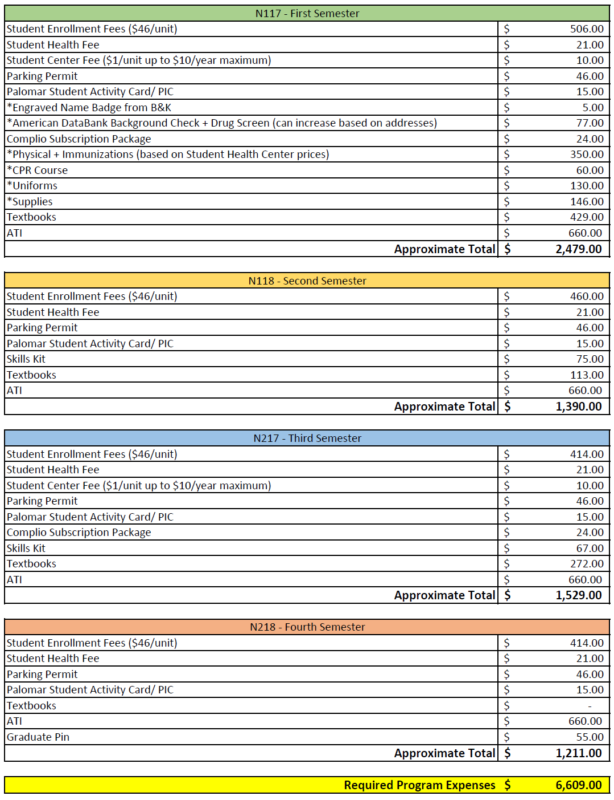
How much does the Palomar College Nursing Program cost?
The ATI Resource Fee is collected as a materials fee by Palomar College, and is due at the time of registration. It is non-refundable, even if a student drops before the add/drop deadline.

Slide 15
How to prepare
Meet with a counselor! A counselor will let you know what requirements you have met and what courses you still need to complete before applying. Your degree is granted by Palomar College, not the Nursing Education Department.
Speak with a counselor regarding any academic planning issues which may arise during your time at Palomar College. Counselors can assist you with creating a semester by semester education plan to achieve your goals.
Get your Palomar ID number on the main Palomar website, then call (760) 891-7511 to make an appointment.
Apply for FAFSA! Even if you don’t think you are eligible for federal aid, you could still qualify for state aid or loans. The FAFSA is how the College will check your eligibility for other financial aid options. Check in with the Financial Aid Office on campus for additional details.
Check your residency! State schools have algorithms built in to their applications that will automatically change your status to out-of-state if you don’t meet residency standards. If you have been in California for at least a year and you are still listed as out-of-state, talk to the Admissions office about how you can change your status to in-state.
Order your official transcripts. We only need unofficial for your application, but any nursing school you attend will ask for your official transcripts once you are admitted.

Slide 16
RN to BSN Bridge Programs
Point Loma Nazarene
Expected completion time: 15 months
Program format: Hybrid
Total for tuition: $17,460
Contact: Sarah Young syoung1@pointloma.edu
Azusa Pacific
Expected completion time: 15 months
Program format: In person or online
Total for tuition: $18,280
Contact: Cori Esparza cesparza@apu.edu
Cal State San Marcos
Expected completion time: 16 months
Program format: 100% online
Total for tuition: $9,880
Contact: Jay Franklin jfrankli@csusm.edu
Grand Canyon University
Expected completion time: 15 months
Program format: 100% online
Total for tuition: $12,600 - $42,000
Contact: Lisa De Angelis lisa.deangelis@gcu.edu
16

Slide 17
Concurrent RN to BSN Programs
Point Loma Nazarene
Requirements: 2 semesters of ADN completed; 3.0 GPA
Program format: Hybrid
Contact: Sarah Young syoung1@pointloma.edu
Grand Canyon University
Requirements: Enrolled in ADN program
Program format: online
Contact: Lisa Deangelis lisa.deangelis@gcu.edu
Arizona State University
Requirements: Enrolled in ADN program; 3.0 GPA
Program format: online
Contact: asu.cep@asu.edu
Boise State University
Expected completion time: Enrolled in ADN program
Program format: online
Contact: rnbs@boisestate.edu
17

Slide 18
Further Questions?
Palomar College Nursing Education
(760) 744-1150 x2580 (Note: We do not have phone access during this time)
nursing@palomar.edu
www.palomar.edu/nursing

