Slide 1
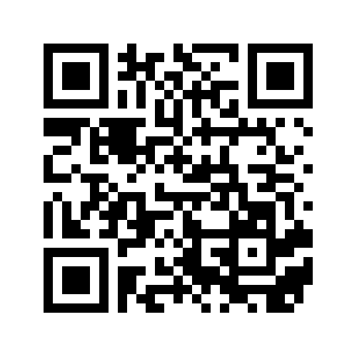
THE NUTS AND BOLTS OF TEACHING AT PALOMAR:
A successful first day and beyond
Go to our Padlet wall and tell us what you are hoping to learn in this workshop: padlet.com/kfalcone1/NutsBoltsSpr17
*Please sign in and grab some snacks*

Slide 2
Welcome!
Your hosts for tonight
Shayla Sivert, Dean, Languages & Literature
Sherry Titus, Director, Office of Student Affairs
Kelly Falcone, Faculty Kinesiology/Health & Professional Development Coordinator
Getting to know you
How many of you are full-time faculty?
How many of you are part-time faculty?
How many of you are first timers at Palomar?

Slide 3
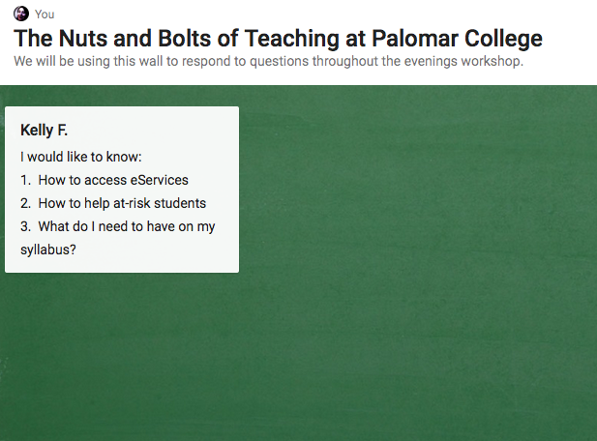
go to: padlet.com/kfalcone1/NutsBoltsSpr17
Throughout tonight's workshop, please post your questions to the Padlet wall. We will be pausing every few slides to view questions and provide answers.

Slide 4
Getting ready for the first day
A successful first day of class
The semester has begun!

Slide 5
Getting Ready for the First Day of Class

Slide 6
How many students do you have in your classes?
What is your maximum class size?
Maximum Class Size:
Set by the PFF Contract and/or the number of student stations in the classroom or laboratory--whichever is smaller. (http://www.palomar.edu/INSTRUCTION/CourseMaxList.pdf)
Please do not allow students to sit on the floor or to bring chairs from other rooms. We need to be concerned about fire code violations.
What is the minimum class size?
Consult your department chair if you are concerned about the lack of enrollment in a class to which you are assigned.

Slide 7
Odds and Ends
Textbooks
Contact department ADA.
Note: Never manage textbook or material transactions with students yourself. All required materials must be listed on the enrollment information when students sign up for the course.
Parking Pass (will be issued at Plenary; easiest to get it then).
Otherwise, go to Campus Police—bring ID.
Other things to think about — Bathrooms, Student Health Services (location & hours), & Security

Slide 8
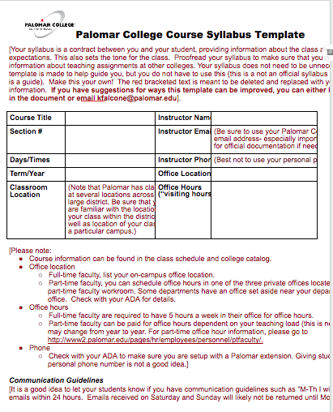
“A Study of Syllabi”
Review the syllabus template provided.

Slide 9
Activity: Small group discussion “A Study of Syllabi”
Please get in groups of 2-3 people.
Using the syllabus template, you have 10 minutes to discuss the following questions:
What parts of this template do you already have in your syllabi?
What parts of this template could you add to your syllabi?
What’s the difference between tracking attendance/participation and grading for attendance/participation?
Do you have a statement in your syllabi about ADA accommodations (students with disabilities) and standards of conduct?
What would you do if a student complained that you had unfair grading practices?
What questions do you have regarding creating a syllabus, getting ready for the first day of class, ensuring a successful semester? (Post questions to Padlet Wall)

Slide 10
Syllabus is done… now what?
Print Services: https://www.palomar.edu/printservices/
Self-service printers: Comet Copy has three self-service copiers located in A-25, NS-122, and the Escondido Education Center.
Online: Post your Syllabus on Blackboard or Canvas.

Slide 11
Where Are You Going?
https://www2.palomar.edu/pages/about/locations/
San Marcos Campus
Camp Pendleton Education Site
Escondido Education Center
Fallbrook Education Site
Mt Carmel
Ramona
Pauma
Which campus are you teaching at?
Do you know what room you are teaching in?
Do you know where to park?
Notes:
GOAL: understand there are several campuses and they need to know which campus they are teaching at.
Palomar College San Marcos Campus
Other Palomar College locations
PC Escondido Center, x8134
PC at Fallbrook High School, (760) 723-1058
PC at Ramona High School
PC at Mt. Carmel High School, x3890
PC at Camp Pendleton, x2259
PC at Pauma Indian Reservation, (760) 742-1121
Center/Sites Staff
Get to know them, and be good to them. They will be the ones to rely on when you’re in a bind.
Services at Palomar College Center/Sites
Call to find out what services are available.
Visit the classroom before class — Get key if needed, use computer and AV Equipment.

Slide 12
Tips for Your First Day of Class
Leave for campus MUCH EARLIER than normal.
Traffic around the campus will be very congested the first week or two.
Parking spaces may be difficult to find as other instructors are coming in early or staying late and students may be taking instructor spaces. Lot 12 will be especially crowded due to the closing of the parking lot next to the Humanities Building.
Crashers: Think ahead about how you will manage students trying to crash your class. (I put a signup sheet for crashers on the door so that my class and I could get started without interruption.)
Arrive early to class so you can be sure to be prepared.
Whiteboard markers
Roster
Check AV equipment
…and so on…
Notes:
There will be an AV workshop at plenary

Slide 13
A Successful First Day of Class

Slide 14
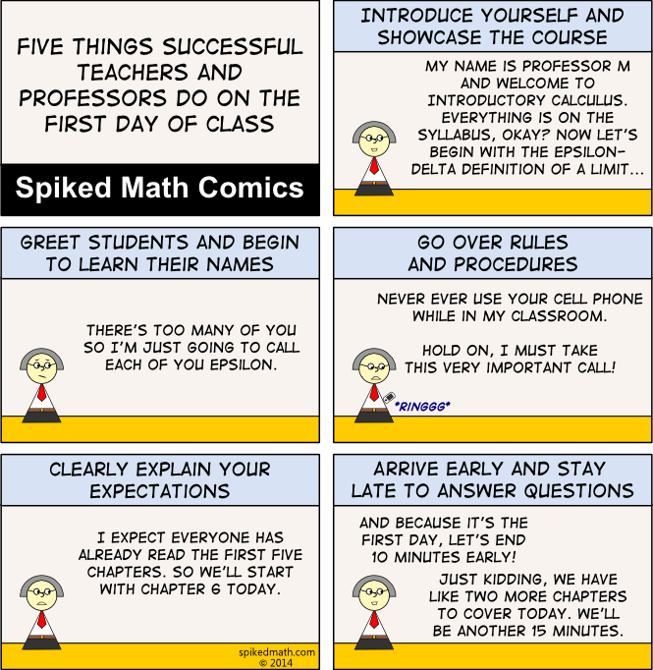
Set the tone for a successful first day and semester!
From Carnegie Mellon University:
Orchestrate positive first impressions
Introduce yourself effectively
Clarify learning objectives and expectations
Help students learn about each other
Set the tone for the course
Collect baseline data on students' knowledge and motivation
Whet students' appetite for course content
Inform students of course requirements
Notes:
Introduce yourself.
Set the tone for the class (be interesting, organized, well prepared, clear, enthusiastic, and approachable).
Create rapport with your students.
Cover the basics and important information in the class syllabus.
Save time for questions.

Slide 15
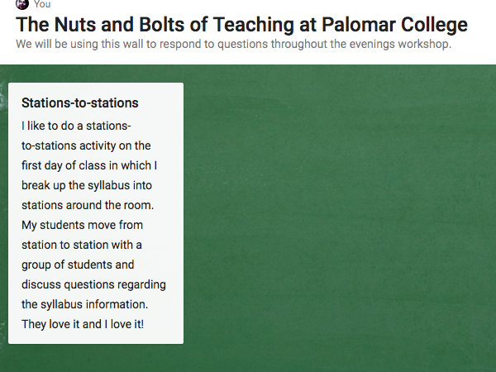
go to: https://padlet.com/kfalcone1/NutsBoltsSpr17
What are your strategies for a successful first day of class?

Slide 16
Overlapping Classes and Auditing
We STRONGLY discourage students from enrolling in overlapping classes. Overlap forms are rarely approved.
You MUST meet and document the missed time outside of normal class time.
Convenience is NOT an acceptable reason.
The Overlapping Class form can be found at: http://www2.palomar.edu/pages/enrollmentservices/files/2015/08/Overlap-Approval-Request-Form-rev-effective-Spring-2012.pdf.
Auditing is typically approved only when a student has already successfully completed the course and needs the course as a refresher, especially in anticipation of taking the next course in a sequence.
Notes:
Students can also audit if they are taking a refresher in which they have already been assigned a grade (say a technology class that has new technology and they need to keep up etc.)

Slide 17
The Semester Has Begun!

Slide 18
Classroom Breaks
For three-hour classes:
A ten-minute break at the end of the first and second hour (teach 50 minutes, 10 minute break), OR a 20 minute break at the midpoint in the class are permissible options.
There is no break associated with the “third hour” (the class ends).
You may NOT “save” or “stack” your breaks at the end of the class—if a class is scheduled for 6-8:50PM, you may not teach 6-8:30 and send the students home.

Slide 19
Basic Skills Toolkit
https://basicskillstoolkit.wordpress.com/
Notes:
Needs to be updated...BSI Committee?

Slide 20
Are you familiar with the support available for students?
Access & Assessment Center, x2476
Veterans’ Services, x2173 (Veterans’ Resource Center)
Tutoring Services
http://www2.palomar.edu/tutoringservices/
Math Center
Writing Center
STEM Center
Early Alert (English and Math)
FYE, TRIO, Athletics
TLC (San Marcos & Escondido)
Summer Bridge, FYE, Village Mentoring, x3931
General Counseling Services, x2179 (Classroom visits can be arranged.)
Career Center, x2194
Transfer Center, x2552
Extended Opportunity Programs & Services (EOP&S), x2449
TRIO, x2761
LGBTQ, x2396
AB 540 & DACA, Nancy Moreno, x3768
Behavioral health referrals for currently enrolled students
Student Health Services, x2381
Counseling, x7144
Campus Police, x2289
Notes:
Basic Skills Toolkit? (www2.palomar.edu/ needs to be updated? Our script should be something like: We have so much available for our students -- if they are veterans, in need of tutoring,

Slide 21
Disability Resource Center
Encourage students with possible disabilities to go to the DRC for diagnosis.
Students with identified disabilities may bring forms with verification to the DRC asking for “reasonable accommodations.” You may never deny a student accommodations from the DRC.
A DRC counselor will give the student an Accommodations Form to show his/her instructor. On the back of that sheet are directions for the professor on how test accommodations work and what information you need to communicate for any testing proctoring.
Feel free to contact and work with DRC personnel.
Disability Resource Center http://www2.palomar.edu/drc/.
Check out this link with information developed by Leigh Ann Van Dyke, one of our DRC Counselors.
Notes:
Check with Brian.

Slide 22
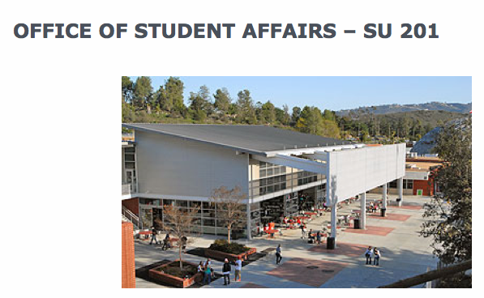
Student Discipline
Sherry Titus

Slide 23
Student Incident Reporting
Sherry Titus-Director, Office of Student Affairs (OSA): stitus@palomar.edu
Student Incident Report
Complete and submit an Incident Report for ALL cases of academic dishonesty, and for other Student Code of Conduct violations, as well.
When in doubt, submit. We track all reported incidents. Students continue attending class and should be informed that their disruptive behavior has been reported to the OSA. They will get a letter/email to see Sherry.
Students have DUE PROCESS rights and have an opportunity to present their side of the story in their hearing with the OSA.
Campus Police are first responders 760.891.7273.

Slide 24
Student Discipline
Instructors may dismiss a student from class for two class sessions. This should be used as a last resort when corrective solutions fail. Document all attempts to resolve issue with the student and provided written documentation to the student and attach to the Incident Report.
You must submit an Incident Report and coordinate with the OSA as students may only be asked to leave class for two sessions; it may take longer than that for them to schedule a meeting with Sherry Titus.
All information can be found on OSA website. Student Code of Conduct http://www2.palomar.edu/pages/studentaffairs/home/student-discipline/.
Be cautious with social media, use your Palomar email and use caution requesting students share private information with classmates.

Slide 25
Student Discipline
Academic Dishonesty (Academic and Administrative Sanctions)
Explicitly state your policy in the syllabus.
Make your grading scale crystal clear, not overly complicated so no one can figure it out, and stick to it. (Make sure that it adds up correctly too. ☺)
Do what you say you will do—if you make one “exception”, then you have defined a new policy for the class.
Use caution with “mandatory” language.
Submit the Incident Report on ALL incidents, great and small, but attempt to resolve at its earliest onset.
Direct students to library resources for plagiarism guidelines or link them in your syllabi.

Slide 26
Student Grade Disputes
Students can file a “grade dispute” once grades are posted. They must provide documentation and/or supporting evidence for the dispute. Below are links to the process and the appeal form itself.
http://www2.palomar.edu/pages/enrollmentservices/appeals-and-petitions/
Grade Dispute form
“Grade disputes” fall under the instructional area and are not included in student discipline, although, conflict often occurs when the student is not aware of their grades throughout the semester (return graded work and keep quality records).
Grades cannot be grieved.

Slide 27
go to: https://padlet.com/kfalcone1/NutsBoltsSpr17
What questions do you have about student discipline?

Slide 28
eServices In Depth

Slide 29
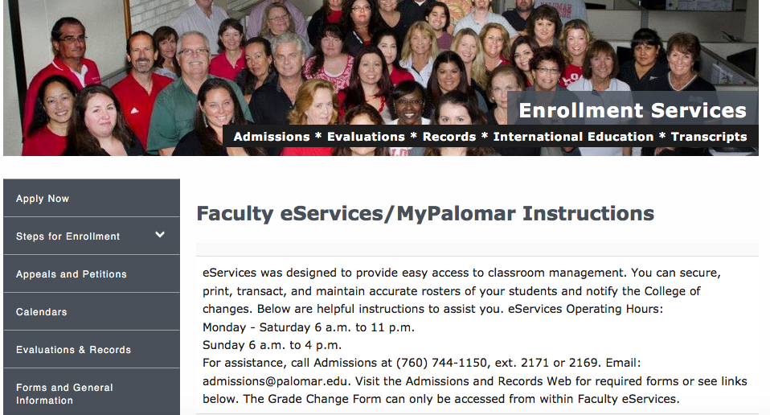
Eservices Instructions
The following link is meant to assist faculty in using eservices more effectively:
http://www2.palomar.edu/pages/enrollmentservices/faculty-eservices-instructions/

Slide 30
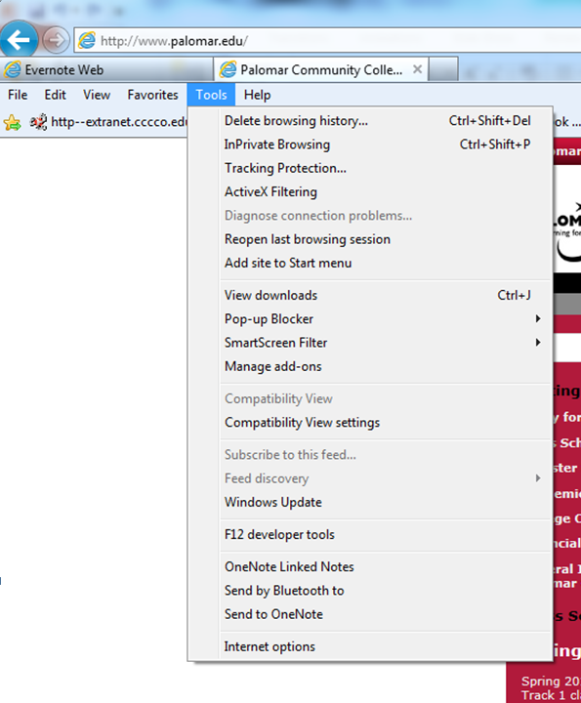
Who’s in your class? eServices
If you have problems using eServices, put your browser in Compatibility View (under Tools menu) OR switch browsers.

Slide 31
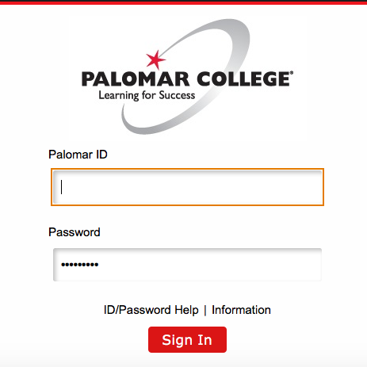
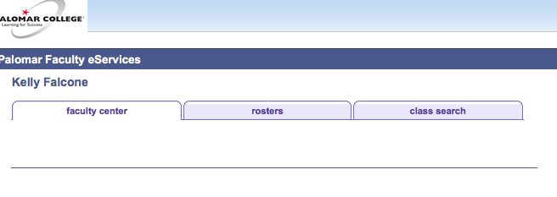
eServices
Sign in using your Palomar ID and password.
Click on Rosters.

Slide 32
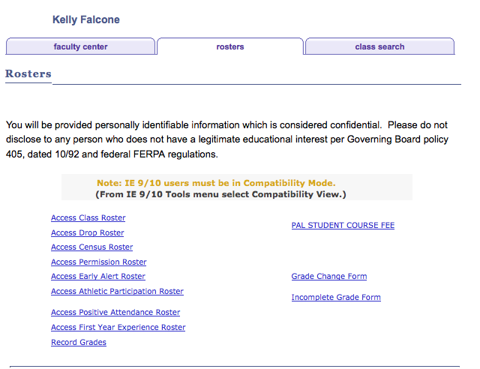
Print your roster and permission #s (eservices) on the night before or day of your 1st class.
Notes:
Be sure to complete the process! Look for the popup telling you that you have completed submission of a roster or grades.

Slide 33
Do You Have a Wait List?
On the Wednesday morning before the semester begins, for classes that have students on a waitlist, the eligible waitlisted student no longer automatically rolls into a spot on the roster if one opens.
A student is ineligible if that student has another class with a time conflict, is enrolled in another section of the same class, etc.)
Students can no longer be added to the waitlist at that point either.
Students will need a permission code to add the class.
If none of the students on a waitlist are eligible and a student drops off of the roster, other students can add the class without a permission number.
After the 1st week, all students will need a permission number to be added to the roster.
An ADA can invalidate a permission number if a student fails to register for this class within a time period set by you.

Slide 34
Permission Codes
Permission numbers or add slips are required if a student wants to add a class that is full.
All students (including waitlisted) require permission codes or signed add slips to enroll in Week 2 of classes.
No students may add a class on or after the Census Date (except for late-start fast-track classes).
Students may drop online without instructor signature (up to the 8th week of classes). However, after two weeks, students will receive a W on their record, which will count as one of their 3 allowed course attempts.
View the academic calendar for important Add/Drop deadline information:
http://www2.palomar.edu/pages/enrollmentservices/calendars/

Slide 35
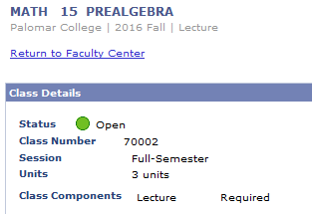
How do I know if I need to give out permission codes?

Slide 36
There are separate rosters for the Census roster and the drop roster.
Notes:
Be sure to complete the process! Look for the popup telling you that you have completed submission of a roster or grades.

Slide 37
Census Roster
The Census Roster is certified one time during the semester
First instructional day of the 3rd week of class for full semester classes
All class rosters, except positive attendance classes, MUST BE CERTIFIED (even if no students need to be dropped)
Students listed on your roster must be active students, i.e., have been attending, participating, etc.
In online classes, students should do something, i.e., take a quiz, turn in an assignment, etc., prior to the census date and certification (as proof of their attendance in your course).
Census Certification is required to claim apportionment funding for your section. (This is the college’s primary revenue source.)

Slide 38
Drop Roster
Available in Faculty eservices
The Drop Roster is designed to be used on an on-going basis starting the first day of class throughout the semester.
Drops before Census means the student gets no grade notation on their record.
The Drop Roster is available to you for all your students through the 50% point of your class (8 weeks for full-term classes) and results in the student getting a “W” grade. This counts as one the three attempts a student has for this course.
The Drop Roster remains available after the 50% point in the semester to just before final grading for Financial Aid, Veterans, and other students whose financial aid is affected by their enrollment. These students will have an “*” preceding their name on the roster.

Slide 39
Repeatability and Drop Dates
Students may only attempt a class three times before being barred from enrolling in that class.
Students may drop a class up to the Census date without a notation on their record—in effect, they never attempted the class.
After the Census date through the 8th week, students may drop with a notation (W) on their records—the W means they attempted the class. The W has no impact on GPA calculation, but does count as an attempt
Bottom line—if a student stays past the 2nd week, it counts as an attempt.
Students who pass a class may not repeat the same class (with very few exceptions).
Keep attendance for all of your students; keep your records for 3 years.

Slide 40
Grades
Possible grades. A, B, C, D, F, FW, P, NP, I, W, MW
The difference between an F and an FW
F = the student earned an F on the basis of all required completed work
FW = the student stopped attending class and consequently earned an F because he/she is missing work and has missed the final.
W = only available until 50% of class completion
Notes:
Kendyl -- implications for FA with F vs FW?
An F and an FW are the same grade, they are both failing. The FW is for someone who failed but did not complete the course. The F is for a students who failed and completed the course.
If the only thing they’ve missed is the final, what’s their grade? (I say what’s your grading policy say?)

Slide 41
Grades (cont.)
Grades are due 5 days after final exams.
Please submit grades on time. Late grade submissions may hurt a student’s chance to register for a class for the next semester and may hurt their chance to transfer as well.
Submit grades via Grade Rosters in eservices.
Family Educational Rights and Privacy Act (FERPA) http://www.ed.gov/policy/gen/guid/fpco/ferpa/index.html

Slide 42
go to: https://padlet.com/kfalcone1/NutsBoltsSpr17
What questions do you have about using eServices?

Slide 43
A few more tidbits about being a successful faculty member

Slide 44
Reporting Your Absences
Report your absences as early as possible.
Go down this list in order until you have SPOKEN to at least one of the following so that your class can be posted:
Your Department ADA or Center Staff
Your Department Chair
Your Division Office (Dean)
The Instructional Services Office: x2246
Evening Administrator, Variable—check email
Campus Police: x2289
Use Blackboard or email to let students know in advance when possible.

Slide 45
Evening Class Resources
Bookstore is open until 7:30 pm.
Enrollment Services is open until 6:00 pm.
A General Information email is sent out each week informing you of that week’s evening administrator.
Campus Police officers escort service to your vehicle and, of course, is available in the event of an emergency, x2289 or 760-891-7273.

Slide 46
PD & TERB
Professional Development (http://www.palomar.edu/pd/)
Contact the PD Office at x2250 or Kelly Falcone (PD Coordinator) at x3643 if you have questions.
Full-Time faculty: PD is required (42 hours)
Part-Time faculty: PD is optional (hours based on teaching assignment, paid hourly in last paycheck)
TERB: Tenure and Evaluations Review Board (https://www2.palomar.edu/pages/tenureandevaluations/)
Do you know when you will be reviewed?

Slide 47
ScanTron Machines
Department Room Open until?
Humanities Building Resource Room 2nd floor 8:30 PM
ART C-13 10PM*
BEHAVIORAL SCI MD-260, x2329 M-Th 7 PM*
EARTH SCIENCES NS-110, x2519 4PM
BUSINESS MD-342 10PM*
FACULTY RESOURCE NS-153 6pm M-TH
EHPS MD-377, x2412 10PM*
LIFE SCIENCES NS-210 10PM*
NURSING HS-200, x2580 4pm
RADIO/TV Q-8 (restricted)
Escondido Center Teachers’ Lounge/EC 204 9:30 PM
Camp Pendleton Back Room M-Th 8:30 AM – 6 PM
Camp Pendleton Counseling Dept. F 8 AM-2 PM
*10PM = Approximate time room is locked by campus police.

Slide 48
Human Resource Services
HRS Office is located in ST-1, ext. 2609.
Mon-Thurs (7:30 am -5:00 pm) Fri (7:30 am – 4:00 pm)
Injured at work?
If you are injured during work, please contact your Dean/Chair/Director and Human Resource Services immediately. If it is after hours, contact Campus Police x2289 or the evening administrator.
Visit the HR Website: http://www2.palomar.edu/pages/hr/
View salary schedules, PFF Contract, Benefits, Salary Advancement, leave information, etc.
Call HRS (x 2609)
PT Faculty– Tania Silva tsilva@palomar.edu or x2148
FT Faculty – Christine Winterle cwinterle@palomar.edu or x2674

Slide 49
Who You Gonna Call…?
Do you know who to contact for help and information?
ADA
Department Chair/Director
Dean
Instructional Services
Office of Student Affairs
Human Resources
Evening Administrators
Campus Police (x2289; 760-891-7273)
Help Desk
Notes:
They can look up all of these extensions and likely will never look at this presentation to find the numbers. Rather show how to look up these extensions using the website directory or outlook.
Is this meant to be in an order of who they should contact first?
Academic Department Assistant (ADA)
Department Chair/Director
Dean
Instructional Services Office, x2246
Office of Student Affairs, x2594
Human Resource Services, x2609
Center Staff
Evening Administration (until 7:30PM) – Will vary, so check General Information email (This means that you need to be using your Palomar email.)
Sherry Titus, Director of Student Affairs, x2594
Campus Police, x2289 OR 760-891-7273 (put this in your cell phone)
All HelpDesk/Information Services, x2140

Slide 50
Where to find contact information?
Use the college website “search” box or directory.
Outlook is also a very good way to find contact information.

Slide 51
Thank you for coming!
Did you fill out your evaluations?
Have an amazing semester!
Have a wonderful semester!

Slide 52
go to: padlet.com/kfalcone1/NutsBoltsSpr17
Please let us know what you are hoping to learn in tonight’s workshop.
Click on the Padlet wall or click the pink plus sign and tell us what you would like to learn.

