Slide 1
Chairs and Directors August, 2015

Slide 2
Enrollment, Budget, and The “Planning” Work Ahead

Slide 3
How We Are Funded

Slide 4
Important Terms
FTES = Full-time Equivalent Student
A Full-time student attends 15 hours/wk (not 12) x 2 semesters
We are funded per FTES ($4943/FTES)
We budget to an FTES Target/Cap (Base + Growth)
Student Headcount
Actual number of students taking classes
Higher than FTES

Slide 5
Example
Student A takes 9 hrs/wk
Student B takes 4 hrs/wk
Student C takes 5 hrs/wk
Student D takes 18 hrs/wk
How many FTES?
What is the Student Headcount?

Slide 6
Example
Student A takes 9 hrs/wk
Student B takes 4 hrs/wk
Student C takes 5 hrs/wk
Student D takes 18 hrs/wk
How many FTES? (36/15) = 2.4 FTES*
What is the Student Headcount? 4.0
*Not the official calculation of FTES, for conceptual purposes only

Slide 7
Important Terms
FTEF = Full Time Equivalent Faculty
Most faculty loads are 15 instructional hours/week
A 3 hour class = 3/15 = 0.2 FTEF
Faculty Headcount
Actual number of faculty members
Larger than FTEF

Slide 8
Example
Instructor A teaches 8 hrs/wk
Instructor B teaches 9 hrs/wk
Instructor C teaches 10 hrs/wk
Instructor D teaches 6 hrs/wk
How many FTEF?
What is the Faculty Headcount?

Slide 9
Example
Instructor A teaches 8 hrs/wk (0.54 FTEF)
Instructor B teaches 9 hrs/wk (0.6 FTEF)
Instructor C teaches 10 hrs/wk(0.67 FTEF)
Instructor D teaches 6 hrs/wk (0.4 FTEF)
How many FTEF? (33/15) = 2.2 FTEF
What is the Faculty Headcount? 4.0

Slide 10
Important Terms
WFCH = Weekly Faculty Contact Hours
Tells us how many hours the class meets each week (not to be confused with units)
Example –Biology 201 is a five unit class.
The lecture meets 8-9:20 on Mondays and Wednesdays and
The Laboratory meets 9:30-12:20 on Mondays and Wednesdays
WFCH =

Slide 11
Important Terms
WFCH = Weekly Faculty Contact Hours
Tells us how many hours the class meets each week (not to be confused with units)
Example –Biology 201 is a five unit class.
The lecture meets 8-9:20 on Mondays and Wednesdays and
The Laboratory meets 9:30-12:20 on Mondays and Wednesdays
WFCH = 9

Slide 12
Important Terms
WSCH = Weekly Student Contact Hours
Hours class meets per week (WFCH) x enrollment
Example: Sociology class of 3 WFCH with 35 students enrolled: 3 x 35 =

Slide 13
Important Terms
WSCH = Weekly Student Contact Hours
Hours class meets per week (WFCH) x enrollment
Example: Sociology class of 3 WFCH with 35 students enrolled: 3 x 35 = 105 WSCH

Slide 14
Important Terms
WSCH/FTEF—Efficiency value
525 WSCH/FTEF is considered the funding baseline for CC’s
WSCH/FTEF = (WFCH x enrollment)/load
Example 1: Sociology 100 (3 WFCH) 35 students enrolled
3 WFCH X 35 enrolled students = 105 WSCH
105 WSCH/.2 load =
Example 2: Biology 101 (3 WFCH) 60 students enrolled
3 WFCH X 60 enrolled students = 180 WSCH
180 WSCH/.2 load =
Example 3: English 100 (4 WFCH) 25 students enrolled
4 WFCH X 25 enrolled students = 100 WSCH
100 WSCH/.267 load =

Slide 15
Important Terms
WSCH/FTEF—Productivity value
525 WSCH/FTEF is considered the funding baseline for CC’s
WSCH/FTEF = (WFCH x enrollment)/load
Example 1: Sociology 100 (3 WFCH) 35 students enrolled
3 WFCH X 35 enrolled students = 105 WSCH
105 WSCH/.2 load = 525 WSCH/FTEF
Example 2: Biology 101 (3 WFCH) 60 students enrolled
3 WFCH X 60 enrolled students = 180 WSCH
180 WSCH/.2 load = 900 WSCH/FTEF
Example 3: English 100 (4 WFCH) 25 students enrolled
4 WFCH X 25 enrolled students = 100 WSCH
100 WSCH/.267 load = 375 WSCH/FTEF

Slide 16
Important Terms
WSCH/FTEF—Why a baseline of 525?
Typical load = 15 hours = Five three-unit classes
The state expects there to be at least 35 students per class x five classes = 175 students per week
175 students per week, meeting 3 hours per week = 525 WSCH (175 x 3)
A hold-over from the days of K-14

Slide 17
FTES Calculation (2015-16)
FTES = WFCH x enrollment x 17.5/525
FTES = WSCH x 17.5/525
FTES = WSCH/30

Slide 18
FTES Calculation Examples
Example 1: Sociology 100 (3 WFCH) 35 students enrolled
3 WFCH X 35 enrolled students = 105 WSCH
105 x 17.5/525 = 105/30 =
Example 2: Biology 101 (3 WFCH) 60 students enrolled
3 WFCH X 60 enrolled students = 180 WSCH
180 x 17.5/525 = 180/30 =
Example 2: English 100 (4 WFCH) 25 students enrolled
4 WFCH X 25 enrolled students = 100 WSCH
100 WSCH x 17.5/525 = 100/30 =

Slide 19
FTES Calculation Examples
Example 1: Sociology 100 (3 WFCH) 35 students enrolled
3 WFCH X 35 enrolled students = 105 WSCH
105 x 17.5/525 = 105/30 = 3.5 FTES
Example 2: Biology 101 (3 WFCH) 60 students enrolled
3 WFCH X 60 enrolled students = 180 WSCH
180 x 17.5/525 = 180/30 = 6 FTES
Example 2: English 100 (4 WFCH) 25 students enrolled
4 WFCH X 25 enrolled students = 100 WSCH
100 WSCH x 17.5/525 = 100/30 = 3.3 FTES

Slide 20
Enrollment Management Defined
An ongoing plan to effectively schedule in support of student achievement while honoring a district’s community, academic, and fiscal responsibilities.
Involves a management team
Consider past, present, and future
Requires DATA
Involves the entire campus community

Slide 21
Classroom issues
Who creates target-when and how
College issues/hotspots (eg
in-service courses)
Audit issues
320 who ? And When?
Local manner in which FTEF/
FTES are allocated and tracked
Is there an annual plan developed? By whom and when? Who monitors it? When are changes made?
Do departments have 2-year plans?
Is calendar developed and followed?
How are ed plans integrated into schedule development?
How is student success measured and rewarded for departments?
Term Length Multiplier
Issues with data: accuracy (factor); x-listed courses/stacked courses; access to reports
Fill rates
Wait lists (problems)
# of classes below 35
WSCH/FTEF
FTES/FTEF
FTES Cap
FTES Target
FTES generated/semester
Did you borrow FTES?
Contract issues
Compliance issues
Class caps; what and who makes them
Bottlenecks

Slide 22
Practical Enrollment Management
Establish an Instructional budget
Determine WFCH that will support that budget
Schedule within the limitations of the WFCH cap

Slide 23
Reaching the Target
Traditionally PC has budgeted as a Large College, a target set by the Chancellor’s Office
Large colleges get a $1M Bonus in addition to apportionment (funding from enrollment)
This year the large college cap is 19,880 FTES
Cap reached through Summer, Fall, and Spring enrollments plus Intersessions
Most of summer enrollment is flexible so if a shortfall, summer can be applied to the previous year (“Borrowing”)--330 FTES (‘12-13), 540 FTES (‘13-14), 1217 FTES (‘14-15)

Slide 24
Reaching the Target
Summer
Fall
Spring
Summer Yr 2

Slide 25
Reaching the Target
Summer
Fall
Spring
Summer Yr 2

Slide 26
Reaching the Target
Summer
Fall
Spring
Summer Yr 2

Slide 27
Reaching the Target
Summer
Fall
Spring
Summer Yr 2

Slide 28
Reaching the Target
Summer
Fall
Spring
Summer Yr 2

Slide 29
Are We a Large College?
For 2015-16, to remain a large college, we must meet the 19,880 FTES target, and make up the 1217 FTES we applied to the 2014-15 cap, i.e. generate 21,097 FTES (19,880 + 1,217)
The 2014-15 schedule produced 18,643 FTES, and did so very inefficiently at 435 WSCH/FTEF
Fall 2015 enrollment is currently down over 4% compared to Fall 2014 enrollment meaning our schedule will generate 17,897 FTES (18,643 x 0.96)

Slide 30
Are We a Large College?
We will need to borrow 3,199 FTES from Summer 2016 to reach the large college cap (21,097 -17,897)
Summer enrollment does not produce 3,199FTES
We are not a large college

Slide 31
Will We Reach Our Budgeted Apportionment?
We have budgeted for an apportionment of 19,320 FTES in 2015-16
We must meet the 19,320 FTES target, and make up the 1217 FTES we applied to the 2014-15 cap, i.e. generate 20,537 FTES (19,320 + 1,217)
The 2014-15 schedule produced 18,643 FTES, and did so very inefficiently at 435 WSCH/FTEF
Fall 2015 enrollment is currently down over 4% compared to Fall 2014 enrollment meaning our schedule will generate 17,897 FTES (18,643 x 0.97)

Slide 32
Will We Reach Our Budgeted Apportionment?
We will need to borrow 2,640 FTES from Summer 2016 to reach our budgeted apportionment (20,537 - 17,897)
Summer enrollment does not produce 2,640 FTES
We will not reach our budgeted apportionment

Slide 33
Stability Funding
3-year Process
Occurs when a district does not attain its base FTES in any given year
1st year - funded as though the district reached its base plus $1M LC Bonus
2nd and 3rd years apportionment will be based upon actual FTES plus $1M LC Bonus
After the 3rd year, the district will be re-benched to its actual FTES

Slide 34
Large College Designation/Funding
Occurs when a district does not attain the large college CAP in any given year
Difference between large and medium designation
Approx. $1M
The District will keep large college funding for a total of 3 years
After the 3rd year, district will be funded for their actual size (large, medium, small)

Slide 35
Simulation Purposes Only
 | FY 15-16 |  | FY 16-17 |  | FY 17-18 |  | FY 18-19
Stability | 19,320 |  | Actual FTES |  | Actual FTES |  | Re-bench New FTES Base
Large College | $1M |  | $1M |  | $1M |  | $0
 |  |  |  |  |  |  | New Designation - Medium

Slide 36
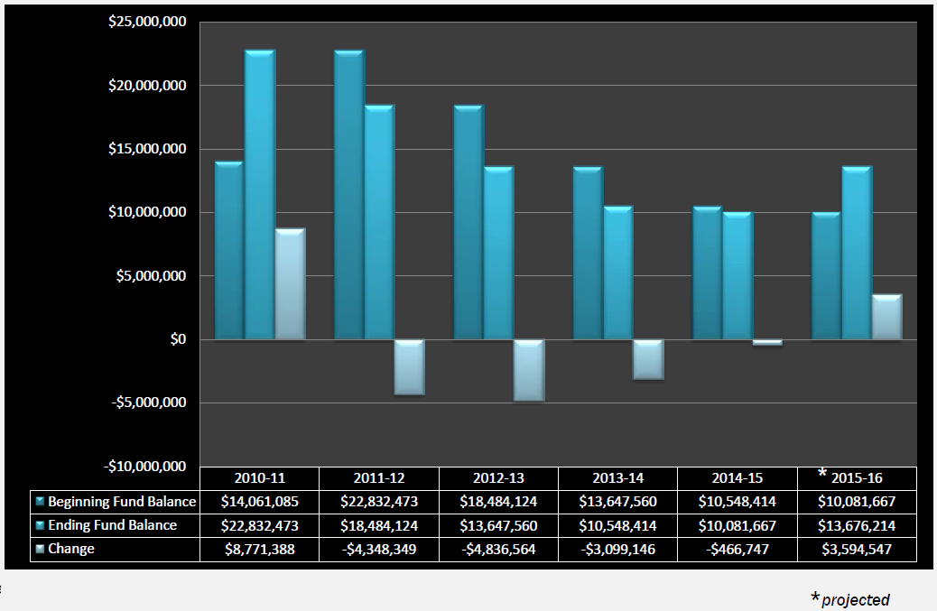
Fund Balance History
*
**
* estimated
** projected with SRP Savings of $3.3M

Slide 37
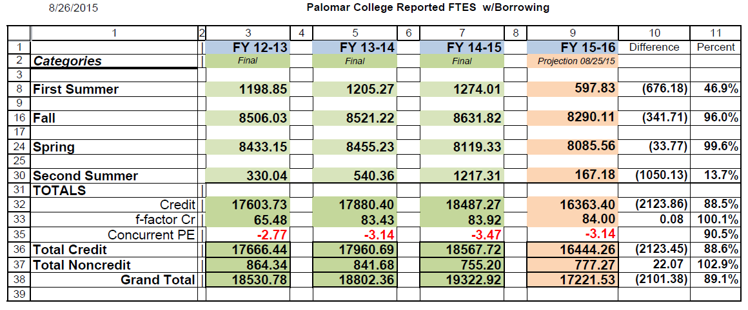
FTES Reporting – Three Years

Slide 38
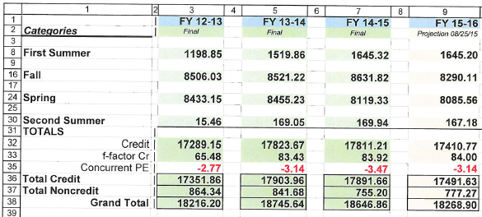
Actual Apportionments

Slide 39
Faculty Obligation Number (FON)
A number of factors are used to determine the minimum # of FT Faculty a college must have on staff = FON
FON is set, in part, by apportionment
This year’s FON based on last year’s apportionment (19,320 FTES)
This year’s schedule will produce less than 18K FTES
We are investigating our options

Slide 40
Cultural Change
Commitment to targets
Appreciate the value of FTES
Appreciate the value of WSCH/FTES
Schedule for student success, needs, and convenience
True program review
Faculty participation

Slide 41
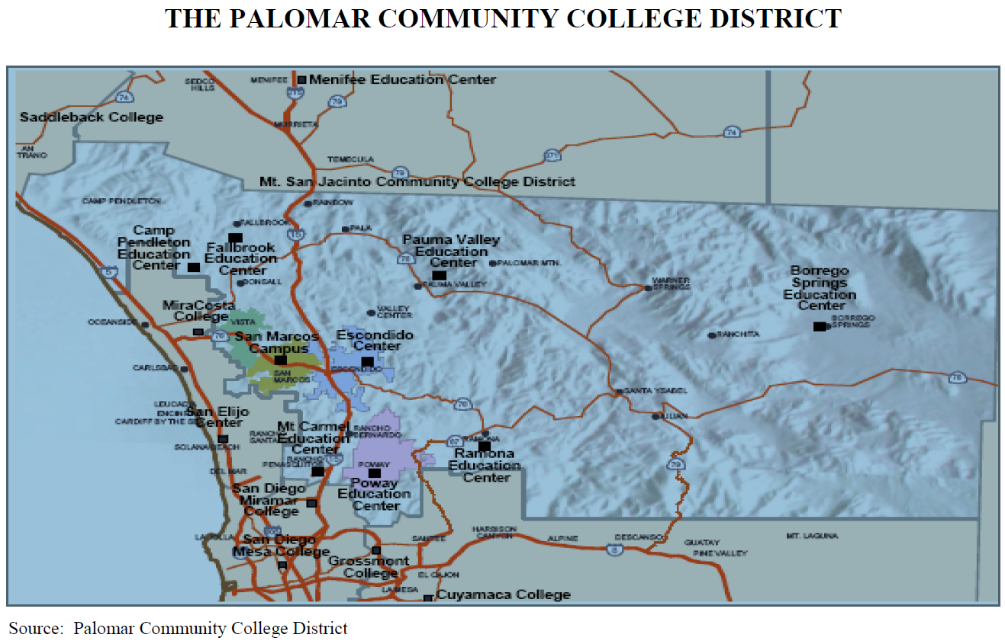

Slide 42
District-Wide Concerns
Balance Budget
Continuous expenditures with continuous revenue
Accreditation
Enhanced fiscal monitoring
ACCJC Recommendations
Retiree Health – Fund 69
$72M Unfunded Liability
STRS/PERS Increases
Gradual Increase to double in 2021

Slide 43
District-Wide Concerns
Prop 30 Tax Expiration
¼ % Sales Tax
4 years, 2013 through 2016
Increased income tax - $250,000
7 years, 2012 through 2018
15.0% of Apportionment Revenue
Declining Enrollment
Large College Designation
Stability Funding/Right Sizing

Slide 44
Accreditation
REAFFIRMED ACCREDITATION ON THE BASIS OF A COMPREHENSIVE EVALUATION
(With a follow-up report due October of 2016, and a site visit by an evaluation team)

Slide 45
Task Force Findings
The structure of accreditation in this region no longer meets the current and anticipated needs of the California Community Colleges.
The ACCJC has consistently failed to meet the expectations outlined in section three of this report.

Slide 46
Task Force Findings
On several occasions the ACCJC has promised changes and has offered reports detailing their efforts to address concerns, but these promises and reports have led to few significant improvements.
The California Community College system and its member institutions have lost confidence in theACCJC.

Slide 47
Task Force Recommendations
1.The Chancellor’s Office should investigate all available avenues for establishing a new model for accreditation, including options such as the following:

Slide 48
Task Force Recommendations
a. Form a combined single accrediting commission with community colleges joining WASC Senior College and University Commission, in keeping with the prevalent model for regional accreditation.
b. Identify other regional accreditors that could serve the California Community Colleges.

Slide 49
Task Force Recommendations
2. The Chancellor’s Office should evaluate possible accrediting agents for the California Community Colleges in a thorough yet expeditious manner and, working through the system’s established consultation processes, bring a recommendation for action to the Board of Governors by Spring 2016.

Slide 50
Task Force Recommendations
3. Until a new accrediting agent for the system is identified, system constituencies should continue to work in a cooperative and proactive manner with the ACCJC to ensure the continuity of the accreditation process for all colleges within the system.

Slide 51
Accreditation
Recommendations (8)
Meeting Standards—Compliance (2)
Institutional Effectiveness (6)

Slide 52
Recommendations--Compliance
Recommendation 1
To meet the standards, the Team recommends the College ensure adequate tutorial support for distance education students. In addition, the Team recommends that the College provide students at Camp Pendleton accessible student services commensurate with the offerings at the San Marcos and Escondido sites. (II.C.1.c, III.C.1.a)

Slide 53
Recommendations--Compliance
Recommendation 2
To meet the standard, the Team recommends the College create an environment that includes the participation of all employees in participatory governance and appropriate councils, committees, subcommittees, task forces, and workgroups. (IV.A.1, IV.A.3)

Slide 54
Recommendations-- Institutional Effectiveness
Recommendation 3 – Enrollment Management
To increase institutional effectiveness, the Team recommends the College develop and implement a comprehensive district wide enrollment management plan to ensure enhanced student access and success and maintain the fiscal viability and integrity of the institution by reducing its reliance on reserves to balance its annual budget. (III.D.1.b, IV.B.2.d)

Slide 55
Recommendations-- Institutional Effectiveness
Recommendation 4 – Staffing
To increase institutional effectiveness, the Team recommends the College develop a college wide process for determining the number of classified staff and administrators with appropriate preparation and experience to provide adequate support for the institution’s mission and purposes. (III.A.2)

Slide 56
Recommendations-- Institutional Effectiveness
Recommendation 5 – Program Review
To increase institutional effectiveness, the Team recommends the College create program review plans for Human Resource Services and finance and Administrative Services that include the same level of detailed narrative and analyses as other College division programs. Additionally, the Team recommends that the College include Program Review Plans for all other College service areas as part of the program review process. (I.B.3)

Slide 57
Recommendations-- Institutional Effectiveness
Recommendation 6 – Institution Set Standards
To increase institutional effectiveness, the Team recommends the College utilize institution-set standards and other student achievement data to develop program-level standards for all College programs. (I.B.3, U.S.D.E 602.17(f))

Slide 58
Recommendations-- Institutional Effectiveness
Recommendation 7 – SLOs
To increase institutional effectiveness, the Team recommends the College takes steps to more clearly define the distinction between course objectives and student learning outcomes and to ensure that the student learning outcomes included in course syllabi are in full conformity with the student learning outcomes adopted by the institution. (II.A.6)

Slide 59
Recommendations-- Institutional Effectiveness
Recommendation 8 – Discipline Preparation
To increase institutional effectiveness, the Team recommends the College curriculum committee stipulate the discipline preparation appropriate to courses in the College’s curriculum within course outlines of record. (II.A.2.b, III.A.1.a)

Slide 60
Annual Financial Report Monitoring Status
ACCJC developed a Composite Financial Index (CFI)
Based on index colleges assigned into one of the following categories of scrutiny.
N (Normal)
M (Enhanced Monitoring)
R (Referred)

Slide 61
Annual Financial Report Monitoring Status
ACCJC developed a Composite Financial Index (CFI)
Based on index colleges assigned into one of the following categories of scrutiny.
N (Normal)
M (Enhanced Monitoring)
R (Referred)

Slide 62
Annual Financial Report Monitoring Status
Operating revenue ratio
Operating deficit
Salary and benefits percentage
Enrollment change
Negative change in cash balance
Student loan defaults
Excess COLA

Slide 63
The Work Ahead!

Slide 64
The IPM
The IPM
Integrates our long-term, medium-term, short-term planning
Plans should speak to each other.
Institutional priorities from the longer-term plans and the shorter-term operational planning come together in the Strategic Plan
Model includes an annual implementation or action plan
Model links resource allocations to planning

Slide 65
The Planning Cycles

Slide 66
A “Different” Approach
We have some opportunities that make planning critical
Enrollment Management
Budget
Staffing
Technology
Student Success and Equity
Communication

Slide 67
A “Different” Approach
Fall 2015
Dialogue and conversation around some “big topics”
What are the “problems?” What are some strategies for addressing them?
Councils, Employee and Constituent Groups, Chairs and Directors, etc…
Summarize what we learn, what we hear
Spring 2015
Move what we have learned from our dialogue into the planning councils for planning and action development
Notes:
Note – This schedule also allows for us to set the stage for the new Superintendent / President. But also gives them the opportunity for input and influence.

Slide 68
Next Steps
Get the information out
Strategize, plan, implement
FTES drives Apportionment

Slide 69
THE END!

