Slide 1
2022-23 Program Review and Planning Please type in the chat – one highlight from your summer!
Instruction Programs
Notes:
Jack will open

Slide 2
Overview
Welcome, Expected Outcomes, and Purpose
PRP Form Review – Overview and Walk Through
Outcomes from Last Year’s PRP process
BIG Picture Timeline PRPs and Resource Allocation
Summary of Changes for this Upcoming Year
Notes:
Jack will provide the overview –2 minutes

Slide 3
Welcome and Expected Outcomes
Explain the purpose of Program Review and Planning (PRP)
Complete your Comprehensive or Annual PRP Form
Describe how the PRPs will influence resource allocation decisions.
Notes:
Jack will provide a welcome. Five minutes

Slide 4
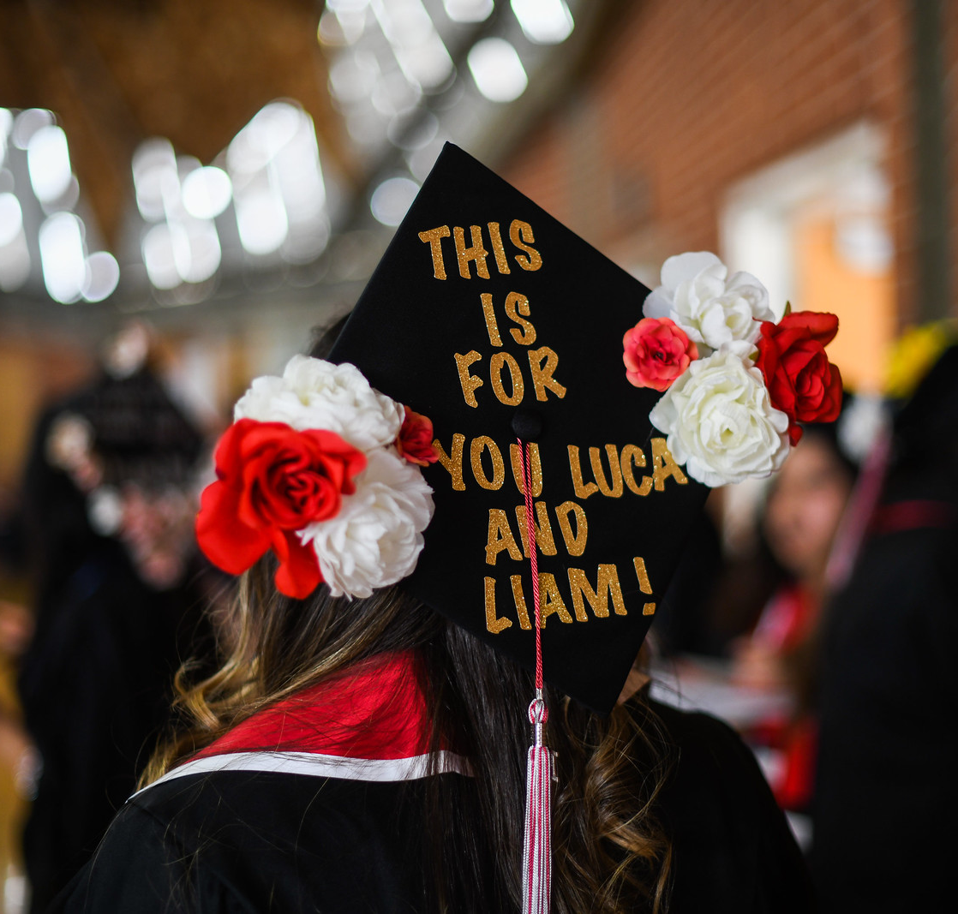
Purpose – Why engage in the PRP process?
Notes:
MICHELLE - Ask participants to type into the chat the answer to this question.

Slide 5
Outcomes from 2021-22 PRPs
All instructional areas completed their PRPs!
Resource requests were downloaded and prioritized across the College
One-time and technology needs
Facilities
Staffing
Budget Committee recommended funding for one-time and technology needs; Facilities is reviewing facilities requests to add to Scheduled Maintenance plan. Program Review and Resource Allocation Committee reviewing funding available to support additional requests
https://www.palomar.edu/irp/wp-content/uploads/sites/238/2022/08/PRP-Resource-Allocation-Status-8_2022.pdf

Slide 6
Summary of Changes for Instructional PRPs
STARTING EARLIER: Access to forms and data now available!
CHAIR CONFIRMATION: No Chair Review! Chairs will need to confirm the PRPs are done.
DATA: Moving to new platform!
RESOURCE ALLOCATION: Clarified and streamlined a bit (we will discuss later in training)

Slide 7
Timeline for Instructional PRPs
TASK | ASSIGNED TO | START | DUE DATE
Webpage, Forms, and Data Updated | IR&P | 08/01/2022 | 08/18/2022
Training | IR&P | 08/18/2022 | 09/16/2022
Disciplines Complete PRP Forms (Comprehensive or Annual) | Disciplines | 08/19/2022 | 10/12/2022
Chairs Confirm Completion | Chairs | 10/12/2022 | 10/14/2022
PEER REVIEWS of COMPREHENSIVE PRPs | EESSC Committee | 10/14/2022 | 11/4/2022
Deans Review PRPs and Engage with Disciplines for Follow up if Needed | Deans | 11/4/2022 | 11/30/2022
Disciplines receive feedback and make any changes | Disciplines | 11/30/2022 | 12/9/2022
Deans sign off on final document | Dean | 12/09/2022 | 12/16/2022
Vice President Review and Feedback | VP | 12/19/2022 | 01/13/2023

Slide 8
Accessing and Completing your PRP
All things Instruction PRP:
https://www2.palomar.edu/pages/irp/program-review-and-planning-3/
PRP Videos! If you haven’t checked them out, please do! https://www.youtube.com/playlist?list=PLwTvB4OVzBj56d1SNyxVcTpKuFTPuRyM4

Slide 9
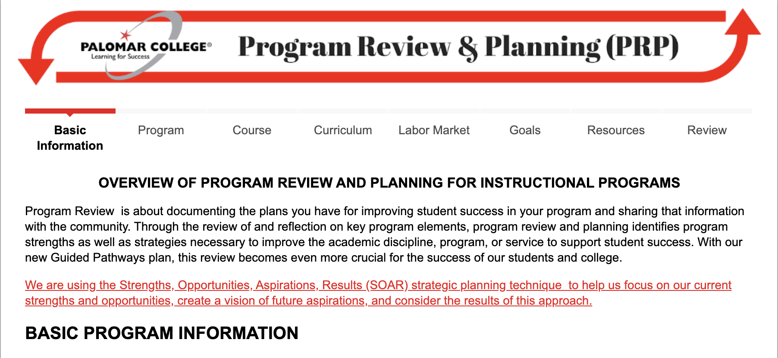
PRP Form PRP Data
https://www.cognitoforms.com/PalomarCollege1/_202223InstructionalProgramReviewAndPlanning
https://www.palomar.edu/irp/program-review-and-planning-3/#step-4-access-prp-data
Notes:
Michelle will navigate to the PRP form / and show how to navigate to PRP Data – 3 minutes
FROM THIS POINT WE WILL FOLLOW THE FACILITATORS Guide sent with this slide deck.

Slide 10
Connecting PRPs to Resource Allocation
Month | Activity
August | IRP Prepares Data, Forms Reviewed, Webpages Updated; Units can Start Early!
September | Units Complete Reviews
October | Units Complete Reviews, Peer Review (EESSC Committee)
November | Deans/Directors Review
December | VPs Review
January | 1st Level RA Prioritization: Divisional List
February | 2nd Level RA Prioritization: Bring Divisional Lists into one single list
March | Funding Sources Identified; Budget Committee; College Council
April | Resource requests processed and integrated into the Budget
May | Integrated Planning Report to College Council
June | Integrated Planning Report to Board

Slide 11
Questions?

