Slide 1
2021-22 Program Review and Planning
Instruction Programs
Notes:
Jack will open

Slide 2
Overview
Welcome, Outcomes, and Purpose
Accessing and Completing the Comprehensive or Annual PRP Forms
PRP Form Review – Overview and Walk Through
Accreditation & Outcomes from Last Year’s PRP process
BIG Picture Timeline PRPs and Resource Allocation
Notes:
Jack will provide the overview –2 minutes

Slide 3
Welcome and Expected Outcomes
Explain the purpose of Program Review and Planning (PRP)
Complete your Comprehensive or Annual PRP Form
Describe how the PRPs will influence resource allocation decisions.
Notes:
Jack will provide a welcome. Five minutes

Slide 4
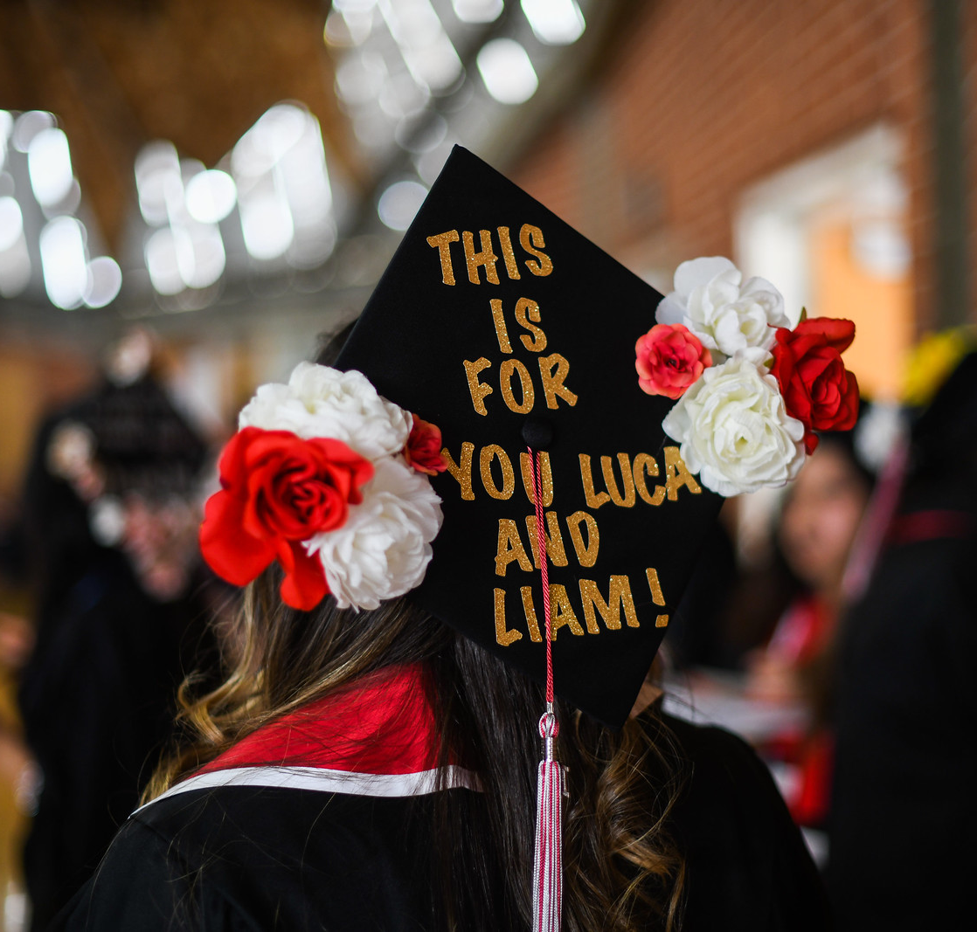
Purpose – Why engage in the PRP process?
Notes:
Wendy / Katy – 5 minutes

Slide 5
Accreditation
March 2022 Site Visit
Program Review and Planning is a centerpiece of the standards:
Standard IB – Institutional Effectiveness
Standard IIA,B,C – Instructional Services, Learning Support Services, Student Services
Standards IIIA, B, C, D – Resources
Site Team will be reviewing our processes and looking at evidence, including completed PRPs
SLOs and assessment!

Slide 6
Outcomes from 2020-21 PRPs
All areas completed their PRPs!
Resource requests were downloaded and prioritized across the College
One-time and technology needs
Facilities
Institutional Needs
Budget committee recommended funding for one-time and technology needs
College budget incorporated recommended needs and included an amount to address institutional needs drawn from PRPs
https://www2.palomar.edu/pages/irp/files/2021/05/PRP-and-Institutional-Planning-Resource-Requests-2021.pdf

Slide 7
Timeline for Instructional PRPs
 | ASSIGNED TO | START | DUE DATE
TASK
Data Posted/Training/Budget Reports Run | IR&P/ADA | 9/1/21 | 9/17/21
Disciplines Develop PRP Form and Submit to Chair | Department | 9/17/21 | 10/15/21
Chair Review | Chairs | 10/15/21 | 10/22/21
Dean Review | Deans | 10/22/21 | 11/5/21
PRP Peer Review | Council | 11/5/21 | 11/19/21
Discipline Revision (as needed) | Department | 11/29/21 | 12/3/21
VPI Review | VPI | 12/31/21 | 1/7/22
* Research will provide drop-in times for data review – sign-up sheet
** Deans will review technology and facilities request and notify chairs to complete forms for Technology Committee and Facilities review.

Slide 8
Accessing and Completing your PRP
All things Instruction PRP:
https://www2.palomar.edu/pages/irp/program-review-and-planning-3/
PRP Videos! If you haven’t checked them out, please do! https://www.youtube.com/playlist?list=PLwTvB4OVzBj56d1SNyxVcTpKuFTPuRyM4

Slide 9
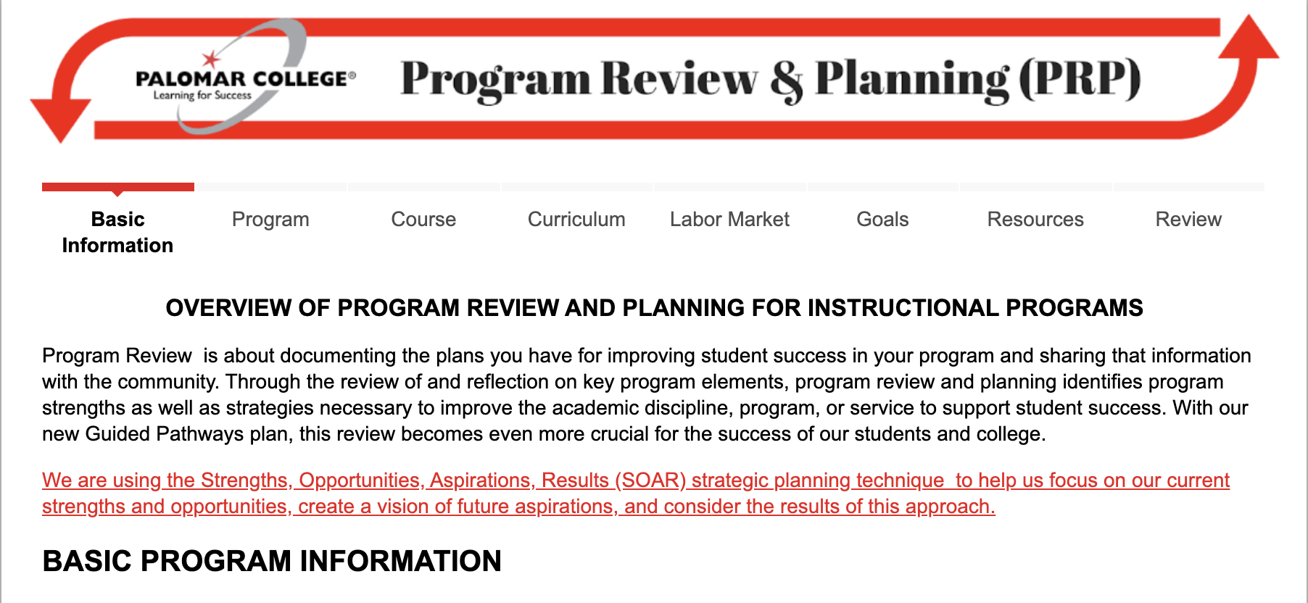
PRP Form PRP Data
https://www.cognitoforms.com/PalomarCollege1/instructionalprogramreviewandplanning20202021
https://www2.palomar.edu/pages/irp/program-review-and-planning-3/
Notes:
Michelle will navigate to the PRP form / and show how to navigate to PRP Data – 3 minutes
FROM THIS POINT WE WILL FOLLOW THE FACILITATORS Guide sent with this slide deck.

Slide 10
Connecting PRPs to Resource Allocation
Month | Activity
August | IRP Prepares Data, Forms Reviewed, Webpages Updated
September | Budget Reports Run, Training, Units Start Review
October | Units Complete Reviews, Deans & Director Review
November | Instructional Peer Review, Final Edits, Facilities and Tech Review
December | VPs Review
January | 1st Level RA Prioritization: Divisional List
February | 2nd Level RA Prioritization: Bring Divisional Lists into one single list
March | Funding Sources Identified; Budget Committee; College Council
April | Resource requests processed and integrated into the Budget
May | Integrated Planning Report to College Council
June | Integrated Planning Report to Board

Slide 11
Questions?

