Slide 1
2021-22 Program Review and Planning (PRP)
Non-Instructional Review

Slide 2
Overview
Welcome, Outcomes, and Purpose
Accessing and Completing the Comprehensive or Annual PRP Forms
PRP Form Review – Overview and Walk Through
Big Picture Timelines PRPs and Resource Allocation
SAOs and Nuventive
Accreditation/Outcomes from Last Year’s PRP process
Notes:
VIKASH will provide the overview –2 minutes

Slide 3
Welcome and Expected Outcomes
At the end of this session you will be able to:
Explain the purpose of Program Review and Planning (PRP).
Complete your PRP Form.
Describe how PRP affects/influences resource allocation decisions.
Notes:
VIKASH will provide a welcome. Five minutes

Slide 4
Program Review and Planning
Who we are and how do we help Palomar meet its mission?
What we do. How we do it. Who we serve.
How do we know we are doing a good job? (Evidence and Assessment)
What are our plans for the future? (What are our aspirations?)
What resources do we need to get there?
(Resource allocation)
Notes:
VIKASH – 3 minutes

Slide 5
Accreditation
March 2022 Site Visit
Program Review and Planning is a centerpiece of the standards:
Standard IB – Institutional Effectiveness
Standard IIA,B,C – Instructional Services, Learning Support Services, Student Services
Standards IIIA, B, C, D – Resources
Site Team will be reviewing our processes and looking at evidence, including completed PRPs
SLO/SAOs and assessment!
Notes:
Michelle – 2 minutes

Slide 6
Outcomes from 2020-21 PRP Cycle
All areas completed their PRPs!
Resource requests were downloaded and prioritized across the College
One-time and technology needs
Facilities
Institutional Needs
Budget committee recommended funding for one-time and technology needs
College budget incorporated recommended needs and included an amount to address institutional needs drawn from PRPs
https://www2.palomar.edu/pages/irp/files/2021/05/PRP-and-Institutional-Planning-Resource-Requests-2021.pdf
Notes:
Michelle – 2 minutes

Slide 7
2021-22 Timeline
Tasks |  | START | DUE DATE
Units Complete PRP |  | 9/17/2021 | 11/5/2021
Immediate Supervisor Review |  | 11/5/2021 | 11/19/2021
Units Revise (as necessary – final supervisor sign off) |  | 11/29/2021 | 12/10/2021
Vice Presidents Review PRPs |  | 12/10/2021 | 01/07/2022
Notes:
Marti - 3

Slide 8
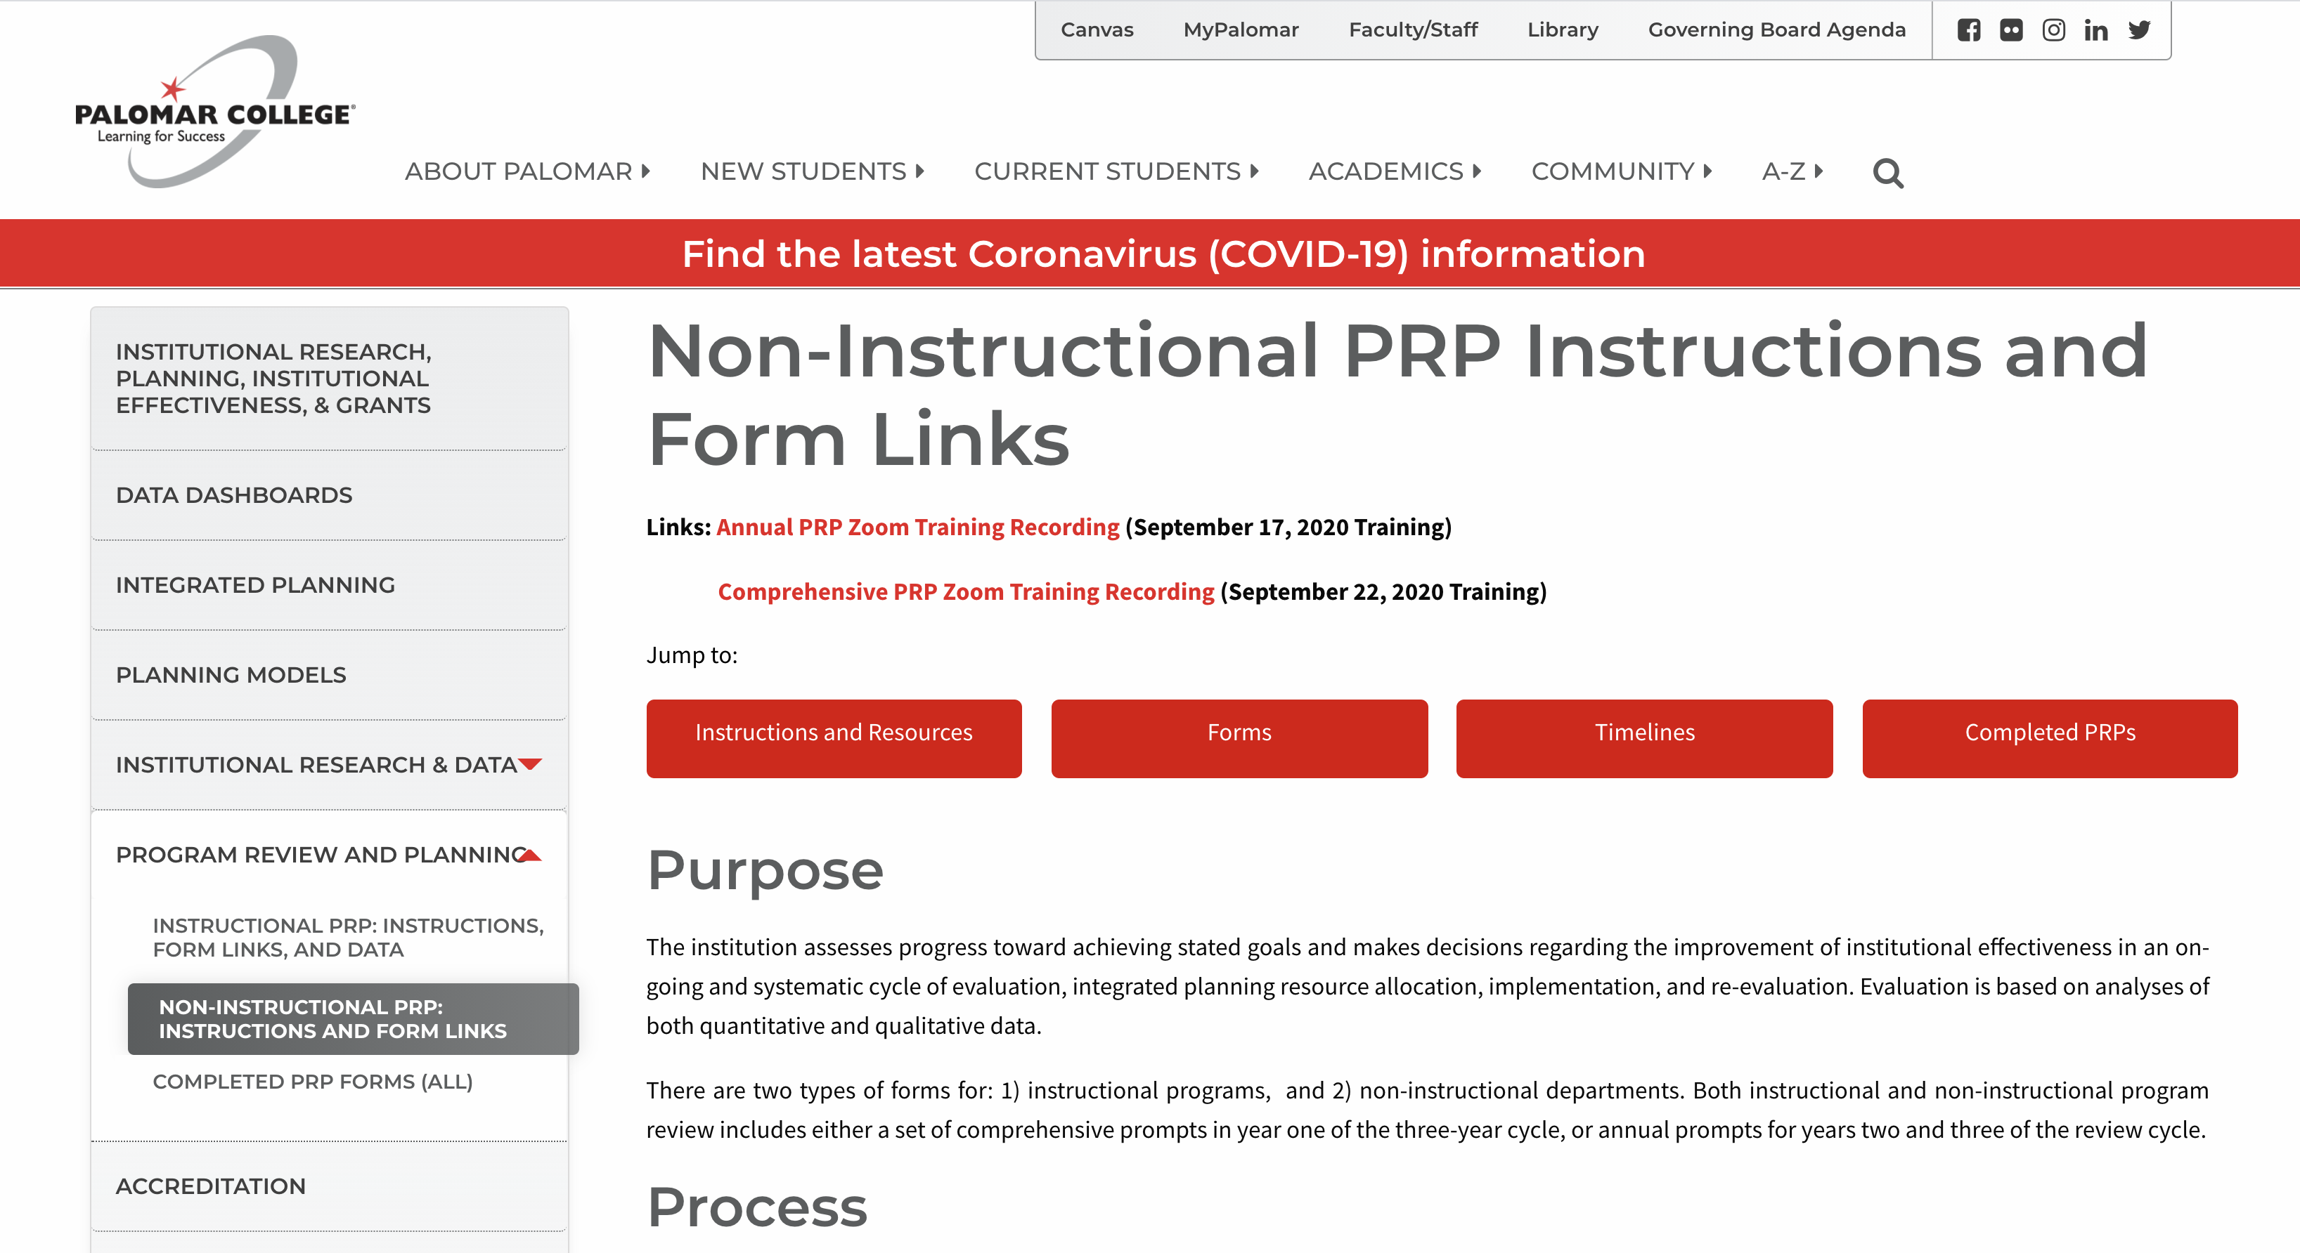
PRP Webpage
NonInstructional PRP Webpage
Notes:
Marti 3 minutes

Slide 9
PRP Form (Comprehensive)
Part I: Basic Unit Information
Part II: Program/Unit Assessment
Part III: Program/Unit Evaluation and Goals
Part IV: Resources
Part V: Feedback and Follow up
Notes:
Michelle – 3 minutes

Slide 10
PRP Form (Annual Update)
Part I: Basic Unit Information
Part II: Program/Unit Assessment
Part III: Progress on Goals
Part IV: Resources
Part V: Feedback and Follow up
Notes:
Michelle – 3 minutes

Slide 11
Program Review and Planning - TIPS
Assessment should be guided by evidence and include a thorough analysis.
PRPs should be completed and shared with/by department/unit.
Goals and improvement plans should be clearly connected to the program assessment (e.g., evidence and SOAR Analysis).
Connect resource requests to your program goals and align with Strategic plan.
Verify one-time requests cannot be covered in existing budget and are in fact one-time requests
Notes:
Michelle – 3 minutes. Avoid “I” – I reviewed the completion rates and found/ I did “X”” to encourage. “Or our student worker, M Jones did X.”
Examples:
“We (our Our Department), reviewed completion rates for our ‘student group’ and found…”
“As a result of reviewing our student survey results, we found that X% of students were satisfied with our services.”
“Themes from Palomar Services survey suggest that…”

Slide 12
Connecting PRPs to Resource Allocation
Month | Activity
August | IRP Prepares Data, Forms Reviewed, Webpages Updated
September | Budget Reports Run, Training, Units Start Review
October | Units Complete Reviews, Deans & Director Review
November | Instructional Peer Review, Final Edits, Facilities and Tech Review
December | VPs Review
January | 1st Level RA Prioritization: Divisional List
February | 2nd Level RA Prioritization: Bring Divisional Lists into one single list
March | Funding Sources Identified; Budget Committee; College Council
April | Resource requests processed and integrated into the Budget
May | Integrated Planning Report to College Council
June | Integrated Planning Report to Board

Slide 13
GOT SAOs?
Notes:
Michelle and Marti

Slide 14
Got SAOs?
A Service Area Outcome (SAO) is a statement about what a client will experience, receive, or know as a result of a given service. Clients can be students, faculty, staff, or community members.
As part of our three-year planning and review cycles, all non-instructional units are asked to:
identify at least two SAOs,
develop a plan and assess their SAOs,
reflect on the results,
and take action, as necessary.
Enter/Update your SAO information into Nuventive Improve
SAO Status Report – sending to Vice Presidents
Sunset old SAOs in Nuventive!!!
Define
Collect Data
Assess
Reflect
Act
Notes:
Michelle

Slide 15
Need Help?
Nuventive Improve
Palomar Username and Password
Marti Snyder: msnyder2@palomar.edu
VIDEO - : https://youtu.be/b1sRa68wm4c
I have the technical stuff! I need help:
Defining,
Refining, and
Assessing!
Notes:
Marti

Slide 16
Need Help?
https://www.hartnell.edu/sites/default/files/Library_Documents/slo/SAOs/Service%20Area%20Outcomes%20and%20Assessment%20for%20Hartnell%20v6.pdf
https://www.valleycollege.edu/current-students/student-life/sao.php
http://www.elcamino.edu/student/studentservices/sdo/sao.aspx
http://www.napavalley.edu/AboutNVC/Planning/SLO/Pages/Outline.aspx
Notes:
Michelle

Slide 17
Questions?

Slide 18
Part I: Basic Information

Slide 19
Basic Information – Annual
Update on Staffing
Update on changes to unit’s responsibilities

Slide 20
Part II: Program Unit Assessment

Slide 21
Program / Unit Assessment - Annual
Service Area Outcomes (SAO)
Update / Bring Current
Updates
Other Assessment Data (quantitative & qualitative)
Achievements and Other Information

Slide 22
Need Help?
SERVICE AREA OUTCOMES TEMPLATE
Date Identified or Last Reviewed | Description of SAO (What is your SAO?) | Assessment Method (How will/do you measure or assess it?) | Criterion (How will/do you know if you met the outcome?) | Date of Assessment | Date of Next Assessment
1)
2)
3)
4)
Contact Michelle Barton: mbarton@palomar.edu – We will send a team!
Find the template on the noninstruction PRP Webpage at:
Notes:
Michelle

Slide 23
Part 3: Progress on Goals

Slide 24
Evaluation and Planning – Annual Progress on Goals
Describe Progress on Goals
Connect your work to the Vision for Success Goals (Strategic Plan 2022)

Slide 25
Part 4: Resources

Slide 26
Resources
Budget
Review Budget Report
Provide information for consideration in budget cycle
Staffing
Staffing Needs (will feed into staff prioritization process)
Technology, Facilities, and Other Needs
Technology Needs ( Technology Review / Inform Technology Plan)
Facilities (Facilities Review)
Equipment and Other Needs
Technology, Facilities, and Other Requests will feed into Institutional Prioritization Process

Slide 27
Part 5: Feedback and Follow-up

Slide 28
Feedback and Follow-Up
Feedback to unit
Inform division priorities and resource allocation
Planning Councils should review a report or summary of PRPs.
Divisions will prepare summary to be included in Strategic Planning Council’s annual report

