Slide 1

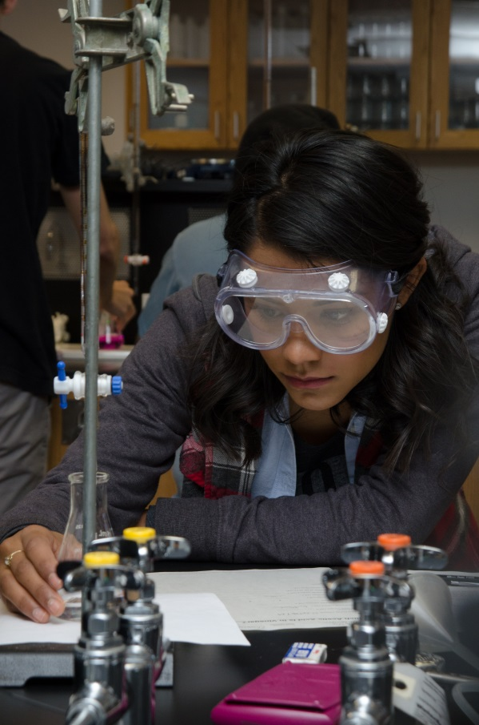
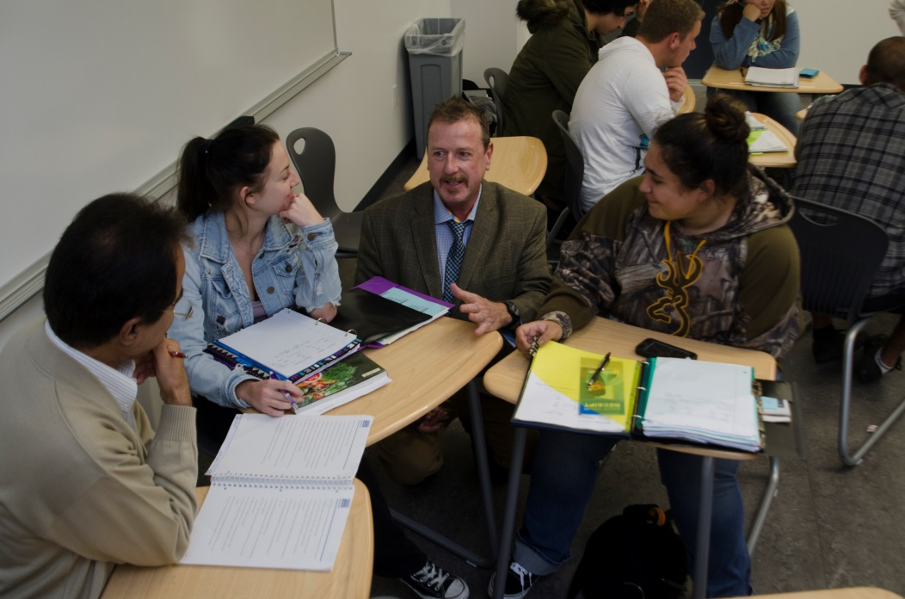
SEM Advisory Committee Workshop
September 30, 2017

Slide 2
Overview/Agenda
TOPIC TIME
Breakfast 9:00-9:30
Welcome and Introductions 9:30-9:45
Why SEM?
  SEM reset 9:45-10:00
  Current Enrollment / Budget 10:00-10:30
  Implications 10:30-10:45
Break 10:45-11:00
Community/College Data/Observations 11:00-12:15
Lunch 12:15-12:45
SOAR / GAP analysis 12:45-2:15
Wrap Up / Next Steps 2:15-2:30
Notes:
Breakfast 9:00-9:30
Welcome and Introduction 9:30-9:45
Why SEM?
SEM reset (purpose/homework) 9:45-10:00
Current Enrollment / Budget 10:00-10:30
Implications 10:30-10:45
Break 10:45-11:00
Community and College data/observations 11:00-12:15
Lunch 12:15-12:45
SOAR / GAP analysis 12:45-2:15 (1.25 for activity - 15 minutes to summarize and prioritize)
Wrap Up / Next Steps 2:15-2:30

Slide 3
Welcome and Introductions
Select a partner and answer the following two questions:
  What does Palomar do well?
    Your Homework!!!
  Why do you care about the future of Palomar?
    On one of your note pads, write down a few reasons why you care about the future of our college?
    Then come to the front of the room and attach your notes to the board.

Slide 4
SEM Reset
Role of our Committee
SEM Purpose Statement and Framework
SEM Planning
  “The critical difference between SEM and other types of planning is the focus SEM planning places on optimizing enrollment, while improving success outcomes and maintaining fiscal viability.”
SEM done well…provides for an infrastructure that allows colleges to adapt to their changing environments
Notes:
Role of our Committee
Fall term = To develop and implement Palomar College’s strategic enrollment plan.
Spring forward = Serve as steering committee to ensure plan is implemented
SEM Purpose Statement
“Strategic Enrollment Management (SEM) is a holistic concept and a process that enables the fulfillment of an institution’s mission and its students’ educational goals.”
SEM Planning
The planning process for strategic enrollment management is much like the planning for other major initiatives or endeavors (e.g., strategic or education master planning).
The critical difference between SEM and other types of planning is the focus SEM planning places on optimizing enrollment, while improving success outcomes and maintaining fiscal viability.
PROCESS CHECK – WHAT DOES THIS MEAN TO YOU?

Slide 5
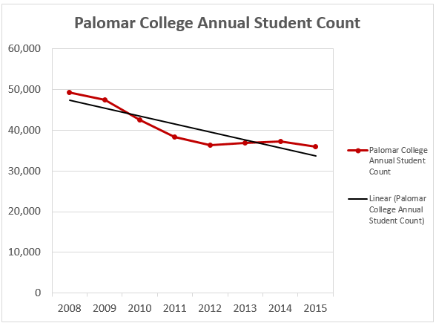
Why SEM?

Slide 6
Why SEM?
2017-18 BUDGET REPORT
Ron Perez

Slide 7
Implications
What struck you about the Budget Report?
Considering the budget, both revenue (FTES) and expenditures, what are the implications for us short-term? Long-term?

Slide 8
Community and
Palomar College Observations
Informed by Data;
Guided by Discussion

Slide 9

LET’S SOAR!
Strengths:
  What can we build on?
  What do we do well as it relates to SEM?
Opportunities:
  What is our community/students looking for?
  Where can we improve or even innovate?
Aspirations:
  What do we care deeply about?
  Considering our strengths and opportunities, who should we become?
  What can we do to make a difference?
Results:
  How do we know we are succeeding?

Slide 10
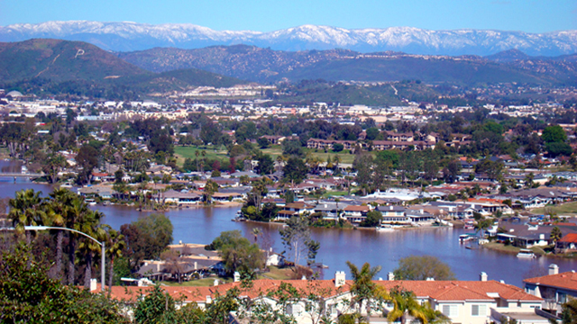
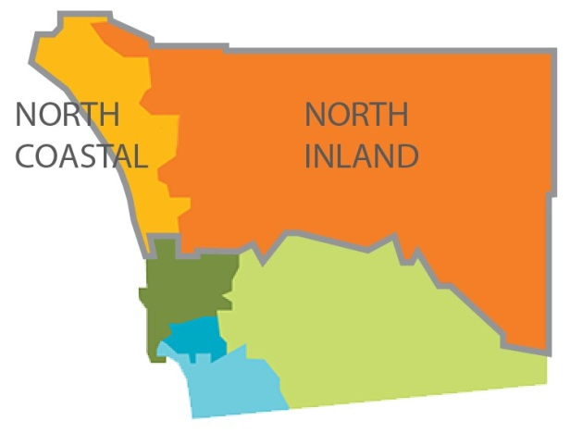
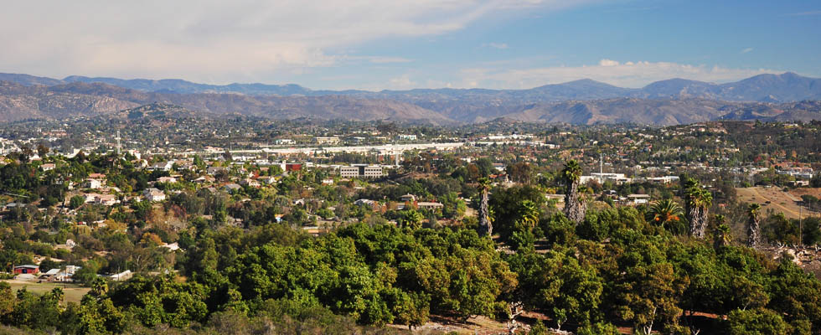
Our District:
The Community We Serve
Labor Market Information

Slide 11
Our District:
The Community We Serve
Palomar Community College District covers 2,550 square miles!
Larger than the state of Delaware.
Q: How many adults (18-64) live in our district?
A: About 547,023!

Slide 12

Higher concentration of Asian/Pac Islander reside Southern portion of the district.
81% Hispanic or White.
18-19 represent just 4.6% of our adult population, but generate about 35% of our FTES.
46% of the population 20-39;
30% over 50.

Slide 13
Our District:
The Community We Serve
A little more than 1/3 have high school degree or less
About 1/3 have some college or an AA degree
A little less than 1/3 have a bachelor’s degree or higher
Notes:
Over 18

Slide 14
Our District :
The Community We Serve
Higher percentage (47%) of residents in southern region of the district have a bachelor’s degree or higher compared to the central (23.5%) and northern (20.8%).
Data Source: SANDAG 2016 Estimates

Slide 15
Our District:
The Community We Serve
Projecting about a 2.4% increase in adult population
With
***Significant increases in:
Hispanic population
ages 30-39
ages 60 and above
Data Sources: SANDAG 2016 Estimate; SANDAG Series 13 Forecasts
Notes:
About 2

Slide 16
Our District:
The Community We Serve
Data Source: Department of Finance (2016 Series)

Slide 17

Labor Market
Notes:
As we begin to strategically think about our district and how to better serve it, we need to look at and consider the labor market.

Slide 18
The Labor Market
12% Growth
Job Turn Over by 2026
New Jobs created by 2026
=
+
Data Source: Economic Modeling Specialists, INC (EMSI): 2017.3 Release

Slide 19
The Labor Market
Data Source: Economic Modeling Specialists, INC (EMSI): 2017.3 Release

Slide 20
Tops 25 Jobs Requiring
On-the-Job Training
Data Source: Economic Modeling Specialists, INC (EMSI): 2017.3 Release

Slide 21
Tops 25 Jobs Requiring a Certificate
Data Source: Economic Modeling Specialists, INC (EMSI): 2017.3 Release

Slide 22
Tops 25 Jobs Requiring an AA/AS
Data Source: Economic Modeling Specialists, INC (EMSI): 2017.3 Release

Slide 23
Tops 25 Jobs Requiring an Bachelor’s +
Data Source: Economic Modeling Specialists, INC (EMSI): 2017.3 Release

Slide 24


Reflection Break
Any Thoughts??
…
Notes:
Looking at our projected job growth, how do you feel Palomar's programs align with job openings in the undustry.
Yes, we know we can't answer this in any detail right now...

Slide 25

Community College Student Enrollment and Demographics

Slide 26
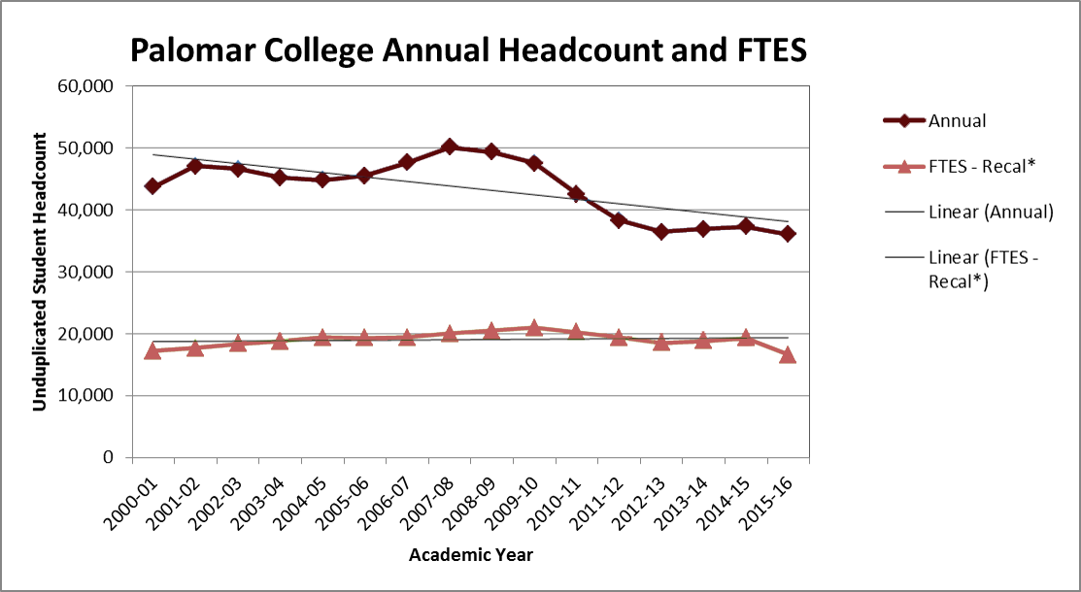
Palomar College Headcount and FTES
*In reporting 2015-16 FTES to the state, Palomar shifted FTES to prior year and did not borrow from “2nd” summer.

Slide 27
Our Students:
Places of Residence
Data Source: MIS Submissions to CCCCO
Notes:
To understand what was happening with our enrollments we felt like we needed to look more closely at where students came from and then also where other students in our district went. While we would have liked to include the CSU in the mix, we were unable to…

Slide 28

High School of Graduation
First Time Students

Slide 29
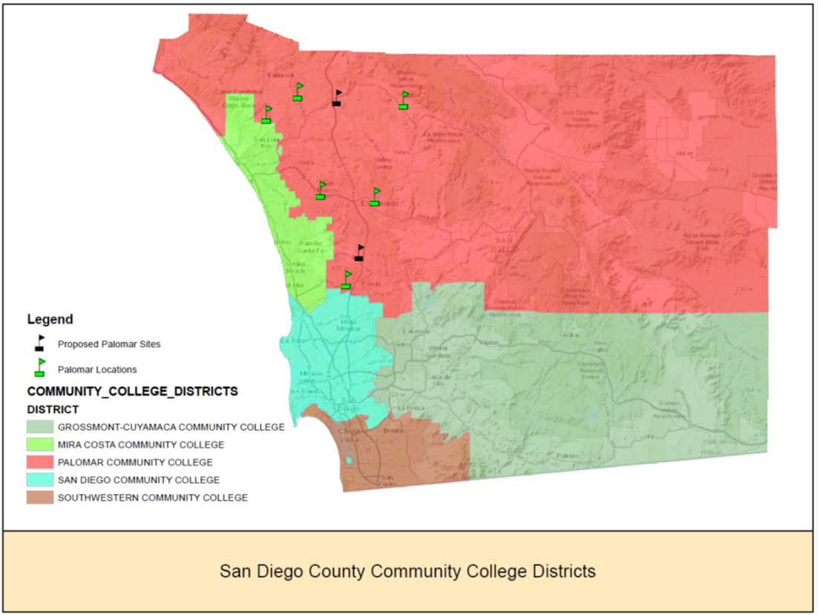
Community College Students in SD
Notes:
To understand what is going on with our enrollment, we started to look at our entire district.

Slide 30
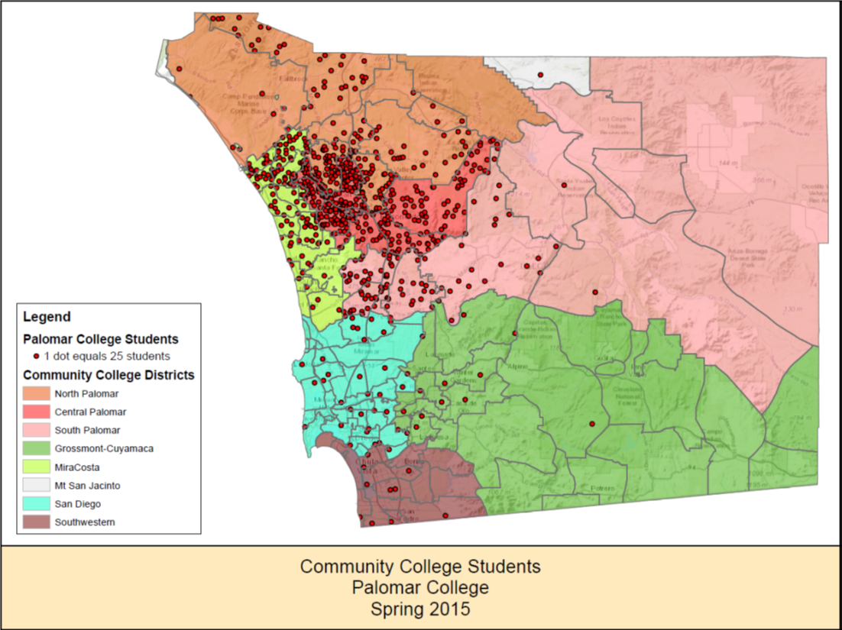
Palomar College Students:
Where do they come from?

Slide 31
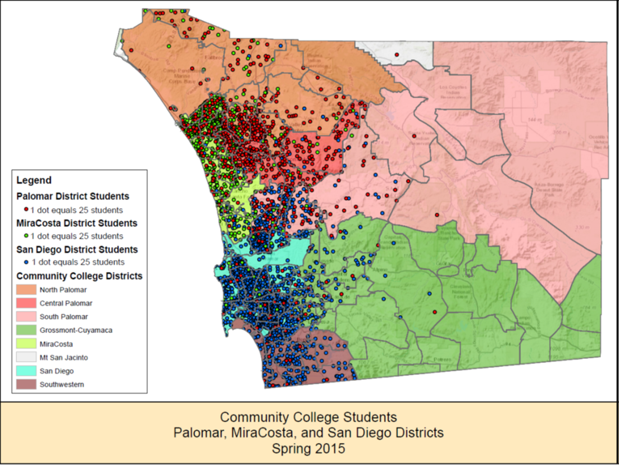
What about our surrounding Colleges?

Slide 32
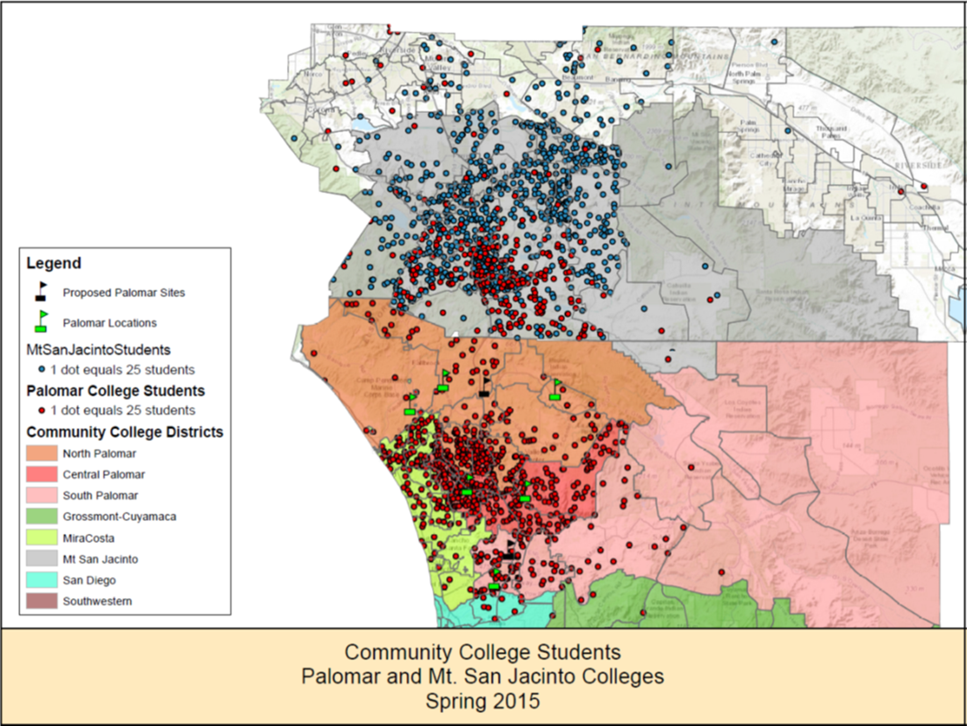
And the college to the north?

Slide 33
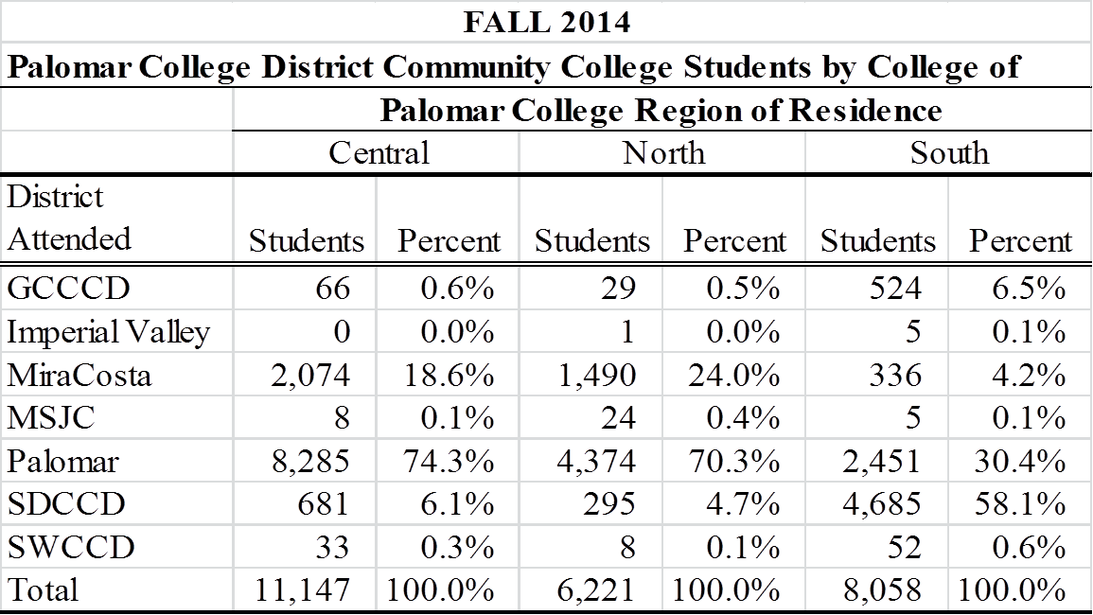
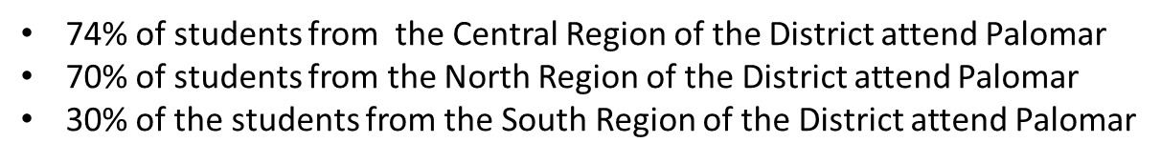
Our District’s Community College Students: Where do they go?

Slide 34
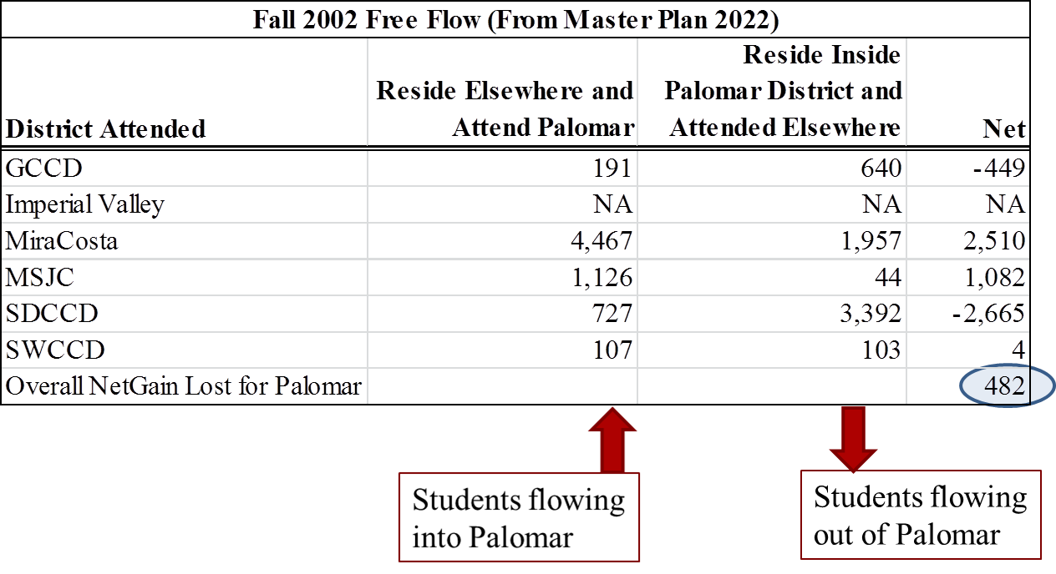
Has it always been this way?

Slide 35
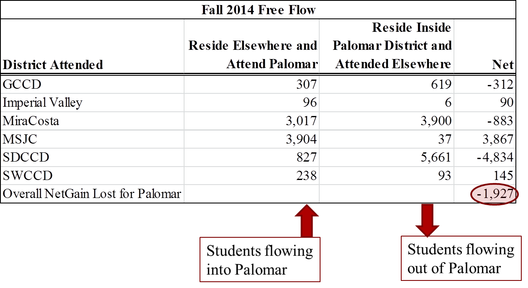
Has it always been this way?

Slide 36
Reflection
Key points
  Palomar serves 59% of the District’s residents attending a community college
  From 2002 to present overall net enrollment flow trends have reversed
  Over 8,000 residents from Southern portion of district attend a community college; Palomar serves 30% of these students while SDCCD serves 58%
  MiraCosta now draws more students from Palomar
  Palomar still attracts students from Mt. San Jacinto; however Mt. San Jacinto is building new comprehensive site off the Interstate 15 and has expanded its concurrent/dual enrollment offerings.

Slide 37



Palomar College Student Demographics
Fall 2016
Palomar has large CTE programs that have traditionally attracted males.
Our Hispanic student population continues to grow over time.
Our younger students critically important, as they generate significant FTES, however…
Remember…Ages 30-39 are expected to grow over time.
Less than 30% of our students are full-time

Slide 38
Our Students:
Student Status
*
* Estimates as of Census
Decreases
Decreases in Continuing Students appears to be a trend.
Decreases in NonCredit could be coming as a result of our current political environment.

Slide 39
Our Students: Demographics
Do they represent our community?
A little more info on Veterans!
Younger Veterans (19-34) are over represented. Our Older Veterans (which there are many more of in San Diego) are under represented.
Data Source: MIS Submissions to CCCCO; SANDAG 2016 Estimates

Slide 40

Reflection Break
Any Thoughts??
Thinking strategically, what opportunities do we have to better serve our community?
Are there any populations we should consider?
How can we address the decreasing high school graduated attendance at Palomar.
What is happening with our continuing students???

Slide 41

Schedule, Courses, and Offerings

Slide 42
Course Offerings
Data Source: MIS Submissions to CCCCO

Slide 43
Course Offerings
Data Source: MIS Submissions to CCCCO

Slide 44
Course Offerings
Data Source: MIS Submissions to CCCCO
* Online course offerings did increase in Spring 2017.

Slide 45

How much FTES does our schedule generate? What resources do we use to generate it?
*
Data Source: PAL FS320
* Fall estimates only
Why is WSCH to FTEF important???
Why 525?

Slide 46

Student Outcomes

Slide 47
Course Success Rates (% A,B,C,CR)
Note*: Data for Spring 2017 is not available at the time of this report.
Note*: Data for Spring 2017 is not available at the time of this report.
Data Source: MIS Submissions to CCCCO
Data Source: MIS Submissions to CCCCO

Slide 48
Course Success Rates by Level
Note*: Data for Spring 2017 is not available at the time of this report.
Data Source: MIS Submissions to CCCCO
Data Source: MIS Submissions to CCCCO
Notes:
Something is wonky about this chart??? You have 2016 – 17 for Basic Skills and AA BUT Not Transfer

Slide 49
Awards
https://sharepoint2.palomar.edu/sites/IRPA/SitePages/Degrees%20and%20Certifications.aspx
Notes:
Most popular Awards??? Insert link.

Slide 50
Average Time to Completion
(AA/AST/Cert only*)
4.68
5.21
5.4
Note*: Time to completion calculated for first-time-to-college students completing in AY 2016.
Data Source: MIS Submissions to CCCCO
Notes:
Change animation

Slide 51
CSU/UC Transfer Volume by Year
Data Sources: http://extranet.cccco.edu/Divisions/TechResearchInfoSys/Research/Transfer.aspx; CSU Analytic Studies

Slide 52
CSU/UC Transfers
Top CSU Transfer Institutions
  CSUSM
  SDSU
Top CSU majors
  Psychology
  Business Admin
  Kinesiology
  Accountancy
  Sociology
Top UC Transfer Institutions
  UCSD*
  UC Irvine / UCLA
Top UC majors
  Political Science
  Psychology
  Computer Science
  Economics
  Biology / Cellular Biology
*Annual UCSD Transfers have decreased from 145 (2011-12) to 95 (2015-16)

Slide 53
Student Success Scorecard Metrics
Completion or momentum points
Broken down by demographic variables
Prepared / Unprepared / Total
Metrics
  Persistence
  30+ Units
  Completion (SPAR)
  Remedial
  CTE Completion
  CDCP
  Skills Builder
New This Year
  1 and 2 Year Transfer Course Achievement Rates
  http://scorecard.cccco.edu/scorecardrates.aspx?CollegeID=061
Notes:
Break up into groups.

Slide 54
Palomar College Scorecard Report
Data Source: CCCCO Scorecard Data

Slide 55


Palomar College Scorecard Report
Metric | Last Year’s Rate | Current Rate | Increase / Decrease
Momentum Points
3-Term Persistence | 72.9% | 68.7%
30+ Units | 68.0% | 68.1%
Basic Skills Comp - English | 43.1% | 45.1%
Basic Skills Comp – Math | 36.2% | 36.3%
Basic Skills Comp - ESL | 24.6% | 22.8%
Transfer Level Ach
English 1 year /2 year | 48.5% / 65.8% | 49.7% / 68.3%
Math 1 year / 2 year | 23.6% / 35.9% | 23.2% / 35.4%
Completion
Completion | 53.4% | 49.7%
CTE Completion | 51.0% | 50.7%
Skills Builder
Increase in Salary | +14.4% | +20.2% | NA

Slide 56
Equity
Success Indicator | Disproportionate Impact (DI) | Overall Measure | DI Threshold | DI Measure
Access | Veterans |  | PI = 0.80 | PI = 0.65
Course Completion | Foster Youth | 70.3% | 56.2% | 54.1%
Academic Standing | Foster Youth | 79.2% | 63.4% | 60.3%
ESL & Basic Skills Completion | African Americans (Math) | 36.2% | 28.9% | 22.6%
Degree & Certificate Completion | African Americans (Unprepared) | 22.6% | 18.1% | 12.1%
 | DSPS Students (Unprepared) | 45.30% | 36.2% | 36.2%
Transfer to 4-Year Institution | African Americans (Unprepared) | 26.3% | 21.0% | 16.7%
 | DSPS Students (Unprepared) | 31.8% | 25.4% | 17.7%
Data Sources: MIS Submissions to CCCCO (Term = Fall 2016); CCCCO Scorecard Data (Cohort Year = 2010); US Census Bureau: American Fact Finder Data

Slide 57

Reflection
What are we doing well with respect to serving our students?
What opportunities exist?
  Are we scheduling courses to meet the needs of our students?
  Do our programs meet their needs?
  Is there an opportunity around persistence and completion?
  Yes, I know we can’t answer these questions fully!

Slide 58


Seriously…
Let’s SOAR!!!

Slide 59

The Student Connection
Connection
From interest in college enrollment to application
Entry
Enrollment to completion of first college-level course
Progress
Enrollment into program of study to 75% of requirement completion
Completion
Complete program of study to credential with labor market value

Slide 60
LET’S SOAR!
Strengths:
  What can we build on?
  What do we do well as it relates to SEM?
Opportunities:
  Where can we improve or even innovate?
Aspirations:
  What do we care deeply about?
  Considering our strengths and opportunities, who should we become?
  What can we do to make a difference?
Results:
  How do we know we are succeeding?

Slide 61
Strengths
What are our strengths? What can we build on?
How do our strengths fit with the reality of our community and our students?
In a small group, ask one or two people to share examples or stories that shows Palomar at its best and when s/he felt proud to be a part of Palomar.
Identify the themes across the examples/stories.
Identify additional strengths to add to the themes.

Slide 62
Opportunities
What are our opportunities?
What can we improve or even innovate?
What do we need to do differently?
In your groups consider the following questions?
  How can we optimize enrollments and student success while at the same time remaining fiscally viable?
  What infrastructure should we have in place to accommodate changes in our environment?

Slide 63
Aspirations
Considering our strengths, our opportunities, our community and our students, where do we go in the future?
What strategic initiatives would support our aspirations?
In your small group, consider our strengths and opportunities.
Where do we go in the future?
What strategic initiatives will support our aspirations?

Slide 64
Results
What measures will we use to let us know we are on track to meet our goals?
Identify a list of indicators that would let us know if we are on track to meet our goals,
optimizing enrollment (meeting enrollment targets),
facilitating student persistence and success while,
remaining fiscally viable.

Slide 65
Short-term, Mid-Term Long-term
What themes emerged?
Short-term strategies?
Mid-term strategies?
Long-term strategies

Slide 66
Wrap Up and Next Steps
Lunch meeting with small group who could not make it. Summarize our discussions.
Need a small writing team to pull all the information together in preparation for next Thursday’s meeting.

Slide 67
Timelines and Meeting Dates
Workshops
September 30th – SEM Planning Retreat
October 5th (3:00-7:00)
Meetings
2nd meeting October
1 meeting in November
1 meeting in December
Notes:
Briefing on our progress developing Strategic Plan 2016
Review and discussion of the Student Success Scorecard 2013

Slide 68
THE END!

