Slide 1
Grants & awards
Palomar College
5/16/2018

Slide 2
To apply for a grant
Institutional Research & Planning
Michelle Barton
Ext. 2534
https://www2.palomar.edu/pages/irp/grant-page/

Slide 3
Great!! Our department gets a grant!
Now what??

Slide 4
Before you can spend…..
Make sure you have a copy of award letter/contract that is signed by
Award payer (Federal/State/Local Agency) &
Palomar College
Special case: sub-recipients
Award is accepted by the Palomar College Board
Most importantly – CALL or EMAIL PAI
Ext. 2896
Pwang-smith@palomar.edu
Ps. if you call me Ping, $5 please :)

Slide 5
I will have a meeting with you in person, to set up the Project Code
Federal: 1112xxx
State: 1612xxx
Local: 1812xxx
Information/items I need:
A copy of signed award letter/contract
Award period
Beginning Date
Ending Date
Department Contact Person
Department Code
Program Code
Agency Contact person if any
Billing/Invoicing
Reporting
Allowable Spending
Indirect Cost?

Slide 6
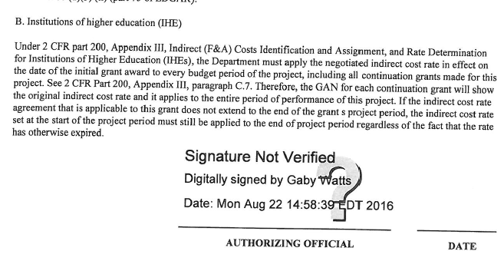
Award letter Example:

Slide 7
No Budget = no spending
Check Mary’s training for references
For grants – submit a Budget Adjustment Form to set up budget
Brandi will assign a project number and provide a revenue account string
Expense Accounts:
Chart of Accounts
Benefits Worksheet
Benefits go with Salary
Set up approved positions with HR
Other allowable spending
Instructional vs Non-Instructional
Indirect cost
%
Capital Assets 600010

Slide 8
Initial Budget Adjustment Form:
Heading color is dependent upon fiscal year.
Examples:
FY1617: Purple
FY1718: Orange

Slide 9
Actual Expense
nVision Report:
David Rice
Quarterly report
Reporting
Invoicing
Expenditure Transfer
Budgets Overview for Account Strings or
nVision Drilldown for expenses paid
You can transfer expenditures from one project to another
You can NOT transfer budget from one project to another

Slide 10
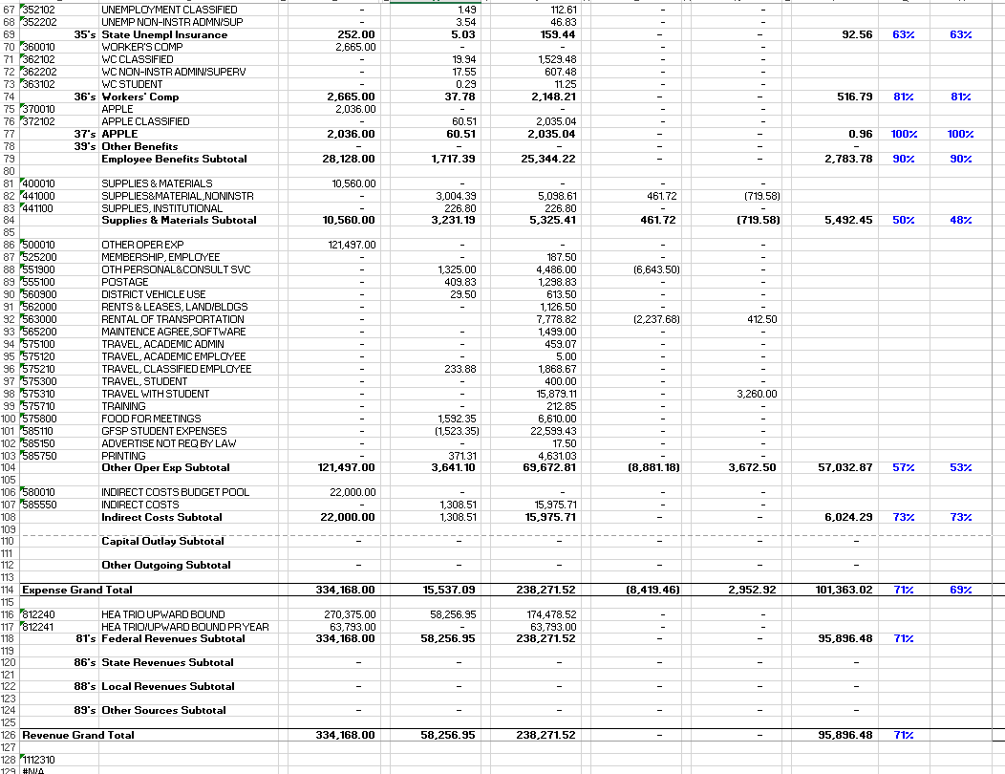
Nvision report example:

Slide 11
Budgets Overview:

Slide 12
Questions?

