Slide 1
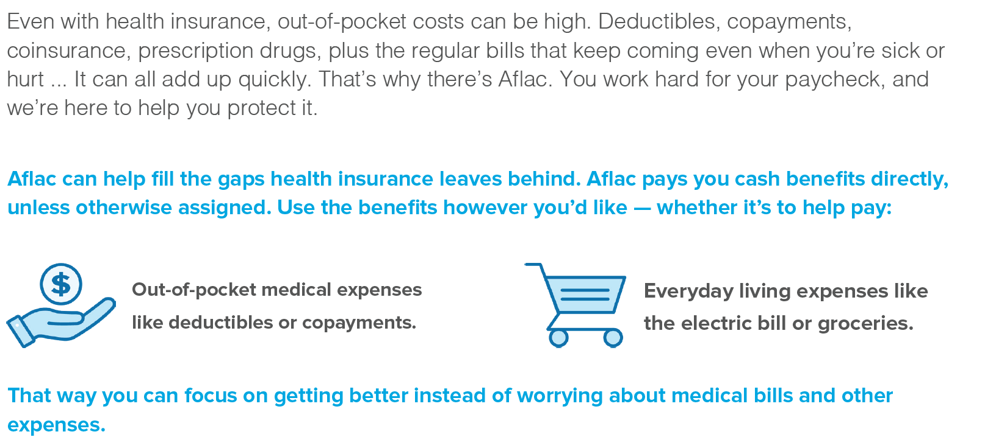
Individual policies are guaranteed renewable. Coverage is portable. Historical rate stability.
Benefits on individual policies are paid directly to policyholders, unless otherwise assigned.

Slide 2
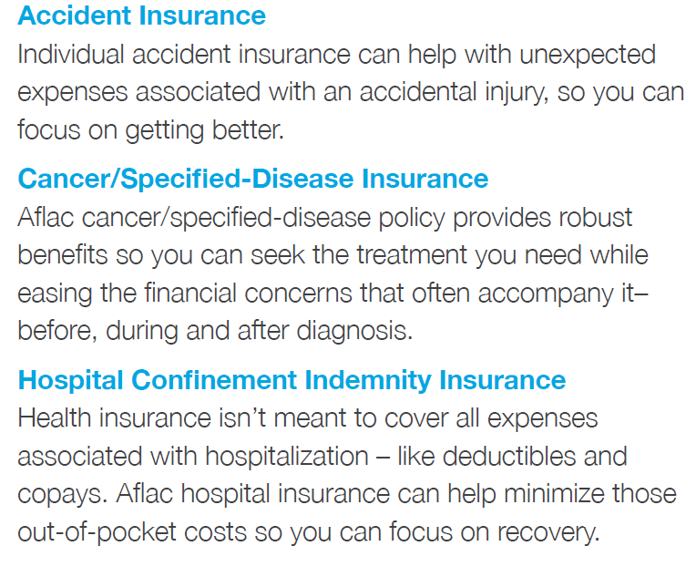
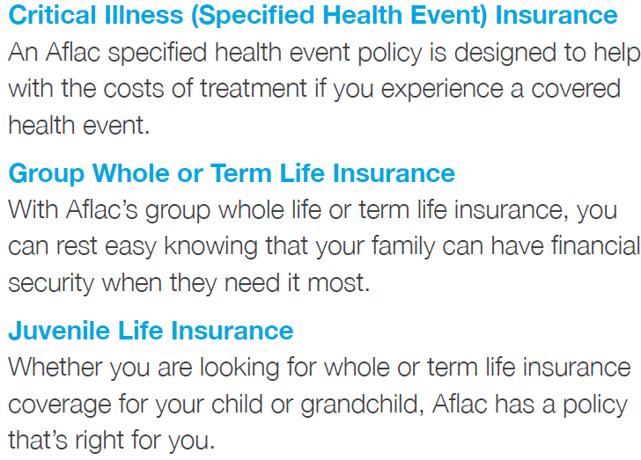
Open Enrollment Planning isn’t complete
until you have Aflac

Slide 3
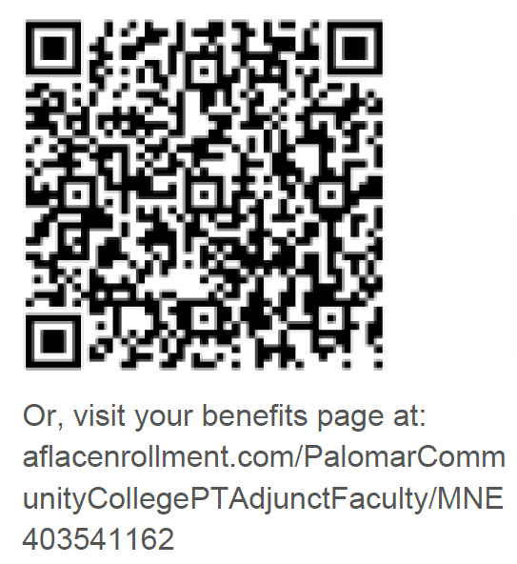
Apply for Coverage
For Questions, Changes or to Apply for Coverage please schedule a 1 on 1 session with your agent.
Jill Krenkler
760-473-8023
jill_krenkler@us.aflac.com

