Slide 1
Benefits Overview
Notes:
Welcome to Delta Dental, your ally in protecting your smile.

Slide 2
DeltaCare® USA
Your plan:
Notes:
You’re covered under a DeltaCare USA plan. Let’s take a look.

Slide 3
Save with DeltaCare USA
Set copayments
No maximums or deductibles
Notes:
DeltaCare USA is a prepaid, fixed copayment dental plan.
Choose a DeltaCare USA dentist and visit this dentist to receive coverage. There are no maximums or deductibles, and you can count on paying no more than the set copayment for each covered procedure.

Slide 4
Emergency and specialty care
Coverage for emergency care
Referrals to specialists arranged by your primary care dentist
Notes:
Your plan includes coverage for emergency and specialty care. If you need to see a specialist, your primary care dentist will coordinate a referral for you.

Slide 5
Find a DeltaCare USA dentist
Go to deltadentalins.com.
Enter your location.
Select DeltaCare USA as your network.
Click Search.
Notes:
To find a DeltaCare USA dentist near you, just use our online dentist directory.

Slide 6
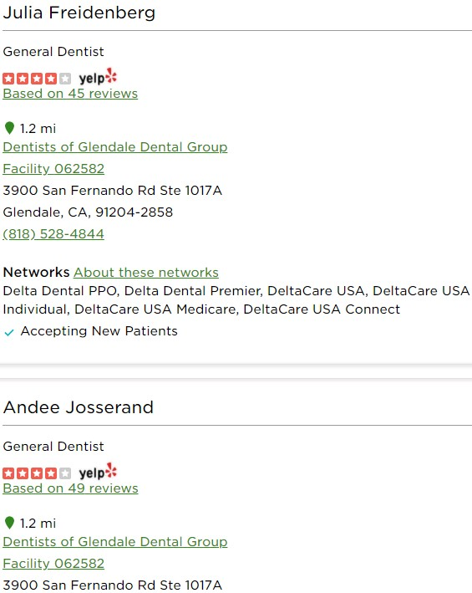
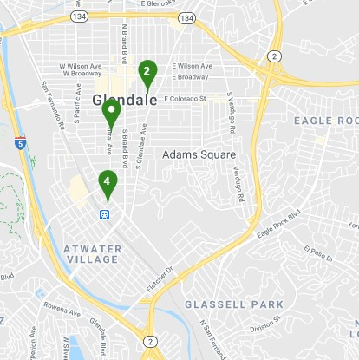
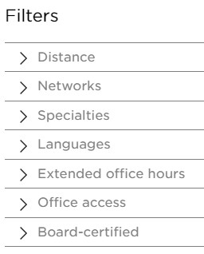
Find a DeltaCare USA dentist
Click on Refine search to adjust the distance of the search or filter by specialty or language.
Notes:
You can adjust the range of your search, or filter the results by specialty, language and more.

Slide 7
Find a DeltaCare USA dentist
Facility number
Select your dentist online or by phone.
Notes:
When you find the dentist you want, make a note of the facility number, and update your dentist online or by calling Customer Service. Changes received by the 21st of the month will go through the following month.

Slide 8
For a full list of procedures, see your plan booklet.
Notes:
Check your plan booklet for a complete list of covered services and copayments.

Slide 9
Savings you can hear and see
Discounts on hearing aids and LASIK eye surgery
Discounts on hearing aids and one year of free follow-up care
62% average savings off retail hearing aid pricing, with a best-price guarantee of 5%
Call Amplifon at 888-779-1429
Discount on LASIK eye surgery, including pre- and post-operative visits
40-50% off national average price
Call QualSight at 855-284-2020
Notes:
Your Delta Dental plan gives you access to great discounts on laser eye surgery from QualSight and hearing aids from Amplifon.
To take advantage of this preferred pricing, just give Amplifon or QualSight a call. A dedicated representative will walk you through the program and help you pick a provider, make an appointment and receive your discount.
Vision corrective services and Amplifon’s hearing health care services are not insured benefits. Delta Dental makes the vision corrective services program and hearing health care services program available to you to provide access to the preferred pricing for these services.

Slide 10
Sign up for an online account
Register at deltadentalins.com
Notes:
You can create an online account to keep track of your benefits. After registering, log in to check your plan details, print your ID card and more.

Slide 11
Go paperless
Notes:
Save time and paper. When you go paperless, you’ll receive an email notification as soon as a new claim statement is available.

Slide 12
Boost your wellness IQ
deltadentalins.com/wellness
Articles
Recipes
Videos
Interactive quizzes
Free wellness e-magazine
Risk assessment
Notes:
Learn more about dental health. At deltadentalins.com/wellness, you’ll find articles, recipes, videos, interactive quizzes, a free wellness e-magazine and even a survey to assess your oral health risks.

Slide 13
800-422-4234
Contact Delta Dental
Monday through Friday, 8 am – 9 pm EST
Automated telephone system: 24/7
Notes:
Got a simple question? Use our automated phone system, available 24/7. You can check your benefits info and more. Just call the customer service number and follow the prompts. For more complicated questions, call during business hours to talk to a Customer Service representative.

Slide 14
Together we shine
Notes:
When choose DeltaCare USA, it’s easy to protect your smile and keep it healthy. Together we shine.

Slide 15
Delta Dental is a registered trademark of Delta Dental Plans Association.
Notes:
Delta Dental is a registered trademark of Delta Dental Plans Association.

Slide 16
DeltaCare USA is underwritten in these states by these entities: AL — Alpha Dental of Alabama, Inc.; AZ — Alpha Dental of Arizona, Inc.; CA — Delta Dental of California; AR, CO, IA, MA, ME, MI, MN, NC, ND, NE, NH, OK, OR, RI, SC, SD, VA, VT, WA, WI, WY — Dentegra Insurance Company; AK, CT, DC, DE, FL, GA, KS, LA, MS, MT, TN, WV — Delta Dental Insurance Company; HI, ID, IL, IN, KY, MD, MO, NJ, OH, TX — Alpha Dental Programs, Inc.; NV — Alpha Dental of Nevada, Inc.; UT — Alpha Dental of Utah, Inc.; NM — Alpha Dental of New Mexico, Inc.; NY — Delta Dental of New York, Inc.; PA — Delta Dental of Pennsylvania. Delta Dental Insurance Company acts as the DeltaCare USA administrator in all these states. These companies are financially responsible for their own products. In WY, you do not need to select a primary care dentist, but you must visit a DeltaCare USA dentist to receive benefits. In the following states, you can maximize your savings when you visit a DeltaCare USA dentist, although you may visit any licensed dentist and receive out-of-network coverage: AK, CT, LA, ME, MS, MT, NC, ND, NH, OK, SD, VT.
Notes:
Your DeltaCare USA plan is underwritten by these entities below.

