Slide 1
Academic Leader
The transition from Tutor/Mentor
EHS

Slide 3
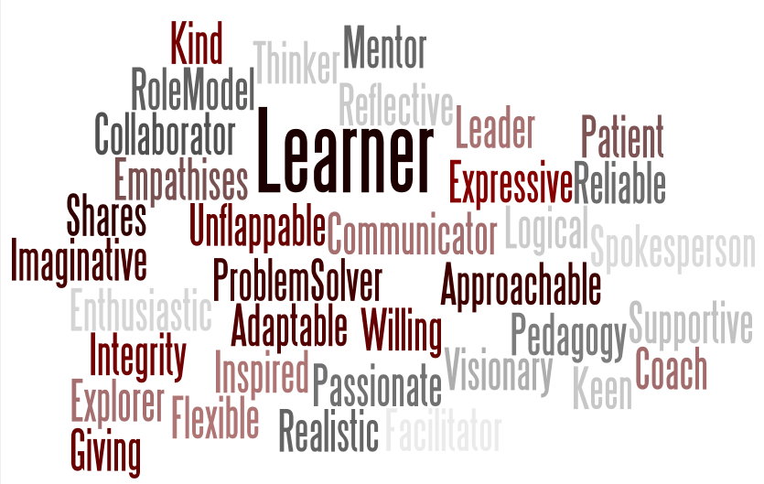
Why Academic Leader
Welcoming
Professional
Sparks interest
Notes:
Will explain how and why we got to the new title.

Slide 4
Example:
Today I learned …
I am still confused about …
I am most excited about …
A question I have is …

Slide 5
Goal setting with each student SMART
S - Specific
M - Measurable
A – Action-oriented
R – Realistic
T – Timely
Notes:
S- A goal of graduating from high school is too general. Specify how this will be accomplished (study in order to receive better grades. M- Establish criteria for how a goal is to be achieved. Measurable does not refer to a timeline; it means determine a way to measure the mentee’s success in completing the long-range goals. A- Be proactive in taking action that will result in reaching the desired goal. R- Strive for attainable goals, considering the resources and constraints relative to the situations. T- Allow reasonable time to complete each goal, but no so much time the mantee loses focus or motivation.

Slide 6
Responsibilities of an Academic Leader
Take ownership
Take initiative
Commitment
Work as a team, play as a team
Build relationships
Be a role model
Build strong tutorial sessions
Notes:
Natalie

Slide 7
Academic Leader Responsibilities
Report urgent matters and sensitive issues to site lead staff
Be in classroom prepared to assist before students arrive
Contact all lead staff regarding emergency call out/sick days
Be engaging and enthusiastic to keep positive relationships in the work site.
No use of phones or electronics when tutoring or when in meetings.
Assist students in developing their study skills to be better prepared them for college level study habits.
Maintain student confidentiality and avoid sharing personal information about a student to other students and staff.
Attend mandatory trainings and seminars to better improve your skill set improving tutoring ability and future career performance.
Submit timesheets in a timely manner and correctly review information.
Display appropriate use of GFSP property and inform SC or PA when supplies are low or property is damaged.

Slide 8
Role of Academic Leader in The Classroom
Assist students by means of
One-on-One tutoring
Group tutoring
Reinforce and reiterate instruction given by the teachers.
Adhere to all school policies and be aware of all school guidelines.
Obey all classroom rules
Take initiative
- Communicate with students and teachers consistently
IMPORTANT NOTE: Academic Leaders are not used solely to monitor the behavior of students. In addition, AL's will not be used solely for clerical/administrative purposes or to run errands.

Slide 9
Academic Leader Behavior
Patience
A positive attitude
Expectations
Honesty
Confidentially
Notes:
Patience- Key when tutoring students as a concept may be difficult for students to grasp when it is easily understood by you. Take the time to help students understand the basic information of a concept before they can understand the general idea. Ask students to tell you what they know so far to make a connection.
A positive attitude- Goes a long way to encourage your students of their good work. Even if they are stuck compliment them on their ability to get as far as they did. If you understand a concept easily but they do not avoid telling them how easy it is as it can strain their confidence making them feel they are behind compared to their peers. Instead let them know that every concept takes time to fully understand making them feel that their trouble understanding the concept is normal.
Expectations- and make them clear to your students. Keeping your expectations set will push them to challenge themselves and will have them realize their potential.
Honesty- will further gain your students respect. If you do not know the answer or procedure to a question, don’t be afraid to admit it. Work with them to find the solution using their resources, or even ask another AL or teacher if you reach an obstacle.
Confidentially, is very important as a GFSP staff member. Avoid sharing personal student information with other students or staff. Also be mindful of documents that contain private information and secure them properly before leaving the work area. If a student shares private information that can be problematic speak to your immediate supervisor as soon as possible.

Slide 10
Who is your immediate supervisor?
Program Ambassador
First point of contact
Direction

Slide 13
Notes:
1. Dress appropriately and professionally. No jeans or tank tops.
2. If necessary, will be given a verbal warning upon dress code violations.
3. If not dressed appropriately, you will be asked to go home to change and your absence will be noted as a “no show” since you did not come prepared to work.

Slide 14
ALs TASKS
Name of AL | Road to Success
 | Cleaning
 | After school Compass
 | Lunch Compass
 | Events Compass
 | College of the Month
 | Posters
 | Deliveries
 | Make copies
 | Inventory
 | Academic Leader of the Month
 | ALs and students of the Month decoration
 | CAHSEE & AEMP Party Friday
 | EHS outreach
 | Organizing inventory

Slide 15
Lunch Activities Groups
Wednesday 03/04/15 | Angelica | Dalia
Thursday 03/12/15 | Stefani | Marco | Natalie
Wednesday 04/01/15 | Dayja | Ben | Luis
Thursday 04/30/15 | Leslie | Ivan
Wednesday 05/06/15 | Dalila | Robert
Thursday 05/28/15 | Khang | Tony
Monday 06/01/15 | Belinda | Ivan
Tuesday 06/02/15 | Scarlett | Diana

Slide 16
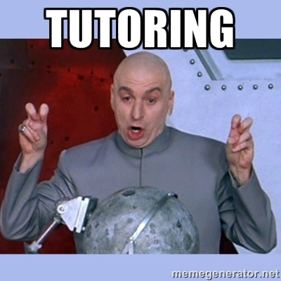
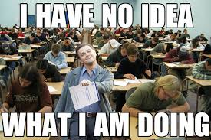
AL Check List:
Clarify expectations
Be available
Check in often
Encourage goal-setting
Be patient
Be positive
Be kind
Do not push
Be flexible
Notes:
Clarify expectations, initially and throughout your tutoring sessions openly communicate the expectations for the sessions to be successful.
Be available, your students should feel confident that you are available, within reason, to answer questions and provide supports. To make your students feel supported, try to take time to remind them to come see you at the GEAR UP office.
Check in often, tutoring is a two-way street. For fear of being bothersome, students may hesitate to reach out. If it’s been a while since you heard from your student, reach out to keep communication open.
Encourage goal setting, Chances are your students have goals. Keep them on track by providing challenges and then lead the process to help your student achieve her/his goals.
Be patient, tutoring is not a race to the finish line. Yes, there are goals to be reached and skills to be learned, but just because your student isn’t moving as quickly as you would if given the same circumstances doesn’t mean your tutoring skills are lacking. It is important to recognize that every student has different goals, time constraints and values.
Be positive, Stay upbeat and encouraging. Your student will have ups and downs. Not every speech will go as planned and not every goal will be met the first time around. It’s your job to point out the positive and keep your student motivated to keep trying.
Be kind, your student may not always give the best speech or get the perfect score on a test, but you never want to make your student feel inadequate, so choose your words carefully. Always be honest, but diplomatic.
Don’t push, a student should never feel obligated to take your advice. Tutoring is not a dictatorship. It’s counterproductive to expect a person to always agree or feel comfortable with your suggestions.

Slide 17
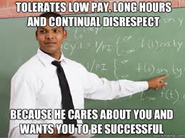

Slide 18
Cecilia’s Top 5 Survival Tips
1
NEVER, EVER TOUCH A STUDENT!
2
ALWAYS report any information that involves a student being hurt emotionally and/or physically!
3
When in doubt or in an uneasy situation CALL FOR HELP!
4
REFRAIN from posting student pictures on your personal social media!
5
MAINTAIN confidentiality and secure student/staff data at all times!

Slide 19
1. You are representing Palomar College, Grant Funded Student Programs, the Director, Dean and VP (within Student Services), the USED, federal grant programs, and many others-please own this responsibility with the utmost of integrity, humility, and learned professionalism.
Calvin One Deer’s Top Ten List of UB SRC Staff Edicts
2. You are working with Minors…children…young people under the age of 18…and therefore every consideration of their welfare should always be uppermost in your mind, whether for one individual or the whole group...supervision, discipline, and teachable moments are constants.

Slide 20
Edicts continued …
3. You are a member of the team...each team player has a role….or spot/base…and go the extra mile or offer assistance as the team needs it….there is always a team leader…and direction(s) should sought and or followed…as given..and team players work together.
4. You are a college para-professional, an up and coming leader and your skills, abilities, and competencies of “20 years +” must be used, utilized, tested, challenged, and refined…be an assertive leader..take the initiative, take charge, volunteer, offer to lead, rise to the occasion, be on top of your game, be ahead of the pack, be in front of the action…so LEAD and teach.
5. You are leader, role model…the students will watch everything that you do, say, and act/react to, so be conscious of your behavior at all times…and use social protocols above theirs…so they learn from you…not the opposite (don’t try to be like them…so they like you)…be positive and visionary.
6. You are paid to do a job…do your job with excellence…and do not let down time…plague you...there is always something to do...or students to talk with…and their can always be an agenda...or make one…add icing to the cake…you are also a teacher/professor…and tutor...you will instruct/teach.

Slide 21
Continues
7. You are an adult. Please act like an adult at all times. Any behaviors unbecoming of an adult, or any immature actions, with yourself, each other, or especially with students will result in immediate disengagement and unemployment, and negative referral on your job records.
8. You are staff member...to help students...you should always be concerned about helping students…whether in class…observing or teaching, or in the dorm, or on the field trip…what are you doing to advance the students.
9. You are a security guard/life guard…safety and security is critical to our groups...students are never left alone…staff should always know where each other are...and stay in communications...and students’ safety should be considered for every single activity or program.
10. Refer to #1 it is that important that it is stated twice. And, as UB SRC staff, you are in “loco parintes”, and you are in place of the director…you have a huge responsibility for human lives, student learning, and a safe environment...please know when the director is not present, you should act and react as if you are the Director…and always work closely with the Lead Staff. And, remember, to be a friend to the staff, supervisors, and the students.

Slide 22
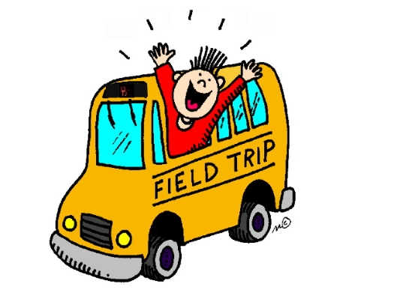

Slide 23
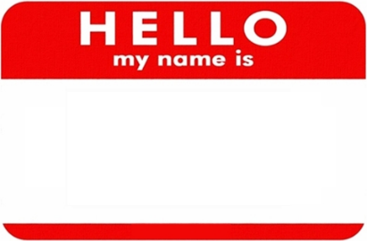
The Day of Fieldtrip:
IVANCITO
All attending staff meet review agenda and responsibilities and logistics of fieldtrip.
ALL staff & student attire: You MUST wear GU shirt and name badge.
Jeans
Comfy shoes (no heels-you will be walking around all day)
ALL students must have a pre-printed name tags.
Have clipboards for ALL staff with an agenda, roster of students, and maps.
Take LOTS of Pictures!

Slide 24
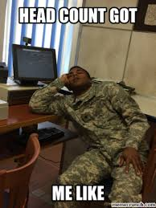
The Day of Fieldtrip continued :
In buses- group leaders should be spread out on the bus and supervise students
ALWAYS do head counts throughout entire trip

Slide 25
Check Out Procedures
Important: Students must be sign out by parent or someone else listed on permission slip.
Person must show ID.
You cannot leave student if he/she hasn’t been picked up.

Slide 26
Safety is The #1 Rule
You are responsible for all bodies that are part of your group at ALL times!
Follow the rules
Safeguard YOU against the accusations of neglect and abuse
GEAR UP’s goal 1:10 ratio
We DO NOT want to lose a child…YOU will be liable
Students cannot go to restroom by themselves you must accompany them
Always carry a first aid kit in case of an emergency
If students take medication, they need to check in their medications with us and we administer their meds to them

Slide 27
Your Conduct
Remember: you are working
This is a time to:
Mentor
Connect
Build relationships with students
This is NOT a time to gather and socialize with your friends

Slide 28
Activity - Tough Session Practice Problems
“My assignment is due tomorrow. Will you help me do these problems?”
POSSIBLE TUTOR RESPONSE:
"Let's take a look at the type of problem you have. We'll work on something similar, so that you'll be able to do the assignment.”
Remember: It is not your job to do students' homework assignments. If you do, the students will not learn how to do the work on their own. Waiting until the last minute to do assignments may also be a sign of poor time management skills. If appropriate, suggest a "Time Management" workshop or coaching session.

Slide 29
“I've already done my homework. I just need you to check it for me.”
POSSIBLE TUTOR RESPONSE:
"Well, you know, we don't proofread assignments. But, I'll tell you what I can do. If you'll show me the areas you're worried about, we'll discuss those problems in general and take a look at your book. Then, you can check your homework.”
Remember: It is not your job to make sure that everything a tutee turns in is perfect. Helping students with specific homework problems is not what you were hired to do. Review similar homework problems and help the student develop the critical thinking skills necessary to do his/her homework assignment independently. Tutees must learn how to check their own work and how to have confidence in the answers they give. If they can do this, they will:
Be able to defend their answers.
Understand more completely.
Develop better self esteem.
Become more independent.

Slide 30
"I've written this paper that I have to give in Spanish to my class. Will you help me?" (Translation: "I did get it written in English, but I can't write it in Spanish. Will you do the translation for me?")
POSSIBLE TUTOR RESPONSE:
"You've gotten off to a good start. You have the paper written. Do as much of the translation as you can. I can't do that for you. But, once you've done as much as you can, right or wrong, then I'll see what type of problems you're having. We'll work on those areas. Then, you can go back and finish your paper."
Remember: It's not your job to do students' assignments. You cannot be with the student forever. They need to learn how to do work on their own.

Slide 31
“Come on. Help me out here. I need you. I can't come during your scheduled times. Can't you make an exception for me?”
POSSIBLE TUTOR RESPONSE:
"I know how tough it is. With my classes and work, I rarely have any spare time either." "Have you considered forming a study group with others in your class" “Have you checked to see what your instructor’s office hours are?"
Remember: It's really hard to say no - especially to someone who considers you as their source of help. Although it is difficult, saying no will help the tutee take responsibility for his/her own learning. You should not be the sole resource for your tutee.

Slide 32
“This instructor is really crazy. She won't even listen to reason. I think she's out to get me.”
POSSIBLE TUTOR RESPONSE:
"Sounds like you're having a bad time. I'm sorry you're finding it difficult to succeed in this class. Perhaps you could show me some of the problems you are having difficulty understanding. I may be able to help clarify them for you. We may also need to review how you are studying for this class. You may have to invest more study time so that lectures are more meaningful and less stressful."
Remember: Regardless of how an instructor is performing, it will not help the student by complaining with them. The student will still have to find a way to understand the material and pass the course. Avoid talking about instructors. Students sometimes use this as an excuse for doing poorly. The more you help them find ways to learn effectively, the less dependent they will be on learning ALL the material through lectures and class time.

Slide 33
“Nothing works. I just can't get it. I study all the time. I don't know what to do.”
POSSIBLE TUTOR RESPONSE:
“Let’s take a look at the list of available workshops on study skills. Maybe one of them would be helpful. Or you may want to make an appointment with a study skills coach to discuss your particular situation.” “If you want, you can take a quick test to determine your learning style. Once you know whether you learn better by seeing, or by doing, or by hearing, we'll both be able to figure out study strategies to help you. Then, we'll take a look at your book.”
Remember: Sometimes the students really are studying, but in a non-beneficial manner.

Slide 34
Difficult Scenarios
Scenario: The student is forced to be there. While most students are here of their own choosing, occasionally, a professor will require a student to come to the UCLA for extra credit points or as part of a contract with the student. When students are required to do something, they may react negatively. In a counseling setting, it is not unlikely that a client may become angry at whomever they have to meet with, even if that person did not set the requirement. Similarly a student who is required to visit a tutor may resist a tutor’s attempts to engage in any conversation. The student hopes he/she can leave as soon as possible.
What to Do: Empathize about being forced to do something. Let the student know that you too have been in situations you were forced into and that you felt the same way he/she does. Try to help the student see that as long as they are here, you would like to help them make good use of their time.

Slide 35
Scenario: This subject is not important to this student. Many students see some of their courses as something that has little to do with their lives or their future careers.
What to Do: Acknowledge the lack of interest in the subject area and try for a small success. Acknowledge the student’s attitude as something many individuals share. Try for a small success and talk about when the student might need this information or skills. Unless the student can see the importance of the material, the probability of changing his/her attitude is unlikely.

Slide 36
Scenario: The student may be anxious about revealing ignorance and he/she may be nervous about being critiqued. Students may be apprehensive when coming to visit a tutor. When we have no idea what’s expected of us and we feel shaky about whether we are going to be ridiculed or asked to demonstrate what we don’t know, we do sometimes respond by withdrawing until we can get a better handle on what’s happening or figure out how we can retreat from the situation with minimal embarrassment.
What to Do: Help the student talk about his or her fears. Try to establish an atmosphere of trust, perhaps by being friendly, and explaining that you are not a teacher and that your job is to help and to listen. Invite the student to talk about his or her anxieties. Empathize and reassure the student that these fears are not uncommon and can be overcome.

Slide 37
Scenario: The student is overwhelmed by other concerns. The student may have just found out that he/she is running out of financial aid, learned that he/she did not perform well on a test, or had a fight with a close friend. Students bring with them a variety of other problems and worries and disappointments that affect their ability to attend to what’s going on in the tutorial.
What to Do: Reschedule for a better time or listen and move on. Ask the student if he/she would prefer to reschedule for another time. If you are comfortable, ask the student if he/she would like to talk about what is bothering them. A few minutes of conversation are likely to help clear the air and ease the student’s frustrations. If you sense that the person starts bringing up other problems because he/she has found a listening ear, it is likely the student has decided to use the time as a support session in which to air his/her troubles. One strategy to get back to work is to acknowledge that you have heard the student and that it is time to move on. For example, “Wow, it sounds like this has been a crazy week for you. Let’s try to focus on this chapter so you have one less thing to worry about. How can I help you with this topic in our remaining time?”

Slide 38
Scenario: The student doesn’t have the language to talk about his or her problems. Effective resolution of difficulties in a course requires the ability to detect problems and develop a strategy to solve those problems. The students who come to see you often do not have these abilities. Therefore, they do not know how to explain to someone else what they would like to work on. These students are likely to come in frustrated and unable to say more than, “I don’t understand,” or “I need help.” They sit in silence because they do not know what to say or how to say it.
What to Do: Offer the student some questions he/she can ask herself.
“Could you tell me where in the problem you start to have difficulty?”
“Do you think you lack information from a previous section?”
“Are you wondering if your work doesn’t meet the assignment?”
You might have to keep listing questions and problems that the student might have until something triggers a response from the student.

Slide 39
Scenario: The student is simply a very quiet person. Some students are naturally shy or quiet, and they are not given to a lot of chatter or small talk. Introverts prefer to deal with the world by taking things in and reflecting on them quietly.
What to Do: Give the student some quiet time to think and work. Ask the student if he/she would prefer to work some problems by himself/herself while you work with another student or look over your notes. Assure the student that you will come back to continue working together. Set a specific task for the student to accomplish.

Slide 40
Scenario: The student knows that if he or she shuts up, the tutor will do all the work. These students wait for the tutor to tell them what to write, how to fix their assignment, or maybe – if they sit silently for a long period of time – the tutor will do the problem for them. In large lecture settings, these students have learned to be quiet and wait for the instructor to tell them what to do.
What to Do: Try minimalist tutoring. Try to ask questions that indicate you are interested in the student’s knowledge on this subject. Avoid answering your own question if the student does not respond. Instead, give the student plenty of time to answer. If there is still no response, show the student where to find the answer, but don’t answer for him/her.

