Slide 1

GOVERNOR’S
JANUARY PROPOSAL
2021-2022 State Budget
Notes:
Economy has recovered from the pandemic much faster than originally anticipated, state revenues are more robust than what was projected 6 months after the Budget Act was enacted.
The State’s budget augmented by a significant infusion of federal aid from the second trance of COVID relief funds from Washington DC

Slide 2
2021-2022 STATE BUDGET UPDATE
The 2020-21 State Budget went from a planned $5.6B surplus to a $54.3B deficit within two months as a result of the pandemic
LAO’s Fiscal Outlook shows revenue growth surpassing the original expectations
Economic recovery resulted in stronger than estimated revenue from the “Big Three” taxes for 2021-2022 (Revenues are estimated at $4.2 billion more than 2020-2021 and $2.8 billion than prior year’s Governor’s Proposal)
Augmented by Federal Stimulus 2.0
Prioritizes urgent needs in the context of COVID19, focusing on student basic needs, reducing equity gaps, stabilizing critical programs and services, and accelerating economic recovery and job creation
Outlook improved but uncertain (Despite higher revenues, state faces $6B operating deficit)
Notes:
Economy has recovered from the pandemic much faster than originally anticipated, state revenues are more robust than what was projected 6 months after the Budget Act was enacted.
The State’s budget augmented by a significant infusion of federal aid from the second tranche of COVID relief funds from Washington DC

Slide 3
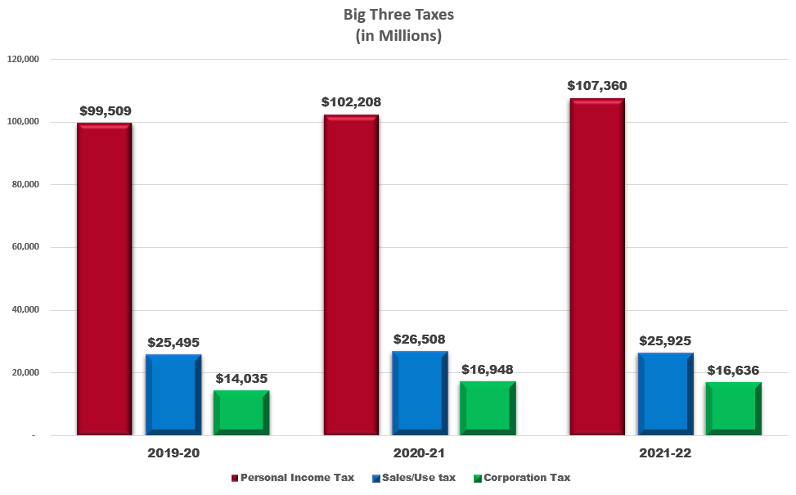
ESTIMATE FOR THE BIG-THREE TAXES

Slide 4
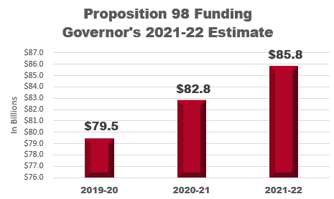
2021-2022 STATE BUDGET UPDATE
Proposition 98 for K-14 Increases to $85.8 Billion
California Community Colleges Only
Around $600 million in funding for one-time and ongoing programs and initiatives
Repays $1.13B of Deferrals (2/3 of $1.45B), carrying over a remaining deferral of $326.5M in 2021-2022
“True-Up” of SCFF 2019-20 through 2021-22
Notes:
The Budget’s improved Revenue estimate resulted in the highest funding ever of Proposition; Proposition 98 provides Minimum Guarantee for schools and CCs, but the Governor and Legislature determines the allocation
The Governor’s Proposal also directs a significant portion of additional funding to Help stabilize districts by paying down 2/3 of deferrals implemented last year, $1.1 billion
DOF estimates Prop 98 – Covers 3 years
One of the most notable critique of the Governor’s proposal is that it doesn’t sufficiently address payment deferrals and growing pension obligations

Slide 5
2021-22 CCCs BUDGET HIGHLIGHTS
SCFF APPORTIONMENT AND ENROLLMENT
SCFF Hold Harmless in effect through 2023-24
$111.1M COLA of 1.5% (Approx. $1.7M for Palomar*)
$23M FTES Growth
COLLEGE AFFORDABILITY AND STUDENT ENGAGEMENT
$250M One-time Student Emergency Assistance Grants; Proposal for all HS Seniors to be required to complete the FAFSA
$100M One-time for basic needs related to food & housing insecurity
$20M One-time for a System-wide effort to provide PD for faculty
$20M One-time for student retention and re-enrollment strategies
$2.5M One-time to provide instructional materials for Dual Enrollment
$30M Ongoing for Mental Health Services & Student Technology Access
$10.6M Ongoing for Distance Learning (Online Education Infrastructure)
OTHER PROGRAMS
$355.8M increased Prop 51 Bond funds ($353.6M in construction phase)
$6M for 1.5% COLA for Categorical Programs (DSPS, EOPS, etc.)
$15M Ongoing for CAI, One-time $10M for Work-Based Learning
*See Condition next page
Notes:
No changes to SCFF at this time.
The Budget proposes early action for CCs to provide Emergency Financial Assistance and to re-engage students who have dropped out during the pandemic
Bond Funds for 1 new project, and 17 continuing projects – Funds are from Prop 51 approved by voters in 2016
The Budget also focusing on workforce retraining, especially those who are unemployed. The budget includes 15M for CAI – build stronger linkages between higher education and gainful employment as CCCs are best suited to support displaced Californians to return to work

Slide 6
2021-22 CCCs BUDGET HIGHLIGHTS
“CALL TO ACTION”
$600,000 One-time for CCCCO to coordinate antiracism efforts in the curriculum
Focus on alignment of Ethnic Studies requirement for CSU (AB1460)
CONDITION FOR RECEIVING THE COLA
Districts to draft actionable plans to close equity gaps
Few details, more information may be included in trailer bill language
OTHER ACTIONS
Requires higher proportion of online courses (10% higher than offered in 2018-19)
Notes:
Budget provides $600K one time for the coordination of systemwide antiracism efforts and for the implementation of the new ethnic studies requirement in the CSU

Slide 7
2021-2022 CCCs BUDGET HIGHLIGHTS
HEERF 2.0 CORONAVIRUS RESPONSE AND RELIEF SUPPLEMENTAL APPROPRIATIONS (CRRSA)
$82 billion for Education; $22.7 billion for California HEERF; At least $1 billion to CCCs; $17M for Palomar College
“Hold Harmless” for Student Aid – No less than $3.8M CARES
Defray pandemic related expenses, including:
Loss revenue
Technology Costs
PD Trainings
Reimbursement of District incurred expenses
Student support activities addressing pandemic related needs
Financial Aid grants to students for tuition, food, housing, health care, child care

Slide 8
STATE REQUIREMENTS FOR APPROVAL OF LOCAL BUDGETS
District is required to:
Adopt a Tentative Budget by July 1
Hold a Public Hearing and Adopt a Final Budget by September 15
Complete Annual Budget and Financial Report by September 30
Submit the CCFS-311 Report to the CCCCO by October 10

Slide 9

THANK YOU
Carmen Coniglio
Senior Director, Fiscal Services
www.palomar.edu/fiscal_services

