Slide 1
Palomar College
Fire 51
Sample Application

Slide 2
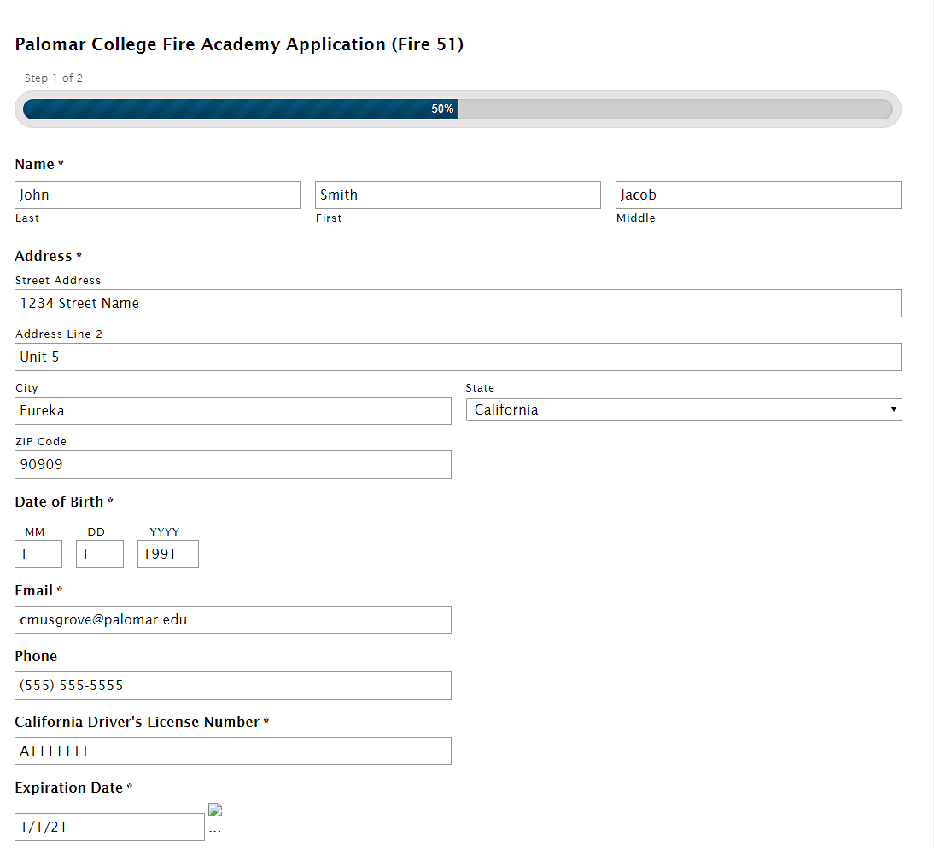
Fill out all required information (designated by a red asterisk)

Slide 3
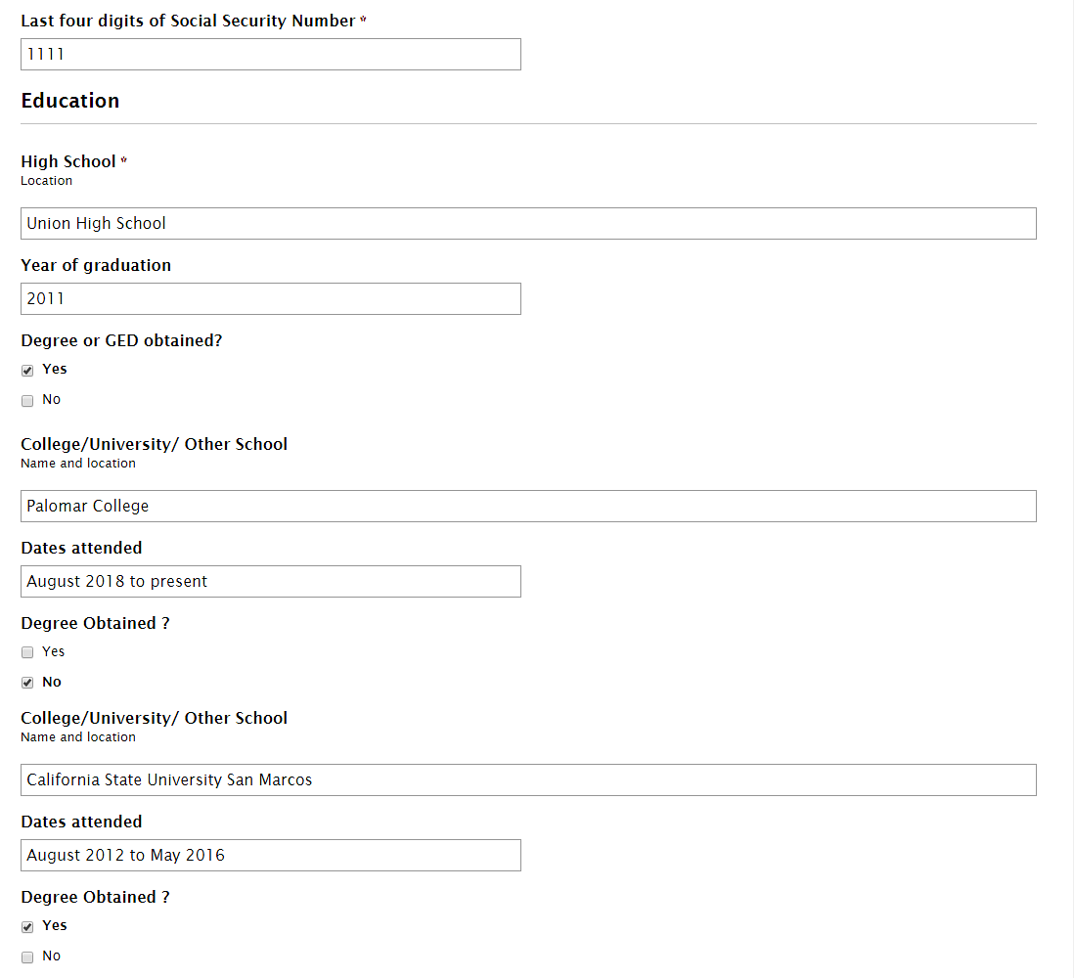
Make sure spelling is correct and boxes are filled in completely

Slide 4
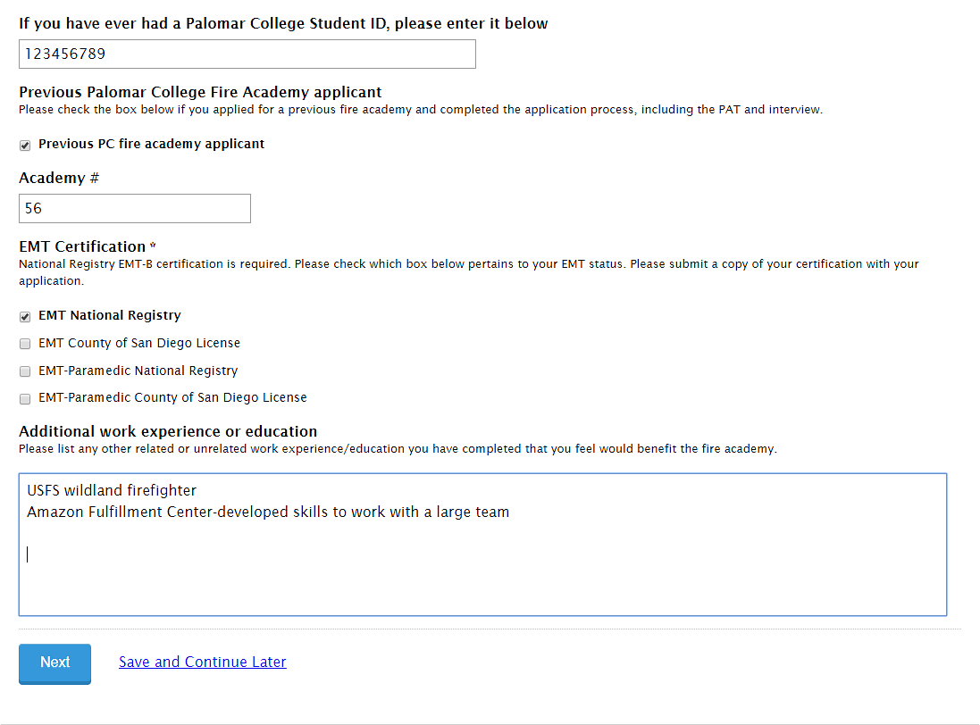
Pay attention to all questions and answer completely. For EMT, check all applicable boxes

Slide 5
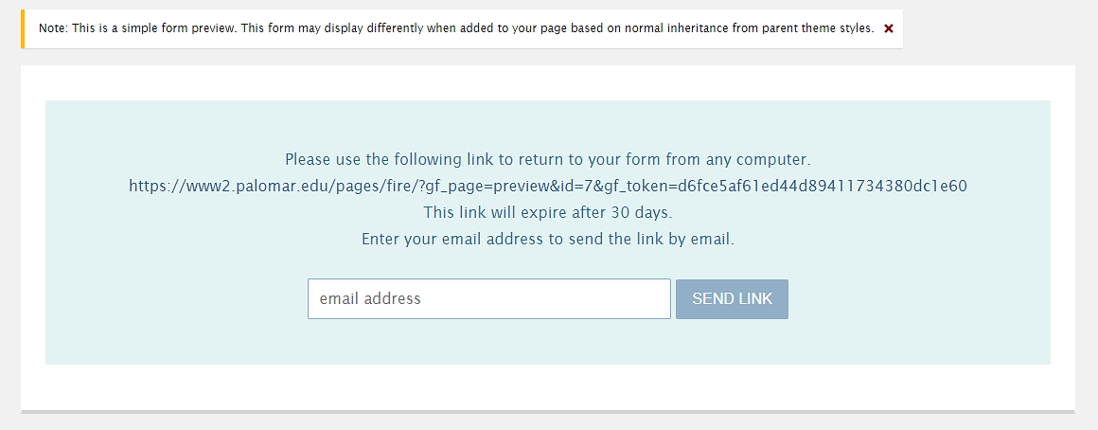
You may resume your application later by providing an email address to receive a link to continue

Slide 6
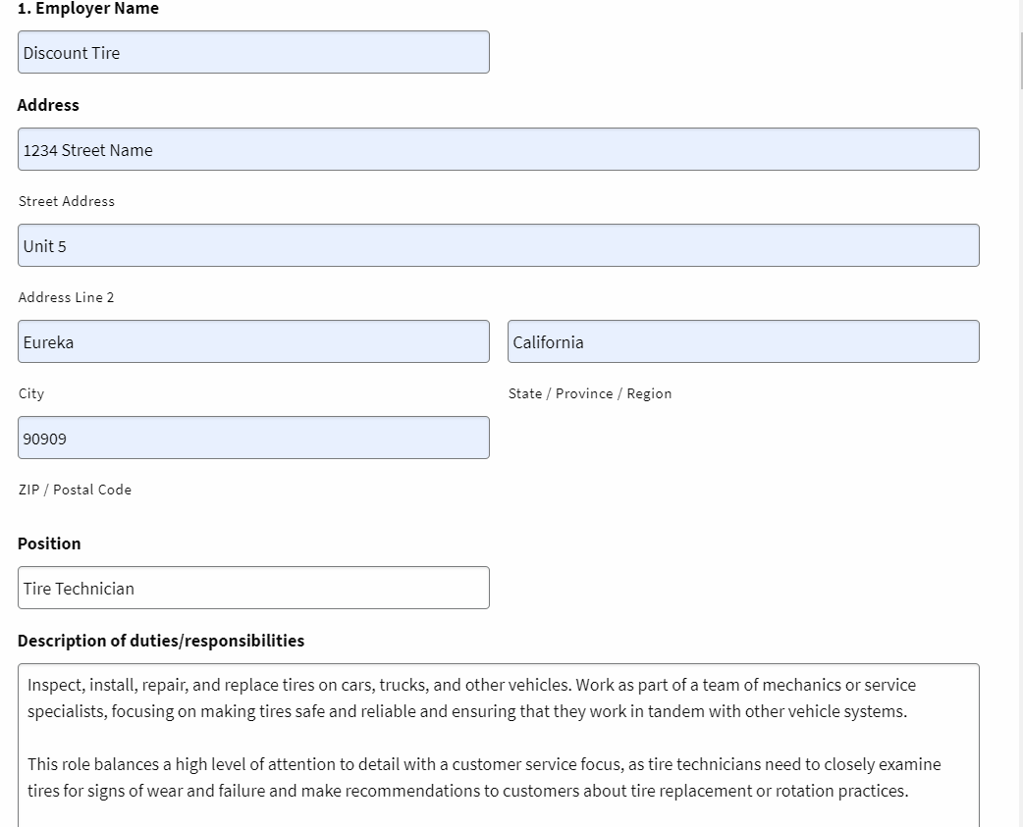
Fill out all boxes of Employer section.
(continued on next slide)

Slide 7
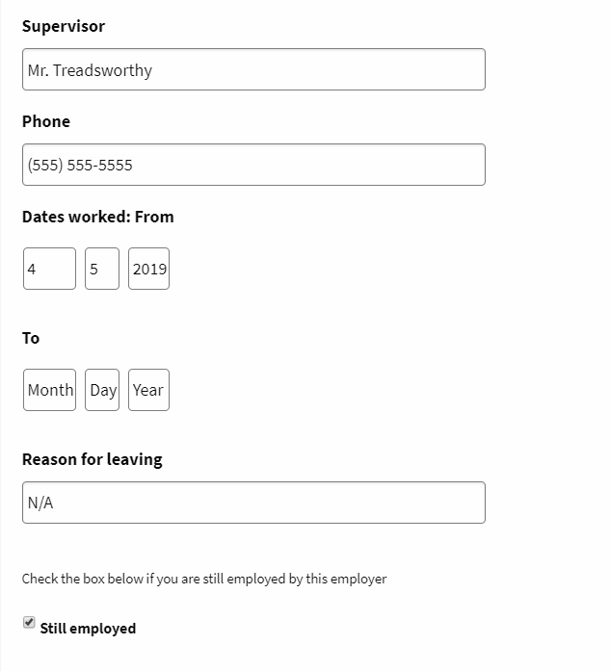
List all employment, beginning with most recent

Slide 8
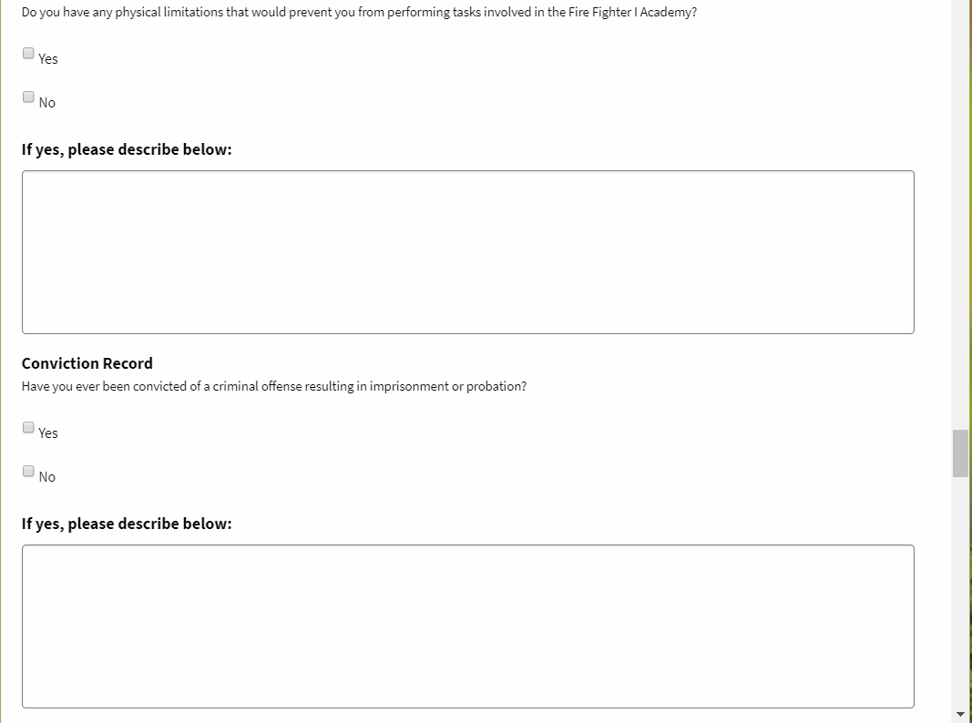
This section is straightforward; answer completely

Slide 9
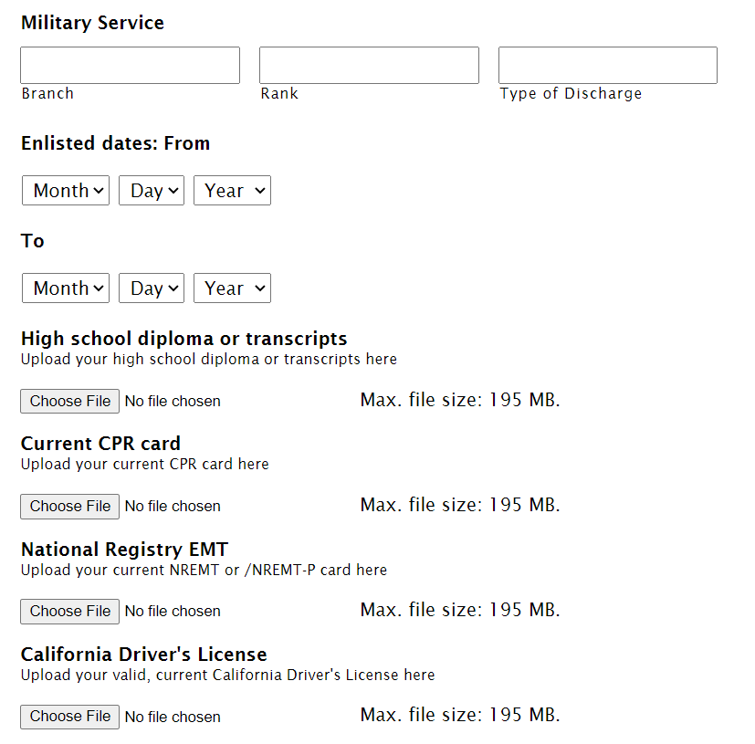
Upload required items in this section

Slide 10
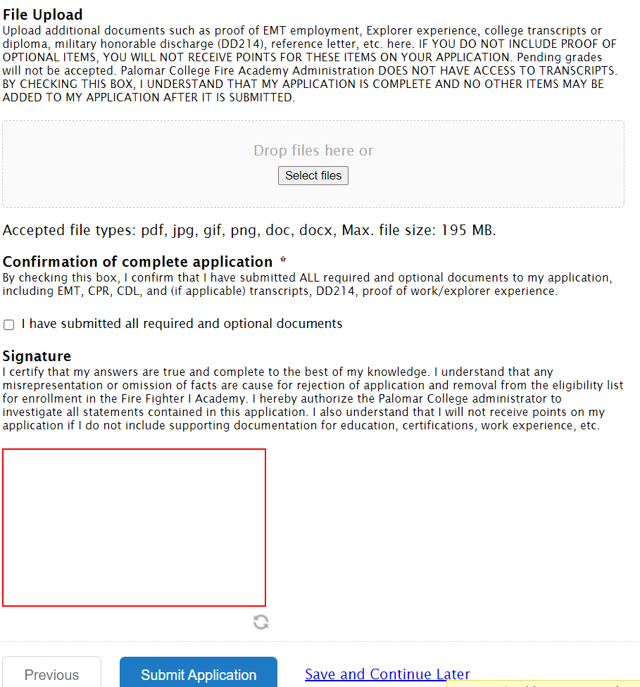
Upload additional documents and sign the application

