Slide 1
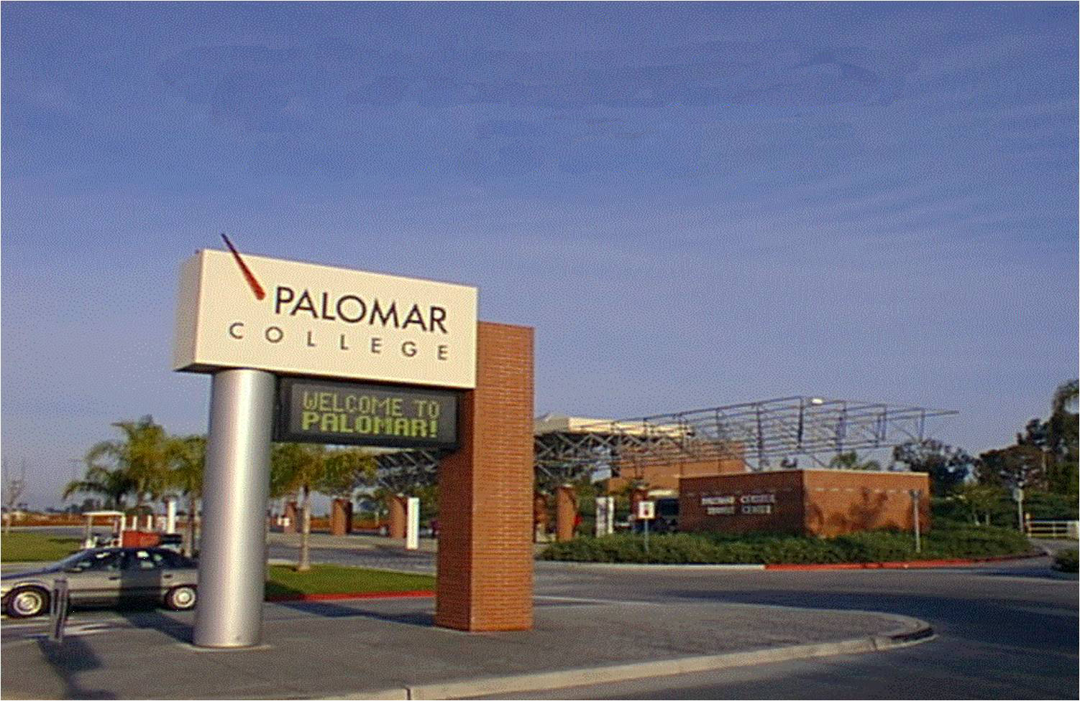
Campus cart Safety Palomar College

Slide 2
ADOPTED BY THE 1990 SAFETY & SECURITY COMMITTEE
All Persons operating Carts
All Departments
SAFETY FIRST !

Slide 3
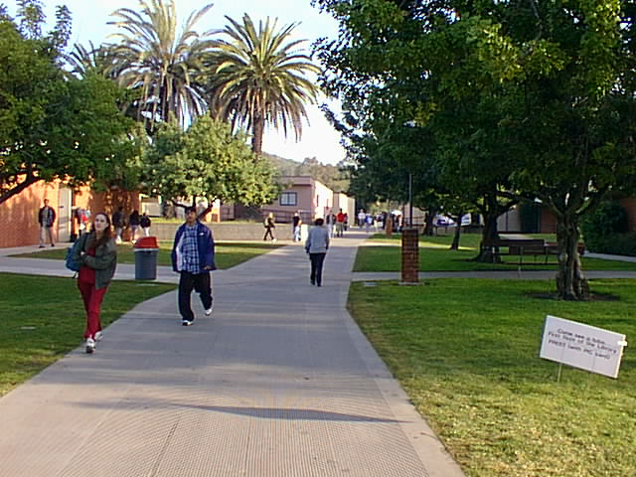
UPON COMPLETION:
You will take a quiz.
You will provide a copy of your driver’s license.
EH&S will go over the answers.
You will receive a Cart Operators Certification Card.

Slide 4
OBJECTIVES
Procedures for operation
Proper maintenance
Safety rules
Restricted areas

Slide 5
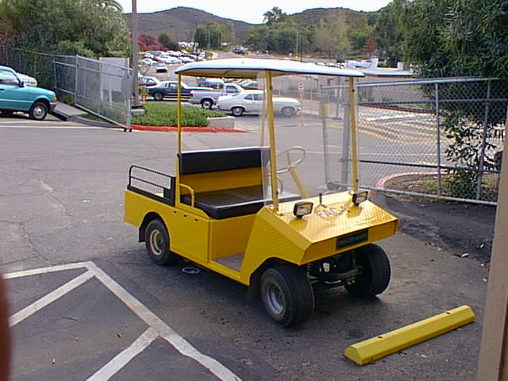
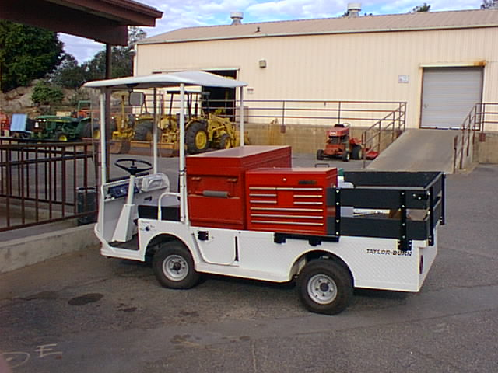
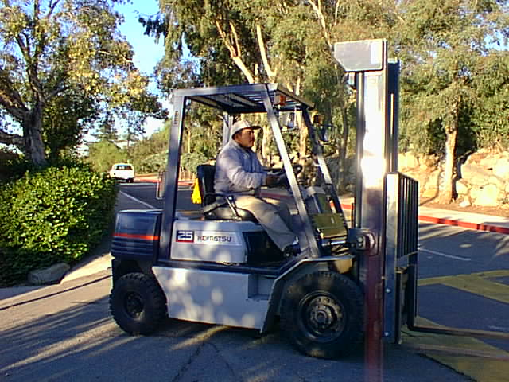
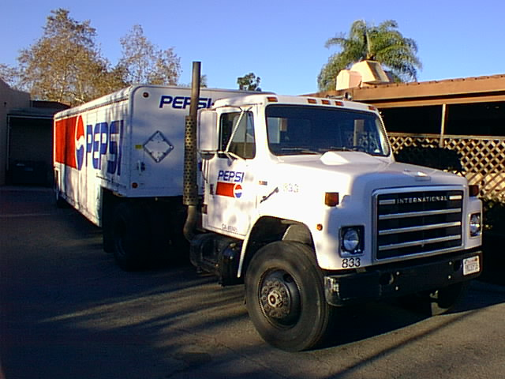
“VEHICLES” INCLUDE...

Slide 6
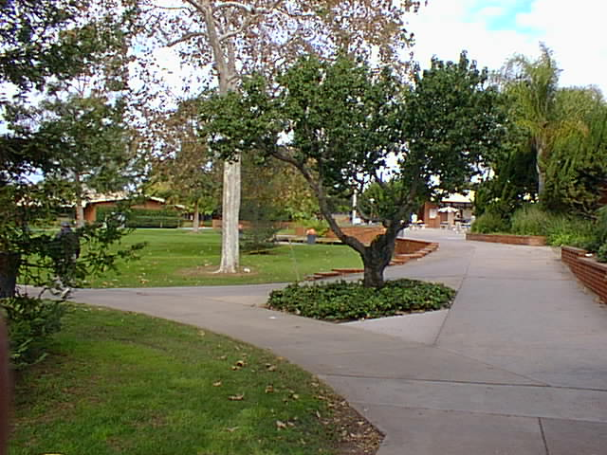
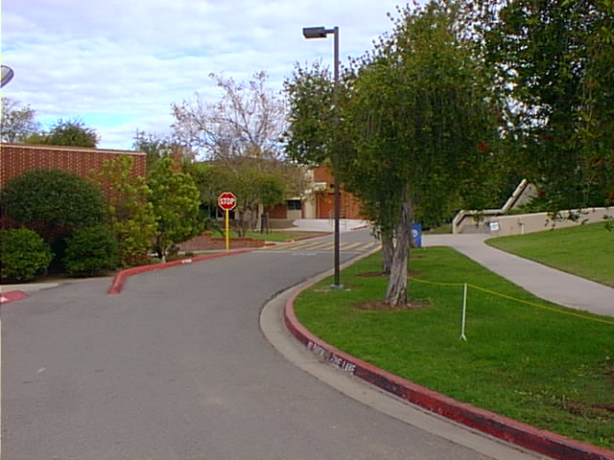
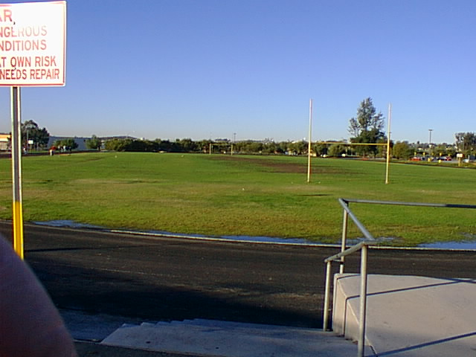
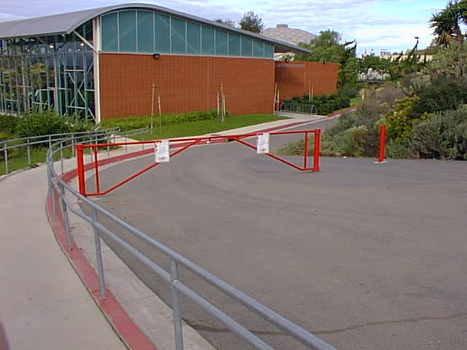
DISTRICT PROPERTY INCLUDES...

Slide 7
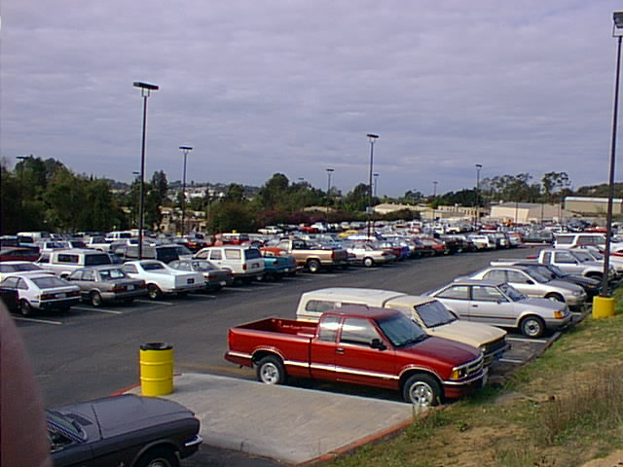
PARKING LOTS AND ROADWAYS

Slide 8
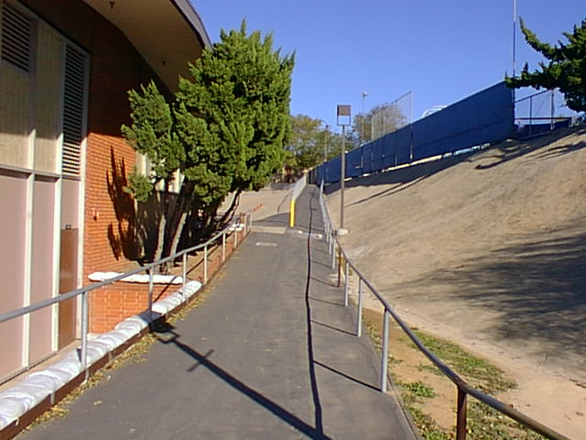
SERVICE ROADS

Slide 9
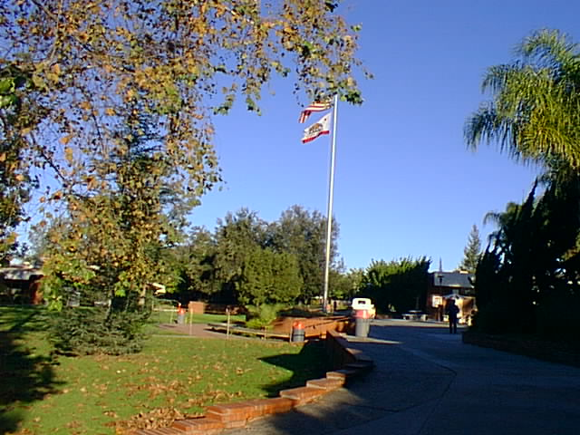
VEHICLE ACCESS
Maintenance Vehicles
Vendor Vehicles
Special Event Vehicles
Privately Owned Vehicles

Slide 10
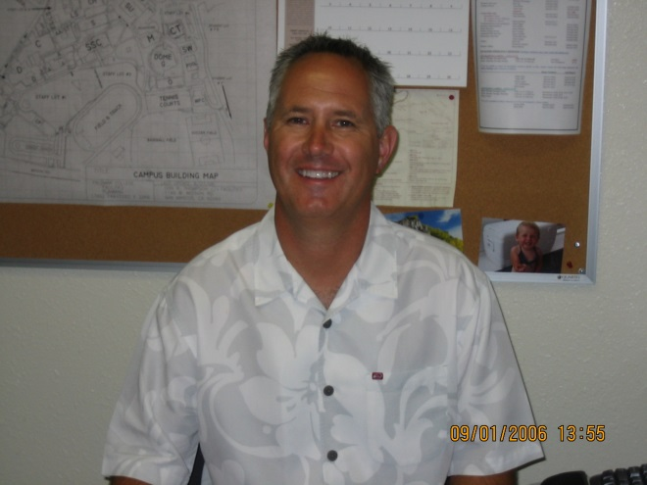
WRITTEN PERMISSION
Have an escort.
Travel at a normal walking pace.
Assume responsibility.
Do Not travel on the lawns.

Slide 11
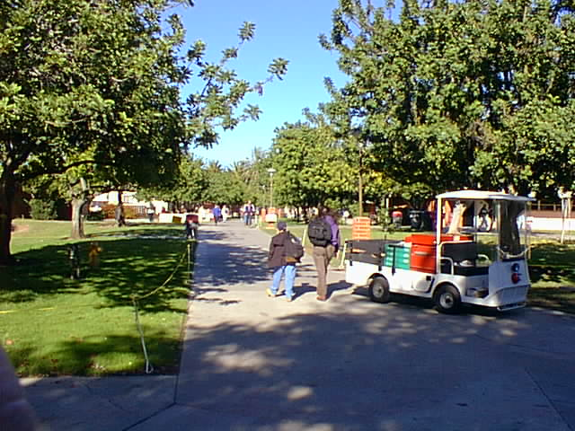
Always give the right of way to foot traffic.

Slide 12
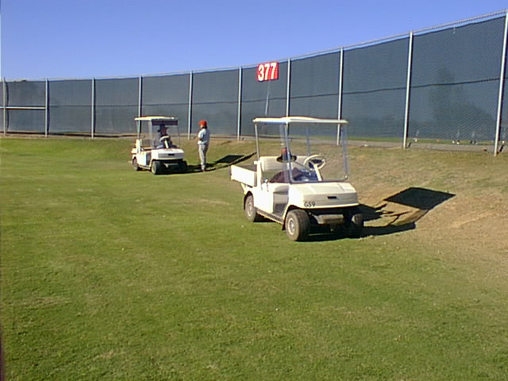
SPECIALLY EQUIPPED VEHICLES ONLY.

Slide 13
ENFORCEMENT
Verbal warning.
Written reprimand.
Suspension of driving privileges.

Slide 14
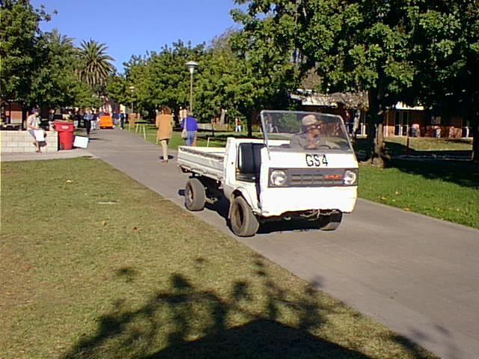
PROPER OPERATION
Basic Operation
Maintenance
Restricted Areas

Slide 15
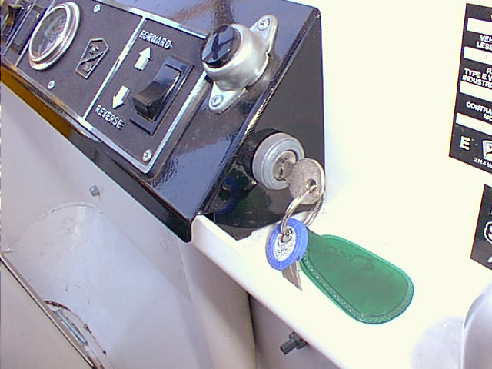
OPERATIONAL KEY SWITCH

Slide 16
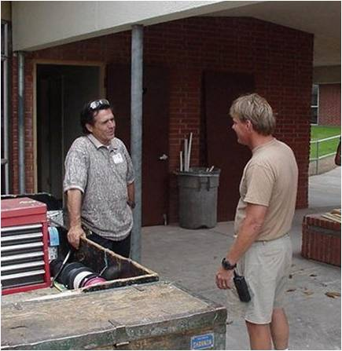
BRAKES
Report faulty brakes to your supervisor immediately.

Slide 17
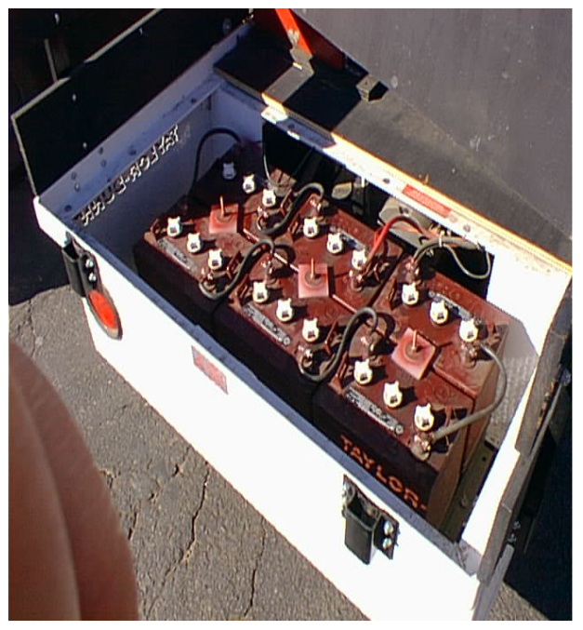
BATTERIES
Do Not touch HOT components.
When Exiting, leave switch in neutral position.

Slide 18
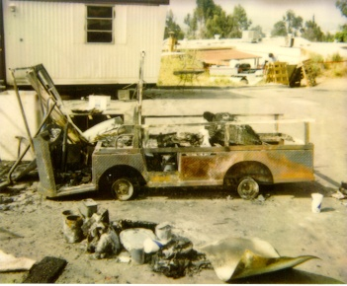
Never Store Flammables On Your Cart!

Slide 19
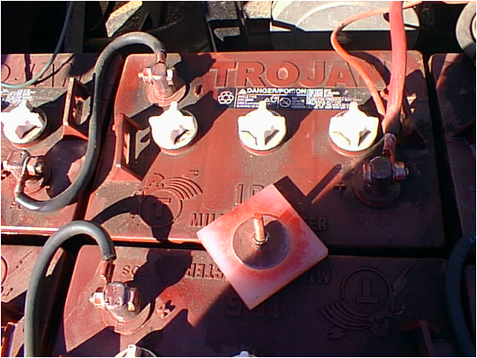
ELECTRICAL CONNECTIONS
Check for Corrosion.
Arcing Terminals.
Low Battery Water.
Cracks or Leaks.

Slide 20
GENERAL OPERATIONAL CHECKS
Is acceleration smooth?
Is the steering tight or loose?
Are the wheels loose?
Do the brakes function properly?
Any unusual smells?
Do the lights work?

Slide 21
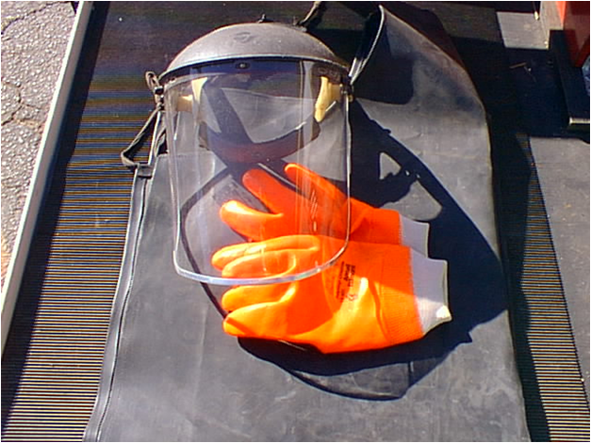
SAFETY ALERT !
Battery acid is highly corrosive!
Always wear protective gear!
Know where the closest eyewash station is located!

Slide 22
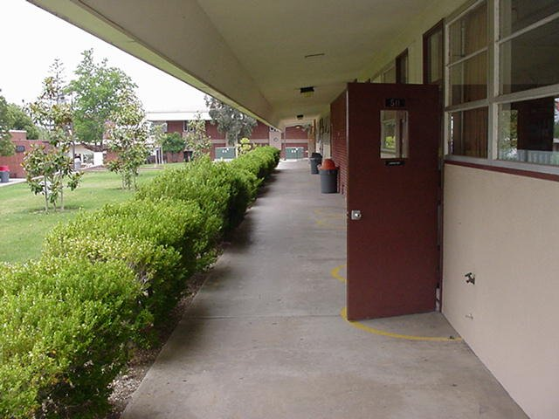
GENERAL SAFETY RULES
Always be able to stop.
Watch your speed.
Watch for open doors.

Slide 23
NEVER!
Allow objects to extend outside the cart!
Carry unsecured objects!
Transport passengers without proper seating!
Loan out your cart!

Slide 24
NEVER!
Leave the key in the cart unattended.
Leave tools unsecured.

Slide 25
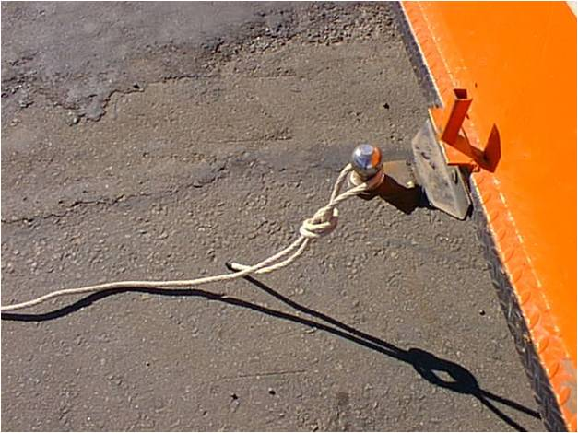
NEVER!
Tow other vehicles with your cart!
(If your cart is disabled, call the cart mechanic, he will make arrangements to have it towed.)

Slide 26
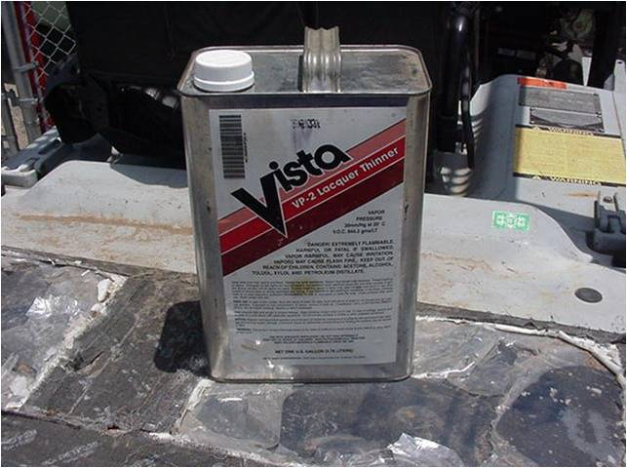
FLAMMABLES:
Transport in proper containers.
Do Not store them on your cart.

Slide 27
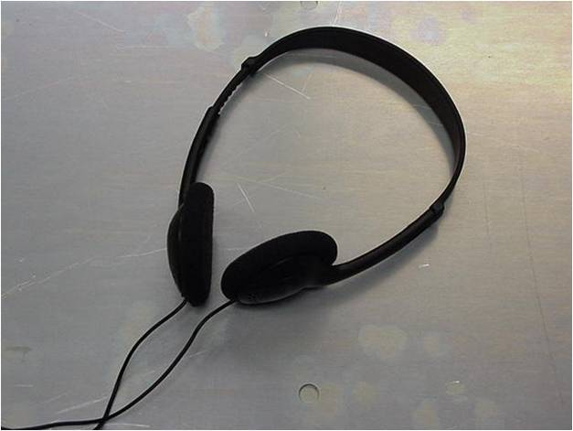
NEVER
Operate a cart while wearing earphones, earplugs or headsets.
Talking / Texting on your cell phone.
Talking on your portable radio.
Drive an unsafe cart.

Slide 28
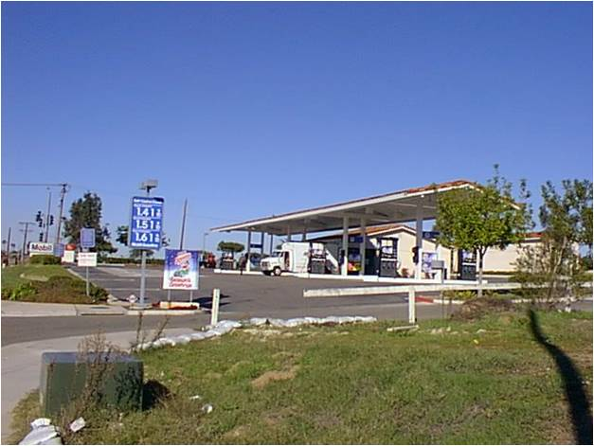
STAY ON DISTRICT PROPERTY
Stay on district property.
Park in closest lot.
Walk.

Slide 29
GENERAL SAFETY RULES
Stay to the right.
Secure all items
Avoid the main sidewalks between 7:30AM & 3:30PM (NOT 1:30PM)

Slide 30
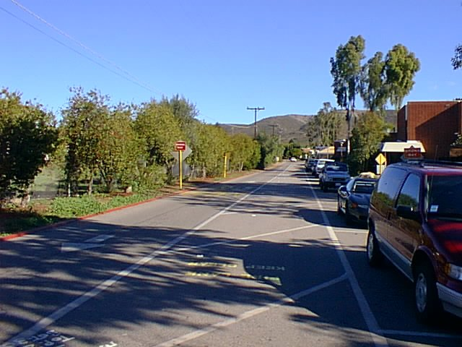
USE FIRE LANES
AS AN ALTERNATE ROUTE

Slide 31
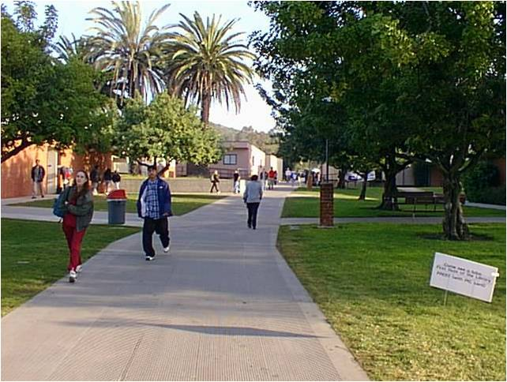
FROM THE WELLNESS TEAM
Good Exercise.
A Chance to see the Campus.
Sometimes Walking is Faster.

Slide 32
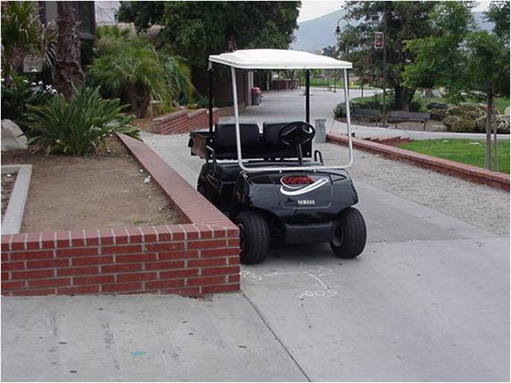
ON THE JOB
Unload tools & materials.
Park & secure your cart at the end of the building.

Slide 33
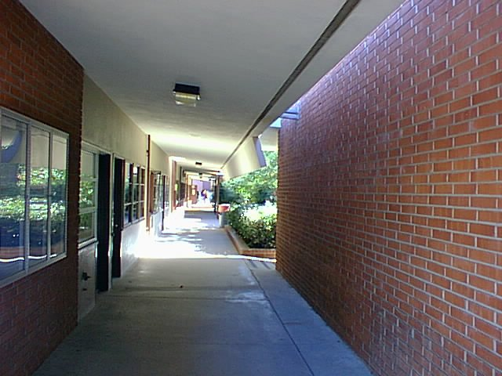
RESTRICTED AREAS

Slide 34
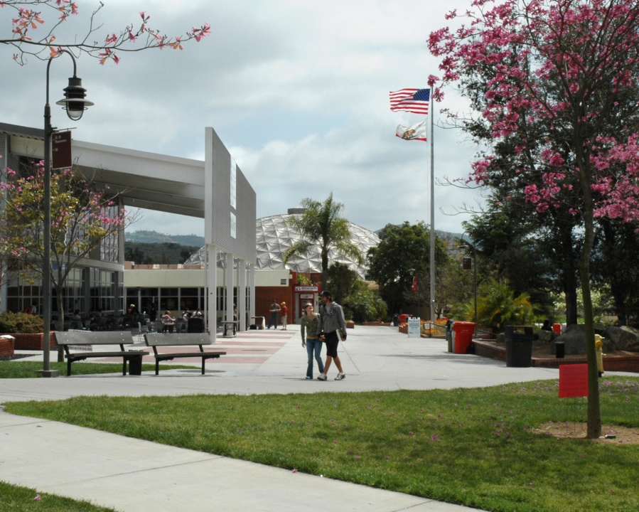
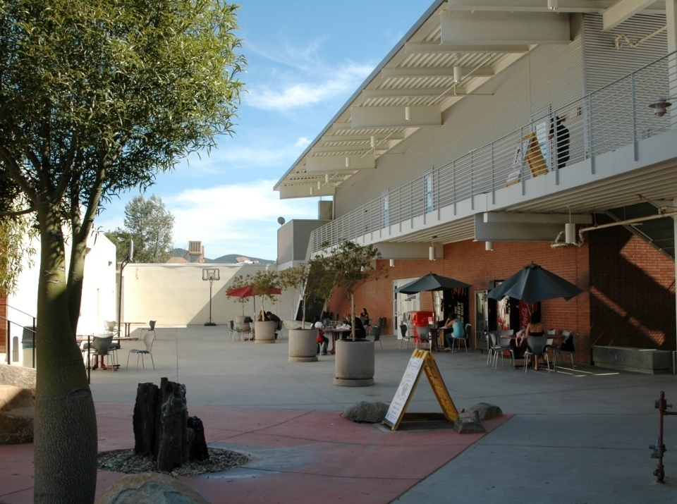
STUDENT UNION

Slide 35
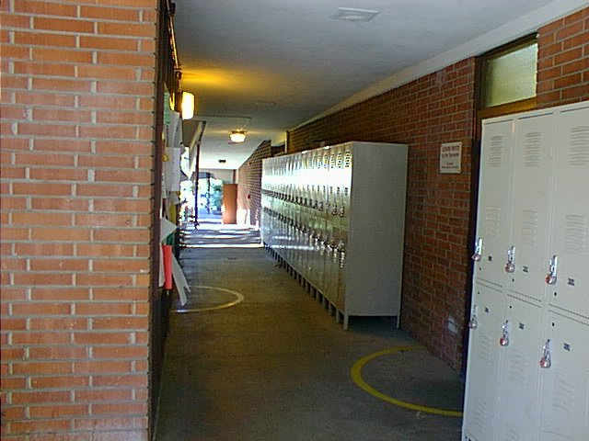
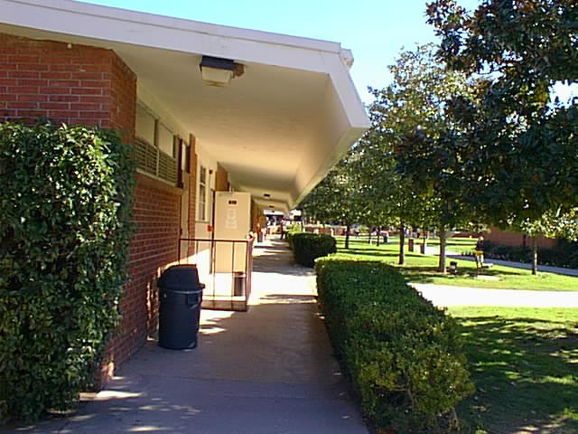
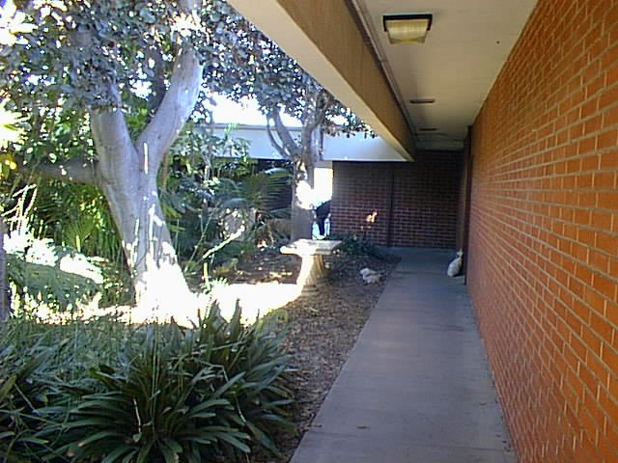
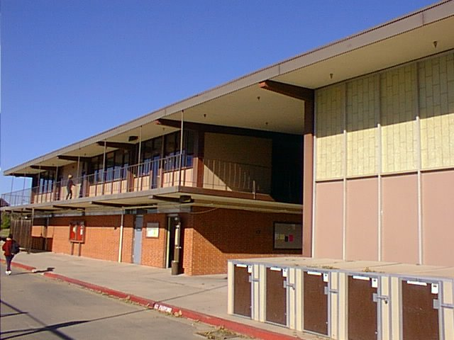
RESTRICTED AREAS

Slide 36
WE’VE COVERED:
Procedures for operating . . .
General cart maintenance . . .
Safety rules . . .
Restricted areas . . .

Slide 37
CART SAFETY QUIZ CLICK ON ADDRESS: http://www.palomar.edu/facilities/pdfs/A09023CartSafetyQuiz.pdf
Don’t forget to provide a copy of your driver’s license to Derrick Johnson, EH&S Supervisor!

Slide 38
DID YOU TAKE THE QUIZ?
If not. Press the letter “P.” This will take you back to the quiz.
If you did, press “Enter” to end the session, or go to the cart safety links page.
http://www.palomar.edu/facilities/pdfs/A09023CartSafetyQuiz.pdf
Thank you

Slide 39
PALOMAR COLLEGE ENVIRONMENTAL HEALTH & SAFETY ALL RIGHTS RESERVED 2001
Written by:
Kelly Hudson-Mac Issac and Don Thompson
Based on the Safety & Security Guidelines of 1990.
Photographs & Narration by:
Don Thompson for the Palomar College EH&S
Produced by:
Kelly Hudson-Mac Issac and Don Thompson
Music:
Festejo, by Jay Leach, from the CD “Beyond Words.”
www.jayleach.com

