Slide 1
Curriculum Orientation and Training
Fall 2015

Slide 2
A Word About the Course Outline of Record
  "While each required course element must be written discreetly, each element should also be developed in light of the other elements, in other words, integrated. For example, there is an interwoven relationship between what the student should be able to do (course objectives) and how this is going to be evaluated (methods of evaluation). Furthermore the objectives must have a clear relationship to the subject or content. The course outline of record should reflect a quality in the course sufficient to attain the objectives."
      -- From "The Course Outline of Record: A Curriculum Reference Guide," The Academic Senate for California Community Colleges, 2008

Slide 3
Purpose of the Course Outline of Record
The course outline of record (COR) is a legal document that must contain certain required elements that are outlined in §55002 of Title 5.
The COR serves as a legal contract between the faculty, student and the college.
The COR ensures rigor and establishes consistency.
The COR serves as a foundation for articulation agreements and C-ID numbers.
The COR clearly lays out the expected content and learning objectives for a course for use by any faculty member.

Slide 4
Planning The Course Outline of Record
Begin with a holistic vision of the course to be proposed.
Determine whether there is a need or rationale.
How is the course appropriate to Palomar’s mission?
  Transfer
  General Education
  Basic Skills
  Career and Technical Training
The COR must reflect a quality of the course to attain the objectives.

Slide 5
Planning The Course Outline of Record
The COR should be integrated, with each element reinforcing the purpose of the other elements in the course outline.
There should be a linked relationship between the objectives and methods of evaluation.
SLO’s should clearly connect to the objectives.
Objectives should be clearly connected to the content.
The course outline must be rigorous and effective in integrating the required components of critical thinking, problem solving, written communication skills, college-level skills, and vocabulary throughout

Slide 6
Course Outline of Record Must Contain all Elements
Unit Value
Contact Hours
Prerequisites, Corequisites or Advisories on Recommended Preparation (if applicable)
Catalog Description
Objectives
Methods of Instruction
Content in terms of Specific Body of Knowledge
Examples of Required Reading, Writing, Outside, and Critical Thinking Assignments
Methods of Evaluation

Slide 7
Elements of the Integrated
Course Outline of Record

Slide 8



Need/Justification/Goals Statement
This statement is submitted directly to the Chancellor’s Office.
It must be appropriate to the California Community Colleges Mission. (California Education Code §66010.4)
  Lower division academic instruction (GE/Transfer)
  Lower division vocational instruction (Career and Technical Education)
  Basic skills
The purpose of the course should be clearly stated.
  For transfer:
    Preparation for the major
    Core requirement for a certificate or degree
    Elective
    General education
  Basic Skills
  For career technical:
    Workforce or labor market needs
    Advisory committee input
If standalone, the course’s role in the college curriculum must be justified.

Slide 9
Units and Contact hours
One credit hour or unit should encompass no fewer than 48 hours of coursework (includes both in class and out-of-class time for student).
The course outline of record should justify or validate these hours relative to the units being awarded.
Articulation agreements and other external factors may need to be considered.
While examples often rely upon using the traditional 3 hours per week to determine a unit, the credit hour or unit is more appropriately defined by hours per course, which more easily allows for alternative term lengths.
A course outline of record that is well integrated will have built a solid case for the number of units being awarded for the learning being achieved by the successful student.
A course requires a minimum of three hours of student work per week, including class time for each unit of credit.

Slide 10
Prerequisites, Corequisites and Advisories for Recommended Preparation
Demonstrate need through one of several methods
  Accreditation mandate
  Assessment/Cut Scores
  Authorized/required by Statute or Regulation
  Courses in Communication and Computational Skills (other disciplines)
  Courses Outside of Discipline (excludes English or Math)
  Health and Safety
  Licensing Agency
  Non-course Prerequisite
  Recency and Other measures
  Sequential Course
  Standard Prerequisite
  Directed Study
Title 5 CCR § 55003
(b) A district governing board choosing to establish prerequisites, corequisites, or advisories on recommended preparation shall, in accordance with the provisions of sections 53200-53204, adopt policies for the following:
(1) the process for establishing prerequisites, corequisites, and advisories on recommended preparation. Such policies shall provide that in
order to establish a prerequisite or corequisite, the prerequisite or corequisite must be determined to be necessary and appropriate for
achieving the purpose for which it is being established.
(2) procedures to assure that courses for which prerequisites or corequisites are established will be taught in accordance with the course outline of record, particularly those aspects of the course outline that are the basis for justifying the establishment of the prerequisite or corequisite.

Slide 11
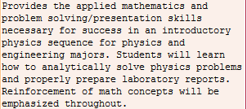
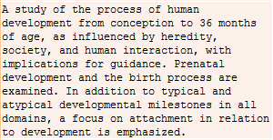
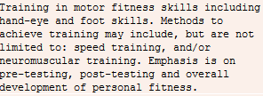
Catalog Description
The course description should be a brief and concise summary of all course content.
The course description should identify
the target audience(s).
Language should convey the role of the course
and distinguish it from other courses.
It is often helpful to compose the description after clear objectives and specific content have been developed.

Slide 12
Course Objectives
Objectives should be stated in terms of what students will be able to do (knowledge, skills and abilities) (4-9 objectives).
Objectives should be concise but complete utilizing verbs reflecting active learning (Bloom’s Taxonomy) with theory, principles and concepts adequately covered.
Objectives should be broad in scope and not too detailed, narrow or specific.
Objectives should clearly connect to achievement of course goals (needs, justification or mission).
The incorporation of critical thinking should be evident throughout all elements (objectives, methods of instruction and methods of evaluation) of the course outline.

Slide 13
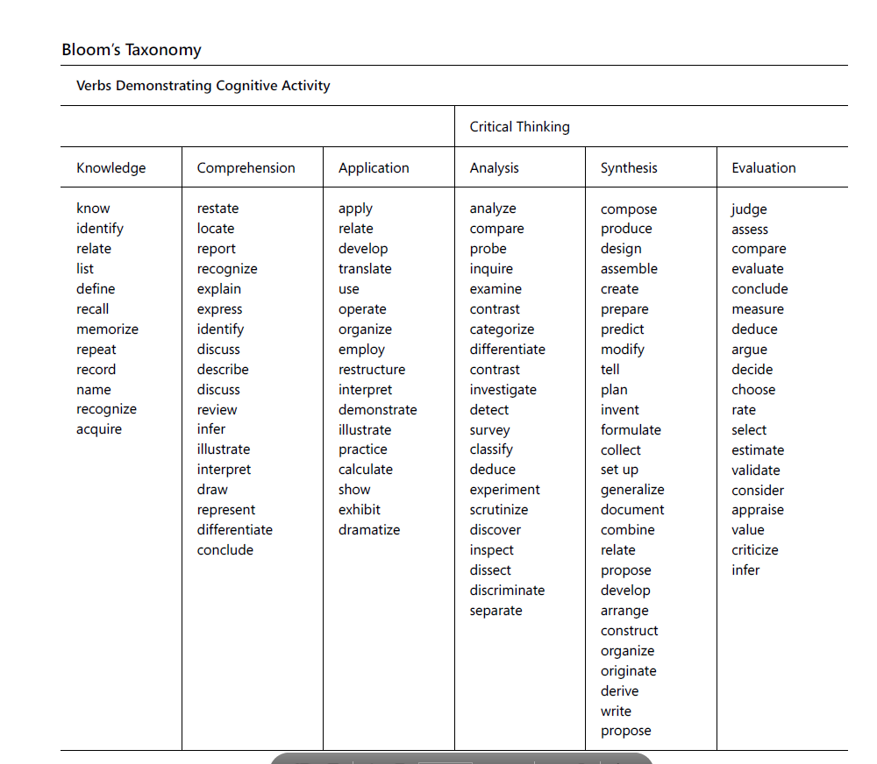
Bloom’s Taxonomy
From “The Course Outline of Record: A Curriculum Reference Guide,” 2008

Slide 14
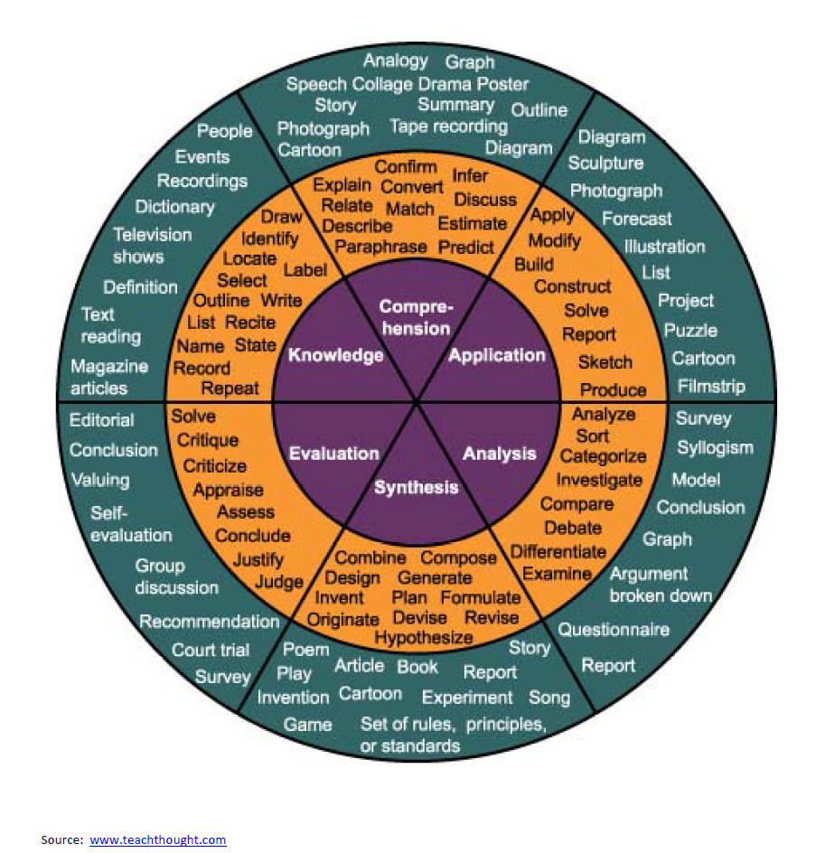
Bloom’s Taxonomy

Slide 15
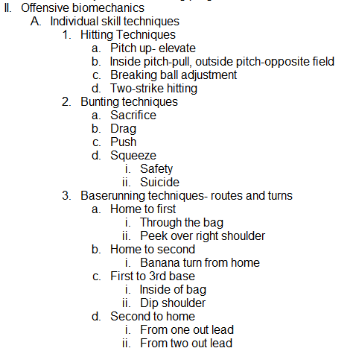
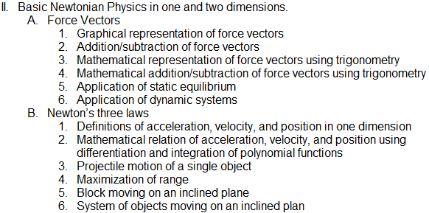
Content in Terms of Specific Body of Knowledge
The content element contains a complete list of all
topics to be taught in the course.
The content list should be arranged by topic with
sub-headings.
Content items should be subject-based with major and
minor sub-headings (recommended three levels where
possible) in outline format.
  The content should define specific level and depth with which the subject should be taught
  (see example).
Content should be threaded back to course
objectives.
Instructors have flexibility in how much time
they spend on each item but they must cover
all items.

Slide 16
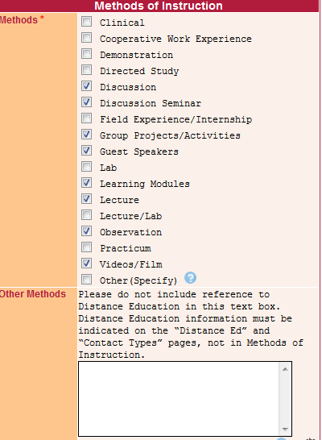
Methods of Instruction
Methods of instruction should be integrated with the stated objectives.
Methods of instruction should focus on what students will be doing as opposed to what instructor will be doing (active learning).
All possible instructional methods should
be listed (specific examples may be provided).
Instructional methods should reinforce
development of critical thinking and
development of college-level vocabulary.

Slide 17
Required Textbooks & Other Instructional Materials
Textbooks and materials should support objectives, course content and student learning activities.
Any course which is a part of CSU GE Breadth or IGETC MUST have a required textbook.
Textbooks should be completely referenced with author, title, publisher and date.
Textbooks should be no older than five years from the effective date.
  Books defined as “definitive textbooks” may be used, however, a newer textbook is usually available. In this case, the definitive textbook may be kept, but the newer one should be listed.
Textbooks play an essential role in course articulation.
Required materials should only include items which are essential for the student to effectively participate in and successfully pass the course.
Other required items may include lab equipment, tools, materials or equipment such as a sport item

Slide 18
Assignments and/or Other Activities
Assignments should reflect reinforcement of objectives and content utilizing a high level of critical thinking.
Required Reading includes supplemental reading material beyond required texts.
  Journals, periodicals, websites, manuals, handouts, supplemental texts, etc.
Required Writing should reflect college-level writing within some aspect of the course
  Journals, lab reports, material usage, idea presentations, essays, position papers, research papers, critiques, etc.
Critical Thinking should be reflected in college level activities practiced during assignments.
Outside Assignments should be sufficient to show independent work and meet minimum study time hours of work per week beyond class time for each unit of credit.
Activities should include analysis, synthesis or evaluative information (Bloom’s Taxonomy).

Slide 19
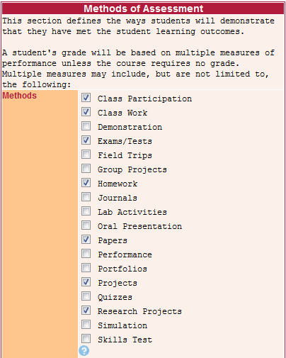
Methods of Evaluation
Methods of evaluation must relate to the course objectives (knowledge, skills and abilities).
Multiple methods of evaluation are preferred in
order to support the diverse populations and
learning styles of community college students.
Methods should demonstrate a likelihood that
students will achieve the objectives
Methods of evaluation should include the student’s
development of critical thinking skills.

Slide 20
References
California Community Colleges, Chancellor's Office. Credit Course Repetition Guidelines. July 2013.
The Academic Senate, California Community Colleges. The Course Outline of Record: A Curriculum Reference Guide. 2008.
California Community Colleges, Chancellor's Office. Program and Course Approval Handbook. July 2013.
California Code of Regulations, Title 5 – Education, Division 6 California Community Colleges
Useful Links
Palomar College Curriculum http://www2.palomar.edu/pages/curriculum/
California Community Colleges Chancellor’s Office, Academic Affairs, Curriculum and Instruction Unit http://extranet.cccco.edu/Divisions/AcademicAffairs/CurriculumandInstructionUnit.aspx
Academic Senate for California Community Colleges http://asccc.org/
Title 5 http://extranet.cccco.edu/Divisions/Legal/Resources.aspx

