Slide 1

Strong Workforce Program Overview
Fall 2017 Plenary
Margie Fritch, CTEE Dean
Susan Garland, Sr. Grants Administrative Specialist

Slide 2
A Call for More and Better CTE Through Innovation
Strategic thinking produces innovations in Career Technical Education (CTE) processes, curriculum and the student experience that can deliver a strong workforce at the speed of business.

Slide 3
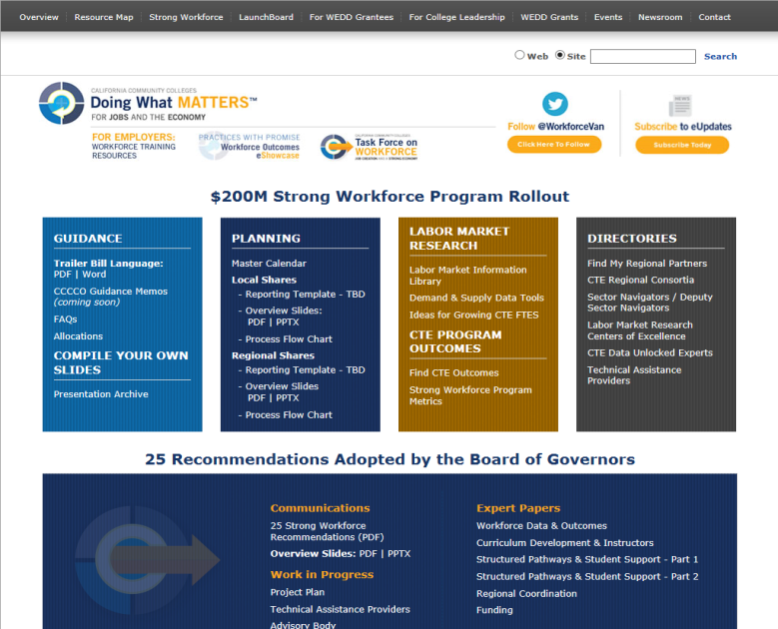

Slide 4
STRONG WORKFORCE TASK FORCE RECOMMENDATIONS
Student Success
Career Pathway
Workforce Data and Outcomes
Curriculum
CTE Faculty
Regional Coordination
Funding

Slide 5
A Different Funding Approach
Focus on outcomes rather than activities
Emphasis on innovation and risk-taking so colleges can be more responsive to regional labor market conditions and student outcomes

Slide 6
A Different Distribution Approach
Funds are ongoing and have been allocated to districts based on local and regional labor market needs, CTE enrollments, and student outcomes.
Plans and budgets are very simple, focusing on proof of regional labor market need and projections regarding how student outcomes will change.

Slide 7
The Incentive Portion
Eighty-three percent of the Strong Workforce Program funding is based on the proportion of full-time equivalent students (FTES) in CTE programs, regional unemployment rates, and regional job openings.
In addition, the legislation stipulates that 17% of the Strong Workforce Program funding should be distributed using an incentive-based funding model that aligns with the progress, completion, and employment measures established under the Workforce Innovation and Opportunity Act (WIOA).

Slide 8
Allocation Model

Slide 9
Successful Workforce Outcomes
Our approximate allocation of $2.1M is subject to the 17% incentive portion
Strong Workforce Program incentive funding rewards colleges and regions that strengthen career and technical education (CTE) programs through regional collaboration and by preparing more students for high-demand, high-wage jobs
Using a points system, colleges and regions receive additional funding for every CTE student who:

Slide 10
Positive Outcomes
Made progress within a program
Earned a certificate or degree
Transferred to a four-year institution
Secured employment
Achieved positive earning outcomes
Extra points are awarded for economically disadvantaged students who attain these outcomes

Slide 11
SAN DIEGO/IMPERIAL REGIONAL PRIORITY SECTORS
ADVANCED MANUFACTURING
HEALTH
ICT/DIGITAL MEDIA
ADVANCED TRANSPORTATION AND RENEWABLE ENERGY
LIFE SCIENCE/BIOTECHNOLOGY

Slide 12
Focus for the Funds
Increase quantity of CTE
Improve quality of CTE
More enrollments in programs leading to high-demand, high wage jobs
More students complete/transfer
More students employed
More students improving their earnings

Slide 13
Plan Elements
Increase the number of students in quality CTE courses, programs, and pathways that will achieve successful workforce outcomes.
Invest in new or emerging CTE courses, programs, and pathways that address a regional labor market need and may become operative in subsequent years and are likely to lead to successful workforce outcomes.
Address Strong Workforce Task Force recommendations.
Provide evidence of regional demand for workers within the funded CTE Program(s) AND
  Identify geography and occupations targeted
  Identify labor market demand and supply gap
  Cite source of labor market information

Slide 14
Guidelines, Definitions & Reasonable Standards
No Supplanting
This shall not be interpreted to mean that a participating community college district is prohibited from eliminating or altering existing programs.
However, the percentage of full-time equivalent students enrolled in CTE courses shall not be reduced from the percentage computed for the 2015–16 fiscal year.

Slide 15
Guidelines, Definitions & Reasonable Standards
Funding CTE Only
Funds expended must show a direct benefit to the requirements of the Strong Workforce Program:
Increase the number of enrollments or quality of CTE courses, programs, and pathways.
Address the recommendations of the Strong Workforce Task Force report.
http://doingwhatmatters.cccco.edu/portals/6/docs/sw/2016_11%20Workforce_Task_Force_Implementation%20Recommendations%20Version%201.pdf

Slide 16
Guidelines, Definitions & Reasonable Standards
Duplication of Effort
Activities funded shall be informed by, aligned with, and expand upon the activities of existing workforce and education regional partnerships, including:
Workforce Innovation and Opportunity Act (WIOA)
Adult Education Block Grant consortia (AEBG)
K-12 CTE programs (CCPT)

Slide 17
Guidelines, Definitions & Reasonable Standards
District Procedures
All fiscal policy and program procedures adopted by the applicable Community College District shall be followed when expending local and regional allocations.
Non-Allowable Activities
Entertainment
Alcoholic Beverages
Contingency (Rainy Day Funds)
Goods and Services for Personal Use
Lobbying
Contributions or Donations

Slide 18
Need Supporting Evidence
Valid Sources of Labor Market Information
Use information that has already been compiled
Emphasis is on reviewing available data and using it to target investments
1) Use data that was validated within the last two years
Validated local or regional employer input through an employer survey or advisory
Regional program approval process
Prior regional planning process
Local biannual program review
2) Find data in a report in the LMI Resource Library
  Filter by sector and region to obtain reports and data
doingwhatmatters.cccco.edu/StrongWorkforce/LMILibrary.aspx
3) Demonstrate living wage attainment
  Programs where at least 50% of students earned a living wage
https://www.calpassplus.org/LaunchBoard/SWP.aspx

Slide 19
ADDITIONAL RESOURCES
Centers Of Excellence (COE)
http://www.coeccc.net/
Data Mart http://datamart.cccco.edu/

Slide 20
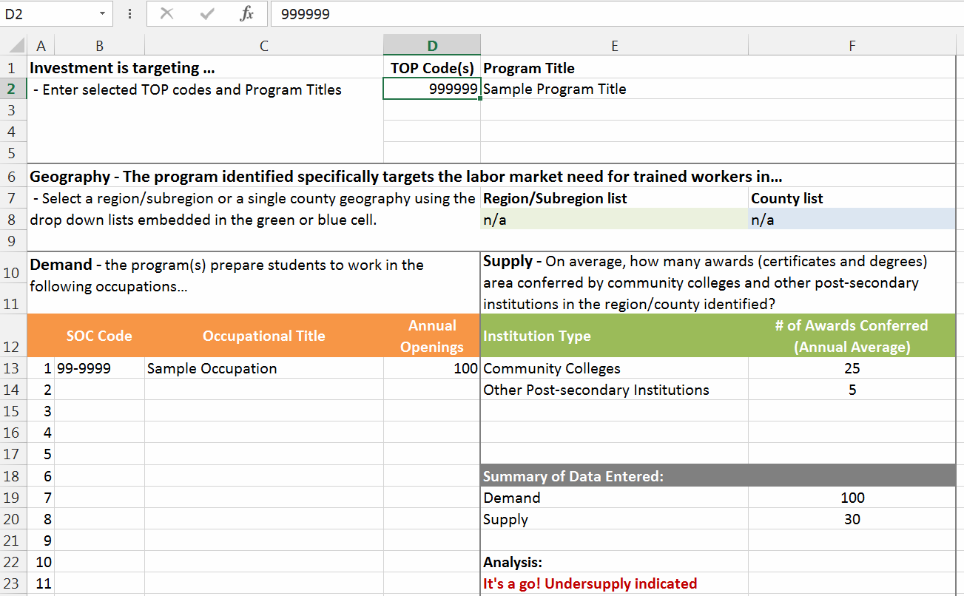
LMI: Labor Market from COE

Slide 21

Explore the Labor Market Library

Slide 22
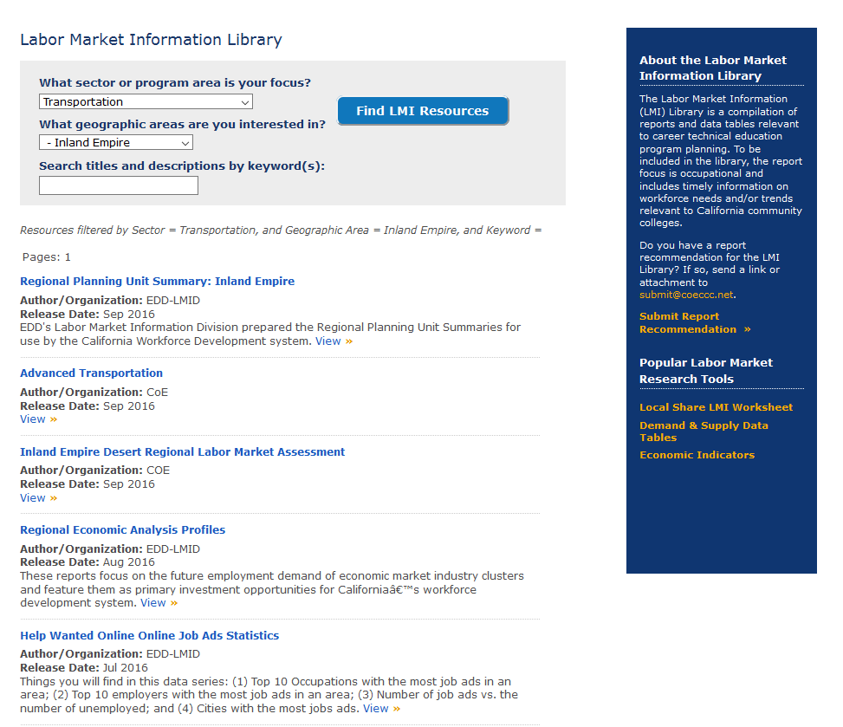
Find Evidence in the Labor Market Library

Slide 23
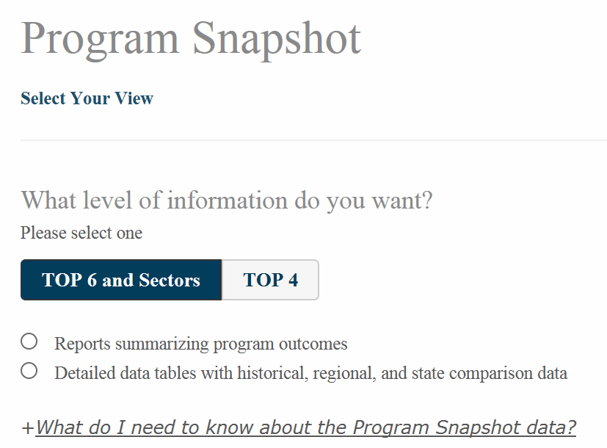

LMI: Livable Wage
Needs Password
and Login

Slide 24
Strong Workforce Program Metrics
Size of CTE Programs (“more”)
required for all programs
Enrollments
Outcomes for CTE Programs (“better”)
pick only those metrics that are relevant for your investment
Completion
Transfer
Employment
Employment in field of study
Second quarter earnings
Median change in earnings
Proportion of students who attained a living wage
Notes:
RP available to answer detailed data questions

Slide 25
Strong Workforce Program Metrics
Colleges should not compile this information on their own. Information has already been complied.
All data points have been pre-populated on the LaunchBoard Strong Workforce Program tab, with benchmarking information.
The source of the information is the data that colleges upload to the Chancellor’s Office for MIS reporting, the Chancellor’s Office match to the state wage file, and CTE Outcomes Survey data.
Notes:
RP available to answer detailed data questions

Slide 26
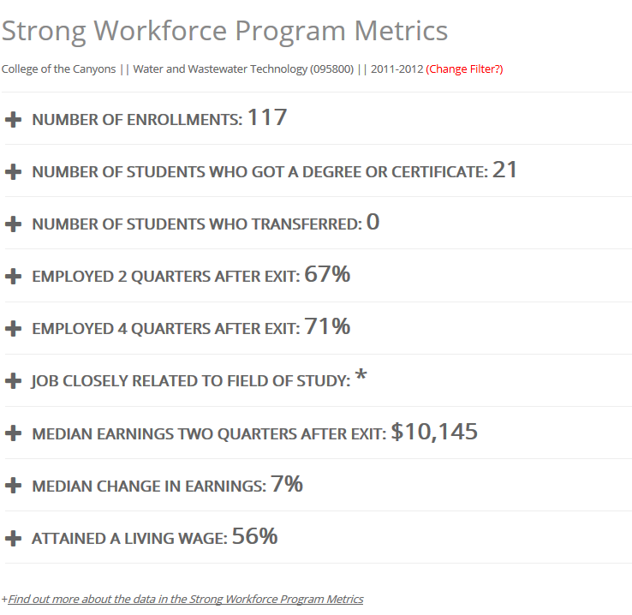
LaunchBoard SWP Metrics Tab

Slide 27
The CTE LaunchBoard, a statewide data system supported by the California Community Colleges Chancellor’s Office and hosted by Cal-PASS Plus, provides data to California community colleges and their feeder K-12 school districts on the effectiveness of CTE programs. This information is intended to facilitate local, regional and statewide conversations about how to improve student transitions from K-12 to college and on to the workforce.
Additional LaunchBoard Information will be presented at plenary session on Friday from 12-12:50 in room H-104
Cal-Pass login access available at the following link:
https://www.calpassplus.org/Launchboard/Home.aspx

Slide 28
PALOMAR’S PROCESS
APPLICANTS MUST ATTEND PLENARY OR WORKSHOP TRAINING
SUBMIT ONE PAGE PROJECT PROPOSAL
SWP COMMITTEE REVIEWS PROPOSAL
SWP COMMITTEE IS COMPRISED OF CROSS SECTION OF THE PALOMAR COLLEGE COMMUNITY INCLUDING FACULTY, IS, FACILITIES, IRP, STUDENT SERVICES AND FISCAL
COMMITTEE SELECTED PROPOSALS SUBMIT ADDITIONAL INFORMATION
FUNDING SUMMARY TO EXECUTIVE COUNCIL FOR APPROVAL
APPROVED APPLICATIONS UPLOADED TO SWP SYSTEM
APPROVED PROGRAMS NOTIFIED-MOST LIKELY 02/01/2018

Slide 29
Stay Up to Date
All worksheets, links, PPT presentations will be available on Strong Workforce tab on CTEE website.
https://www2.palomar.edu/pages/ctee/department-links/strong-workforce/
Additionally, check back on the Doing What Matters/Strong Workforce Program site for updates and additional resources.
http://doingwhatmatters.cccco.edu/StrongWorkforce.aspx

Slide 30
QUESTIONS
?
Margie Fritch, CTEE Dean, mfritch@palomar.edu
Susan Garland, Senior Grants Administrative Specialist x3047 sgarland@palomar.edu

