Slide 1
Formal Military Training and CPL Date: March 11, 2021 Time: 12:00am – 1:00pm Peggy Campo, Professor Anatomy and Physiology Norco College, MAP Faculty Lead Terence C Nelson, MEd MS, Counseling Faculty and MAP Project Regional Lead

Slide 2
Overview
Brief Overview of Credit for Prior Learning (CPL) Policy;
Tools available: MAP and ACE Military Guide;
The Joint Service Transcript (JST);
Rigorous ACE Faculty Panelist review process and gain confidence in the validity and reliability of the ACE Recommendations;
How to use the ACE Military Guide
Notes:
Jamar

Slide 3
What would you like to come away with from today’s presentation?
Please respond to this question in the Chat
Notes:
Janet

Slide 4
Poll: Who is here today.
Notes:
Janet

Slide 5
What is Credit for Prior Learning (CPL)?
Credit for Prior Learning (CPL) is college credit awarded for validated college-level skills and knowledge gained outside of a college classroom. Students’ knowledge and skills might be gained through experiences such as:
Military training
Industry training
State/federal government training
Apprenticeships, internships, work-based learning, or other industry-based experiential learning
Validated volunteer and civic activities (e.g. Peace Corps)
This CPL definition does not include knowledge and skills already assessed and awarded credit through formal education at regionally accredited in-state and out-of-state institutions.

Slide 6
CPL Policy Reform – A Brief Overview
The Board of Governors unanimously approved an amendment to title 5 § 55050, Credit for Prior Learning
The CPL policy is designed to help community colleges meet goals and commitments outlined in the Vision for Success, including to increase degree and certificate completion, close equity gaps, and meet California’s projected workforce demands
Policy reforms encourage districts and colleges to provide students consistent and equitable access to CPL, to promote quality, integrity and equity in the award of credit

Slide 7
Title 5, 55050 Credit for Prior Learning
(a) The governing board of each community college district shall adopt and publish policies pertaining to credit for prior learning. The policies shall be transparent and accessible to all stakeholders, published at least in college catalogs. Procedures for students to attain credit for prior learning shall include, but not be limited to, credit by examination, evaluation of Joint Services Transcripts, evaluation of student-created portfolios, evaluation of industry-recognized credential documentation, and standardized exams.

Slide 8
Title 5, 55050 Credit for Prior Learning
(d) Credit may be awarded for prior experience or prior learning only for individually identified courses with subject matter similar to that of the individual's prior learning, and only for a course listed in the catalog of the community college. Colleges shall consider the credit recommendations of the American Council on Education pursuant to Education Code section 66025.71. Upon a student's demonstration of sufficient mastery through an examination or assessment, an award of credit should be made, if possible, to California Intersegmental General Education Transfer Curriculum, California State University General Education Breadth, and local community college general education requirements or requirements for a student's chosen program. Award of credit may be made to electives for students who do not require additional general education or program credits to meet their goals.

Slide 9
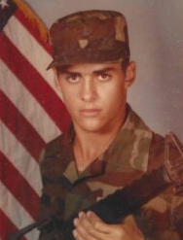
First Recipient of MAP-Enabled CPL
Darrell Palmer is a Norco College student and a U.S. Army veteran who served a Tactical Satellite / Microwave Systems Operator (MOS 26Q). We are excited to report that in Spring 2020, Mr. Palmer was awarded 26 (15 from MAP) units of applicable credit towards his Digital Electronics AS degree. Because he is being granted the credit he deserves, Darrell is getting back 6 months of his life and saving thousands of dollars on student fees, textbook costs, and living expenses. We look forward to a day in the very near future when Darrell’s story will be replicated across the region and state.
https://news.readysetcareer.org/stories/cte-pathways-for-veterans-through-credit-for-prior-learning-map-and-the-iedrc-college-collaborative/

Slide 10
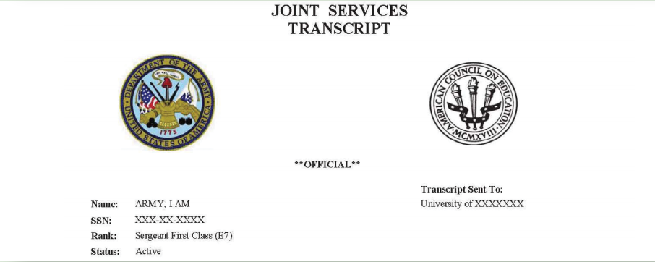
The Joint Serviced Transcript (JST)
The Joint Services Transcript (JST) is a synchronized transcript presenting data for the United States Army, Marine Corps, Navy, and Coast Guard. Each JST is “owned” by the service member’s or veteran’s specific service, so you will see each service’s seal with the American Council on Education (ACE) seal at the top.

Slide 11
The JST
Each JST includes:
Personal service member data
Military course completions—all courses that have been evaluated by the American Council on Education (ACE), with full descriptions and credit recommendations
Military occupations—full descriptions, skill levels, and credit recommendations
College level test scores—CLEP, DSST, and NCPACE
Other learning experiences—additional completed courses and occupations that have not been evaluated by ACE for college credit
An academic institution courses page (not available for Army JSTs)
https://www.acenet.edu/Documents/Joint-Services-Transcript-Brochure.pdf
Notes:
l The JST is accepted by more than 2,300 colleges https://www.acenet.edu/Documents/Joint-Services-Transcript-Brochure.pdf
and universities. l Electronic JSTs are free. l Stakeholders (service members, veterans, colleges, and universities) can create JST accounts and receive transcripts at https://jst.doded.mil/jst.

Slide 12
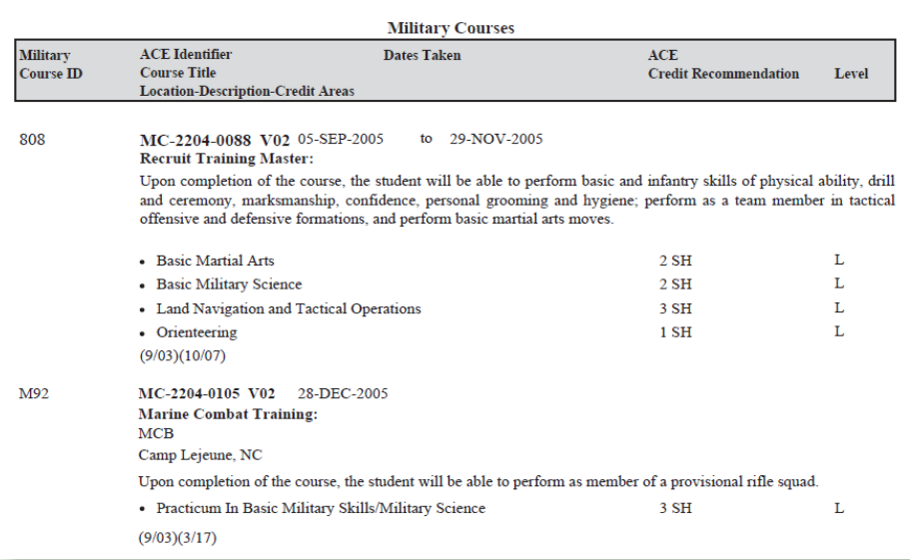

Slide 13
ACE Recommendations
Since 1945, the American Council on Education (ACE) has provided a collaborative link between the military and higher education. The ACE Military Evaluations program is funded through a contract from the Department of Defense. Through the review of military training (courses) and experiences (occupations), ACE evaluations result in college credit recommendations for members of the Armed Forces. The Military Guide, available on the ACE website, presents ACE credit recommendations for more than 23,000+ courses and 3,400+ occupations that have been evaluated since 1954. This data also populates the Joint Services Transcript (JST) for Army, Marine Corps, and Navy service members and veterans.

Slide 14
ACE Recommendations
An ACE military evaluation is a rigorous, hands-on process conducted by a team of teaching faculty from relevant academic disciplines, representing a diversity of colleges and universities. The team assesses and validates whether the courses or occupations have the appropriate content, scope, and rigor for college credit recommendations. (Actual credit transferred is solely at the discretion of the college or university.)
ACE does not select the courses or occupations for evaluation.
Recommendations are aligned into semester hours of equivalent:
Graduate Level
Upper Division
Lower Division
Vocational

Slide 15
ACE Course Evaluations
Faculty collaboration
100% consensus •
At least 3 faculty per discipline
Aligned subject area expertise
No magic elixir
Content, scope, and rigor
Learning outcomes; alignment to assessment
Current curriculum
Not always credit
Insufficient materials
Inadequate Assessments
Limited scope
Too military specific

Slide 16
The Military Guide
​​​The Military Guide is the sole source of information for all military courses and occupations evaluated by the American Council on Education (ACE) from 1954 to present. ​​ACE's Military Guide presents credit recommendations and detailed summaries for formal courses and occupations offered by all branches of the military. New courses and occupations are continually being evaluated by ACE, and these entries are added to the Military Guide on a daily basis.
https://www.acenet.edu/Programs-Services/Pages/Credit-Transcripts/Military-Guide-Online.aspx

Slide 17
​HOW TO USE THE ACE MILITARY GUIDE COURSE SEARCH
https://www.youtube.com/watch?time_continue=5&v=lwY7mHybsl4

Slide 18
​HOW TO USE THE ACE MILITARY GUIDE OCCUPATION SEARCH
https://www.youtube.com/watch?time_continue=2&v=OtElnTjz3Mc

Slide 19
Breakout Session
Pairs will be randomly assigned into breakout rooms.
Go to:
https://www.acenet.edu/Programs-Services/Pages/Credit-Transcripts/Military-Guide-Online.aspx
Practice searching for courses or if more advanced, occupations.
Return in 20 minutes to share experiences.

Slide 20
Military CPL at Norco College and IEDRC Colleges- Military Articulation Platform (MAP)
Shorten the college path and increase access and career attainment in CTE for our veterans by:
Designing and deploying an integrated cloud-based platform that:
Connects college courses to ACE recommendations; so that…
Discipline faculty experts may determine appropriate articulations; and…
Make articulated units available to veterans as credit for prior learning; and…
Colleges may do outreach to regional veterans, offering specific CPL in targeted CTE programs leading to immediate employment in high wage jobs.
3/11/2021
20

Slide 21
https://militaryarticulationplatformweb.azurewebsites.net/modules/security/Login.aspx

Slide 22
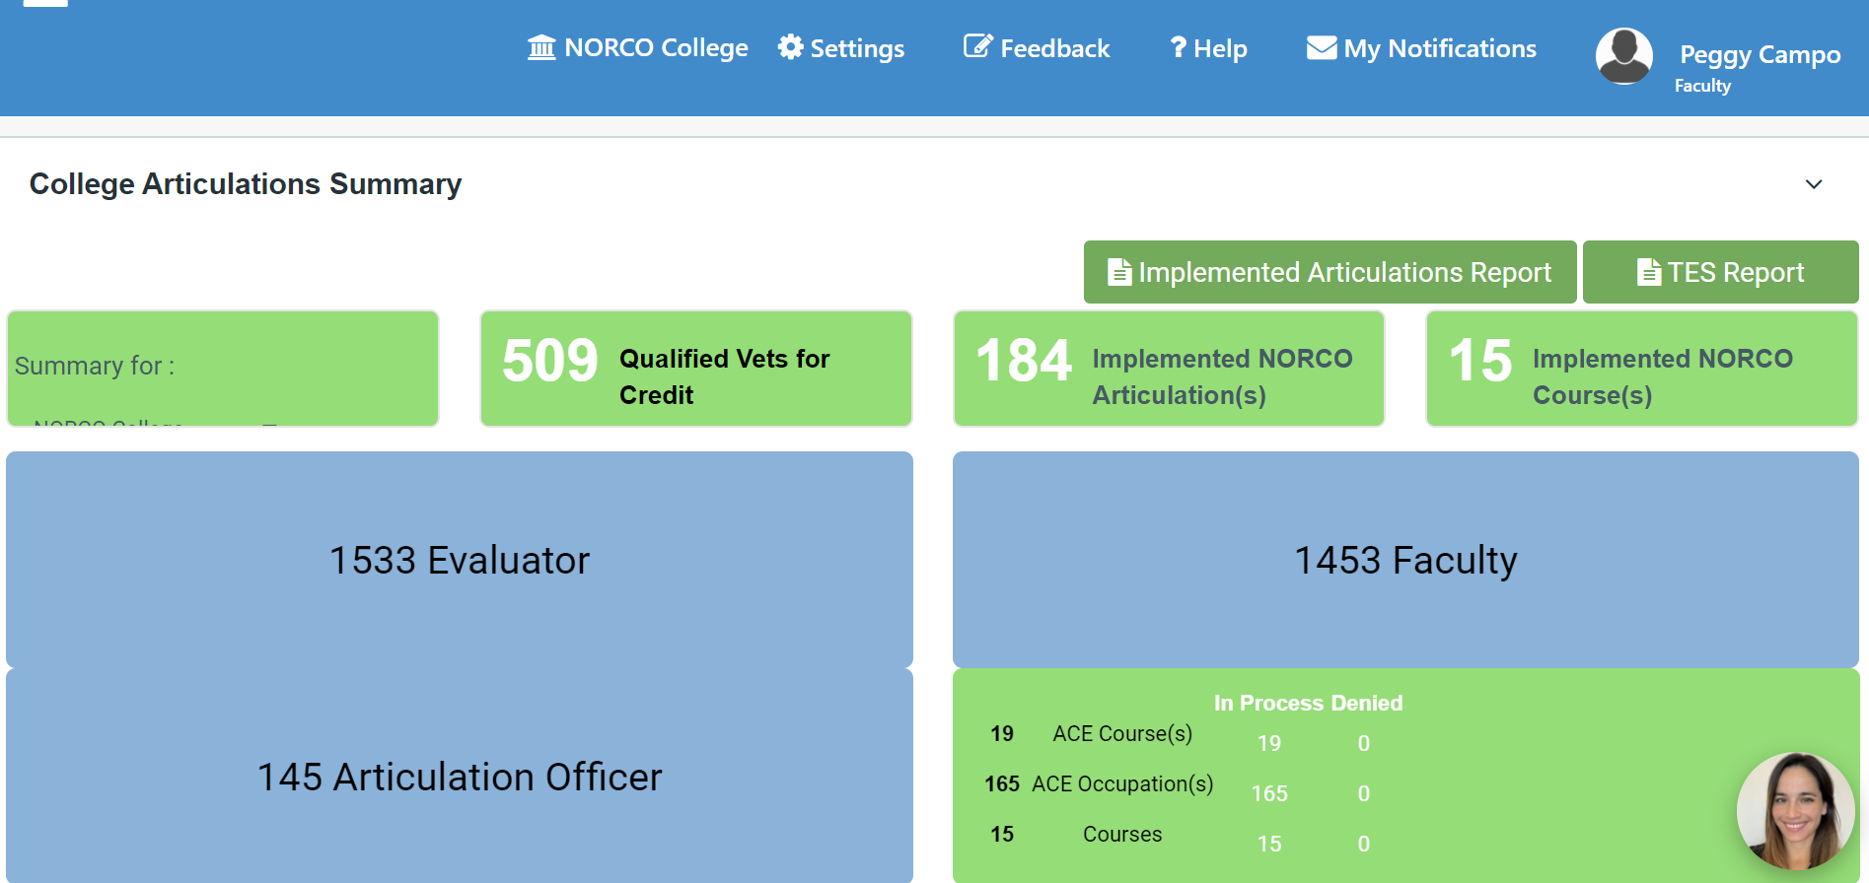

Slide 23
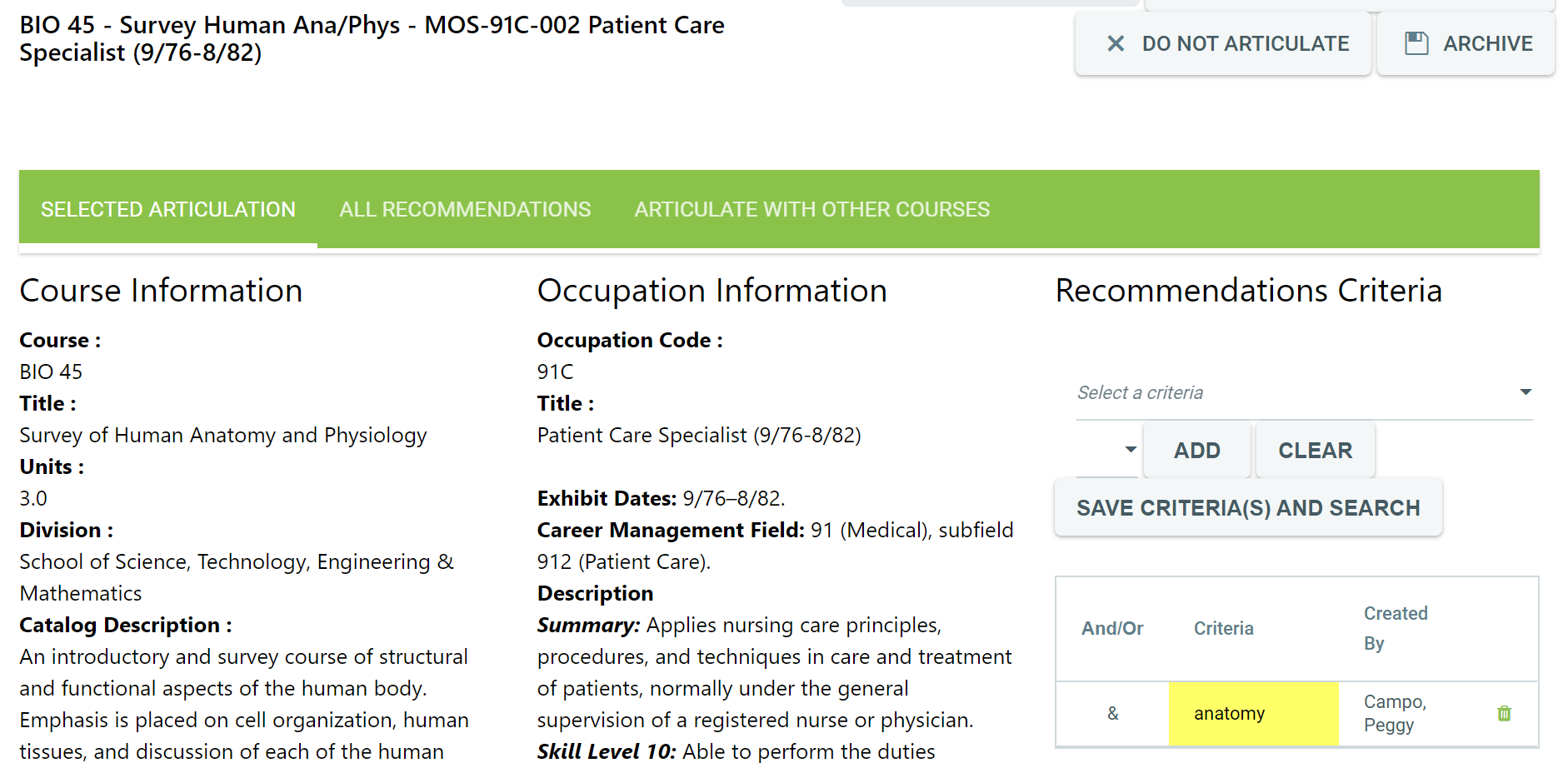

Slide 24
Contact Information
Peggy Campo – Peggy.Campo@norcocollege.edu
Terence Nelson – Terence.Nelson@norcocollege.edu
Thank you for Attending!
Notes:
Jamar

