Slide 1
Palomar Application
Workshop
Welcome

Slide 2
Complete or Update College Application: www.palomar.edu/apply
Use Google Chrome

Slide 3
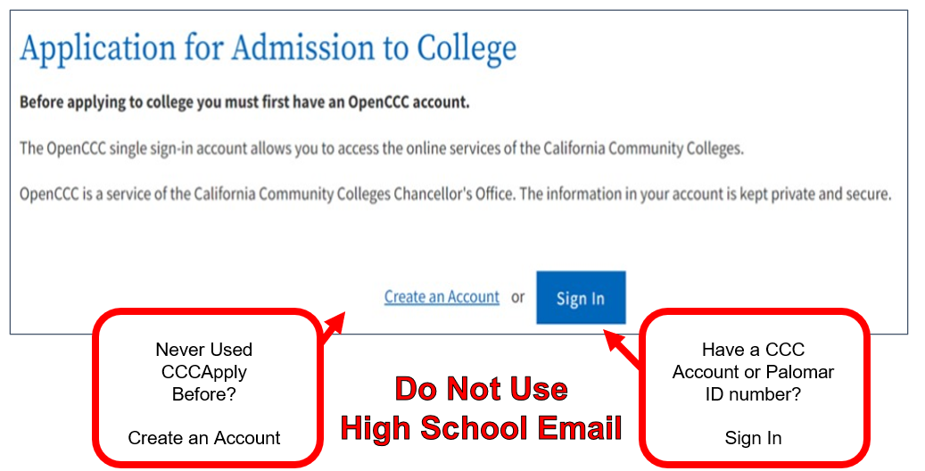
Create a CCC Account or Sign In

Slide 4
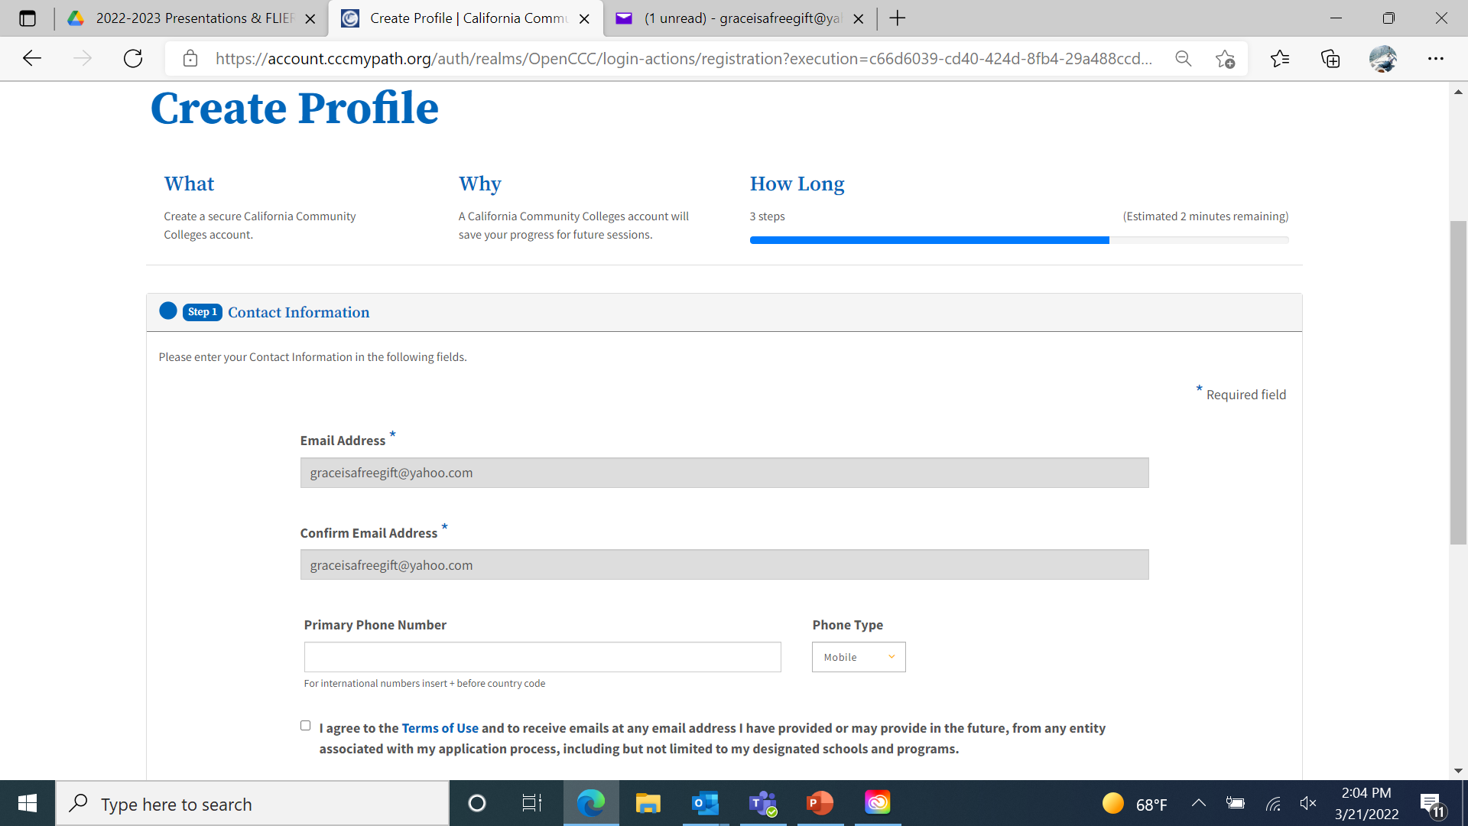
Create New Account
Do Not Use
High School Email

Slide 5
Signing into Account
GET VERIFICATION CODE:
Use Cell Phone Number or Personal Email
Do Not Use
High School Email

Slide 6
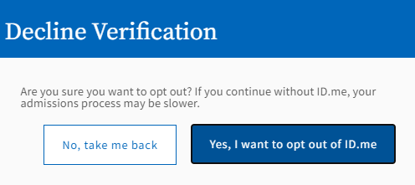
This is new… ID.me & CCC
“Verify Later”

Slide 7
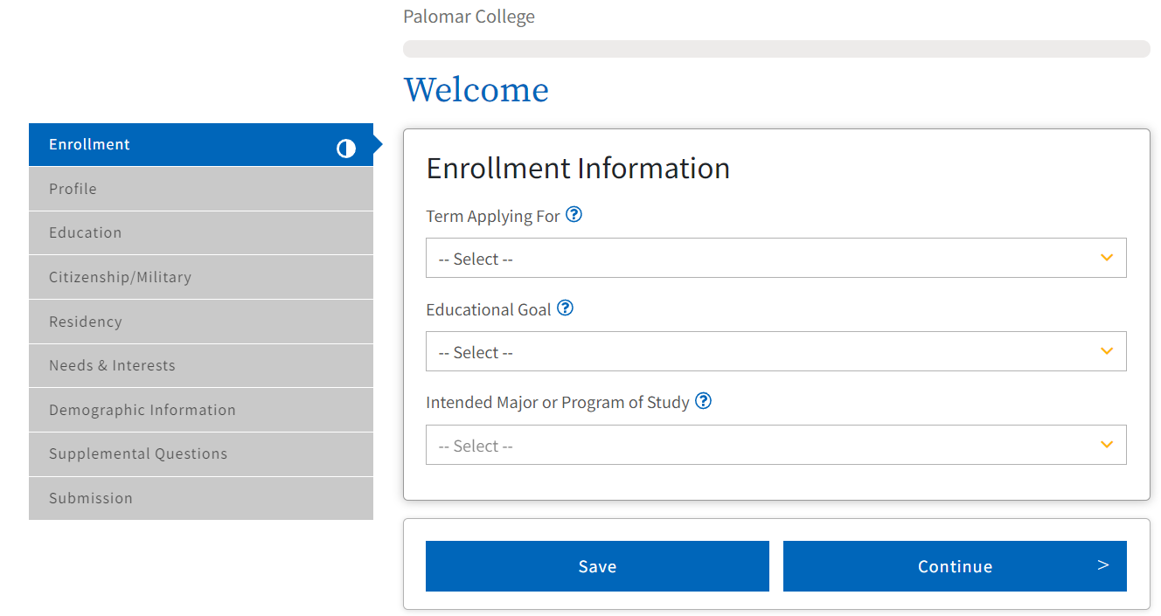
Start a New Application
Apply for Spring 2025
It does not matter what you choose as your educational goal or intended major.

Slide 8
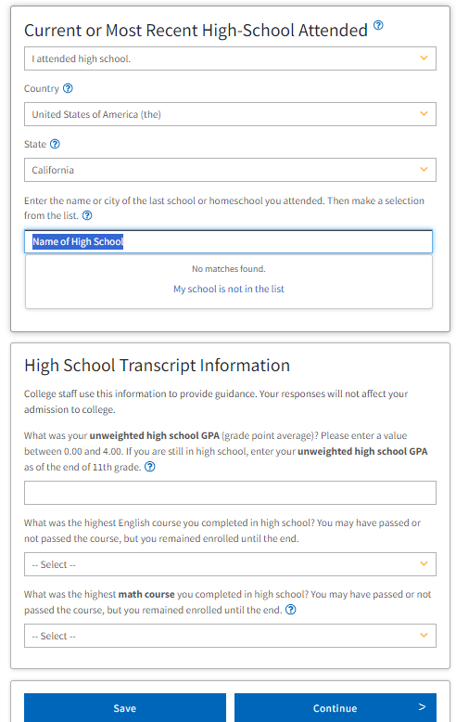
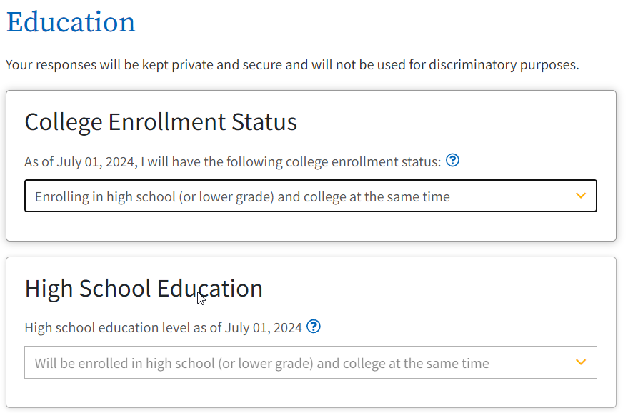
Education Levels

Slide 9
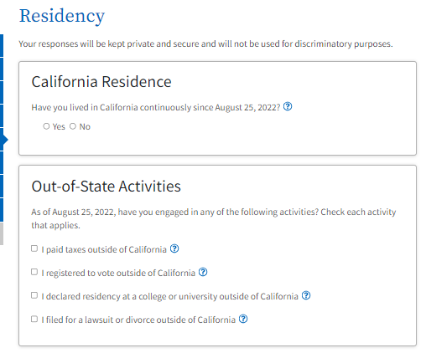
Important: California Residency
Raise Hand if just moved to California since August 25, 2022
Critical:
If you have lived in California since August 25, 2022,
DO NOT select any of these.

Slide 10
SSN or Tax ID Number (TIN)

Slide 11
Residency
If no documents for citizenship or not started immigration process:
Select “Other” and check the “No Documents” box.

Slide 12
Submitting Your Application: 3 Consents

Slide 13
Confirmation Information
Take a picture and save.
If you do not receive you Palomar ID number in 3 Business Days:
Email your:
-Full Name
-CCCID
-CCC Confirmation Number -Screenshot of a Photo ID
To Palomar College Admissions Department at:
admissions@palomar.edu
Approximately 3 business days for the Palomar ID number to be sent to the email entered in the application.

