Slide 1
Motivation
Defined: the internal state of desires, needs, and fears that drives the individual to act. It purpose is to relieve a state of tension that causes one to feel unsafe, imbalanced, or insecure.

Slide 2
Motivation
Internal Sources:
Self- challenge, self-knowledge, desire to help others, competence,
External Sources:
Recognition, money, reward, fear, power, love, approval, pleasure

Slide 3
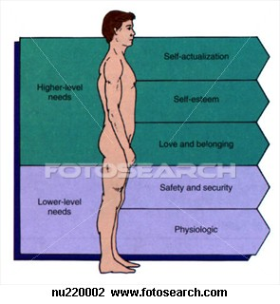
Maslow’s Hierarchy of Needs
As one moves to higher levels of the pyramid, the needs become more complex.
You cannot rise to the next level of need until the lower level need is met first.
Missionaries who preach God to people in poverty will fail as a result.

Slide 4
Values Follow Unmet Needs
Experience: If your experience was not getting love from your parents.
Need: Your need will be to be loved by others.
Values: You will likely value things like support groups, family gatherings, and work parties that spur harmony, acceptance and love.
Experience Need Values

