Slide 1

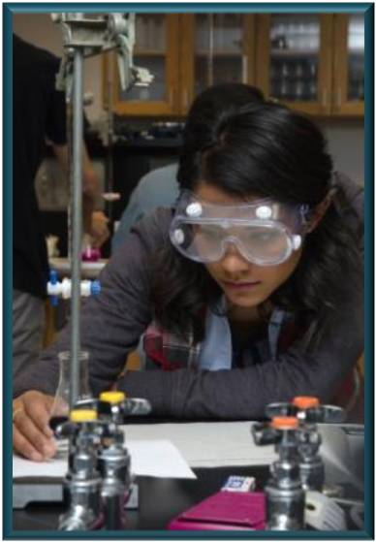
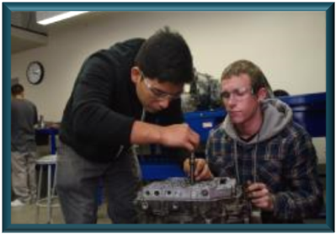

Institutional Effectiveness
Governing Board Workshop
April 26, 2016
Notes:
Before we start I thought I would make note of a couple of interesting facts -
This date in history in 1800, the Library of Congress was opened. It is now the largest library in the world.
According to tradition, April 23 is the day that we celebrate William Shakespeare's bday. Not quite certain his true bday, however church records show that he was baptized on April 26 and 3 days was the customary amount of time to wait before baptizing a newborn. We do know however, that he died 52 years later on April 23, 1616.
And, on April 25th 1990, the Hubble Telescope was released into space by the Space Shuttle Discovery. It is said that the Hubble Telescope. “The images have become part of our culture.” – Astro Physicist Mario Livio.

Slide 2
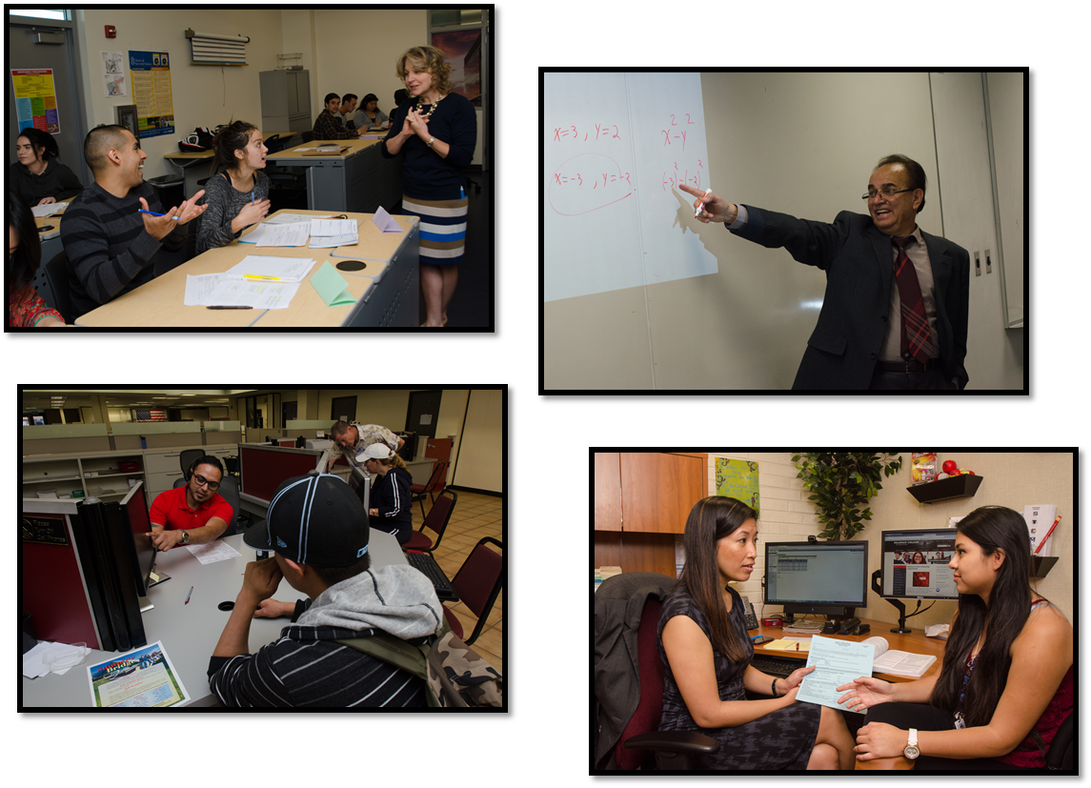
Self-Evaluation Instrument Timeline
Notes:
Before we start I thought I would make note of a couple of interesting facts -
This date in history in 1800, the Library of Congress was opened. It is now the largest library in the world.
According to tradition, April 23 is the day that we celebrate William Shakespeare's bday. Not quite certain his true bday, however church records show that he was baptized on April 26 and 3 days was the customary amount of time to wait before baptizing a newborn. We do know however, that he died 52 years later on April 23, 1616.
And, on April 25th 1990, the Hubble Telescope was released into space by the Space Shuttle Discovery. It is said that the Hubble Telescope. “The images have become part of our culture.” – Astro Physicist Mario Livio.

Slide 3
Self-Evaluation Instrument - Timeline
Link to self-evaluation – April 27, 2016
Board completes self-evaluation – May 11, 2016
Review results during May workshop

Slide 4
Institutional Effectiveness

Slide 5
Overview
Student Enrollment and Demographics (3 slides)
Staff Demographics (done – April 5th workshop)
Enrollments and Distribution of Course Offerings
Progress and Achievement
  Institution-Set Standards (ACCJC)
  Goals/Targets (IEPI)
  Scorecard
  Equity (completed in 11/2015)

Slide 6
Student Enrollment and FTES

Slide 7
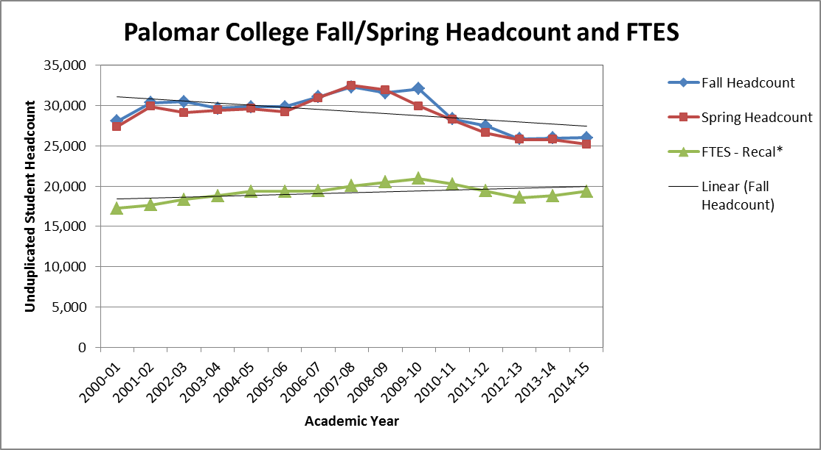
Student Headcount
Notes:
A Note on headcount…This chart in our presentation shows fall term headcount. While we do not have a “final” headcount for Spring, we do know that it will be down significantly over the previous spring, which is not a good sign when you consider some of the additional data we will be reviewing. A comparison at CENSUS headcount was down by about 2% but projected FTES was down even more. Looking at the status of current enrollments (before all positive attendance is entered) enrollments seem to be down more than the 2% at Census.

Slide 8
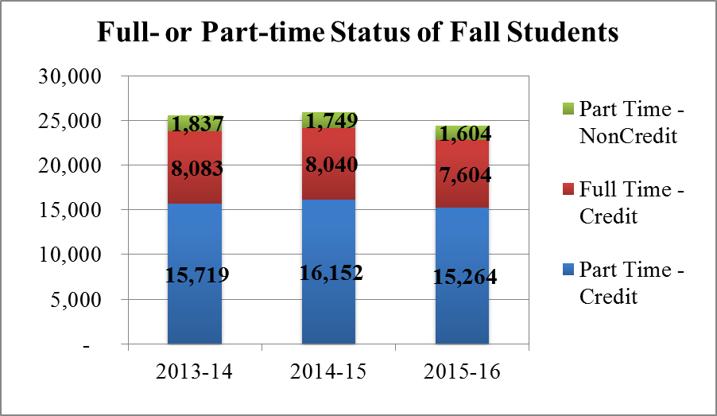
Full/Part-time Status of Students

Slide 9
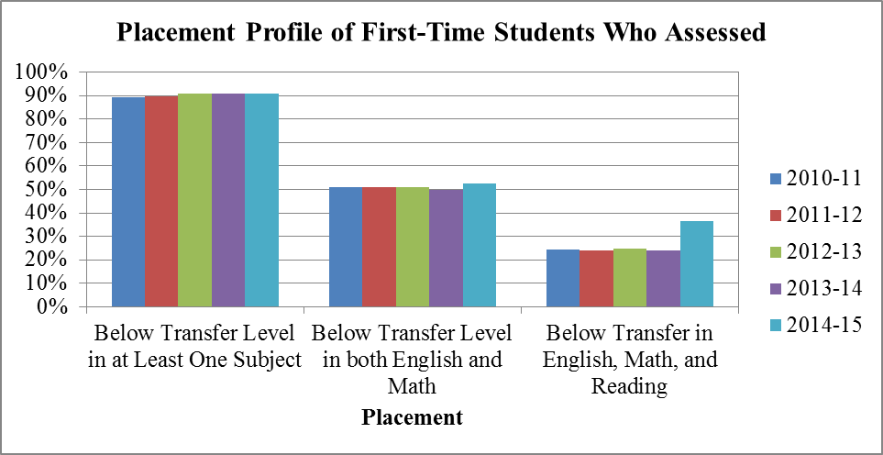
Placement of First-time Students

Slide 10
Enrollments and Distribution of Course Offerings

Slide 11
Enrollments and Course Offerings

Slide 12
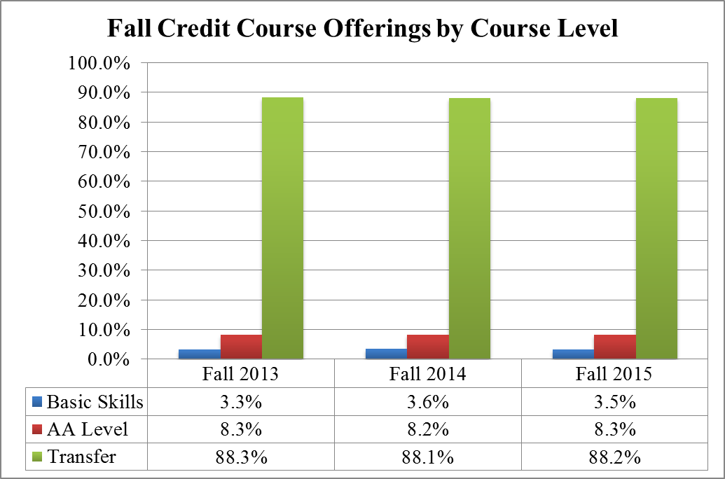
Course Offerings

Slide 13
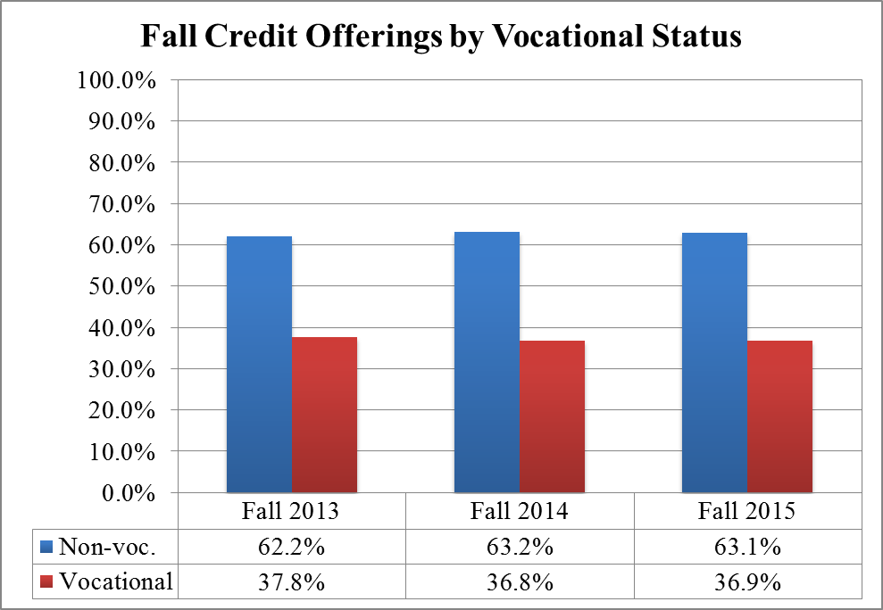
Course Offerings

Slide 14
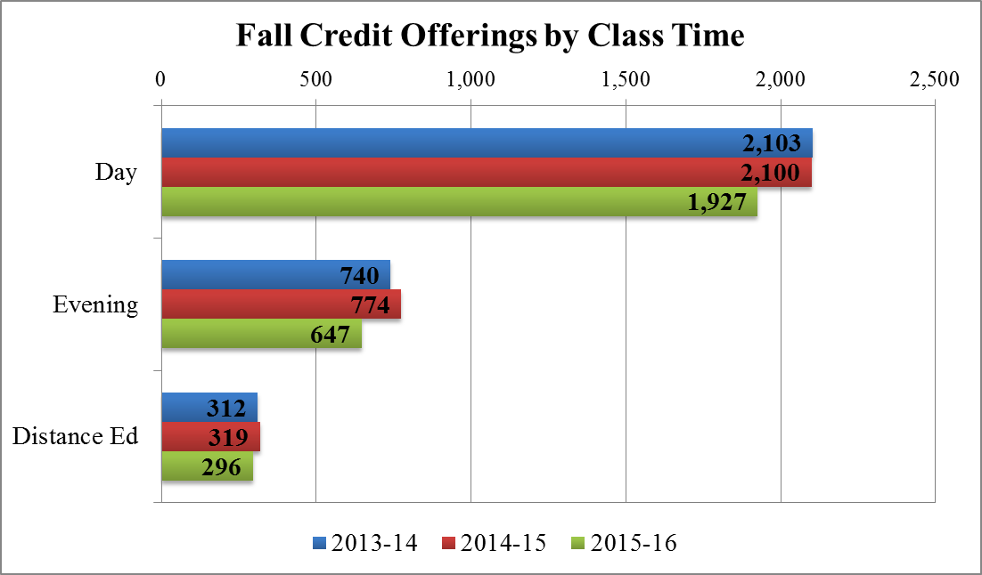
Course Offerings

Slide 15
Summary
Declining/flat enrollments paired with increased offerings is impacting our FTES, Fill rates and WSCH/FTEF
Majority of courses offered are transfer-level courses
One third of the courses offered fall into vocational education and about 10% of course offerings are distance education

Slide 16
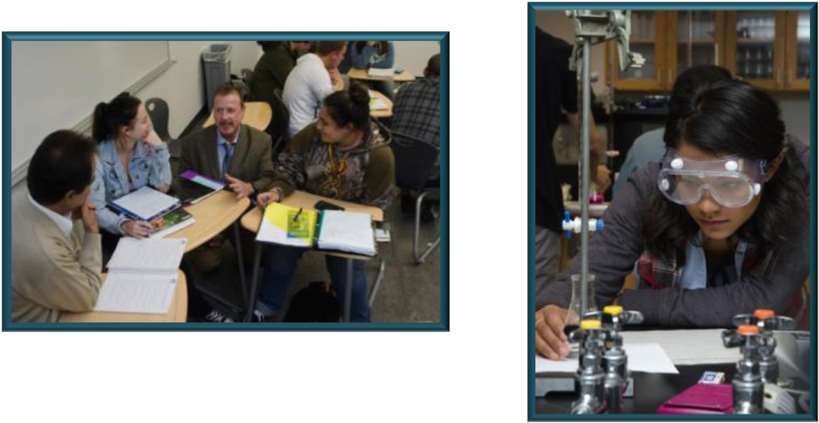
Student Progress and Achievement
Institution-Set Standards
Institutional Effectiveness Targets
Course Success Rates
Scorecard

Slide 17
Institution-Set Standards
Required to have them
  Identified level of performance determined by the institution to be acceptable
  Used to assess both institutional and programmatic performance
  Assessed for “reasonableness” and “effectiveness” by external peer evaluators
Not a goal, but they have to be reasonable. We cannot set standards based on the “minimum” value over time unless we have some logic to support

Slide 18
Institution-Set Standards
For this year, our Institution-set Standards fall into the following three categories
  Course success rate
  Degrees and Certificates
  Transfers

Slide 19


2014 ACCJC Annual Report
Institution-Set Standards
Metric | Standard | Actual | Met
Fall Course Success Rate | 70% | 70%
Degrees | 1,100 | 1,423
Certificate | 1,200 | 1,816
Transfer Count | 1,745 | 2,139
Transfer Rate | 40% | 40%

Slide 20
Framework of Indicators –
Institution-Set Goals – Year 2
Institutional Effectiveness Partnership Initiative – IEPI
Required by Legislature
Goals… “Aspirational”
Developed by Advisory Committee Workgroup
Have Implemented by June 15, 2016

Slide 21
Goals/Targets – Year 1
First Year – One Year Goals
  Goal setting activity – balanced need to meet requirement of legislation and time necessary to set goals
  Year 1 Metrics
    Student Performance and Outcomes – Annual Course Success Rate
    Accreditation Status - Status
    Fiscal Viability – Ending Balance
    Compliance w/State and Federal Programmatic Guidelines – Audit

Slide 22
Goals/Targets – Year 2
Second Year – One year and Six year goals
  Discussion on metrics continues
  Year 2 Metrics
    Student Performance and Outcomes
      Fall course success rate
      Required college choice related to unprepared students
        Outcome (SPAR)
        Basic skills improvement (math, English, ESL)
    Accreditation Status – Status
    Fiscal Viability – Ending Fund Balance
    State and Federal Compliance
      Fiscal Audit
      Federal Audit
      State Compliance
https//:misweb.cccco.edu/ie/
June 15, 2016 – DUE

Slide 23
Goals/Targets – Year 2
Second Year – One year and Six year goals
  Discussion on metrics continues
  Year 2 Metrics
    Student Performance and Outcomes
      Fall course success rate
      Required college choice related to unprepared students
        Outcome (SPAR)
        Basic skills improvement (math, English, ESL)
    Accreditation Status – Status
    Fiscal Viability – Ending Fund Balance
    State and Federal Compliance
      Fiscal Audit
      Federal Audit
      State Compliance
https//:misweb.cccco.edu/ie/
June 15, 2016 – DUE

Slide 24
Recommended Goals - Year 2
Metric | Year 1 Goal | Year 6 Goal
Student Performance and Outcomes
Fall Course Completion Rate (70%) | 71% | 71%
Math Basic Skills Improvement Rate (36.2%) | Under discussion | Under discussion
Accreditation Status
Accreditation Status | FA - N | FA - R
Fiscal Stability
Ending Fund Balance (9.3%) | 7% | 7%
State and Federal Compliance
Fiscal Audit | Yes | Yes
Federal | Yes | Yes
State Compliance | Yes | Yes

Slide 25
Scorecard

Slide 26
Student Success Scorecard Metrics
Completion or momentum points
Broken down by demographic variables
Prepared / Unprepared / Total
Metrics
  Persistence
  30+ Units
  Completion (SPAR)
  Remedial
  CTE Completion
  CDCP
NEW METRIC this year
  Skills Builder
Notes:
Break up into groups.

Slide 27
Skills Builder Metric
Who are skills builders?
  Workers who are maintaining and adding to skill-sets required for ongoing employment and career advancement.
  These students do not earn community college certificates or degrees and don’t transfer to four-year universities.
  Most skills-builders take only one or two CTE courses.
  Most skill-builders are older students, who have had experience in the workforce.

Slide 28
Skills Builder Metric
Skills Builders Metric
  Who is included in the metric?
    Completed at least one course (.5 units). Some number of these units must be in a course coded as: Apprenticeship, Advanced Occupational, Clearly Occupational
    No longer enrolled after one year
    Did not subsequently earn an award or transfer to a four-year institution
    Did not fail a CTE Course during the academic year

Slide 29
Skills Builder Metric
Skills Builders Metric
  What is measured?
    By TOPS code (Taxonomy of Programs Code- e.g., Public Safety, Fire, EME, Accounting)
    Difference in inflation-adjusted wages from one year before enrollment year to one year after.
    Median percentage change in earnings across the cohort
  What is presented in the Scorecard?
    Top ten disciplines with the highest enrollment*

Slide 30
Skills Builder Metric for STATE
http://scorecard.cccco.edu/scorecardrates.aspx?CollegeID=000#home

Slide 31
Palomar College Scorecard Report
http://scorecard.cccco.edu/scorecardrates.aspx?CollegeID=061

Slide 32
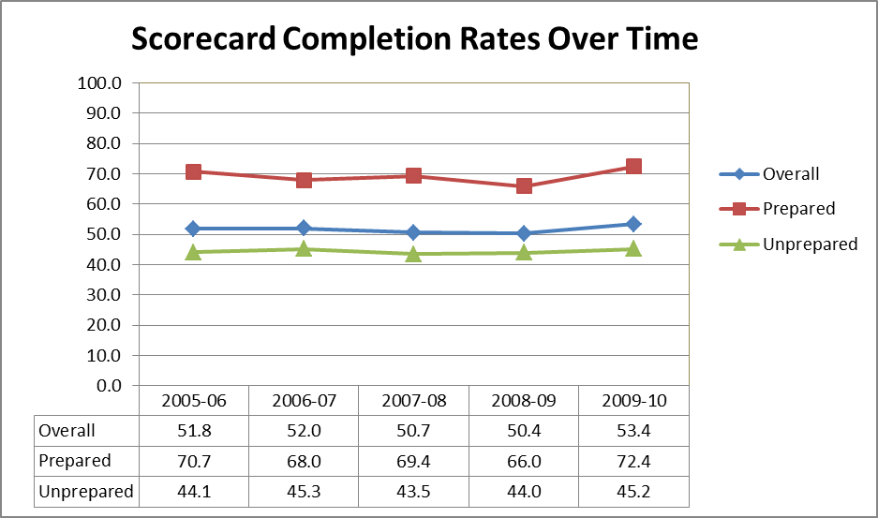
Palomar College Scorecard Report

Slide 33
Palomar College Scorecard Report

Slide 34
Completion Rate Peer Grouping
Updated peer groups for the Completion Scorecard
Diverse academic and economic environments of students are important factors affecting individual student achievements and overall institutional performance.
Identified uncontrollable factors, or predictor variables, associated with completion. (“Environmental Factors”)
Using regression modeling and cluster analysis, identified colleges that closely resembled each other in terms of the uncontrollable factors.

Slide 35
Scorecard 2014-15 Peer Group Completion Rates

Slide 36





Scorecard Summary
Metric | Last Year’s Rate | Current Rate | Increase / Decrease
Momentum Points
3-Term Persistence | 71.5% | 72.9%
30+ Units | 65.2% | 68.0%
Basic Skills Comp - English | 42.3% | 43.1%
Basic Skills Comp – Math | 33.2% | 36.2%
Basic Skills Comp - ESL | 30.0% | 24.6%
Completion
Completion | 50.4% | 53.4%
CTE Completion | 48.8% | 51.0%
Skills Builder
Increase in Salary | NA | +14.4% | NA
>=.5% increase
<=.5% increase

Slide 37
What is next?
Continuing to deliver excellent instruction and student support services to our students…
Developing Strategic Plan 2019 (based on district priorities)
  Teaching and Learning
  Stabilizing and Growing Enrollment
  Fiscal Stability
  Staffing and Diversity in Hiring
  Outreach, Retention, and Success
  Strengthening Message to Community – “destination college”
Developing new Staffing and Technology plans
Continuing to implement Master Plan 2022 (Education and Facilities)
  Preparing for South Education Center
  Moving forward on San Marcos buildings
Preparing our accreditation follow-up report
Implementing new assessment and placement process (Common Assessment Initiative and Multiple Measures)

Slide 38
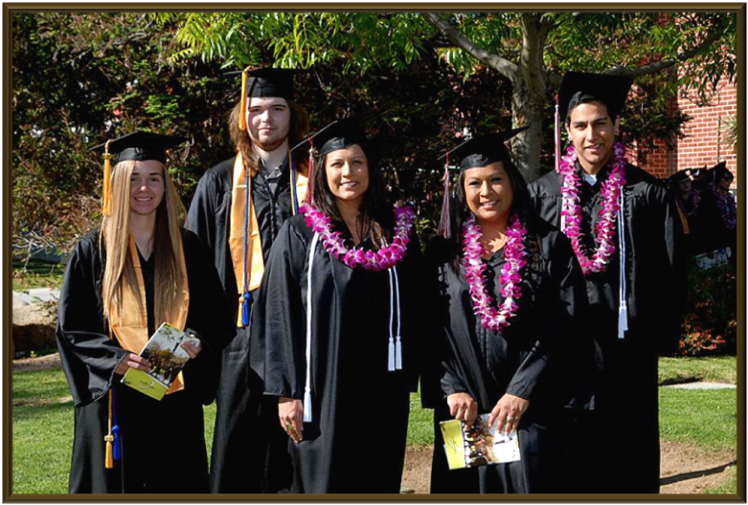
The END!

